Slide 1
Incorporating sgplot in the development of Official Statistics
Joshua Bird
Population Health Analysis

Slide 2
Structure
Project background
‘Official Statistics’ overview
sgplot overview
The project
Acquiring official statistics designation
Incorporating sgplot
Lessons learned

Slide 3
Background
Tackling drug deaths is a SG priority
January 2021: National Mission announced
Alcohol and Drug Partnerships (ADPs)
Responsible for coordinating local response
Subject to scrutiny/accountability
Annual reporting mechanism
Notes:
The level of harms from alcohol and drugs in Scotland are high in comparison to the rest of the UK and Europe and cause avoidable damage to people’s lives, families and communities. Tackling the high level of drug related deaths in Scotland is a priority for the Scottish Government.
On 20 January 2021, the then First Minister made a statement to parliament, which set out a National Mission to reduce drug deaths and improve the lives of those affected by drugs through improvements to treatment, recovery and other support services.
Scotland’s 30 Alcohol and Drug Partnerships (ADPs) bring together local partners including health boards, local authorities, police and voluntary agencies, to co-ordinate the response to substance use issues. They are responsible for commissioning and developing local strategies for tackling problem alcohol and drug use and promoting recovery, based on an assessment of local needs

Slide 4
ADP Annual Report: Old Workflow
Data collected via Questback
Collated in Excel
Analysed in Excel
Graphed in Excel
Too much point-and-click!
Notes:
This reporting mechanism is a survey, and it had been in place for a number of years. And this was the workflow, which I’m sure seems familiar to you
After last years’ report we all decided that the process needed a refresh, and as part of the process we sought to turn this into an official statistics publications
Which has now been deprecated….

Slide 5
Objective
Create a better statistical product for stakeholders
Notes:
So basically, our objective was to create a better product for our stakeholders. But what exactly does that mean? Adhere to code of practice, adhere to accessibility guidance, whilst ensuring that these increased requirements would not impede the timely delivery of this annual report

Slide 6
SG publishes a LOT
Advice and guidance
Agreement
Consultation analysis
Consultation paper
Corporate report
Correspondence
FOI/EIR release
Factsheet
Form
Impact assessment
Independent report
Map
Minutes
Progress report
Regulation/directive/order
Research and analysis
Speech/statement
Statistics
Strategy/plan
Transparency data

Slide 7

What are ‘Official Statistics’?
Three designations
Accredited Official Statistics (formerly ‘National Statistics’)
Official Statistics
Official statistics in development (formerly ‘Experimental Statistics’)
Notes:
Official statistics are statistics produced by the UK government or devolved administrations.
There are three designations, and a few of you may know this but recently a refresh of these designations took place : Accredited official statistics are a sub-set of official statistics that have been independently reviewed by the Office for Statistics Regulation and confirmed as complying with the standards of trustworthiness, quality and value in the Code of Practice for Statistics. Once this confirmation has taken place it receives a kitemark which I’m sure you may have seen
Official Statistics are those which comply with the standards of trustworthiness, quality, and value in the code of practice, but have not yet been independently reviewed by OSR
Official statistics in development are official statistics that are undergoing a development; they may be new or existing statistics, and will be tested with users, in line with the standards of trustworthiness, quality, and value in the Code of Practice for Statistics.

Slide 8
Code of Practice
Trustworthiness
Confidence in the people and organisations that produce statistics and data
Quality
Data and methods that produce assured statistics
Value
Statistics that support society’s needs for information
Notes:
In order for a publication to be designated as official statistics, and this complies for any classification, you need to actively document to the code of practice, which is based upon three pillars, which are listed here: trustworthiness, quality and value. So at first glance this may seem like a bureaucratic rigmarole, but actually we found it really beneficial because this annual survey had been going on for several years and was veering somewhat close to what might be described as path dependency, so working through each of these pillars enabled us to refine and ultimately enhance our approach to collecting data.

Slide 9
Code of Practice – Value
Principles:
Relevance to users
Accessibility
Clarity and insight
Innovation and improvement
Efficiency and proportionality
Notes:
In addition to reworking the content, there was also scope to revamp what the publication looked like. And that is where sgplot comes in

Slide 10

sgplot
R package for creating accessible plots in the Scottish Government
Extension of ggplot
https://datasciencescotland.github.io/sgplot/
Notes:
In a highly serendipitous twist of fate, we were undergoing this development exercise right

Slide 11
Making the case
Skills (or lack thereof)
Ease of implementation
Invoking the Code of Practice

Slide 12
Old Workflow
Data collected via Questback
Collated in Excel
Analysed in Excel
Graphed in Excel
Too much point and click

Slide 13

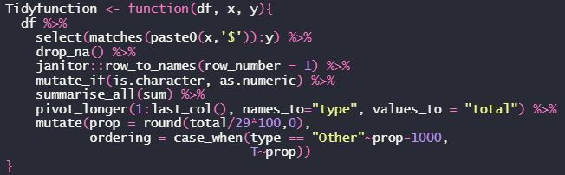
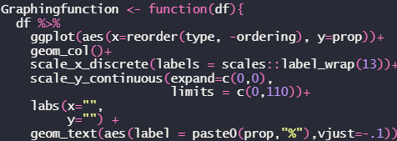
New Workflow: Ex1
Libraries
Data import
Wrangling
Vis
Notes:
New workflow:
When you’re loading libraries you load the sgplot library, and then the use_sgplot() call from that library, which automatically loads all the theme and aesthetic qualities and so forth
The next step was a wrangling function I wrote using mostly dplyr, which not only did the analysis of every question, but also converted it into a tidy format. This removed the human element from
And finally, we took the decision not to present data from previous years’ reports, given that this was the first year being official statistics. I’ll return to this point in a minute, but effectively what it meant was that we’d be presenting bar charts almost exclusively. This was beneficial because I only had to write a single function for creating the graphs which youc an see here. The major benefit of loading sgplot was that I didn’t have to faff about specifying themes, text size, text colour,
Then import the data both of these would have been in a setup script as Alice described earlier
gridlines, etc etc

Slide 14
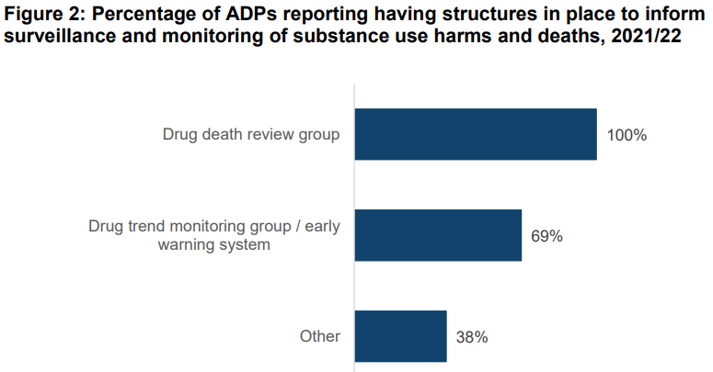
Old Workflow: Ex1

Slide 15
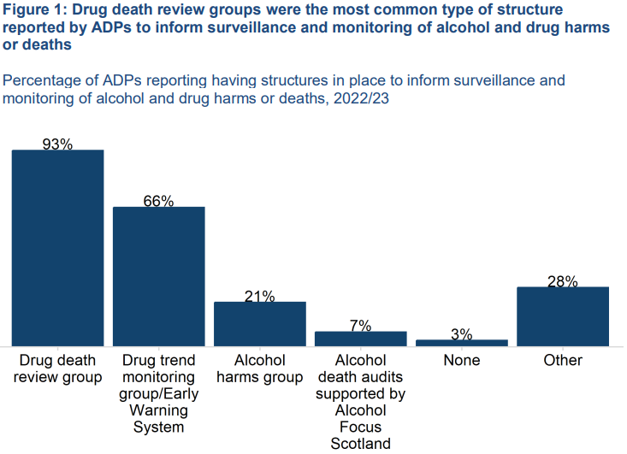

New Workflow: Ex1

Slide 16
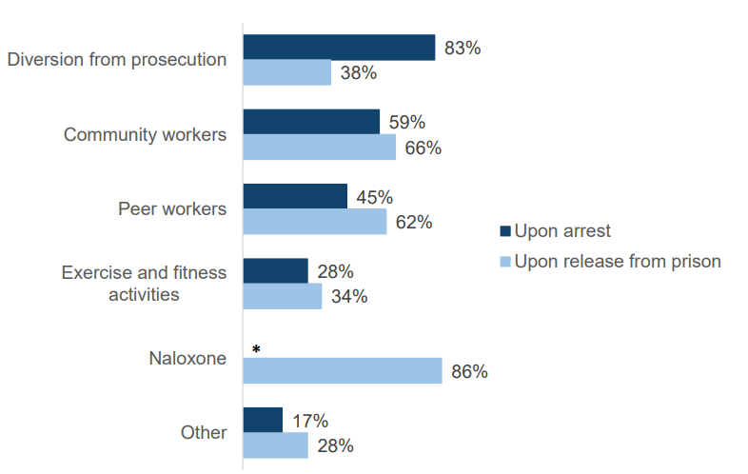
Ex2

Slide 17
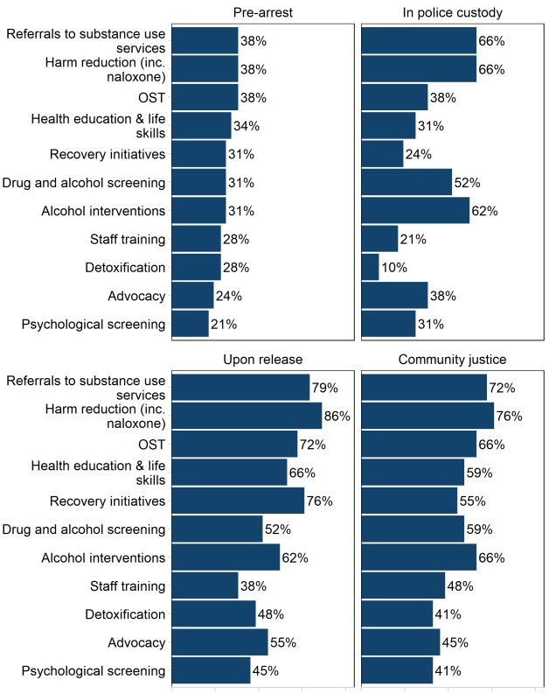

Ex2

Slide 18
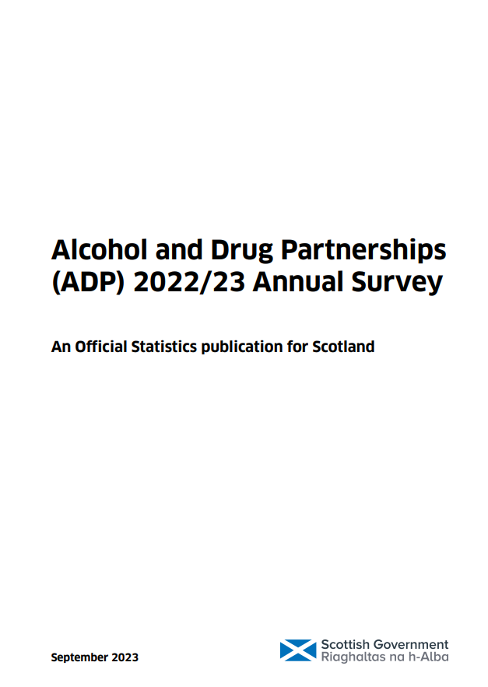
Outcome
Notes:
By incorporating SG plot…

Slide 19
Code of Practice – Value
Principles:
Relevance to users
Accessibility
Clarity and insight
Innovation and improvement
Efficiency and proportionality
Minimal APS blowback!
Notes:
tatistics producers should be creative and motivated to improve statistics and data, recognising the potential to harness technological advances for the development of all parts of the production and dissemination process.
Statistics and data should be published in forms that enable their reuse. Producers should use existing data wherever possible and only ask for more where justified
The most validating part of this whole process was that when we submitted this to APS they came back with only three comments,

Slide 20
Reflections
Explain the why of employing sgplot:
Simplicity
Accessibility/Reproducibility
Corporate theme
Open source!
Ensure tools/methods are fit for purpose
Incorporation into future publications
Personal – accessibility objective
Notes:
At the outset, you really want to articulate the why of employing sgplot. in our case, the first reason was quite simply, the simplicity. That is to say, if you’re already familiar with the grammar of ggplot2 which I’m sure many of you are, then sgplot is very easy to incorporate
As I’ve touched on, not only does it enhance the accessibility of a publication but also an R workflow means this work is reproducible and portable
Corporate theme
Open source!
Armed with SG plot I caught myself numerous times trying to think how I could shoehorn my data into an interesting data visualisation, but obviously this is wrong way round from how you should do it. Because this was the first year we published as official statistics we made the decision not to present data from previous iterations of this survey, hence why the majority of graphs in the publication ended up being bar charts, which are fairly uninteresting as visualisations go. However that underscores the importance of making sure the tools and methods are commensurate with data story you’re trying to tell
The positive experience has given us a toe hold to incorporate into future work. So for example, in this case we only used sgplot to produce the graphics whereas the rest of the publication was done in Word. In future there may be scope to incorporate the whole workflow into markdown which I don’t need to convince this crowd will confer numerous benefits. Also we’re discussing the possibility of employing sgplot in other publications
Performance Appraisal is an aspect of our work as civil servants which I’m sure you all take very seriously and have kept up on, and as part of this we must have a mandatory diversity objective, and I was able to use this process as an example of producing statistical publications that adhere to best practice for accessibility and inclusion

