Slide 1

R Shiny: Disease prevalence in Primary Care Scottish Government R User Day Disease prevalence in Primary Care
Julia Moeller
06/12/2023

Slide 2
R Shiny: Disease prevalence in Primary Care
Background
User group
User personas
Wireframes
App building
Challenges and future developments

Slide 3
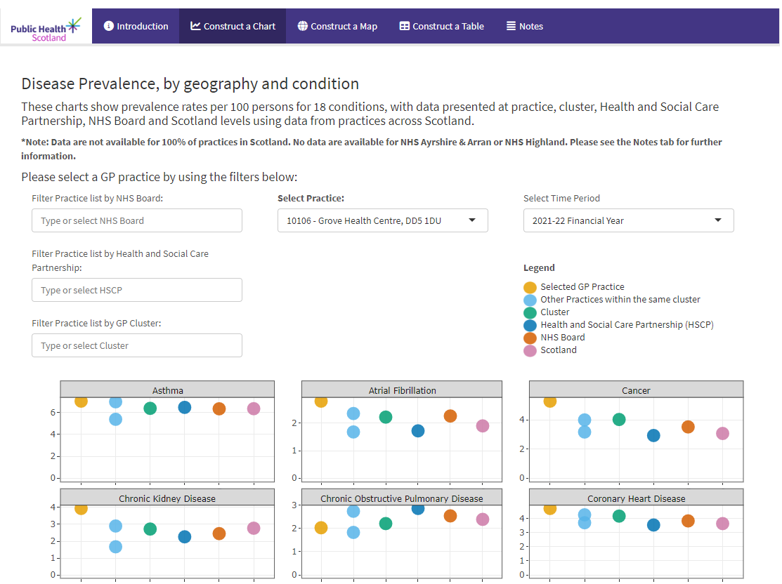
Background
Based on old Quality Outcomes Framework (QOF)
Scottish Primary Care Information Resource (SPIRE) data 2018-2022 shown in Shiny app
Prevalence per 100 patients for 18 of the most common diseases per practice e.g. cancer, COPD, asthma and mental health
2023 version
New conditions (Epilepsy and Eating Disorders)
Prevalence per sex and five-year age group
Dashboard review

Slide 4
User group
Feedback from users of 2022 dashboard
Most and least important feature, usefulness and, accessibility and user friendliness.
Input from “typical users”
Analyst
Primary Care strategic lead
GP advisor
Fortnightly meetings discussing users’ data and visualisation needs

Slide 5
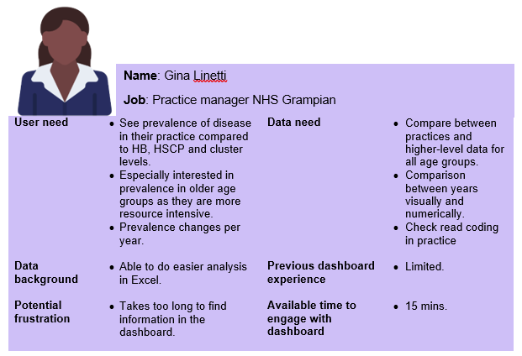
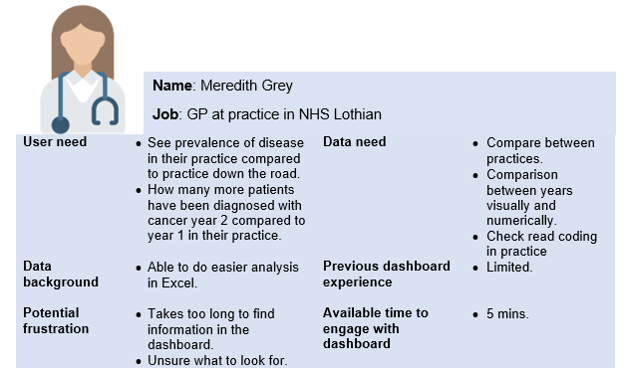
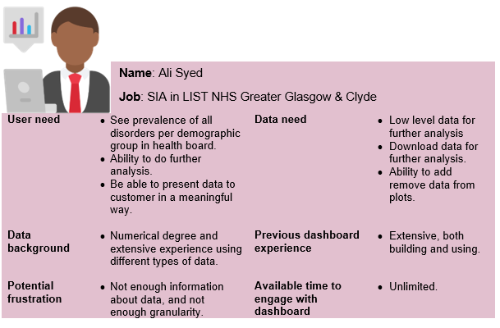
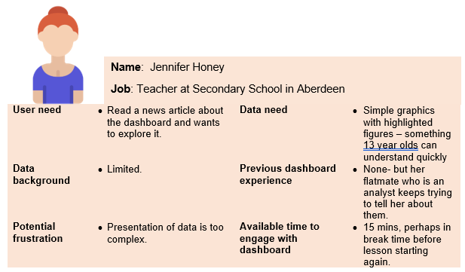
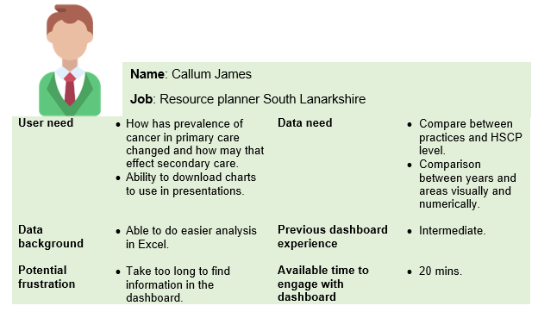
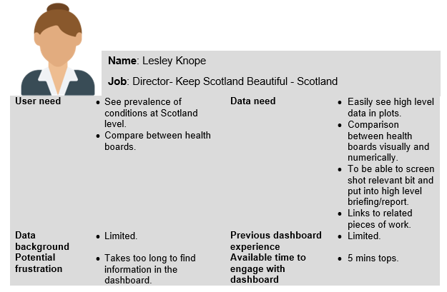
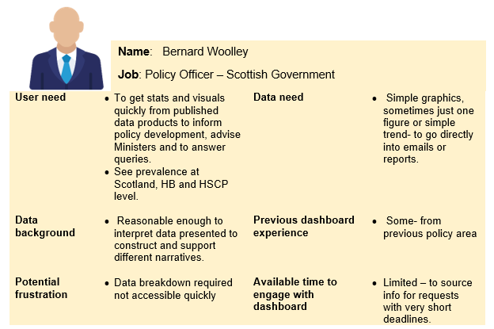
User personas
Possible users and what they might need from the dashboard

Slide 6
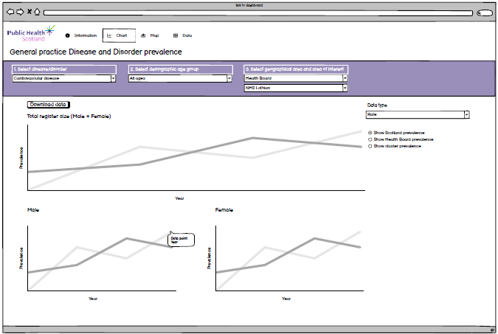
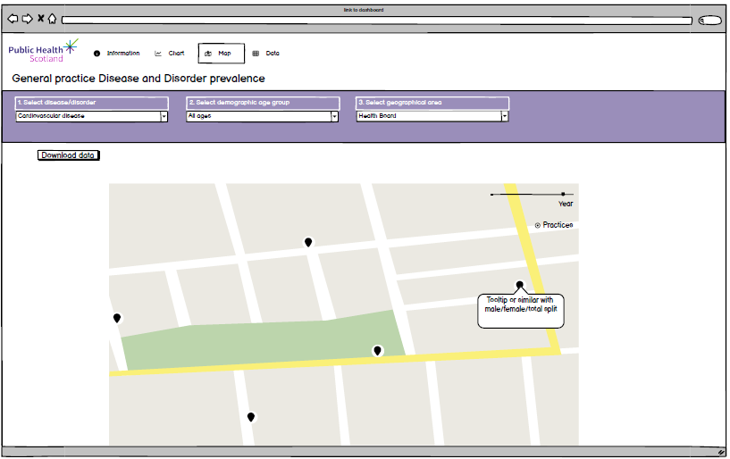
Wireframes
Sketches of dashboard versions using Balsamiq

Slide 7

App building: Shiny
Pros
Open source
Easy to collaborate using Github/Gitea
Highly customisable with CSS, html and JavaScript
Fun!
Cons
Can be tricky to learn
You need a server
Can be frustrating!

Slide 8
App building: Disease prevalence 2023 version
Goal: An app that is easy to interact with and that allows for comparison between different aggregates of data
Information tab
About, how to use the dashboard, data, accessibility, notes and dashboard updates
Chart tab
Show prevalence per condition and age group across time with the option of comparison between data aggregates
Map tab
Overview of condition prevalence per NHS Board or HSCP with the option of viewing individual practice
Data table
Filter through all data and download as csv for further use

Slide 9
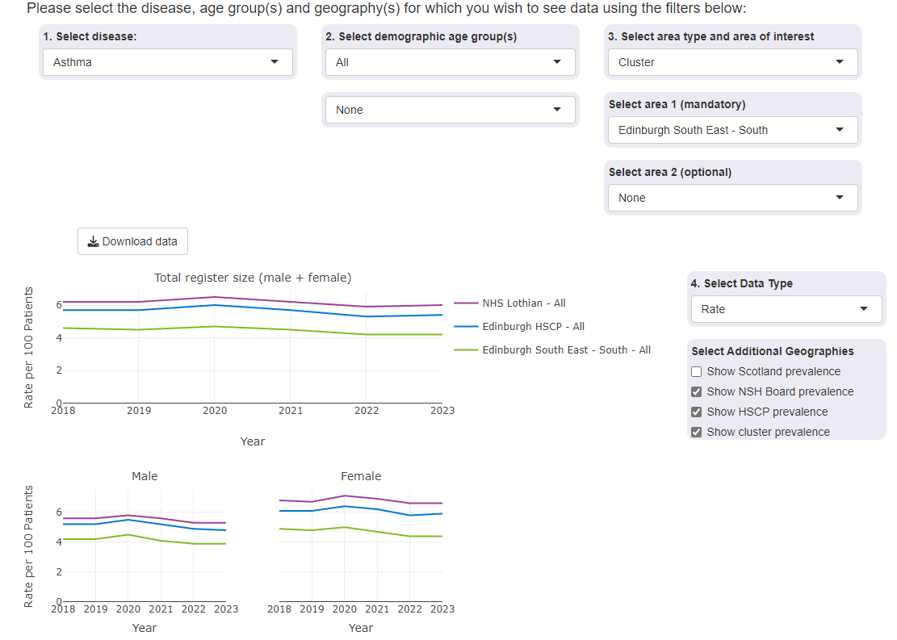
App building: Chart tab
Line charts to show prevalence across time
Charts for total list size and separate male/female list sizes
Build charts in plotly for interactivity
Data filtering
Condition, age group, area type and area of interest, data type and responsive additional geographies based on area type.

Slide 10
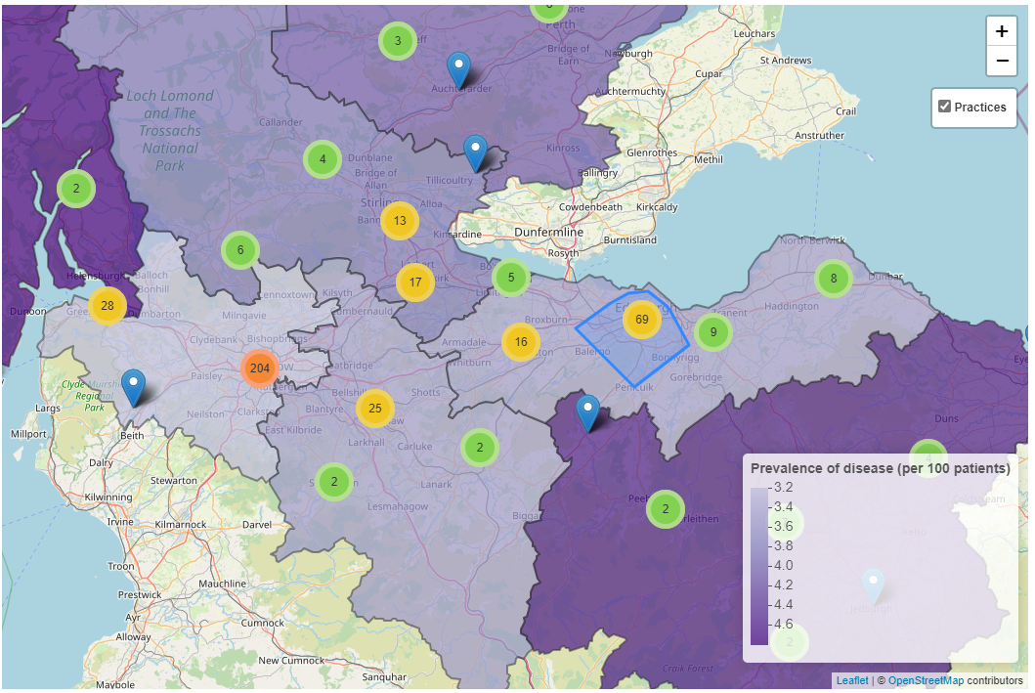
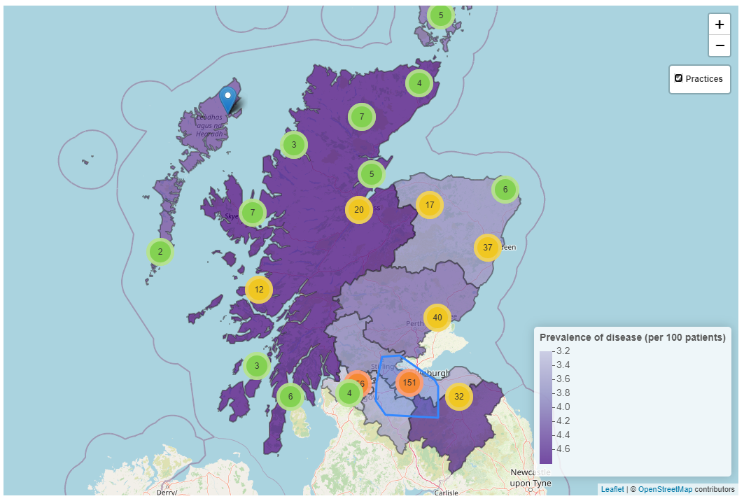
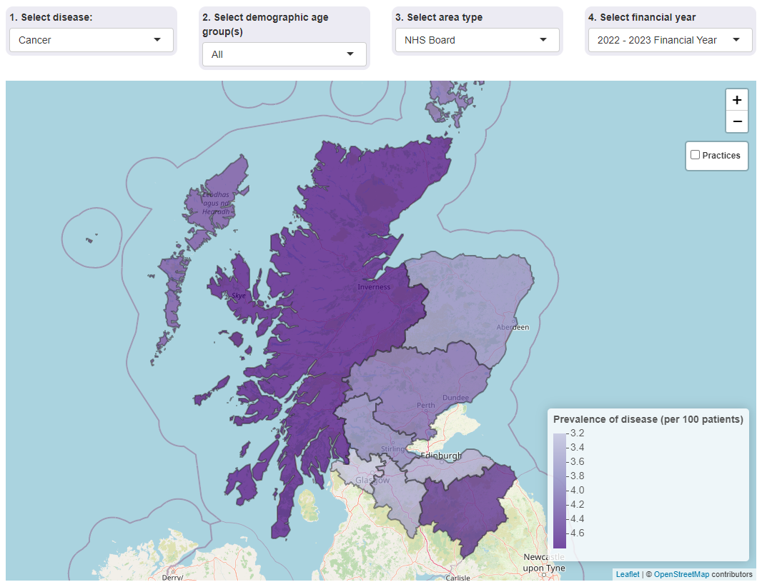
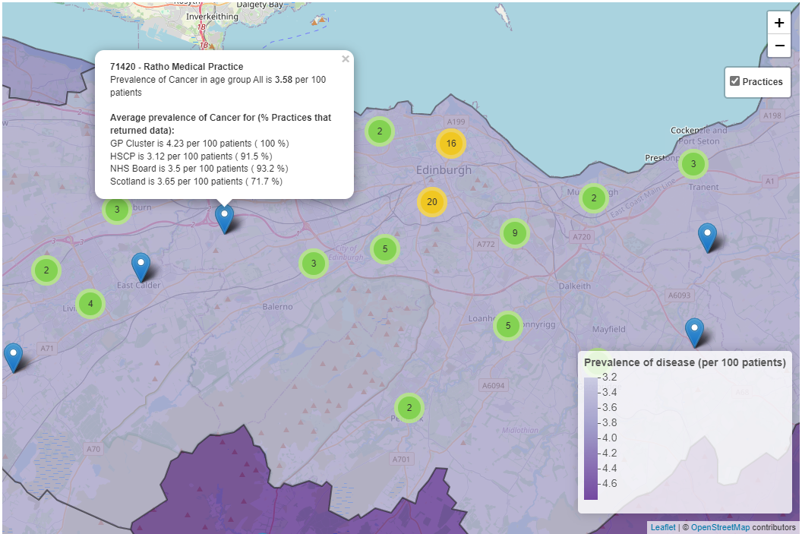
App building: Map tab
Map of Scotland where prevalence per condition, age group, area (NHS Board or HSCP) and year can be interacted with
Map created using leaflet

Slide 11
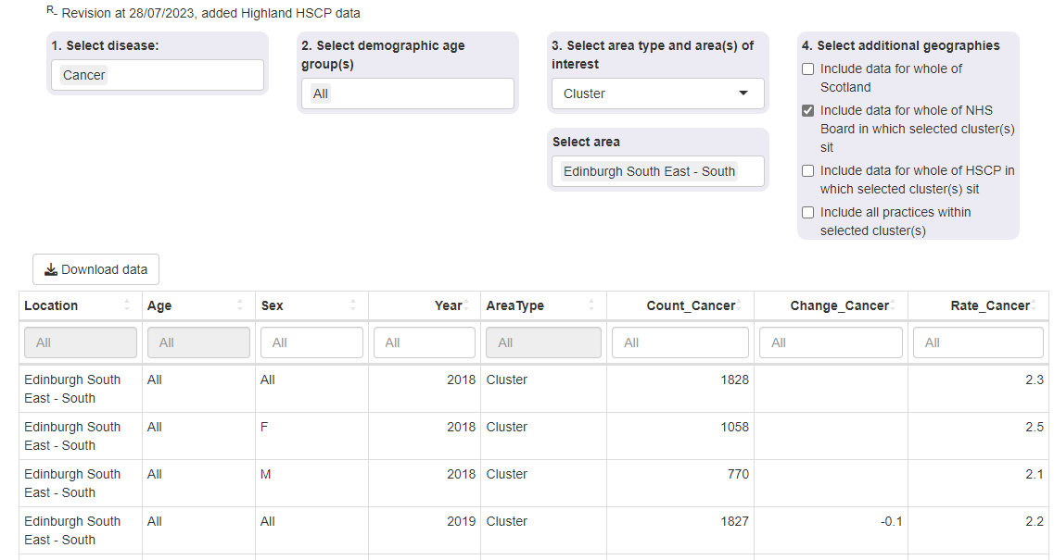
App building: Data download
Filter data on condition, age group, area type and area of interest, data type and responsive additional geographies based on area type
Table with data select and button for downloading previewed data as csv

Slide 12
Challenges
Map was slow to load and interact with
Solution: Plot individual practices in cluster
Dashboard would not deploy
Solution: Used profvis package to profile code and make it more efficient
Future developments
New tab with data generalisation for Scotland level
Update dashboard with 2024 data from new extraction tool PCIS

