Slide 1
Data Platforms
Notes:
A team within the Data Domain in the Office of the Chief Statistician.

Slide 2
Intro
Analytical Data Management System (ADM)
Analytical Workbench (AWB)
Data Acquisition and Procxed
What we do?
Notes:
Data Platforms provide three key components, Analytical Data Management (ADM) and Analytical Workbench (AWB).
What do we do – we are the Data Platforms team and our aim is to support analysts of all professions with their use of data.

Slide 3
Identified issues
Issues identified by analysts in SG:
I need a secure place to share data with a member of a different division
My new start wants to use R while the data is in SAS
I can’t find relevant datasets and the local expert is on leave
Another government department wants to know what our data handling policy is before sharing data
We want to publish using new tools like Shiny apps (or the new tech of your choice)
I know we comply with GDPR but how do I prove it?
Notes:
Here are some of the issues identified by analysts in SG. We have listened to these and included features in our systems to combat them.

Slide 4
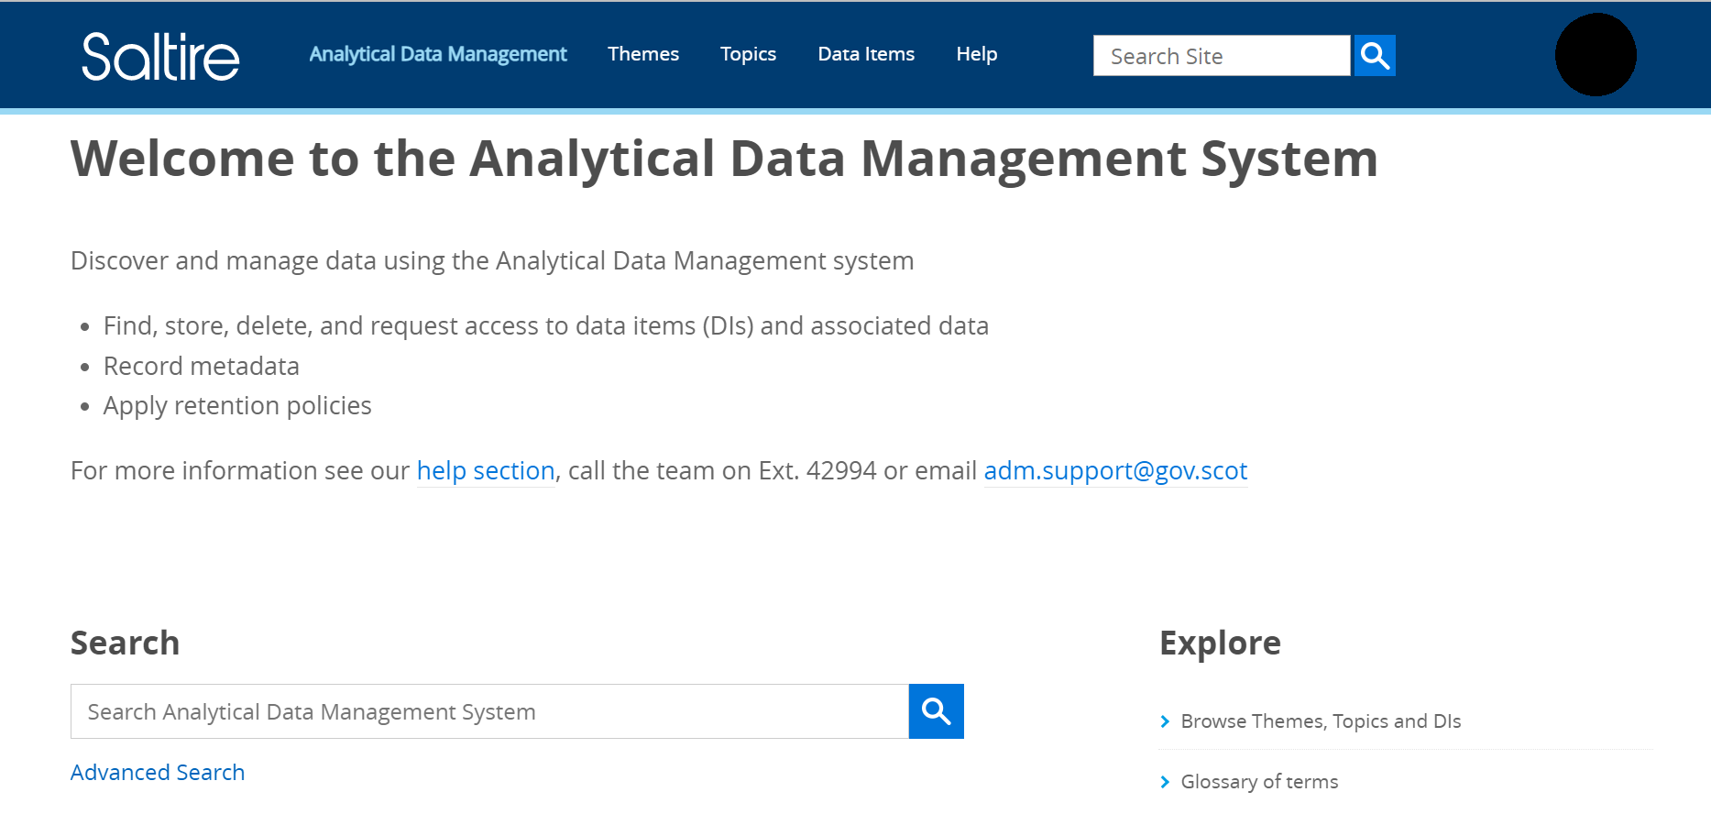
Analytical Data Management System
Scots users only
Data catalogue
Data store
User guidance
Store, access and manage data
Notes:
The Analytical Data Management System is a platform for analysts across the Scottish Government to store, access, and share data. It provides a secure location for finding, storing and managing data.
The Analytical Data Management system allows you to control your data consistently and effectively, make your data more visible and provide helpful metadata.
The Analytical data management system complies with UK GDPR and lets you chose the retention policy for your data which will be applied regardless of staffing changes.
Always welcome feedback.
There is a link further on in the presentation.

Slide 5
Analytical Workbench
Do you need:
  access to up-to-date analytical software?
  memory and processing power?
  access to open source and licenced statistical tools?
  secure collaboration spaces?
  develop, test, build and upload content?
We provide:
private cloud within EIDF
accessible, publishing dashboards
access to virtual desktop
open-source solutions
templates
Notes:
The Analytical Workbench is an internal and external platform. It originated from the Scottish Public Sector Analytical Collaborative programme, SPACe.
The Analytical Workbench provides access to tools and software, with a focus on open-source solutions. Through the workbench you also have access to a world-class data centre that offers high performance computing power and the ability to collaborate across organisational boundaries; providing the ability to share resources, code and ideas.

Slide 6
Analytical Workbench
Is a trusted source for Scottish Government data
Provides interactive content to supplement static publications
Is hosted by the University of Edinburgh Information Services
Is managed by EPCC

Slide 7
Analytical Workbench workflow steps
# | Task | Owner | Notes
1 | Discuss and record requirements in content log | Analyst/Data Platforms
2 | Review styling, presentation and accessibility guidance | Analyst | See Resources
3 | Develop, test and build content | Analyst
4 | Set up ObjectiveConnect folder and invite analysts | Data Platforms
5 | Email analytical.workbench@gov.scot to request website | Analyst | At least 10 working days before site is required
6 | Upload zipped content to ObjectiveConnect folder the day before release | Analyst | Name the .zip so it unzips as requested website name
7 | Release unzipped content to make website | EPCC

Slide 8




  Designed for Public Sector Collaboration
  Established IG and
  Legal framework
  improved public
  services through
  better use of data
  Three security zone levels
  Secure File Transfer
  Secure Project spaces for shared teams
  Hosted in the EIDF
Collaboration
Security & Safety
Tools
Processing Power
  Windows OS
  Linux OS
  RStudio and Python
  QGIS, NVivo and Stata
  Git version control
  Package management with conda and pip
  Scalable VM’s
  Part of Scotland’s Super-Computer campus
  Storage for large datasets
  GPU processors available
Notes:
The Analytical Workbench centres around collaboration, security & safety, Processing power and tools.
Accessible text
Collaboration – AWB is designed for pubic sector collaboration, has an established IG and legal framework and offers opportunities to improve public services through better use of data.
Security and Safety – Ability to select appropriate levels of access. Secure file transfer and secure project spaces for shared teams. It is hosted in the EIDF.
Processing Power – Scalable virtual machines. Built on Scotland’s national super-computer. Provides storage for large datasets and GPU processors for spatial analysis.
Tools – Windows and Linux operating systems, R Studio and Python, QGIS and NVivo. Version control and package management tools.

Slide 9
Data Acquisition
Secure acquisition, quality assurance and storage of data.
Local Authorities, Health boards and Public Bodies
Procxed
dbxED
Rapid feedback on data quality
Efficient data collection process
Notes:
The Data Acquisition team supports the secure acquisition, quality assurance and storage of administrative data.
The administrative data comes from Local Authorities, Health Boards and Public Bodies.
The data collections platform, Procxed, is a secure web-based, data collection platforms designed for secure transfer of data onto Scottish government services. It provides rapid feedback on data quality and the opportunity to address these issues quickly and close to source. This shortens the data collection process, reduces the work on data providers and collection managers and improves the quality of data.
Data acquired through Procxed is stored on an SQL server db, dbXed).
Procxed is best suited for administrative data where the quality can be improved by the data provider using the validation error feedback process.

Slide 10
Procxed Data Acquisition
Source data gathered and stored by DP as part of admin processes. Data extracted as per specification.
Data Uploaded to Procxed. Errors reported fed back to Data Providers who amend their data and reload. Repeat until clean.
Data is tested against predefined business rules. DP given time period to address quality issues. Data is ‘submitted’ by DP when deemed clean.
Clean submitted data is then extracted into SCOTS domain, & transformed from XML to SQL tables.
Optional 2nd stage validation by stats team. Errors issued via spreadsheet & erdmConnect with amendments coded for audit purposes.
Data prep & release into warehouse (normalise, add datazone, mask dob/poscode, version)
Data storage
Analysis
Data Provider
data
AWS Cloud
SCOTS
Errors
Procxed
1st stage validation
Transform & upload
Monitor Completion
Reminders
Apply business rules
Produce QA reporting
Completeness check
Collate reruns
Optional SQL db
2nd stage validation
Cross year checks
Cross organisation checks
Statistical checks
dbXed
SQL db
Odbc
tool agnostic
Access controlled
Versioned
Read only
R
data
data
Data Provider
data
sas
Errors
Data Provider
data
sql
Errors
data
Excel
data

Slide 11
Resources
Analytical Data Management
ADM user guide
Analytical Data Management - adm.support@gov.scot
AWB user guide
Analytical Workbench – analytical.workbench@gov.scot
Yammer groups
  R users community
  RAP community
  Visualisation community

