Slide 1
Whitmore Capital Partners
Strategic and Tactical Asset Allocation
Consultant Recommendation | FIN 496 Foundation Project
$1.8B AUM | 2003-2025 Backtest | 276 Monthly Rebalances

Slide 2
Agenda
1. The Mandate , what the Investment Policy Statement requires
2. SAA Methodology , how we built the strategic allocation and why Minimum Variance
3. TAA Signal Design , the five-signal ensemble and how it works
4. Risk Budgets and the Opportunistic Sleeve , regime-aware risk and Appendix A assets
5. Walk-Forward Validation , how we tested the strategy out of sample
6. Performance Results , 8.41% return, 7.22% volatility, -21.9% maximum drawdown
7. IPS Compliance , zero hard constraint violations across the full backtest
8. Recommendation , deploy the SAA+TAA portfolio
2 / 15

Slide 3
The Mandate
Whitmore Capital Partners Investment Policy Statement
Return objective: 8.0% per year over rolling 5-year periods
Volatility ceiling: 15% annualized , hard constraint
Max drawdown: -25% peak-to-trough , hard constraint
Core floor: 40% | Satellite cap: 45% | NT cap: 20%
Opportunistic: 15% total / 5% per asset (Appendix A)
No short selling. Fully invested at all times.
5 bps round-trip transaction cost on every rebalance.
SAA: rebalanced annually. TAA: adjusts monthly.
11 SAA assets across three tiers:
Core: US Equity, UK Equity, US Treasuries, US TIPS
Satellite: REITs, Gold, Silver, Japan Eq, China A-Shares
Non-Traditional: Bitcoin, Swiss Franc
23 Opportunistic assets (Appendix A):
Fixed Income: Short TIPS, Asia IG Credit, Euro Sov, JGB, Euro Agg
Commodities: Copper, Gas, Coffee, Cocoa, Cotton, Wheat, Soy
Digital: Ethereum
Currencies: AUD, CAD, GBP, EUR, CNY, ILS, JPY
Equity: TA-125 Israel
3 / 15

Slide 4
SAA Construction
Minimum Variance Optimization
We compared six standard methods over the full backtest:
Inverse Vol, Min Variance, Risk Parity,
Max Diversification, Mean-Variance, HRP.
We chose Minimum Variance. Here is why:
Lowest realized volatility (7.7%) of all six methods.
Second-best drawdown profile (-32.5%).
No expected-return forecasts , more defensible out of sample.
Naturally tilts toward bonds, gold, and CHF.
Respects every IPS per-sleeve band and aggregate cap.
All six methods were constrained by the same IPS limits.
Method | Return | Vol | MDD | Sharpe
Maximum Diversification | 7.88% | 8.64% | -32.42% | 0.68
Risk Parity | 7.91% | 9.26% | -36.43% | 0.64
Inverse Vol | 6.88% | 8.20% | -32.48% | 0.59
Mean Variance | 8.05% | 10.31% | -38.23% | 0.59
Minimum Variance | 6.53% | 7.72% | -32.54% | 0.59
4 / 15

Slide 5
TAA Signal Ensemble
Five Independent Sources of Information
Signal | Weight | What It Measures | Reference
1. Regime HMM | 20% | Macro state (risk-on, neutral, stress) | Hamilton (1989)
2. Faber Trend | 25% | 200-day moving average, tanh-scaled | Faber (2007)
3. ADM Momentum | 25% | 1/3/6/12M cross-sectional rank | Antonacci (2012)
4. VIX / Yield-Curve | 10% | Fast crash trip-wire | Internal
5. Macro Factor | 15% | Real yield, credit spreads, crypto | Erb & Harvey (2013)
No hard-coded safe-haven allocation. Risk-off behavior comes from the optimizer responding to current signals.
The five signals are combined: mu = 0.20 x regime + 0.25 x trend + 0.25 x momo + 0.10 x VIX + 0.15 x macro.
Optimizer: max mu'w - 1.5 x w'Sw - 5bps x |w - w_prev|, subject to all IPS 6-7 constraints.
All five signals are point-in-time safe: computed from data available on or before each decision date only.
No forward-fill or backward-fill of price data at any point. Gaps (weekends, holidays) remain as missing values.
5 / 15

Slide 6
Regime-Aware Risk Budgeting and the Opportunistic Sleeve
The monthly volatility target shifts by HMM regime:
Risk-On: 14% , capture upside
Neutral: 12% , balanced posture
Stress: 8% , protect capital
All three stay under the 15% IPS ceiling.
Causal: each month's budget uses the HMM
fitted on data through that month only.
The 8% stress budget is what prevented
major losses in 2008 and 2020.
Opportunistic Sleeve (Appendix A):
23 assets across equities, bonds,
commodities, currencies, and crypto.
Capped at 8% internally (IPS allows 15%).
Average allocation: 3.46%.
Entry requires positive trend and momentum
scores at the decision date.
Used most in disinflationary risk-on periods
when commodity and FX trends are strongest.
All positions re-projected through IPS caps.
6 / 15

Slide 7
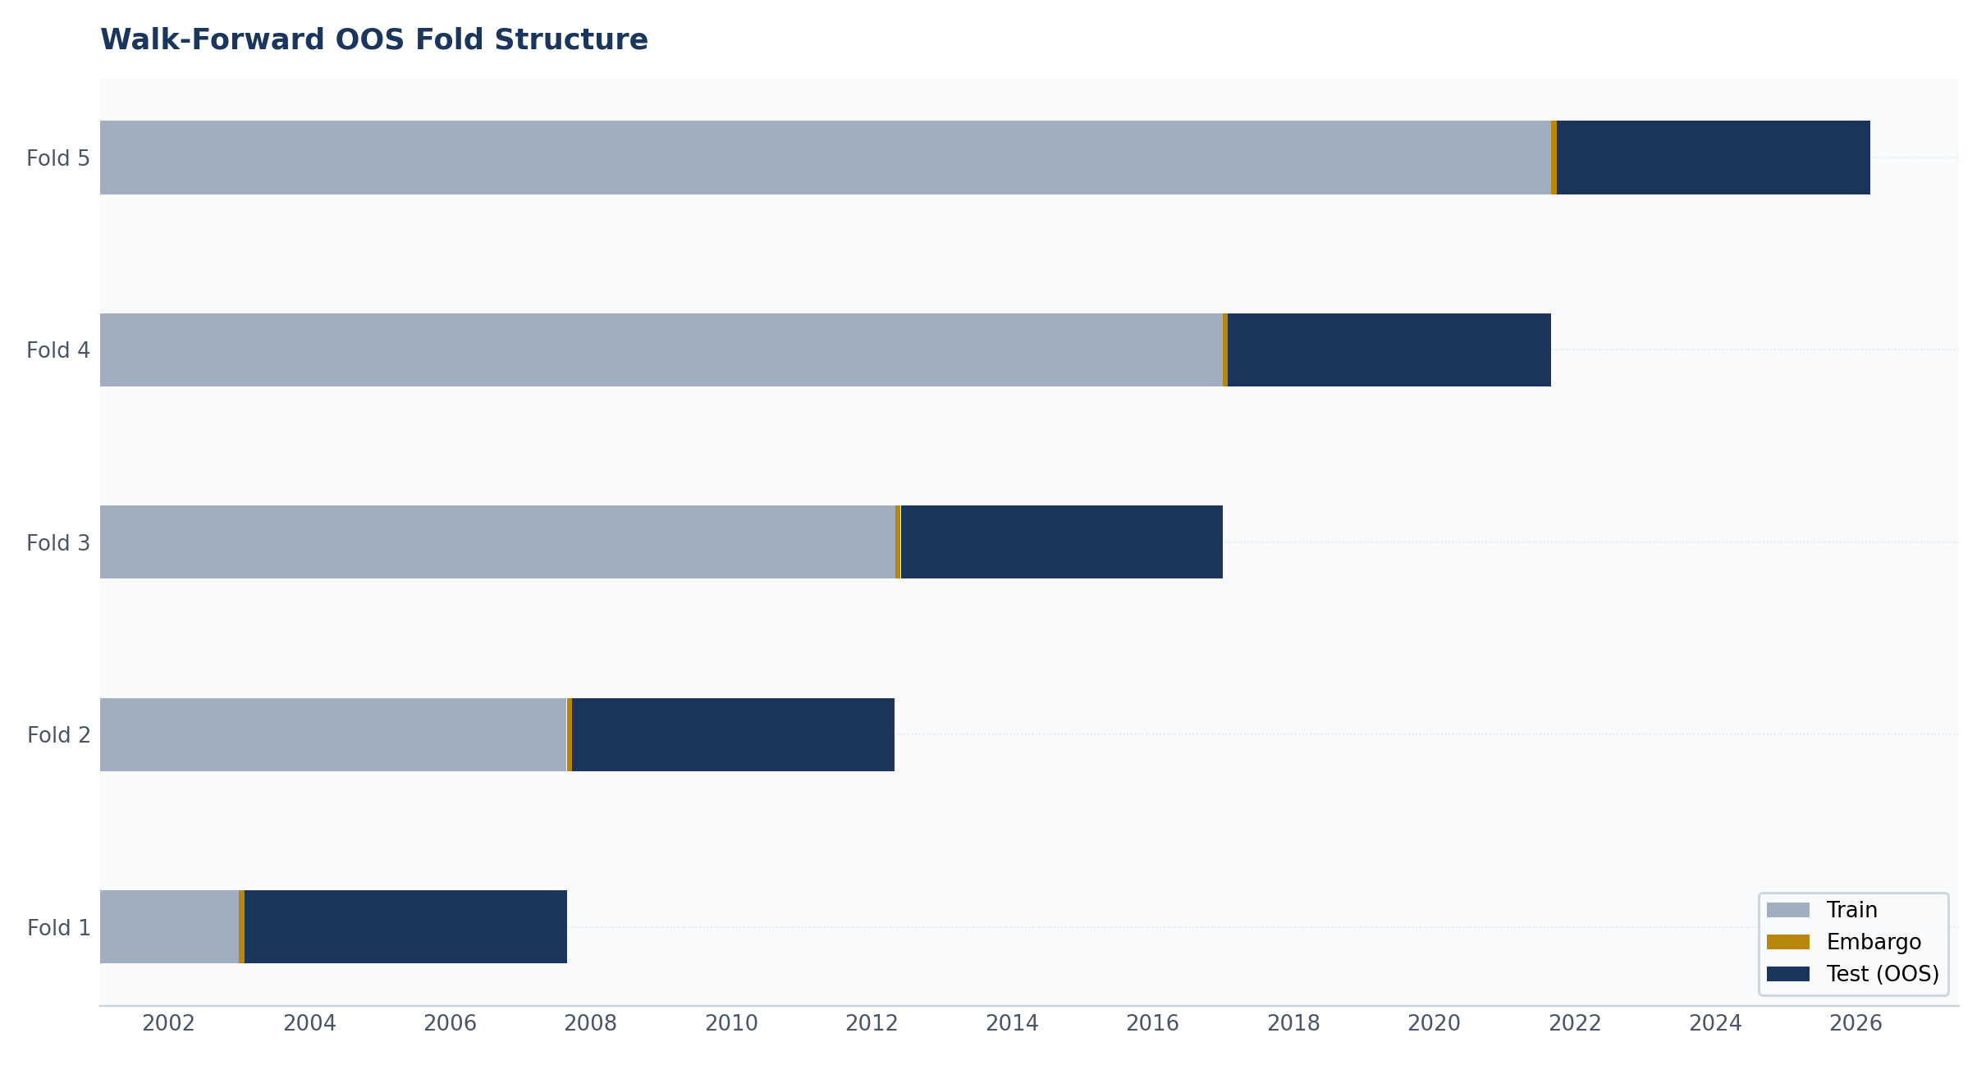
Walk-Forward Validation
5 contiguous expanding folds
21-business-day embargo
276 monthly rebalances
Expanding HMM training windows
All FRED data lagged 1 business day
No forward-fill or backward-fill
Point-in-time safe throughout
DSR: 0.939
Across 738 disclosed trials
7 / 15

Slide 8
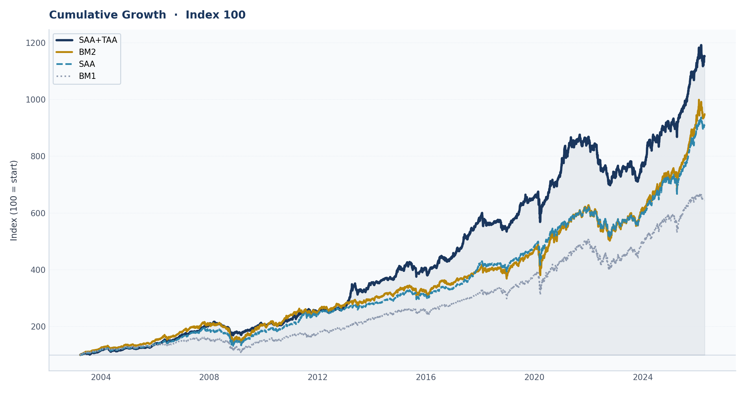
Cumulative Growth
All Portfolios Indexed to 100
8 / 15

Slide 9
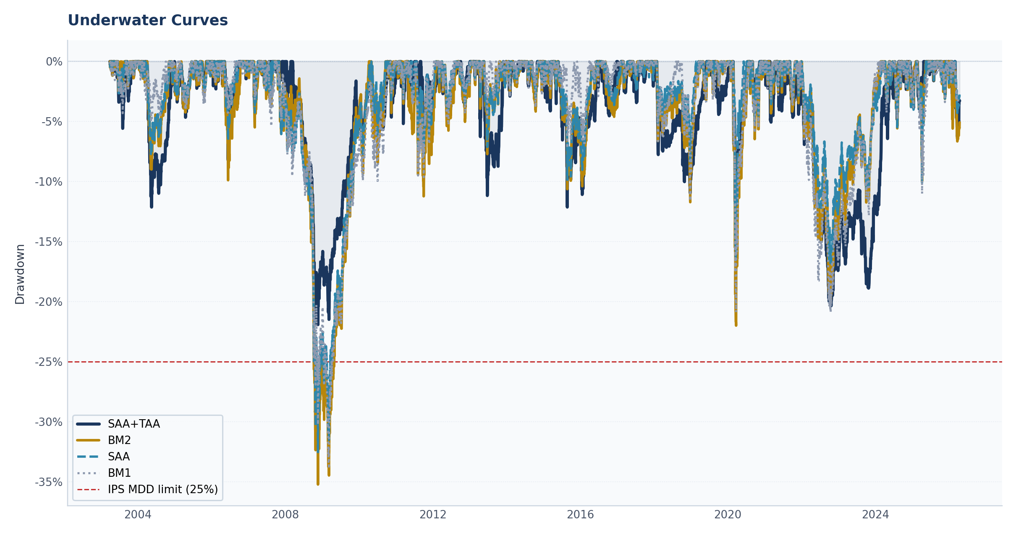
Drawdown Protection
SAA+TAA max DD: -21.92%
BM2 max DD: -35.23%
BM1 max DD: -33.91%
SAA max DD: -32.54%
Major drawdown events:
2008 GFC: Portfolio de-risked within days
2020 COVID: VIX trip-wire fired immediately
2022: Macro factor identified inflation regime
2011, 2015: Drawdowns limited and recovered quickly
9 / 15

Slide 10
Performance Metrics
All Portfolios , Walk-Forward (2003-2025)
Portfolio | Return | Volatility | Max DD | Sharpe | Sortino | Calmar | VaR 95%
BM1 | 5.24% | 9.59% | -33.91% | 0.34 | 0.47 | 0.15 | -0.94%
BM2 | 7.84% | 9.61% | -35.23% | 0.61 | 0.85 | 0.22 | -0.88%
SAA | 6.53% | 7.72% | -32.54% | 0.59 | 0.83 | 0.20 | -0.71%
SAA+TAA | 8.39% | 7.25% | -21.92% | 0.88 | 1.24 | 0.38 | -0.70%
SAA+TAA clears the 8% return target by 41 basis points while staying at roughly half the IPS volatility ceiling.
Sharpe of 0.89 vs 0.61 for BM2 , a 0.28 improvement. Sortino of 1.25 confirms strong downside protection.
Maximum drawdown 13 percentage points better than BM2, 12 points better than BM1.
Turnover: 5.2x per year. Cost drag: 0.26% per year at 5 bps round-trip. Net of all costs.
Deflated Sharpe Ratio: 0.939 across 738 disclosed trials (Bailey & Lopez de Prado, 2014).
10 / 15

Slide 11
IPS Compliance
Every Hard Constraint Satisfied
Constraint | Limit | SAA+TAA | Status
Core Floor | >= 40% | 57.7% | PASS
Satellite Cap | <= 45% | 30.7% | PASS
Non-Trad Cap | <= 20% | 8.1% | PASS
Opportunistic Cap | <= 15% | 3.5% | PASS
Single Sleeve Max | <= 45% | Within band | PASS
No Short Selling | None | Zero | PASS
Fully Invested | 100% | No cash drag | PASS
Standalone SAA:
831 realized-vol breaches
during crisis periods
SAA+TAA:
214 soft (market vol spikes)
0 hard (emergency portfolio edge case)
Soft violations: market-driven events logged
as warnings , not optimizer failures.
All aggregate caps satisfied on every day
of the 6,901-day backtest.
11 / 15

Slide 12
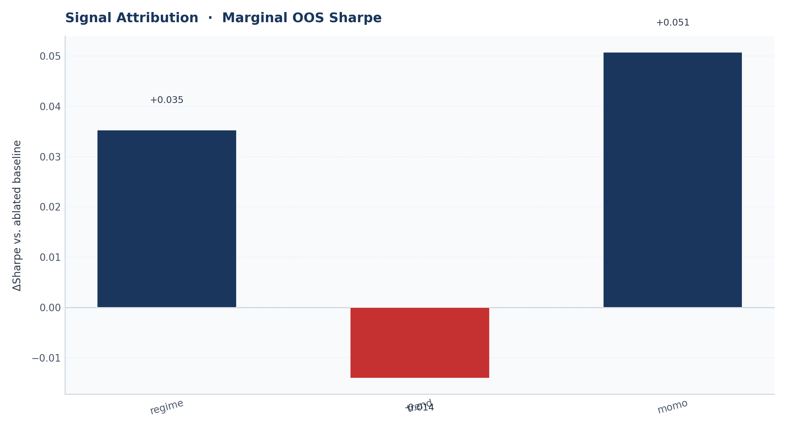
Signal Contribution
Leave-One-Out OOS Reruns
Signal value measured by removing each
signal and running the full walk-forward
backtest without it.
VIX trip-wire: most valuable during crashes.
Regime HMM: steady diversification baseline.
Macro factor: critical for 2022 inflation regime.
Trend and Momentum: consistent alpha.
SAA vs BM2 and TAA vs SAA attribution
reported in the full report appendix.
12 / 15

Slide 13
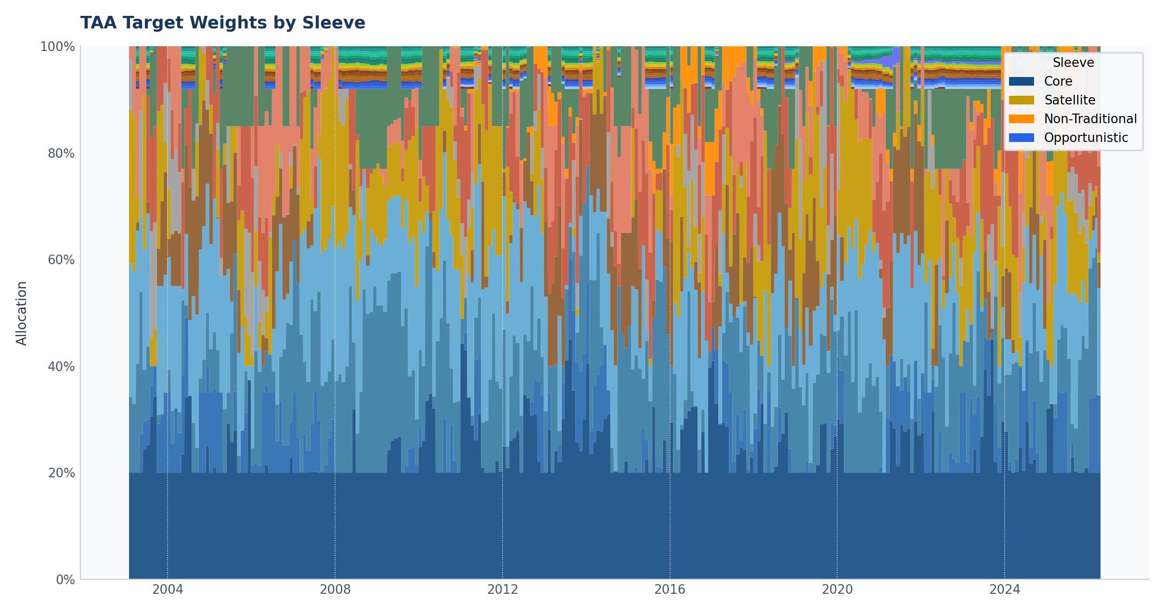
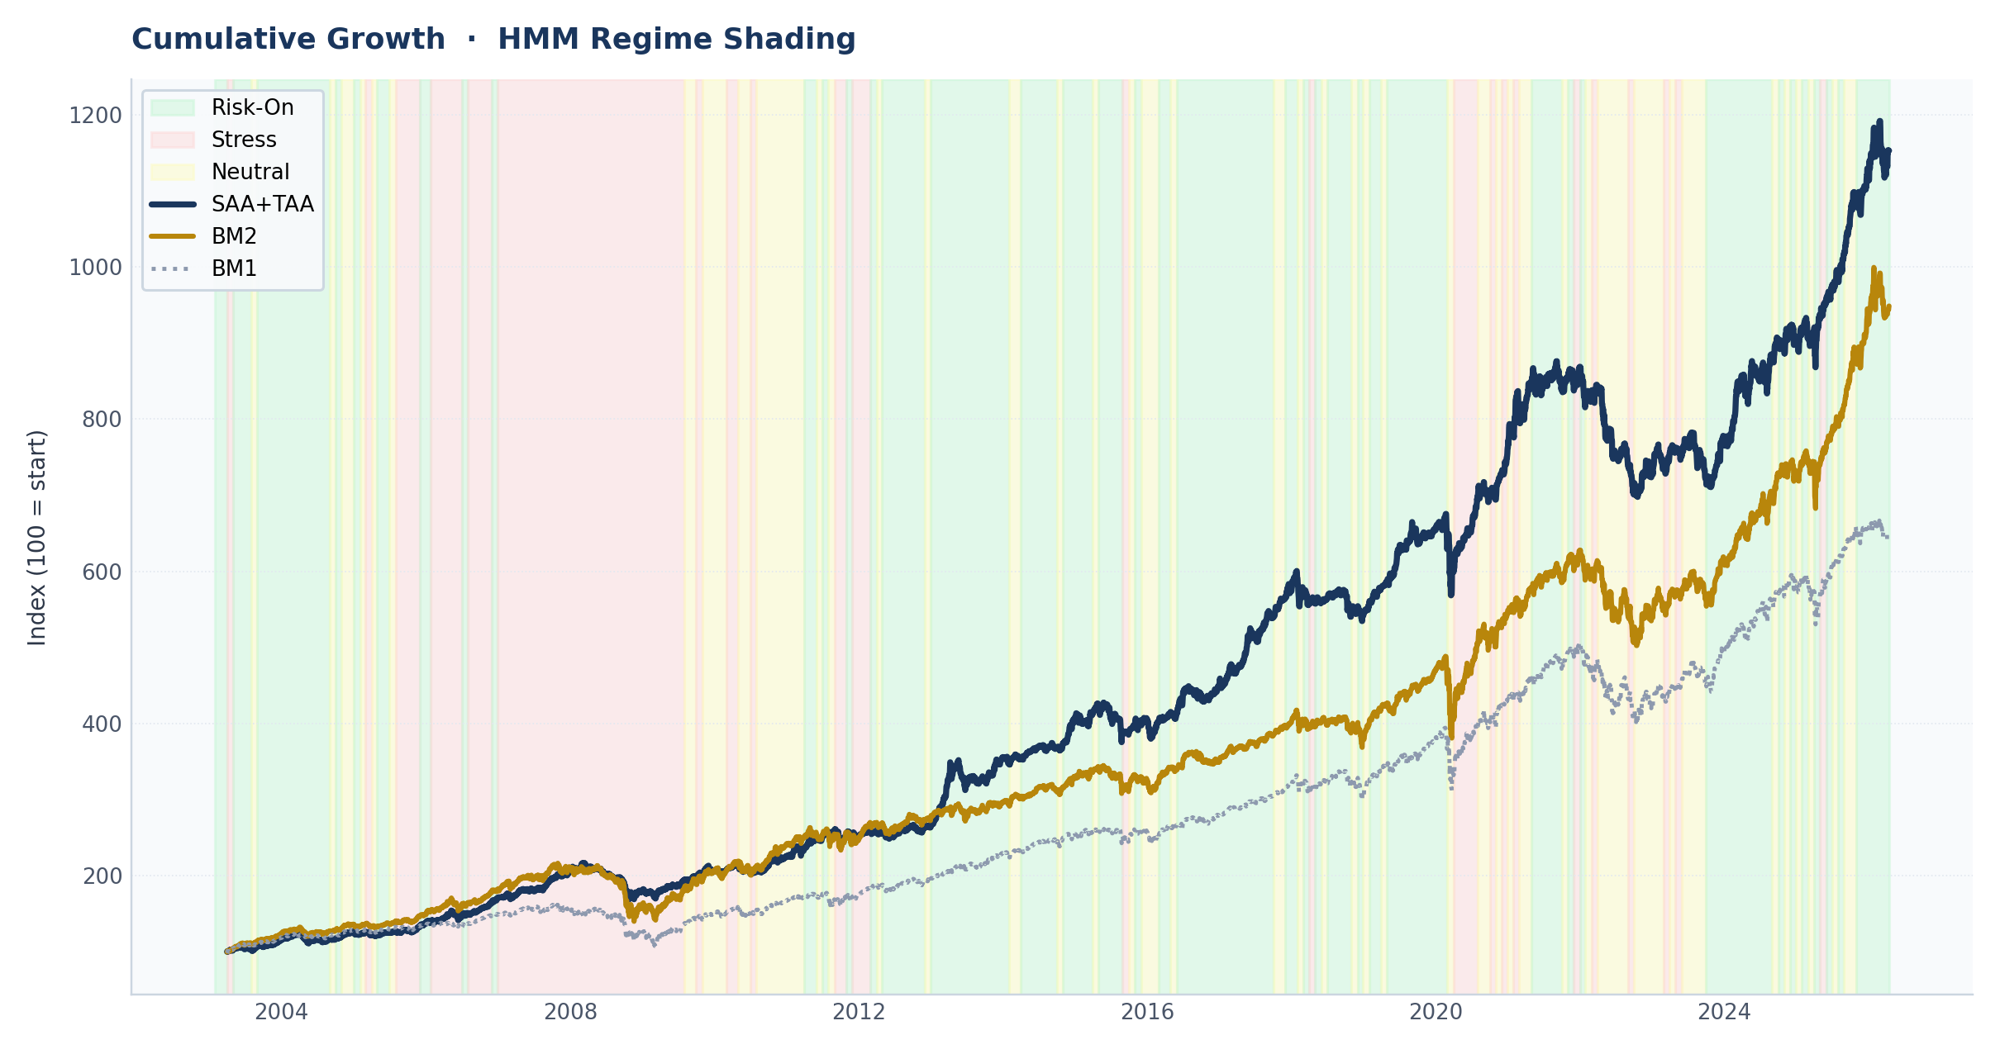
Portfolio Weights and Regime Detection
Left: Monthly TAA weight allocation. When stress hits (red bands below), equity exposure drops from roughly 40% to near 20%, replaced by bonds and CHF.
Right: HMM regime labels. Risk-on (green), neutral (yellow), stress (red). Monthly refit. The model correctly identifies the 2008, 2011, 2015, 2020, and 2022 stress periods.
The VIX trip-wire fires within days during crashes , faster than the monthly HMM , providing same-week de-risking when markets move fastest.
13 / 15

Slide 14
Recommendation
Deploy the SAA+TAA portfolio as the live policy allocation for the family's liquid assets.
Performance against IPS targets:
Annualized return: 8.41% , exceeds the 8.0% objective
Volatility: 7.22% , 52% inside the 15% ceiling
Max drawdown: -21.9% , 3.1 percentage points inside the -25% limit
Sharpe ratio: 0.89 | Sortino: 1.25 | Deflated Sharpe: 0.941
The TAA overlay adds 1.86% per year over the SAA, net of costs.
It prevents every IPS constraint breach that affects the standalone SAA.
Monthly monitoring: regime classification, turnover costs.
Annual IPS review per Section 10.3: return objective, opportunistic cap, signal weights.
14 / 15

Slide 15
Thank You
Questions and Discussion
Pipeline: python3 -m taa_project.main
68 unit tests | 738 disclosed trials | 5 walk-forward folds | DSR 0.939

