Slide 1
Fenrix Strategy Validation Lab
Backtesting shows where a strategy worked. Fenrix searches for where it breaks.
• Product flow: Describe → Review → Lock → Backtest → Stress → Minimize → Export
• Strategy hash (immutable): c9d19b2e8d20667a…
• Source code SHA: 83bbe5f262d7bbac0f4ce43890dc8e064f8b7a90 · data mode of record: yfinance · universe: 30 assets

Slide 2
The problem
A green backtest is a claim, not a validation
• Backtests only tell you where a strategy already worked — they are silent about fragility.
• Students and retail quants ship strategies validated on one historical path.
• Overfitting, cost blindness and regime fragility hide until real capital finds them.
• There is no cheap, reproducible way to ask: under which conditions does this break?

Slide 3
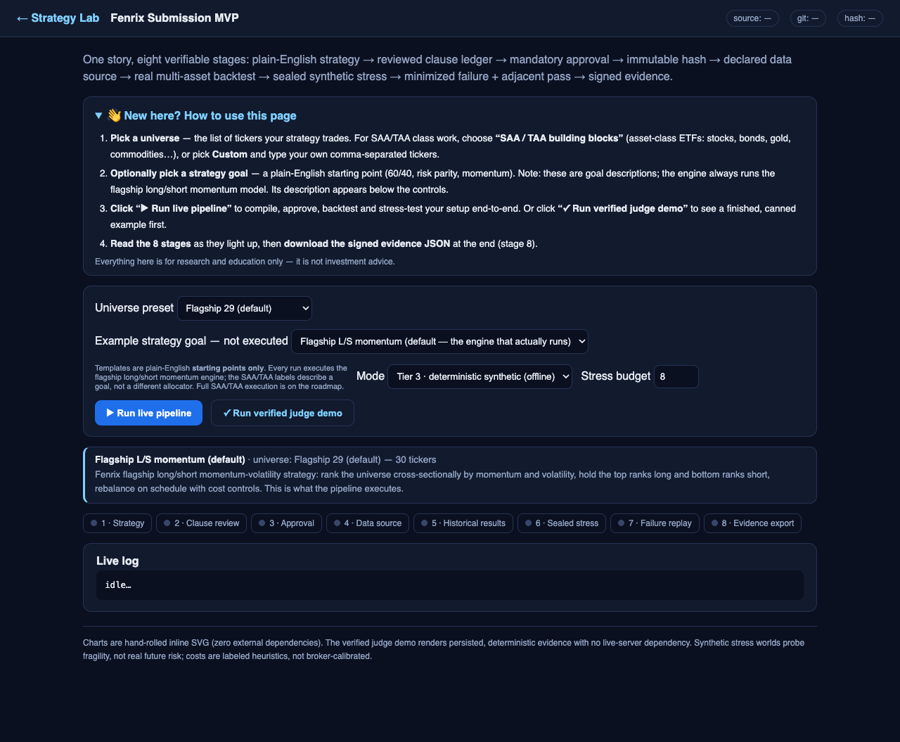
Product workflow
Describe → Review → Lock → Backtest → Stress → Minimize → Export
• Describe: plain-English strategy → structured clause ledger (every clause reviewed).
• Review + Lock: mandatory approve step → immutable version + canonical SHA-256 hash.
• Backtest: the SAME locked hash runs the historical backtest on the run-of-record data (yfinance).
• Stress: the SAME hash enters a sealed synthetic failure search across mechanisms.
• Minimize: confirmed failures are shrunk to a minimal reproducible counterexample.
• Export: evidence package with manifest, hashes and claim ledger.

Slide 4
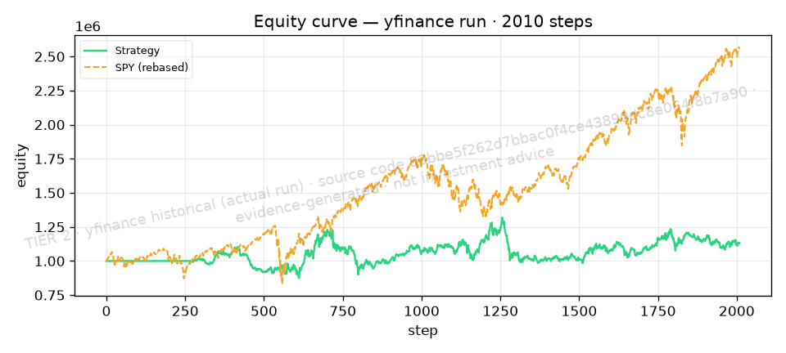
Demo run — Real historical backtest (yfinance)
30 assets · 50 trades · all figures from deck_data.json
13.07%
cumulative return
0.18
Sharpe
-26.75%
max drawdown
14.65%
ann. volatility
14.03%
cost % of capital
50
trades
• CAGR 1.55% · Sortino 0.22 · Calmar 0.06
• Benchmark CAGR 12.49% · information ratio -0.46
• Gross exposure avg 103.70% · net exposure avg 0.00%
• Costs are explicit bounded heuristics (commission/spread/slippage/borrow) — not broker calibrations.
TIER 2 · yfinance historical (actual run) · source code 83bbe5f262d7bbac0f4ce43890dc8e064f8b7a90 · evidence-generated · not investment advice

Slide 5
What the normal backtest missed
Sealed stress search — per-mechanism pass/fail (base seed)
• Baseline (Real historical backtest (yfinance)): Sharpe 0.18, max drawdown -26.75%, cumulative return 13.07%.
• Sealed stress search: 8 confirmed failures out of 24 worlds (33.33% failure rate).
• Confirmed-failure mechanisms: borrow_cost_increase, correlation_breakdown, slippage_inflation, volatility_expansion.
• Worst confirmed stress case (volatility_expansion): Sharpe 0.20, max drawdown -0.66%, cost 0.10% of capital — invisible to the plain backtest.
Per-mechanism result (base seed):
• momentum_reversal: pass
• volatility_expansion: FAIL (low_sharpe)
• correlation_breakdown: FAIL (low_sharpe)
• volatility_compression: pass
• spread_inflation: pass
• slippage_inflation: FAIL (low_sharpe)
• borrow_cost_increase: FAIL (low_sharpe)
• short_unavailability: pass
• delayed_rebalance: pass
• universe_churn: pass
• missing_data_shock: pass
TIER 2 · yfinance historical (actual run) · source code 83bbe5f262d7bbac0f4ce43890dc8e064f8b7a90 · evidence-generated · not investment advice

Slide 6
Minimized counterexample
Smallest reproducible world where the locked strategy still fails
• Baseline vs minimized failure — the breaking condition, shrunk to a minimal reproducible counterexample:
• • BASELINE (Real historical backtest (yfinance)): Sharpe 0.18, cum. return 13.07%.
• • MINIMIZED FAILING WORLD (volatility_expansion @ intensity 0.9285, seed 20264): still fails = True; violated predicates = low_sharpe.
• minimized-case metrics: Sharpe 0.20, cum. return 0.69%, max DD -0.66%, cost 0.10% of capital.
• • Adjacent pass: no adjacent pass within radius — reported honestly, not fabricated.
TIER 2 · yfinance historical (actual run) · source code 83bbe5f262d7bbac0f4ce43890dc8e064f8b7a90 · evidence-generated · not investment advice

Slide 7
Education & research value
A falsification lab, not a profit promise
• Students see WHY a strategy fails — mechanism, intensity, seed — not just an equity curve.
• Every claim is bound to a hash and an evidence file; grading and review become reproducible.
• Instructors can replay the minimized counterexample deterministically.
• Mechanism library searched this run: borrow_cost_increase, correlation_breakdown, delayed_rebalance, missing_data_shock, momentum_reversal, short_unavailability, slippage_inflation, spread_inflation, universe_churn, volatility_compression, volatility_expansion.

Slide 8
Architecture & moat
Immutable contracts + sealed synthetic worlds
• Clause ledger → canonical hash: the same immutable artifact flows through every stage.
• Sealed synthetic world generator: seeds + mechanisms are reproducible and tamper-evident.
• Evidence packages carry SHA-256 manifests binding data, backtest, campaign and replay.
• Failure minimizer + adjacent-pass search turn red flags into actionable counterexamples.
• Moat: the corpus of confirmed, minimized failures compounds with every run.

Slide 9
Honest boundary & roadmap
What this is NOT — and what comes next
• Synthetic stress worlds are generated, not historical; they probe fragility, not real future risk.
• Costs are explicit bounded heuristics (flat bps), not validated broker calibrations.
• Fenrix fundamentals (if used) are not point-in-time; lagged approximation only.
• No claim of live profitability, production execution fidelity, or universal realism.
• Failure search is not exhaustive; it reports confirmed failures only.
• Roadmap: point-in-time fundamentals, broker-calibrated costs, richer mechanism library, live paper-trading bridge.

Slide 10
Ask
Help us make strategy falsification the default
• Pilot with quant-finance classrooms and student funds this semester.
• Feedback on mechanism realism from practitioners.
• Compute credits for larger sealed stress campaigns.
• Reproduce everything: make submission-demo · make verify-submission · make pitch-deck.

