Slide 1
Memory Organization and Buffer Construction for GPGPU for 2D Physics
A presentation by:
Scott Young
A presentation to the Department of Computer Science
in partial fulfilment of the requirements for the degree of
Bachelor of Science (Honours in Software Engineering)

Slide 2
Outline
2D Physics with Circles
Parallelism
Memory Model for OpenCL
Component Wise Addition
Position Updating
Collision Detection
Collision Resolution
Collision Information Buffer
Strategies 0, 1, and 2
Results
References

Slide 3

2D Physics With Circles
Circles have a position
Circles have a radius
Circles have a mass
Circles have a velocity
Circles exist within the arena
Figure 1

Slide 4
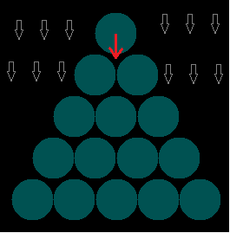
Parallelism
Every Circle moves based on it's velocity, acceleration, position, and whether it has hit a wall or not. Therefore position updates are parallel in the number of circles.
Figure 2

Slide 5

Parallelism
Collision detection and resolution works on pairs of circles. The information required is unique to every pair of circles.
Figure 3

Slide 6
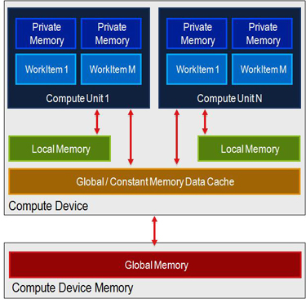
Memory model for OpenCL
OpenCL Uses a Streaming Memory Model
Each Work Item has a unique global index and local index
Parallelism is achieved by taking advantage of this structure
Figure 4 [1]

Slide 7
Component wise addition
__kernel void add_floats(__global float* a,
__global float* b,
__global float* out,
int n)
{
int i = get_global_id(0);
if( i >= n ){
return;
}
out[i] = a[i] + b[i];
}

Slide 8
Position updating
__kernel void update_position(__global float4* circle,
__global float2* velocities,
__global float2* gravity,
int circles,
float time_step,
float restitution)
{
int i = get_global_id(0);
if(i >= circles){ return; }
float2 newPosition = circle[i].xy + velocities[i]*time_step + 0.5f*gravity[0]*time_step*time_step;
/*calculate the change from any wall bounces and store in changeFromWallBounce*/
circle[i].xy = newPosition;
velocities[i] = restitution*newSpeed + changeFromWallBounce;

Slide 9
Collision Detection
__kernel void detect_collisions(__global float4* circle,
__global float2* collision,
int potential_collisions, int circles)
{
int c = get_global_id(0);
int i = 0;
int j = 0;
if(c >= potential_collisions){ return; }
collision[c].xy = (float2)( 0.0f, 0.0f );
//calculate the indexes for i and j and store in pair
i = pair.s0; j = pair.s1;
float min_distance = circle[i].z + circle[j].z;
float2 distance_vector = circle[j].xy - circle[i].xy;
float distance =
native_sqrt( dot( distance_vector, distance_vector ) );
if(distance < min_distance){
float2 normal = distance_vector/distance;
collision[c] = (min_distance-distance)*normal;
}
}

Slide 10
Collision Resolution
__kernel void resolve_collisions(__global float4* circle, __global float2* collision,
__global float2* velocities,
int potential_collisions,
int circles, float restitution)
{
int c = get_global_id(0);
if(c >= potential_collisions){ return; }
float2 mtv = collision[c];
float mtv_length = native_sqrt( dot( mtv, mtv ) );
if( mtv_length == 0 ){ return; }
//calculate the pair of indexes
int i = pair.s0; int j = pair.s1;
float2 posI = circle[i].xy - 0.5f*mtv;
float2 posJ = circle[j].xy + 0.5f*mtv;
circle[i].xy = posI; circle[j].xy = posJ;
float invMassI = 1/circle[i].s3;
float invMassJ = 1/circle[j].s3;
float inverseMassSum = invMassI + invMassJ;
float2 normal = mtv/mtv_length;
float2 Vij = velocities[i] - velocities[j];
float J = (-(1+restitution)*dot(Vij, normal))/(inverseMassSum);
velocities[i] = velocities[i] + J*invMassI*normal;
velocities[j] = velocities[j] - J*invMassJ*normal;
}

Slide 11
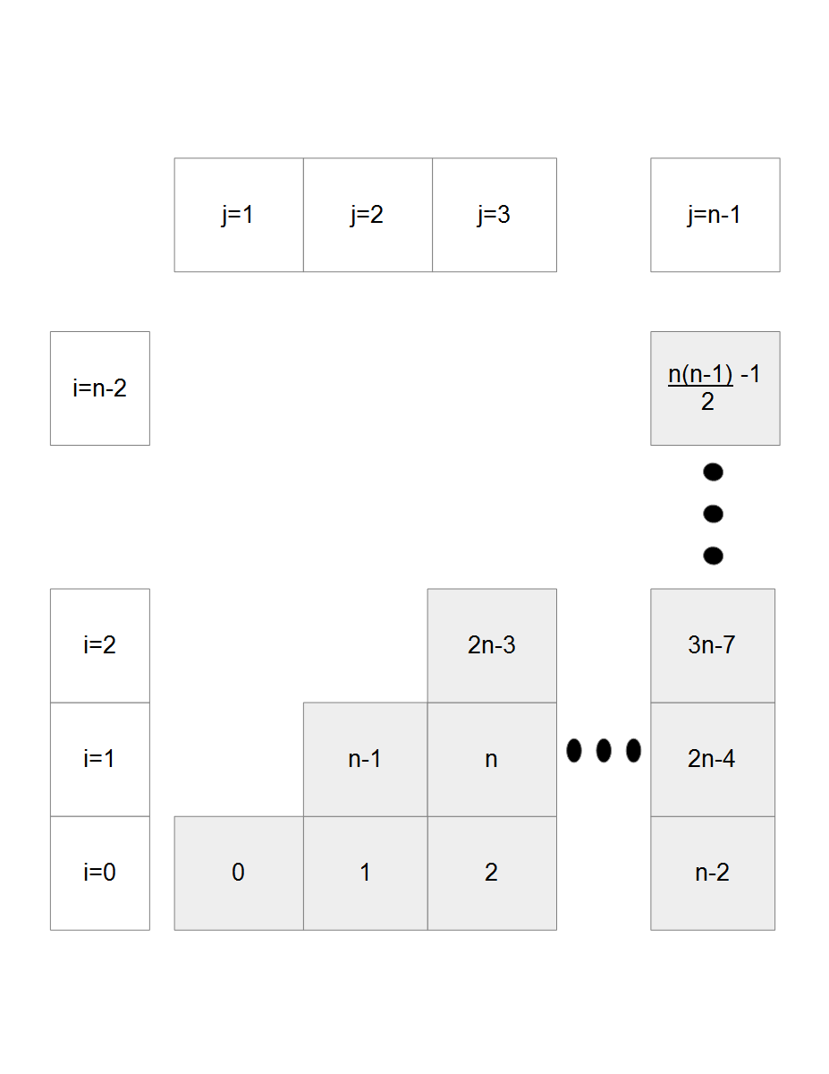
Collision Information Buffer
The physics engine needs a way to store collision information
For every pair of objects (i, j) there must be exactly 1 collision.
Access times need to be fast in order for the system to handle all the collisions quickly
Figure 5

Slide 12
Strategy 0
The i value can be calculated by solving
for
If ii is it's own greatest integer part
Else
Then get j from

Slide 13
Strategy 1
An identical array could be used that will store the (i, j) pair for a given collision index, at that collision index.

Slide 14
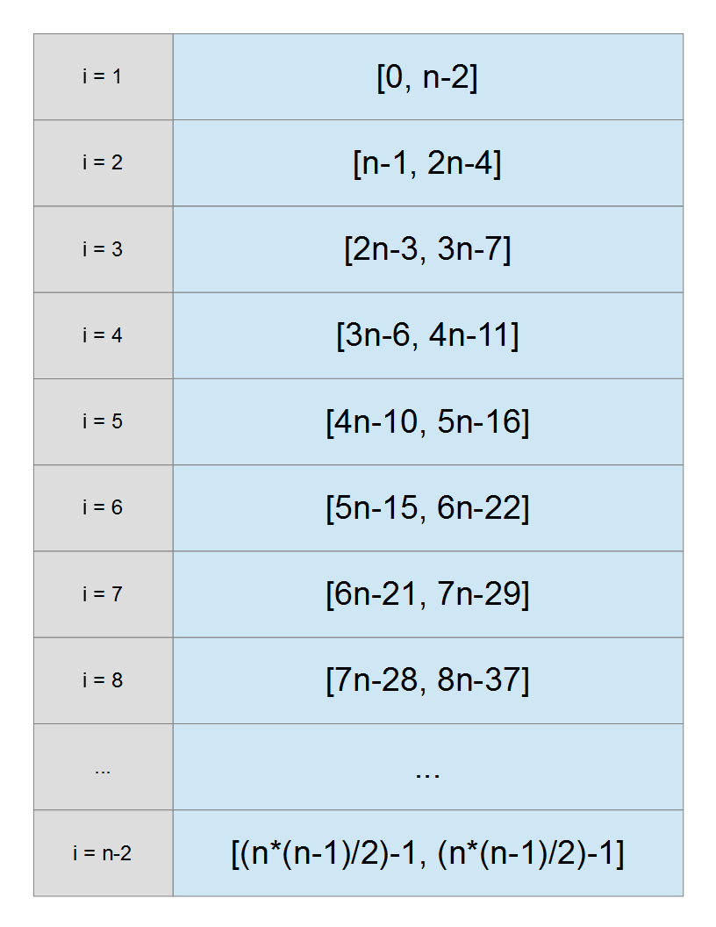
Strategy 2
Instead of using the previous array which grew quadratically, a linearly growing array that stores the minimum and maximum collision index for each i
Then calculating i is a binary search through the array
Figure 6

Slide 15
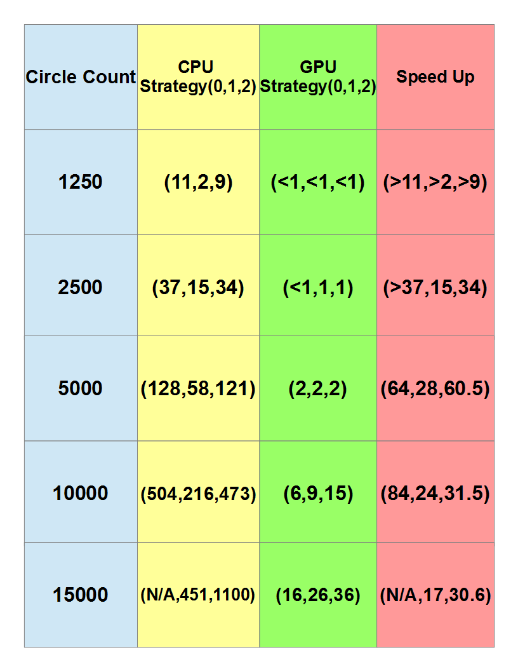
Results
The strategies were tested on the CPU and GPU
Strategy 1 is the best strategy for CPU usage
Strategy 0 is the best strategy for the GPU
Strategy 2 outperformed strategy 0 on the CPU but was the worst on the GPU
Figure 7

Slide 16
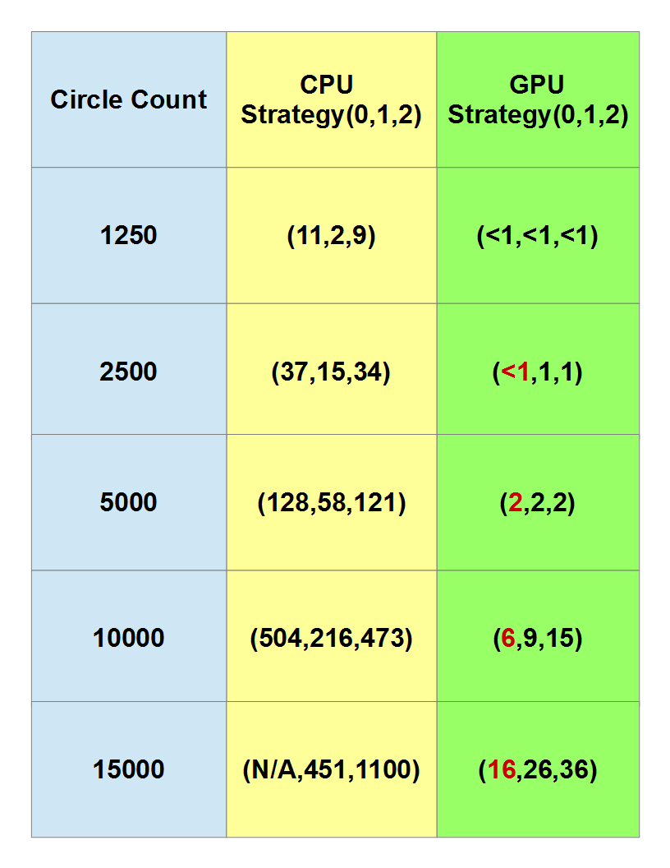
Results
The floating point indexing was inaccurate on the GPU after 2116 circles but ran without error on the CPU until crashing at 14665 circles
Therefore strategy 1 is the preferred strategy until GPU floating point accuracy reaches CPU floating point accuracy
Figure 8

Slide 17
References
http://www.codeproject.com/KB/showcase/Memory-Spaces/image001.jpg

Slide 18
Questions?

