Slide 1
Adelaide uni computer science projects extra info
2/08/2022
John pitman
Confidential – Not for further distribution internally or externally to AusCycling without prior permission of the author

Slide 2
Basic modelling concepts

Slide 3
“all models are wrong, some are useful”

Slide 4

Energy balance eqn.
$Power_{in} ∗mechanical efficiency$
$$=Power_{KE}+Power_{PE}+Power_{aero}+Power_{rollingresistance}$$

Slide 5

Forward integration over time
$acceleration=\frac{force}{mass}$
$power=force∗speed$
$v=u+at$

Slide 6
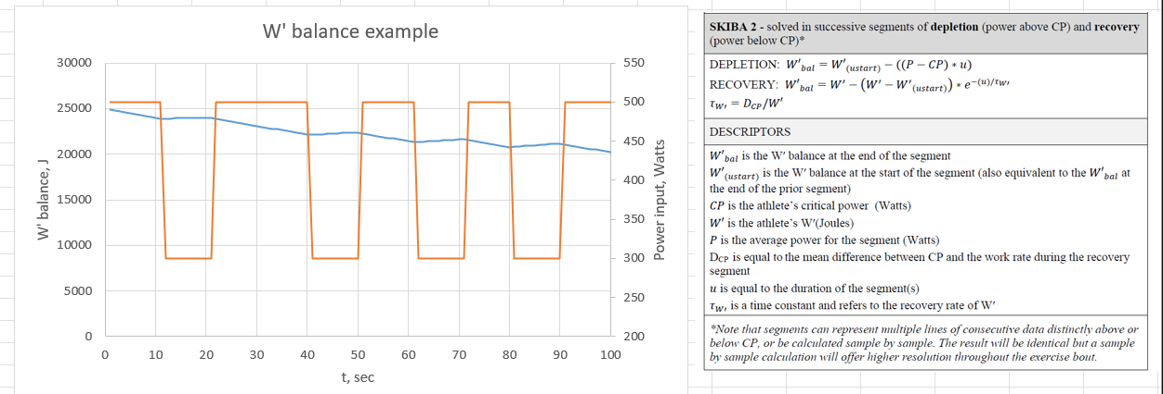
Physiological supply model
The weak link in the modelling process!
We will use the Skiba critical power mode
Basic concept – 2x ‘energy buckets’:
Threshold power – sustainable for ~40min to 1 hour
‘Over-threshold’ power – smaller bucket of energy that can be deployed over shorter durations – can be ‘recharged’

Slide 7
Project #1: Team pursuit strategy tool

Slide 8

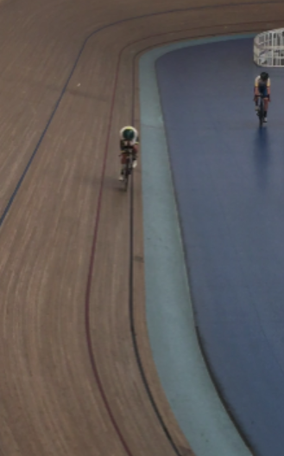
Velodrome physics insights
Middle of the straights
Only point on the track where they are upright

Slide 9
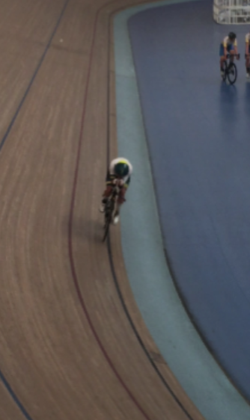
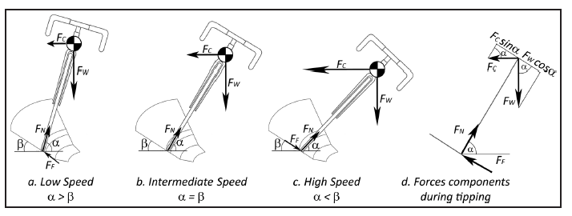
Velodrome physics insights
Pre bend entry
Riders begin tipping into the bend
If CoM velocity is a pure function of the lean angle, this would imply they are slowing down at this point
Not the case
They are not in ‘balance’ during the transition

Slide 10
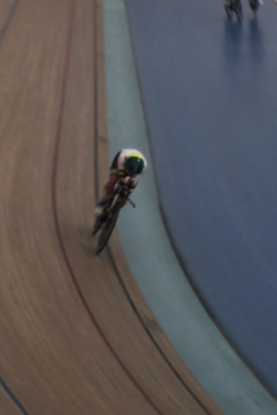
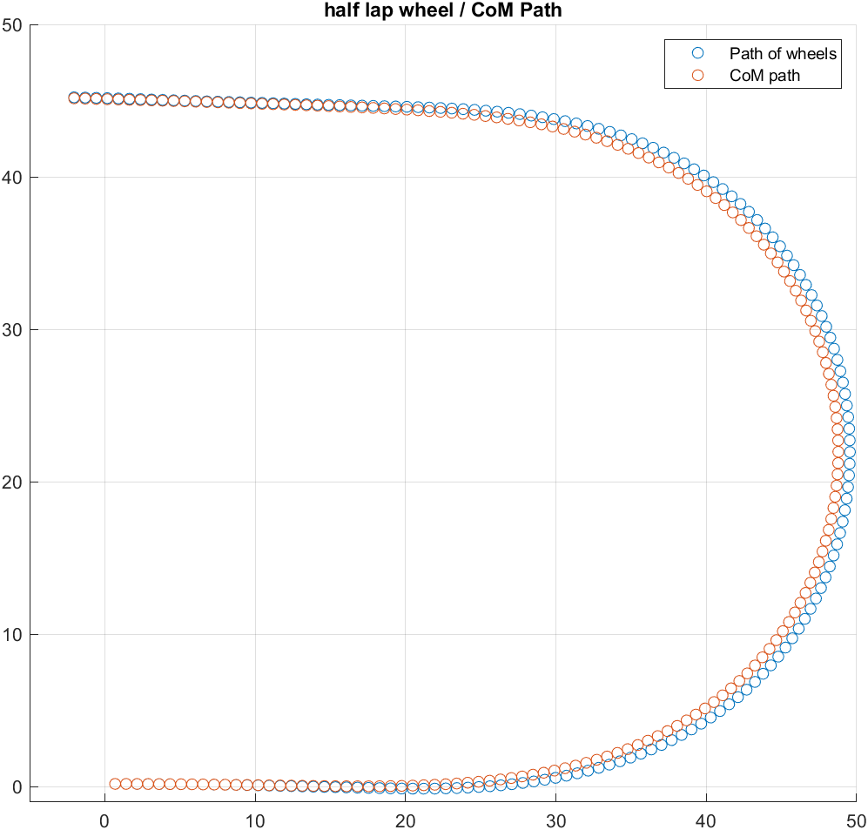
Velodrome physics insights
Bend entry
Trajectory of wheels and CoM begin to diverge
Rotation centre, angular velocity of CoM and wheels is not equal

Slide 11
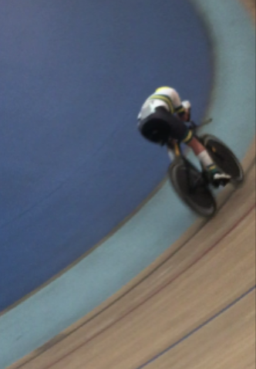
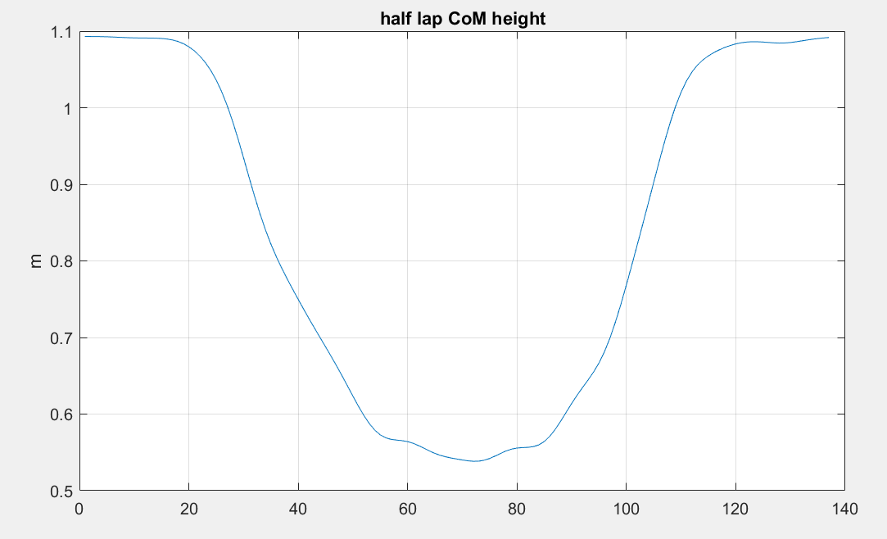
Velodrome physics insights
Mid-bend
CoM and wheels have similar angular velocity about common centre
CoM speed relative to wheel speed is now a function of lean angle
CoM height is at a minimum

Slide 12
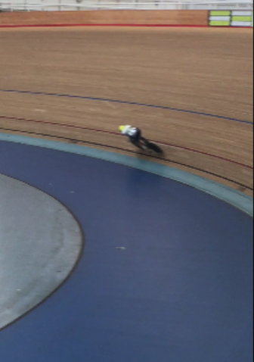
Velodrome physics insights
Bend exit
As rider follows path of the track, reducing turn curvature means the (reducing) centrifugal force at each instant acts to reduce the effort the rider needs to lift their centre of mass back up again

Slide 13
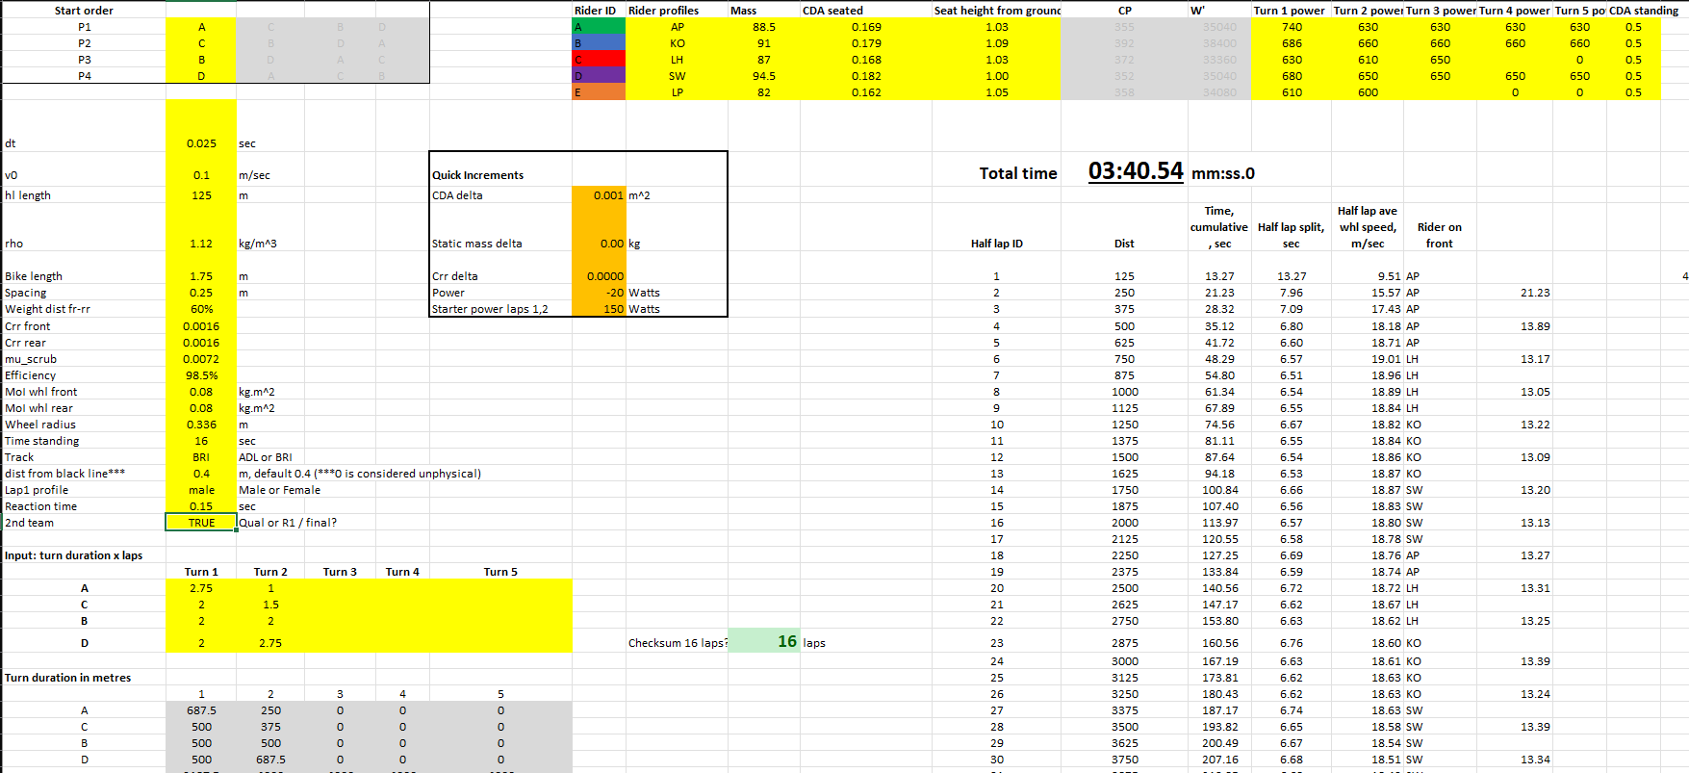

Slide 14
Project #2: Outdoor road TT prediction tool

Slide 15
examples
Best bike split
Spreadsheet

Slide 16
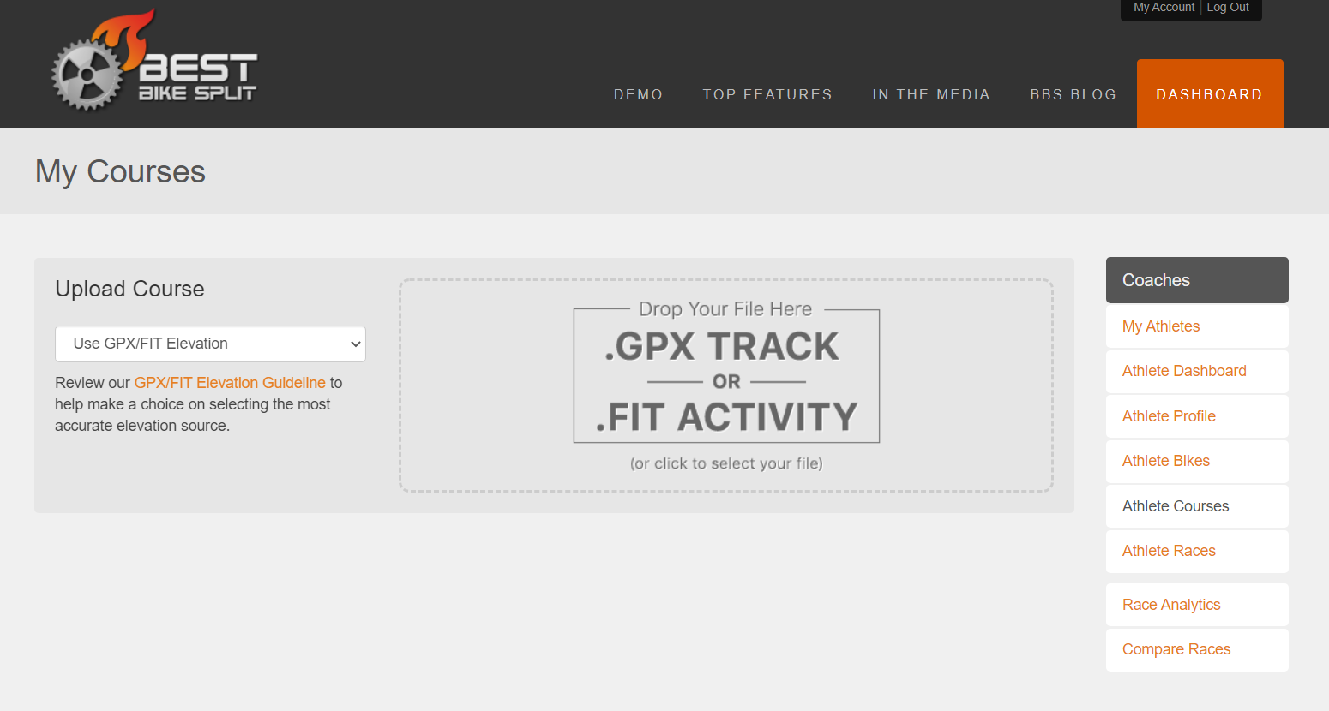

Slide 17
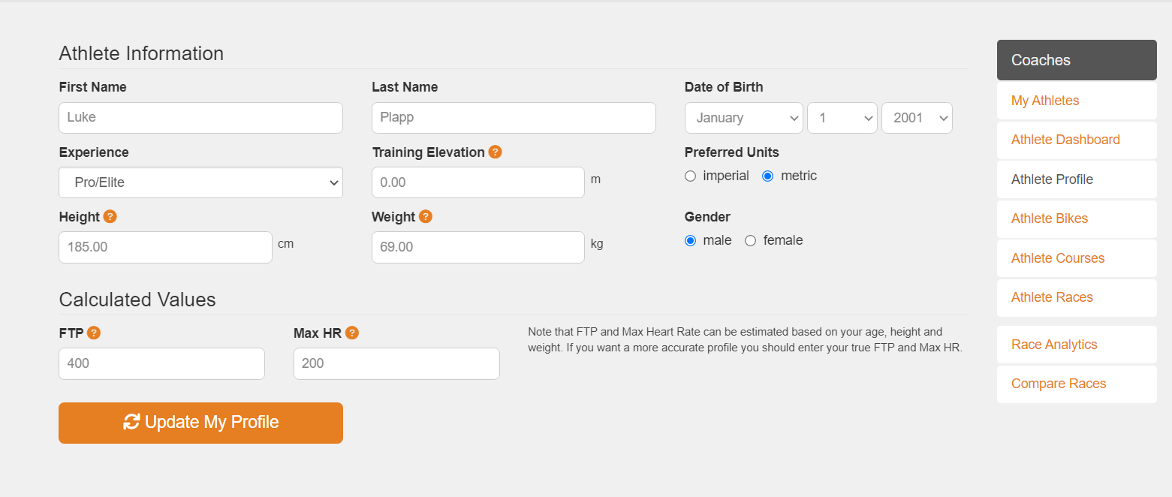

Slide 18
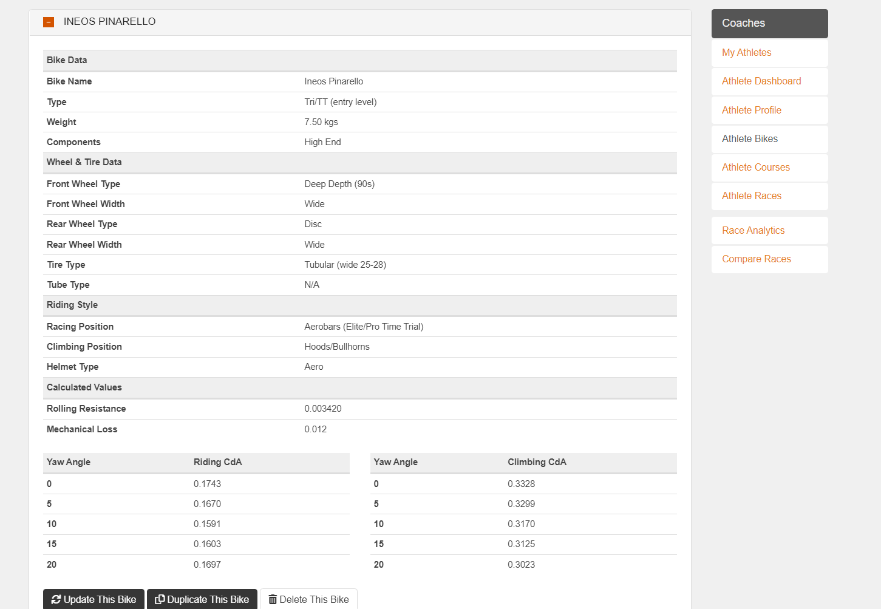

Slide 19
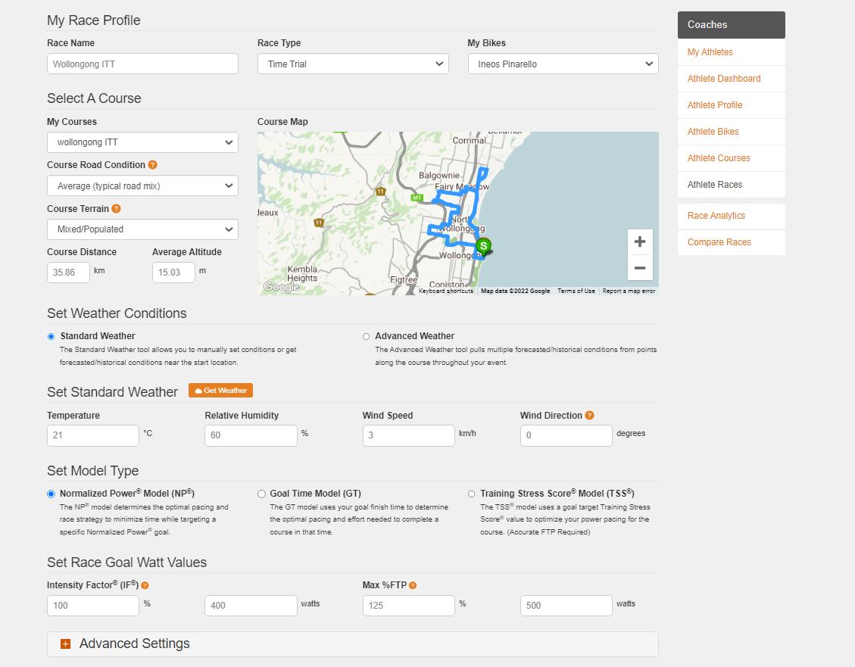
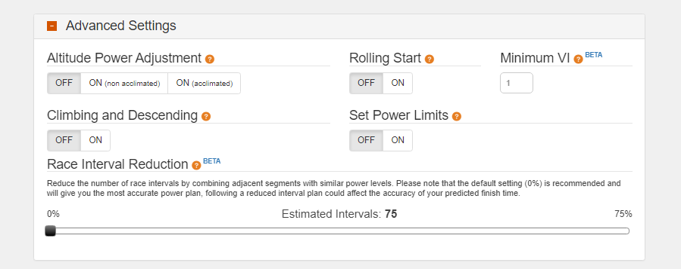

Slide 20
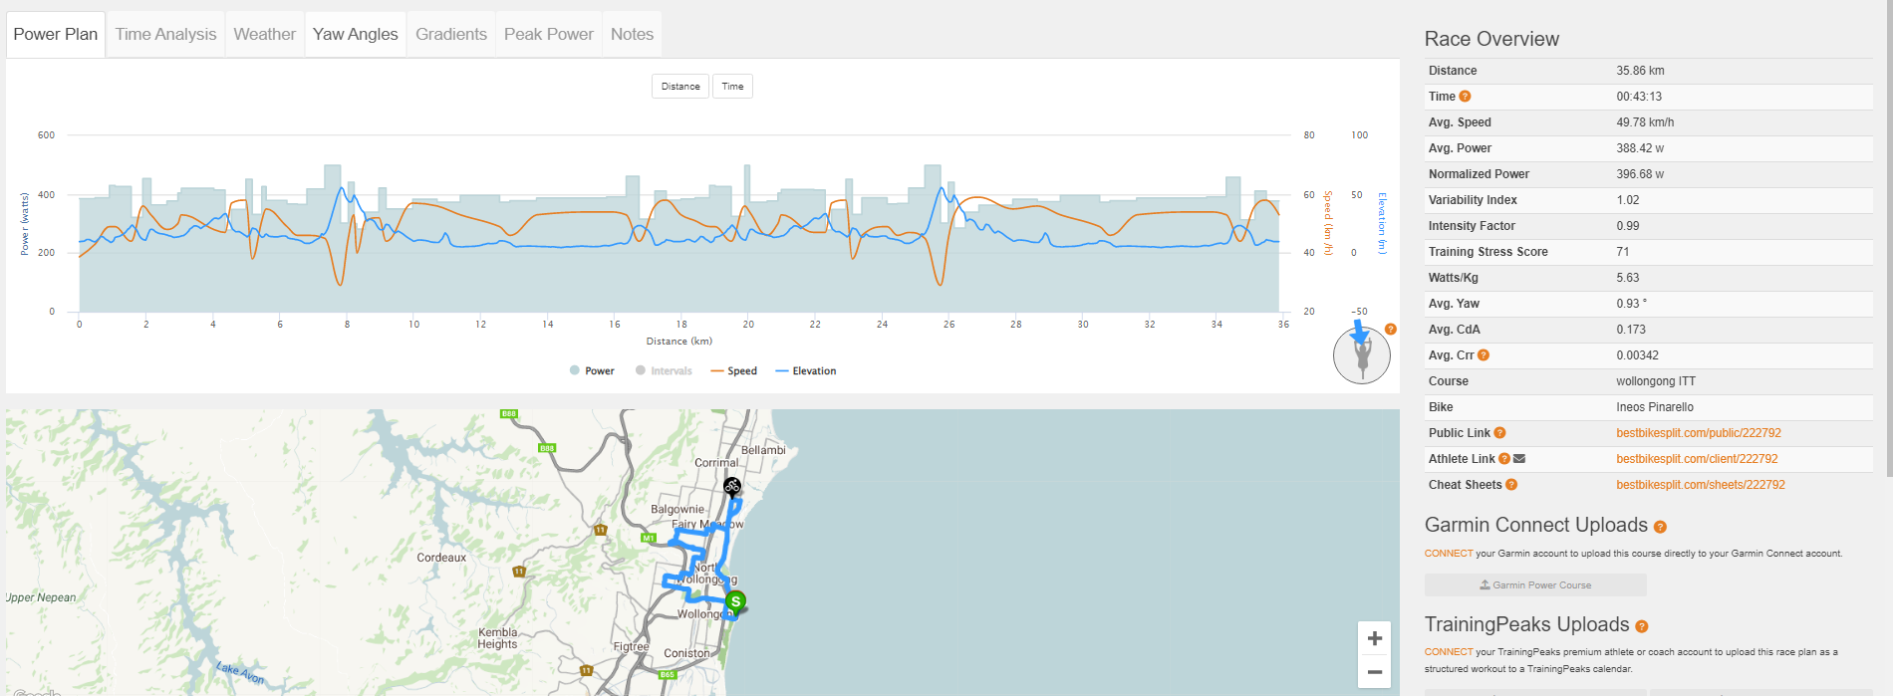

Slide 21
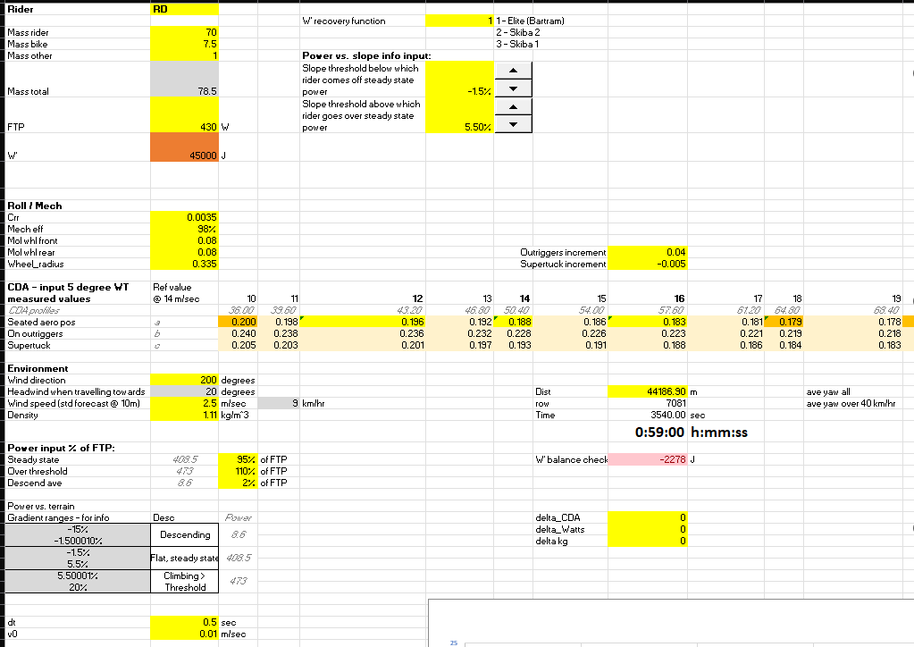

Slide 22
