Slide 1


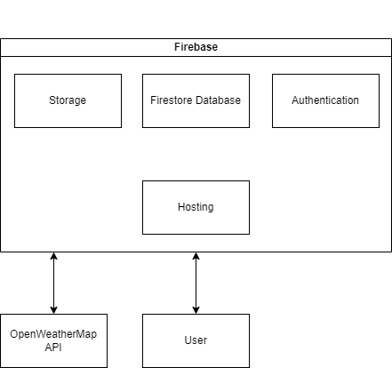
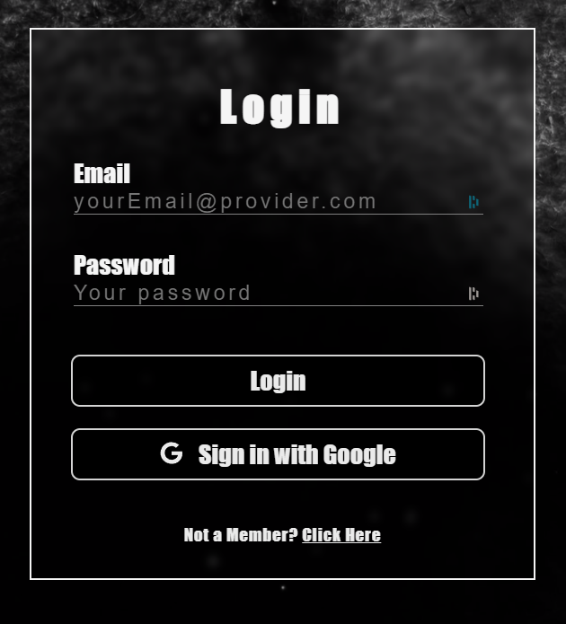
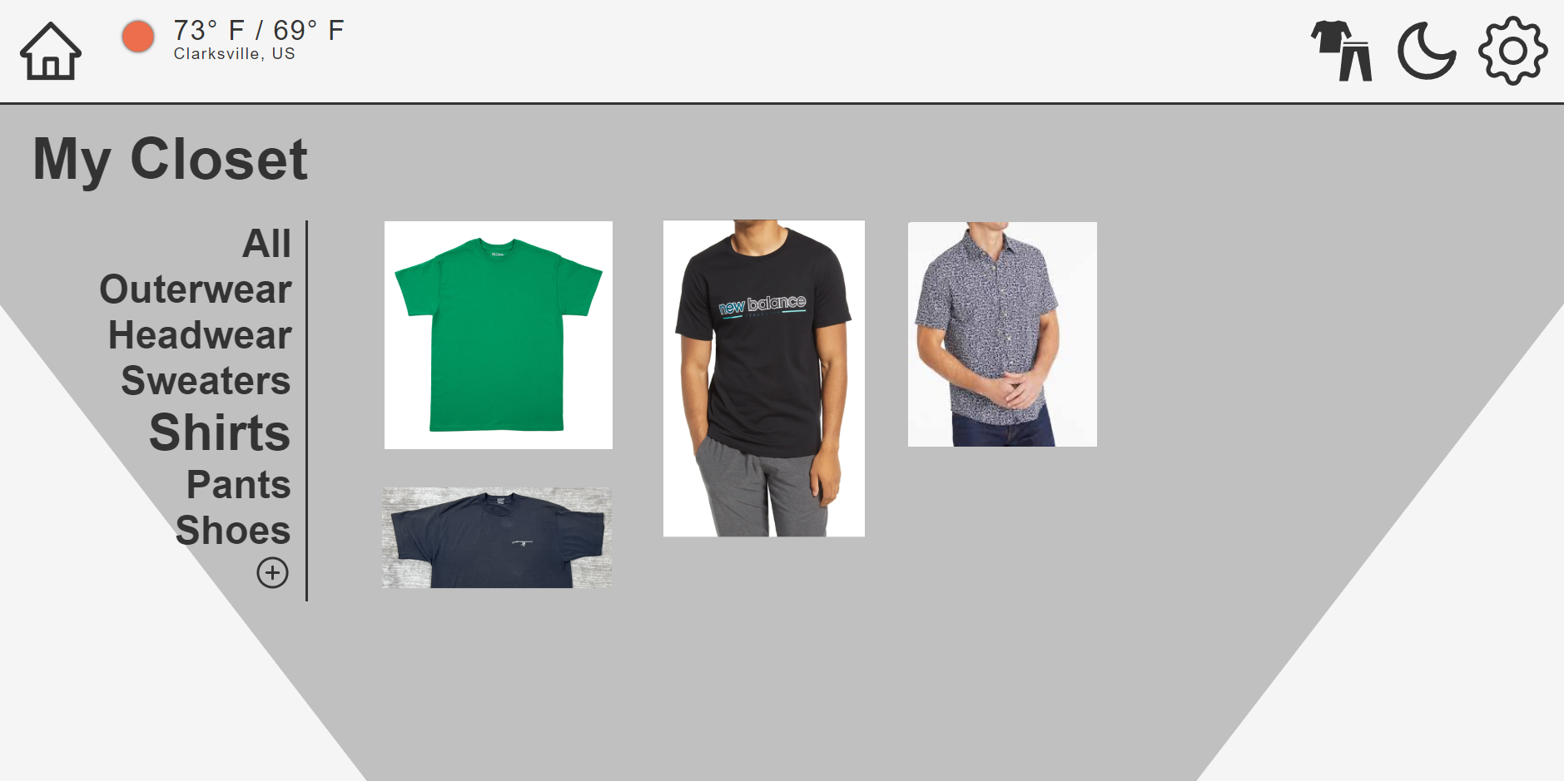
V-Closet
Scott Lam, Thomas Simmons, Leo Ras
Dept. Of Computer Science and Information Technology
Abstract
Technology
Design
In light of the continuous expansion of technology without any signs of decline, it is imperative to innovate and revolutionize the market. Many people struggle to find the perfect outfit or ideas for their attire. They may wish to explore new styles to customize their wardrobe but may be hesitant to spend money on trying different options. To address these issues, we have developed V-Closet, an online virtual wardrobe.
V-Closet is designed to provide a solution by allowing users to create an account and upload pictures of their clothing items, categorizing them as pants, shirts, hats, and other accessories. The website will have access to up-to-date weather information and will provide recommendations to users on what to wear based on the weather conditions, such as rain, cold or hot weather, and other climate events.
Additionally, V-Closet will serve as a marketplace, offering buying, selling, and trading capabilities. Users will have the option to trade or sell their clothing items to other users, providing a platform for wardrobe customization and exchange.
The majority of our web application has been developed using Firebase, a comprehensive and robust mobile and web application development platform owned by Google. Firebase offers a diverse range of tools and services that enable developers to create high-quality applications with ease.
For efficient management of documents and clothing photos, we have leveraged two Firebase products: Storage and Firestore. Storage facilitates the storage of clothing photos submitted by our users on Google's secure cloud infrastructure, while also providing mechanisms to regulate access to the images. Firestore manages documents that contain information about each clothing item, such as color, category, and links to the corresponding photos stored in Storage.
Firebase Authentication has been set up to handle user sign-up and login processes on our web app. Our current web app setup supports email/password authentication and third-party authentication with Google (as depicted in Figure 3). Each user is granted access only to their own photos and documents, ensuring data privacy.
To make our web app accessible on the internet, we will be utilizing Firebase Hosting for deployment. To ensure secure communication, all traffic to our site will be encrypted through HTTPS, as facilitated by Firebase Hosting.
The V-Closet website will feature a minimalistic design with a black-and-white color scheme, consisting of 9-10 pages built using React, a component-based framework for code reusability and easier code management.
Key components such as a top navigation bar with Home, Wardrobe, Toggle, and Settings icons will be integrated for seamless navigation. The Toggle icon will change the website's background color based on the theme selected, while the Settings icon will take users to the settings page. The settings page will provide users with account controls and allow the choice of a location for the weather API.
The landing page will prompt users to login or sign up, with authentication handled by Firebase. The Home Page will use an OpenWeatherMap API to provide weather-based outfit recommendations, with a separate WeatherTracker component for tracking location and weather data. The Wardrobe Page will allow users to manage their clothing inventory, with options for categorization and color sorting.
The Add Item Page will allow users to upload photos of their clothes using an ImageUploader component. The website aims to consistently recommend clothes based on weather conditions through the Recommendation component, which sorts through the user’s cloths.
Figure 2: This Block-Diagram represents our web application and the technology it runs on. It is a simplification of the interaction between our systems and the user.
Background
Closet organization applications currently exist to help users control their wardrobe and plan their outfits. These applications, though, focus mainly on styling, recycling, and finding outfit inspirations. So far, a wardrobe organizer that plans outfits in accordance to weather data does not exist.
In creating V-Closet, we gathered information on various geolocation and weather APIs that would support our intended use. We incorporated these APIs in our project to provide a unique service that we believe many users will benefit from.
By automating daily outfits and ensuring its compliance with forecasted weather conditions, V-closet can help eliminate the difficulty of making outfit decisions, promote the reuse and recycling of clothes, and bring user the confidence of dressing correctly for any occasion, at any time, and during any type of weather.
Figure 3: Modernized and Minimalistic Black-and-White Login Form with Dual Login Options - Input or Google
References
React: https://react.dev
Firebase: https://firebase.google.com
OpenWeatherMap API: https://openweathermap.org
Acknowledgements
We would like to thank Dr. Karen Meisch for her support of students in the College of Science, Technology, Engineering & Mathematics, and Dr. Leong Lee for his support of students in the Department of Computer Science and Information Technology.
Figure 1: The wardrobe page design showcases a sleek monochromatic color scheme, a user-friendly side navigation bar for easy categorization, a top navigation bar for enhanced accessibility, and real-time weather information to provide users with personalized clothing suggestions. Images showcase user-uploaded clothing items.

