Slide 1
V-Closet
Scott Lam
Leo Ras
Thomas Simmons

Slide 2
Overview
Introduction
Technology
Design
Known Bugs
Future Work

Slide 3
Introduction

Slide 4
Introduction
V-Closet is an online wardrobe that suggests personalized outfits based on the weather
Functions as a marketplace for buying, selling, and trading clothes
Users can categorize their clothes for easy organization
Provides a comprehensive solution for managing wardrobe and staying on top of fashion trends

Slide 5
Technology

Slide 6
React
React was used for the development of the website's user interface
React allows for the creation of reusable UI components
Reusable components can be combined to create complex and responsive layouts.
React has a wide variety of tools and libraries available
Third-party plugins and modules can be used

Slide 7
Firebase
Firebase is used to develop our web application, a platform by Google
Storage and Firestore are used for managing photos and documents
Firebase Authentication handles user sign-up and login processes, ensuring data privacy
Firebase Hosting will be used for deployment and secure communication through HTTPS

Slide 8
OpenWeatherMap API
OpenWeatherMap meets weather data needs as it's user-friendly and offers a basic service at no cost
GeoDB Cities was chosen to provide geographic coordinates based on user input for OpenWeatherMap API
Customizable geolocation data interface
Free-to-use
Minimizing overhead for the application

Slide 9
Design

Slide 10
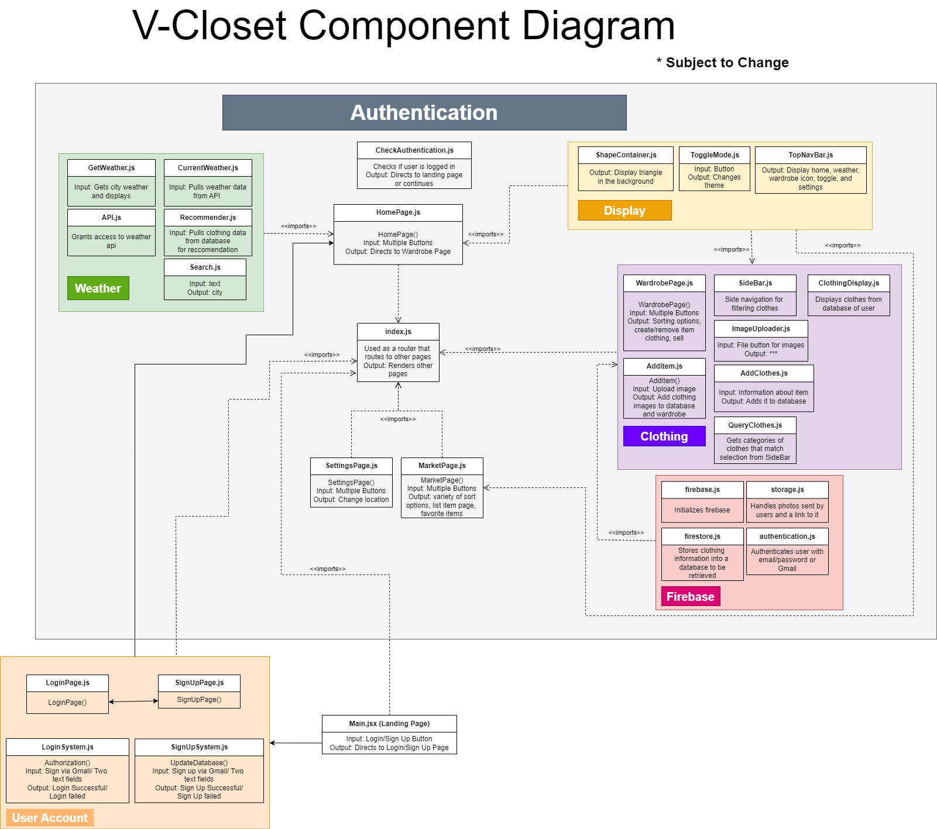

Slide 11
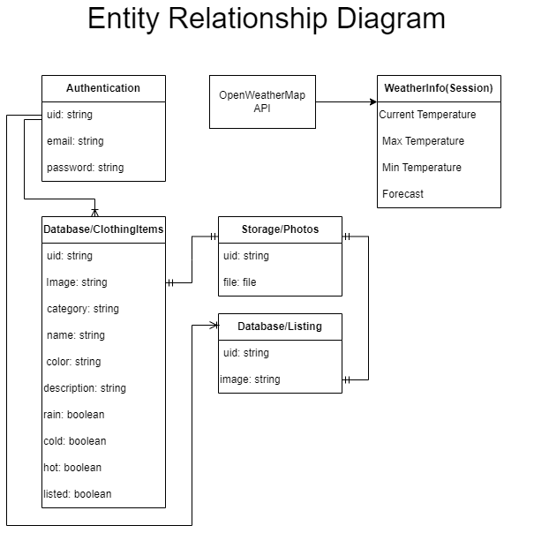

Slide 12
Known Bugs

Slide 13
Known Bugs
When not logged in, user may see the page such as the home page for a split second
Solution: Loading page animation
Result from working on a localhost, many test accounts created no longer work on hosting
Solution: Deleting previous users, collections, and Storage files can easily fix this bug
Logout button sometimes requires two clicks to function
Solution: Unknown

Slide 14
Future Work

Slide 15
Future Work
Increased security for users
Change password
Email verification
Deleting their account
Social Media Aspect
Profile system
Following/followers system
Likes and comments system
Event calendar
More advanced Recommendation System

Slide 16
V-Closet: https://v-closet-f9736.web.app/

