Slide 1
Youth Transitions and Economic Activity: A Re-examination of NCDS data
Scott Oatley
soatley@ed.ac.uk

Slide 2
Outline
Forms part of PhD thesis
Revisit historical data on youth transitions
Use contemporary statistical techniques to assess prior literature on topic
Test underlying influence of structural inequalities on choice and opportunity
Notes:
Looking at the NCDS 1958 data, and comparing that with the BCS 1970 data and the UKHLS creating synthetic cohorts from 1991 onwards + if I have time using Next Steps as well
Some literature has already covered the older datasets – especially the NCDS. Bynner has done some great work comparing NCDS and BCS data in a longitudinal context among others. The issue with this older work is that it was primarily restricted by the data analysis methods of the time – little to no sensitivity analysis of certain measures, zero handling of missing data – which isn’t just an issue with older data analysis. Overall there are some gaps here that mean it is useful to go back to older datasets like the NCDS.
As mentioned, this work conducts sensitivity analysis on social stratification measures used within the model as well as handling missing data techniques.
The overall aim of this research is to understand the structural level inequalities influence upon indiviudals choice and opportunity – in this context the choice and opportunity of entering economic activity for t he first time post-mandatory schooling. The wider project will bring in other datasets to compare different cohort based experiances.

Slide 3
A (very short) literature review
Landscape of the NCDS cohort (Bynner 2005; Blanden 2004)
Structuration vs Individualisation (Beck 2002; Gayle et al 2009)
‘New Structuralism’ (Devine 2017)
Life Course (Mayer 2004; Elder 1994)
Notes:
I understand the importance of a literature review (but for the sake of this group I’m focusing much more on the models and results compared to the lit). If you want to ask questions about it at the end feel free, I just didn’t want to stand here and talk to you all about literature that most of you have probably read before.

Slide 4
National Childhood Development Study (NCDS)
The NCDS follows the lives of all people born in England, Scotland and Wales in one week of March 1958
It is a nationally representative longitudinal social survey (Power and Elliott 2006)
Analysis uses data from birth until age 23 – accounting for five sweeps

Slide 5
NCDS
Year | 1958 | 1965 | 1969 | 1974 | 1981
Sweep | 0 | 1 | 2 | 3 | 4
Age | Birth | 7 | 11 | 16 | 23

Slide 6
Research Questions
What are the patterns of social inequality in youth transitions?
How have patterns and trends in youth transitions changed over time?
How have the social processes that underpin youth transitions changed over time?
How can youth transitions be more comprehensively understood within a life course perspective?

Slide 7
Overall Research Question
What are the patterns of social inequality in youth transitions?
How do Structural Inequalities influence choice and opportunities in the transition from school-to-work?

Slide 8
Proposed model
Economic Activity
Educational Attainment
Sex
Housing Tenure
Semi-dominance NS-SEC
Notes:
Initial Model deals with NS-SEC, Educational attainment, sex, and housing tenure. Following this, a sensitivity analysis of social stratification measures is conducted. Three models in total are produced: one with NS-SEC, one with CAMSIS, one with RGSC. Following goodness-of-fit statistics a model is selected to go forward with. After this model selection a secondary sensitivity analysis is conducted using the same measure but constructed with SOC 1990 and SOC 2000 SOC codes. After this, handling missing data is assessed and multiple imputation is performed and substantive effects are compared.

Slide 9
 | n | %
Economic Activity of Respondent on September when they are 16
Employment | 3,217 | 38.25%
Non-Traditional Education | 744 | 8.85%
School | 2,551 | 30.33%
Training/Apprenticeships | 1,641 | 19.51%
Unemployment and OLF | 258 | 3.07%
Educational Attainment O-levels
Less than 5 O-Levels | 5,426 | 64.51%
Five or more 5 O-Levels | 2,985 | 35.49%
Sex of Respondent
Female | 4,215 | 50.11%
Male | 4,196 | 49.89%
Housing Tenure of Respondent when Child
Own Home | 4,045 | 48.09%
Don't Own Home | 4,366 | 51.91%
NS-SEC Social Class of Parent when Respondent Child SOC2000
Large Employers and higher managerial occupations | 261 | 3.10%
Higher professional occupations | 410 | 4.87%
Lower Managerial and professional occupations | 1,038 | 12.34%
Intermediate occupations | 805 | 9.57%
Small employers and own account workers | 1,024 | 12.17%
Lower supervisory and technical occupations | 1,372 | 16.31%
Semi-routine occupations | 1,485 | 17.66%
Routine occupations | 2,016 | 23.97%
RGSC Social Class of Parent when Respondent Child SOC2000
Professional | 362 | 4.30%
Managerial and Technical | 1,720 | 20.45%
Skilled non-manual | 905 | 10.76%
Skilled manual | 3,501 | 41.62%
Partly skilled | 1,205 | 14.33%
Unskilled | 718 | 8.54%
 | Mean | SD
CAMSIS Score of Parent when Respondent Child SOC2000 | 44.57 | 13.63
n |  | 8411
Data Source: NCDS [Sweeps 0-4]
Notes:
Descriptive Statistics

Slide 10
The Model
Multinominal Logistic Regression
Employment is Reference Category for DV
N=8,411
Predicted Probabilities and Quasi-variance used to graph results
See supplements on Github: https://github.com/Scott0atley/YouthTransitions/tree/main/Q-Step to look at full models
Notes:
Less than 5 O-levels Ref for educational attainment
Female Ref for Sex
Own home Ref for Housing Tenure
NS-SEC 2 Ref for NS-SEC

Slide 11
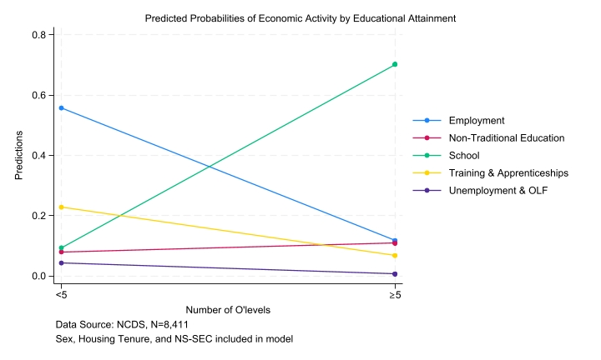
Results
Table 1 – Q-Step Appendix
Educational Attainment
https://github.com/Scott0atley/YouthTransitions/tree/main/Q-Step
Notes:
Education is for those transitioning into Employment, school, or Unemployment & OLF the single biggest predictor

Slide 12
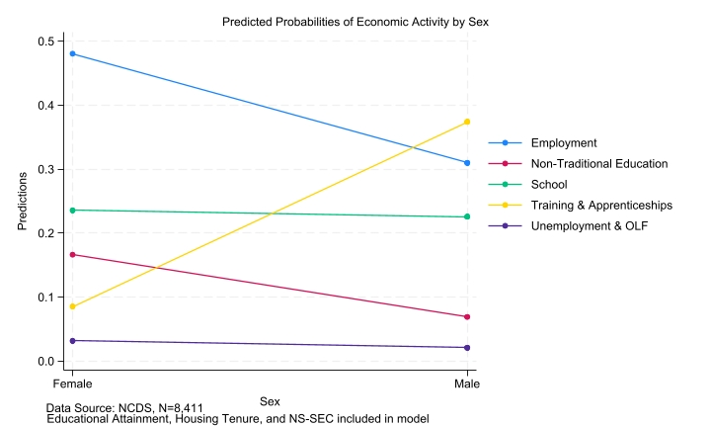
Results
Table 1 – Q-Step Appendix
Sex
https://github.com/Scott0atley/YouthTransitions/tree/main/Q-Step
Notes:
Sex is the single biggest predictor of entering non-traditional education and training & apprenticeships

Slide 13
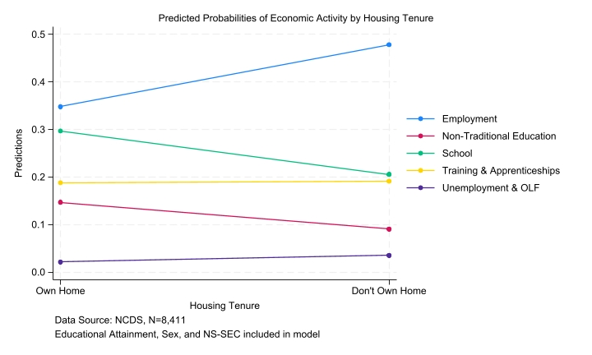
Results
Table 1 – Q-Step Appendix
Housing Tenure
https://github.com/Scott0atley/YouthTransitions/tree/main/Q-Step
Notes:
Housing Tenure has a statistically significant though substantively tiny significance across each economic activity category

Slide 14
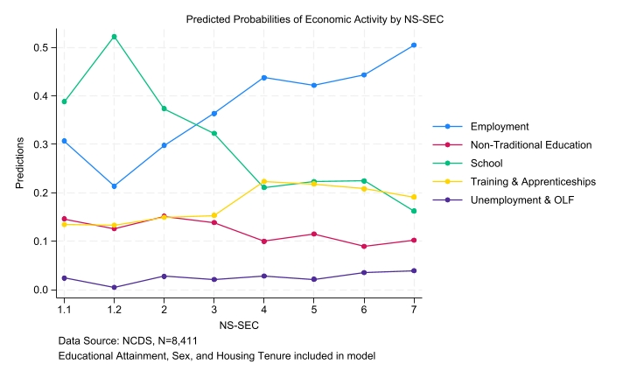
Results
Table 1 – Q-Step Appendix
NS-SEC
https://github.com/Scott0atley/YouthTransitions/tree/main/Q-Step

Slide 15
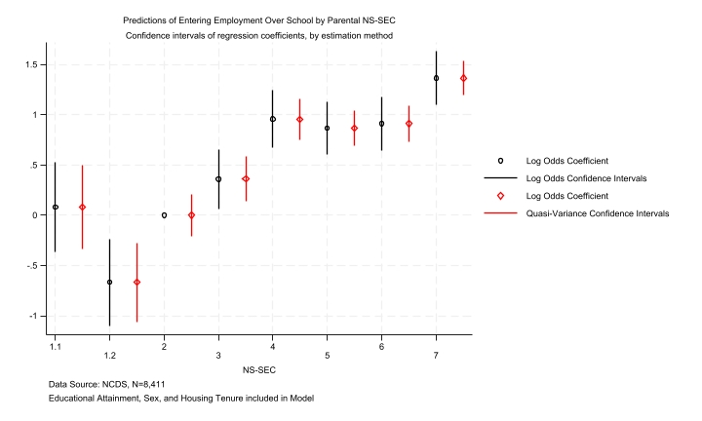
Results
Table 1 – Q-Step Appendix
NS-SEC Log odds versus Quasi-variance
https://github.com/Scott0atley/YouthTransitions/tree/main/Q-Step
Notes:
Won’t spend too long on these, just to illustrate the coefficient plots (using log odds) and quasi-variance statistics to overcome the reference category problem of categorical independent variables in regression models and illustrate another way of showing these effects.

Slide 16
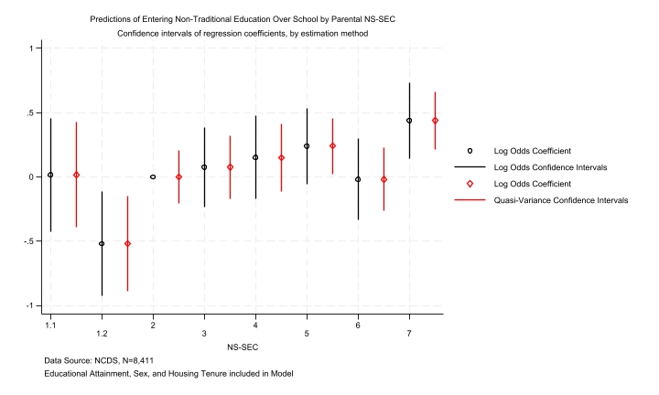
Results
Table 1 – Q-Step Appendix
NS-SEC Log odds versus Quasi-variance
https://github.com/Scott0atley/YouthTransitions/tree/main/Q-Step

Slide 17
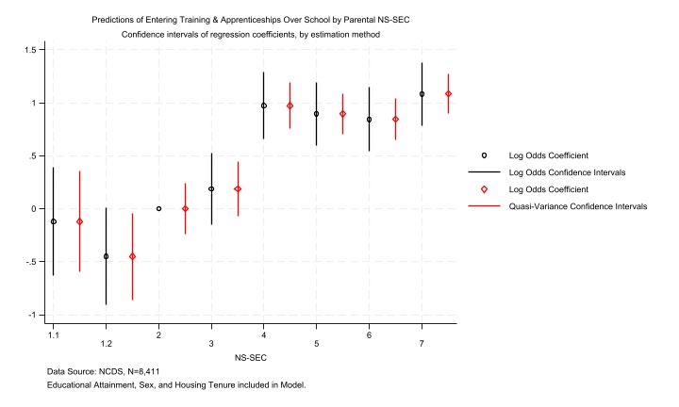
Results
Table 1 – Q-Step Appendix
NS-SEC Log odds versus Quasi-variance
https://github.com/Scott0atley/YouthTransitions/tree/main/Q-Step

Slide 18
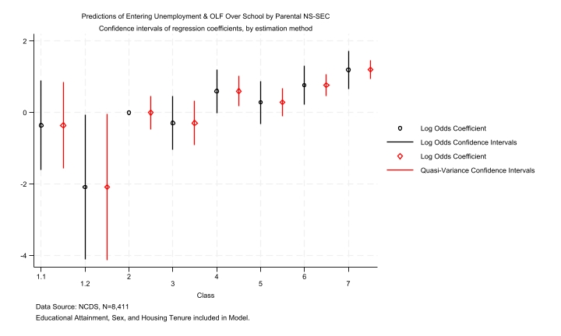
Results
Table 1 – Q-Step Appendix
NS-SEC Log odds versus Quasi-variance
https://github.com/Scott0atley/YouthTransitions/tree/main/Q-Step

Slide 19
Substantive Findings
Table 1 – Q-Step Appendix
Structural inequalities matter (prior research confirms this already)
They matter for different avenues of choice and opportunity (Here is the slightly new stuff)
Other structural inequalities like housing tenure matter but not as much as social class & sex (New Structuralism isn’t evident in NCDS cohort)
Educational Attainment has the strongest influence on continuing in school (Intuitively obvious)
https://github.com/Scott0atley/YouthTransitions/tree/main/Q-Step

Slide 20
Sensitivity Analysis of Social Stratification measures
Table 2 – Q-Step Appendix
Does the use of a certain social stratification measure impact the substantive findings of this model?
To assess this: Sensitivity Analysis
Three models
(1) NS-SEC
(2) CAMSIS
(3) RGSC
https://github.com/Scott0atley/YouthTransitions/tree/main/Q-Step
Notes:
Those are some nice findings, easy to understand and all that.
However, what if something small was changed in the models. What if instead of the proud Weberian I pretend to be, I reject modernity and embrace tradition? What if we used RGSC, or another measure of social stratification altogether, say CAMSIS instead of NS-SEC. Would the substantive results change? If so, does this not have a marked impact on model selection?

Slide 21
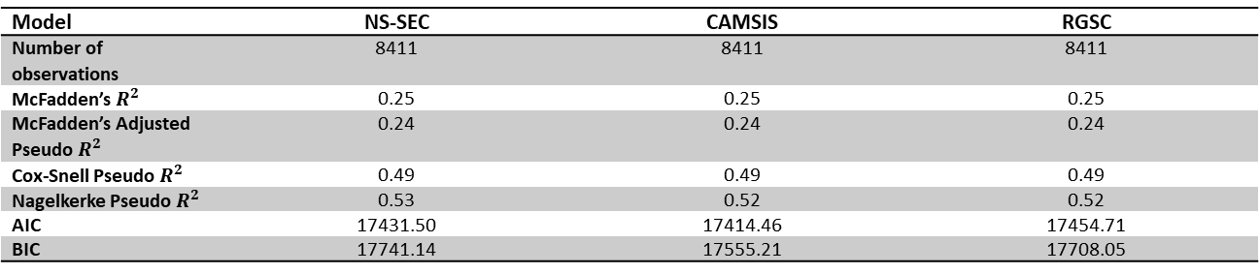
Substantive Findings
Table 2 – Q-Step Appendix
NS-SEC and RGSC models are substantively identical
CAMSIS model is statistically significant across categories with zero substantive significance
Model | NS-SEC | CAMSIS | RGSC
Number of observations | 8411 | 8411 | 8411
McFadden’s $R^{2}$ | 0.25 | 0.25 | 0.25
McFadden’s Adjusted Pseudo $R^{2}$ | 0.24 | 0.24 | 0.24
Cox-Snell Pseudo $R^{2}$ | 0.49 | 0.49 | 0.49
Nagelkerke Pseudo $R^{2}$ | 0.53 | 0.52 | 0.52
AIC | 17431.50 | 17414.46 | 17454.71
BIC | 17741.14 | 17555.21 | 17708.05
https://github.com/Scott0atley/YouthTransitions/tree/main/Q-Step

Slide 22
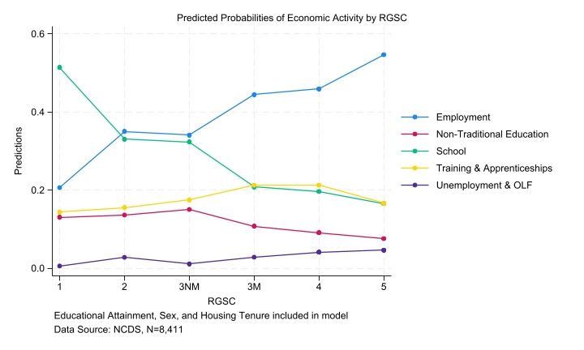
Sensitivity Analysis of Social Stratification measures
Table 2 – Q-Step Appendix
https://github.com/Scott0atley/YouthTransitions/tree/main/Q-Step
Notes:
Here are RGSC and NS-SEC side by side social stratification measures mapped out across all five economic categories
May be better to instead have five graphs, each one maps all three measures to one economic activity… Thoughts?

Slide 23
Sensitivity analyses of SOC codes
Table 3 – Q-Step Appendix
So far, I have been using a SOC 2000 construction of social stratification measures
How accurately does a SOC 2000 construction of NS-SEC represent the social landscape of the 1958 cohort?
Would an earlier SOC construction, say SOC 90 be a more suitable construction to use?
https://github.com/Scott0atley/YouthTransitions/tree/main/Q-Step
Notes:
Now that we know that NS-SEC is the best suited model, another set of models look at the comparison of the same measure of social class, NS-SEC under different constructions using SOC codes 90 and 2000
Like for like coefficient plots and qv statistics are placed alongside each other to represent results – note for the Unemployment & OLF category SOC90 graph could not be adequately constructed due to low n skewing results.
Alongside this a comparison of marginal effects graphs is used across all variables.
Finally a look at the goodness-of-fit stats. These statistics won’t be the sole determinant in selecting a model going forward but do provide some insight.

Slide 24
Sensitivity analyses of SOC codes
Table 3 – Q-Step Appendix
Would an earlier SOC construction, say SOC 90 be a more suitable construction to use?
Back to RQs:
How have patterns and trends in youth transitions changed over time?
How have the social processes that underpin youth transitions changed over time?
https://github.com/Scott0atley/YouthTransitions/tree/main/Q-Step
Notes:
This question really relates to my 2nd and 3rd research questions. My PhD research extends beyond the NCDS and into other cohorts: the 1970 BCS, the synthetic cohorts constructed using the BHPS and UKHLS, and Next Steps.
If this was a snapshot study – only looking at data of the NCDS cohort, there would be a strong argument to use the earlier SOC constructions as they ought to best represent the British occupational landscape of the time.
When conducting a comparison of cohorts there thus becomes a question of what to do? There are as I see it, two possibilities: the first is to selected the closest SOC construction to the cohort for each model – this would present the most accurate picture of each individual cohort but would inject a level of difference in models that are supposed to be as similar as possible. The second is to select a single SOC construction for all models going forward allowing for the most similar model construction across cohorts – this however runs the risk of not appropriately illustrating the occupational reality of a given cohort.
My belief is to cautiously choose the second approach – informed also with goodness-of-fit statistics. Whilst the GOF should not determine the model in this particular scenario, if the SOC90 model is providing massively better AIC and BIC stats then that would sway my view on this matter.
I also could be completely talking out my… This is really more a bunch of questions I have stuffed into a slide – love to hear your thoughts at the end.

Slide 25
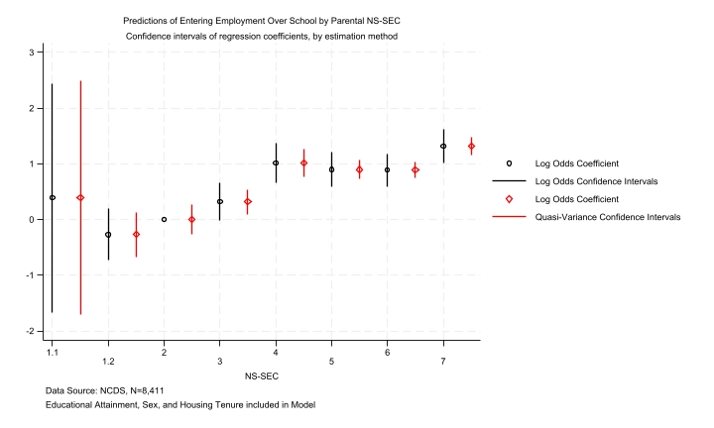
Comparative Results
Table 3 – Q-Step Appendix
Employment Over School
SOC2000
SOC90
https://github.com/Scott0atley/YouthTransitions/tree/main/Q-Step

Slide 26
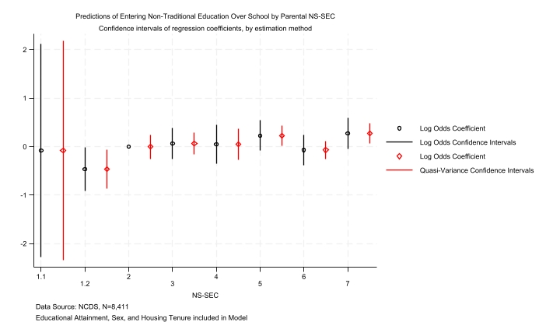
Comparative Results
Table 3 – Q-Step Appendix
Non-Traditional Education Over School
SOC2000
SOC90
https://github.com/Scott0atley/YouthTransitions/tree/main/Q-Step

Slide 27
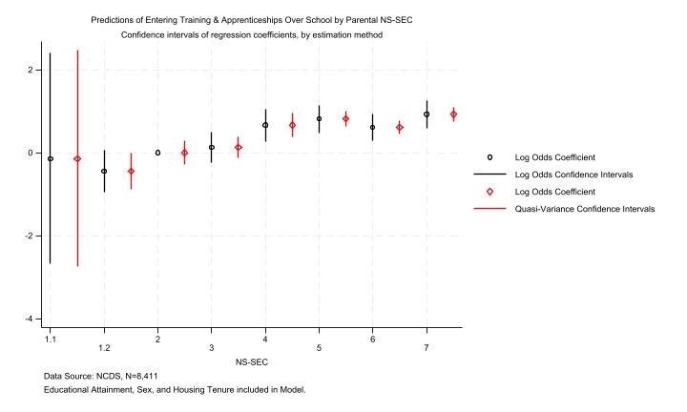
Comparative Results
Table 3 – Q-Step Appendix
Training & Apprenticeships Over School
SOC2000
SOC90
https://github.com/Scott0atley/YouthTransitions/tree/main/Q-Step

Slide 28
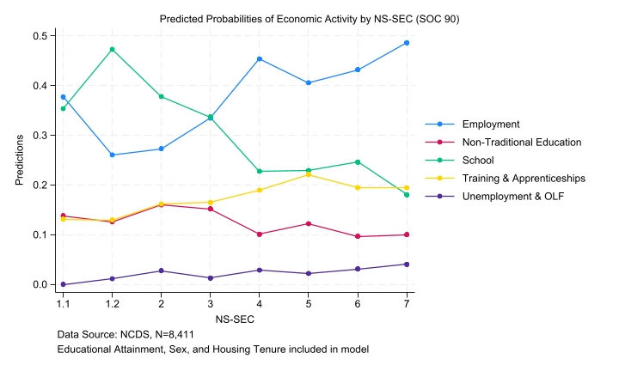
Comparative Results
Table 3 – Q-Step Appendix
Marginal Effects – NS-SEC
SOC2000
SOC90
https://github.com/Scott0atley/YouthTransitions/tree/main/Q-Step
Notes:
Employment line
Trianing & apprenticeships

Slide 29
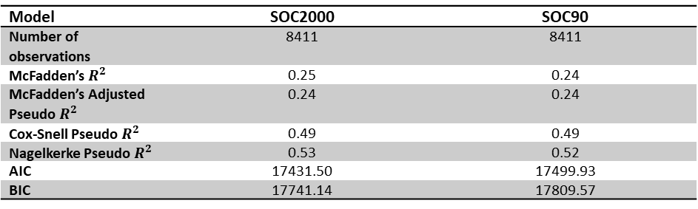
Goodness-of-fit Statistics
Table 3 – Q-Step Appendix
Model | SOC2000 | SOC90
Number of observations | 8411 | 8411
McFadden’s $R^{2}$ | 0.25 | 0.24
McFadden’s Adjusted Pseudo $R^{2}$ | 0.24 | 0.24
Cox-Snell Pseudo $R^{2}$ | 0.49 | 0.49
Nagelkerke Pseudo $R^{2}$ | 0.53 | 0.52
AIC | 17431.50 | 17499.93
BIC | 17741.14 | 17809.57
https://github.com/Scott0atley/YouthTransitions/tree/main/Q-Step
Notes:
Not much in it, but it does push me towards the SOC 2000 model all things considered.

Slide 30
Handling Missing Data in the NCDS
Table 4 – Q-Step Appendix
N | Percent Complete (%) | Educational Attainment | Economic Activity | Housing Tenure | NS-SEC
8411 | 67 | ✓ | ✓ | ✓ | ✓
2201 | 17 | ✓ | ✓ | ✓
1636 | 13 | ✓ | ✓
251 | 2 | ✓ | ✓ |  | ✓
Total = 12536
https://github.com/Scott0atley/YouthTransitions/tree/main/Q-Step

Slide 31
How to handle missing data?
Multiple Imputation versus FIML
https://github.com/Scott0atley/YouthTransitions/tree/main/Q-Step
Notes:
Handling missing data measures just isn’t as widespread as it should be. Often times you will see in a paper ‘’we noticed there was missing data and concluded there was no bias introduced’’ – How?? Why?? What??
Two main statistical approaches – IPW weights are also an option but a different can of worms
Really you have FIML or MI
- very very limited discussion and debate on these two approaches together – tends to be that one discipline uses one method and another uses another, little to no communication. Allison is one example that is bucking this trend but is a tad wrong in their conclusions in my view.
Quick breakdown – FIML uses the sem command in stata with the (mlvm) estimation option whilst MI uses a semi-Bayesian approach with auxillary variables – very short explanation but don’t have time here. All that is needed to be known is that both require the assumption of either a MCAR – missing completely at random or a MAR – missing at random assumption. The first assumes that the missingness is not associated with anything but the missingness itself – a hard assumption to prove. The second assumes that data missing is associated with the missingness as well as an underlying aspect of the model – think rich people not answering income questions on a survey etc.
Who knows if one is better than the other? Practically no one, because there is virtually no work on this.
I conducted an initial simulation – seen next slide – that simulated a seeded dataset with a OLS regression with 3 binary independent variabels, the third variable has a level of missingness introduced to it – two separate simulations were conducted, one under an mcar mechanism and one under a mar assumption. This then is used to assess if one method of handling missing data is better than another. This simulation was repeated 10 times with different seeds to test the underlying conclusions.

Slide 32
Table 1: Simulation Regression Models Using a MCAR Principle
 | Complete Records 'God Model' |  | Complete SEM |  | Missingness Introduced at Independent Variable 3 |  | All Missingness coded as =0 |  | All Missingness coded as =1 |  | Single Use Modal Imputation |  | FIML |  | Imputed with no auxiliary variables and 10 imputations |  | Imputed with 10 imputations |  | Imputed with 100 imputations
Independent Variable 1 | -0.18 | *** | -0.18 | *** | -0.18 | *** | -0.26 | *** | -0.26 | *** | -0.18 | *** | -0.18 | *** | -0.17 | *** | -0.18 | *** | -0.18 | ***
 | (0.02) |  | (0.02) |  | (0.02) |  | (0.01) |  | (0.01) |  | (0.02) |  | (0.02) |  | (0.02) |  | (0.02) |  | (0.02)
Independent Variable 2 | -0.19 | *** | -0.19 | *** | -0.20 | *** | -0.26 | *** | -0.26 | *** | -0.20 | *** | -0.19 | *** | -0.19 | *** | -0.20 | *** | -0.20 | ***
 | (0.02) |  | (0.02) |  | (0.02) |  | (0.01) |  | (0.01) |  | (0.02) |  | (0.02) |  | (0.02) |  | (0.02) |  | (0.02)
Independent Variable 3 | -0.19 | *** | -0.19 | *** | -0.20 | *** | -0.06 | *** | -0.06 | *** | -0.20 | *** | -0.20 | *** | -0.20 | *** | -0.19 | *** | -0.19 | ***
 | (0.02) |  | (0.02) |  | (0.02) |  | (0.01) |  | (0.01) |  | (0.02) |  | (0.02) |  | (0.02) |  | (0.02) |  | (0.02)
Intercept | 1.15 | *** | 1.15 | *** | 1.16 | *** | 1.29 | *** | 1.31 | *** | 1.16 | *** | 1.15 | *** | 1.15 | *** | 1.16 | *** | 1.16 | ***
 | (0.02) |  | (0.02) |  | (0.03) |  | (0.02) |  | (0.01) |  | (0.03) |  | (0.02) |  | (0.02) |  | (0.02) |  | (0.02)
Number of observations | 1000 |  | 1000 |  | 512 |  | 1000 |  | 1000 |  | 512 |  | 1000 |  | 1000 |  | 1000 |  | 1000
AIC | -1245.53 |  | 819.95 |  | -649.50 |  | -1125.29 |  | -1125.41 |  | -649.50 |  | 825.34
BIC | -1225.90 |  | 844.49 |  | -632.55 |  | -1105.65 |  | -1105.78 |  | -632.55 |  | 894.05
Adjusted R-squared | 0.80 |  |  |  | 0.81 |  | 0.78 |  | 0.78 |  | 0.81 |  |  |  | . |  | . |  | .
*** p<.001, ** p<.01, * p<.05 Data Source: Simulation using a MCAR principle. 51 per cent missingness introduced.
Notes:
Quick run through of what we are seeing here. Simulation starts with a Complete Records ‘God model’ a model we would never actually see in a typical study because it has everything there. Then we move to the same model using the SEM framework for comparison later. Then we introduce missingness at independent variable 3 – this missingness is MCAR. Then we go on to the ‘bad missing data solutions’ where we could all missingness =0 on independent variable 3 and then do the same but code as =1. Finally we also conduct single use modal imputation – it would be mean if it were a metric variable. Then we move to the ‘good’ handling missing data ways. First we start with Full information maximum likelihood, then MI with zero auxillary, then MI with 10 imputations, finally a MI model with 100 imputations.
MCAR simulation works as expected The missingness introduced at variable 3 doesn’t alter the substantive results at alland when we conduct out handling missing data methods they all return near identical results – this is what everyone wants when they do this.
Now on to the tricky issue.

Slide 33
Table 2: Simulation Regression Models Using a MAR Principle
 | Complete Records 'God Model' |  | Complete SEM |  | Missingness Introduced at Independent Variable 3 |  | All Missingness coded as =0 |  | All Missingness coded as =1 |  | Single Use Modal Imputation |  | FIML |  | Imputed with no auxiliary variables and 10 imputations |  | Imputed with 10 imputations |  | Imputed with 100 imputations
Independent Variable 1 | -0.18 | *** | -0.18 | *** | -0.11 | *** | -0.16 | *** | -0.27 | *** | -0.27 | *** | -0.21 | *** | -0.17 | *** | -0.17 | *** | -0.17 | ***
 | (0.02) |  | (0.02) |  | (0.02) |  | (0.02) |  | (0.01) |  | (0.01) |  | (0.02) |  | (0.02) |  | (0.02) |  | (0.02)
Independent Variable 2 | -0.19 | *** | -0.19 | *** | -0.12 | *** | -0.17 | *** | -0.27 | *** | -0.27 | *** | -0.22 | *** | -0.18 | *** | -0.19 | *** | -0.19 | ***
 | (0.02) |  | (0.02) |  | (0.02) |  | (0.01) |  | (0.01) |  | (0.01) |  | (0.02) |  | (0.02) |  | (0.02) |  | (0.02)
Independent Variable 3 | -0.19 | *** | -0.19 | *** | -0.14 | *** | -0.23 | *** | 0.03 |  | 0.03 |  | -0.16 | *** | -0.21 | *** | -0.20 | *** | -0.20 | ***
 | (0.02) |  | (0.02) |  | (0.02) |  | (0.02) |  | (0.02) |  | (0.02) |  | (0.02) |  | (0.02) |  | (0.02) |  | (0.02)
Intercept | 1.15 | *** | 1.15 | *** | 0.81 | *** | 1.11 | *** | 1.29 | *** | 1.29 | *** | 1.23 | *** | 1.12 | *** | 1.13 | *** | 1.14 | ***
 | (0.02) |  | (0.02) |  | (0.04) |  | (0.02) |  | (0.02) |  | (0.02) |  | (0.03) |  | (0.02) |  | (0.02) |  | (0.02)
Number of observations | 1000 |  | 1000 |  | 513 |  | 1000 |  | 1000 |  | 1000 |  | 1000 |  | 1000 |  | 1000 |  | 1000
AIC | -1245.53 |  | 819.95 |  | -696.98 |  | -1290.15 |  | -1098.29 |  | -1098.29 |  | 792.03
BIC | -1225.90 |  | 844.49 |  | -680.02 |  | -1270.52 |  | -1078.66 |  | -1078.66 |  | 860.74
Adjusted R-squared | 0.80 |  |  |  | 0.31 |  | 0.81 |  | 0.77 |  | 0.77 |  |  |  | . |  | . |  | .
*** p<.001, ** p<.01, * p<.05 Data Source: Simulation using a MAR principle. 51 per cent missingness introduced.
Notes:
Here is the exact same models using the exact same seed but with a MAR mechanism introduced instead of an MCAR mechanism.
What we can see is that after missignness is introduced the model substantive effects alter – just slightly however in this seed.
We can also see that the ‘bad’ ways to handle missing data are still bad – the coded = 0 does luck into a nearly correct result but that is simply due to the naïve nature of a binary variable – if this were a categorical variable it would have failed completely.
Moving on to all the ‘good’ approaches, all MI models do pretty well – even the no auxillary approach, the FIML does well but not as good as MI even the no auxiallry approach. Be careful – this could be a fluke, or it could be something exciting.
I replicated this simulation 10 times using different seeds. Results confirm that this was a fluke but the general conclusisons are the same – the ‘good’ ways to handle missing data are all ‘good’ and it doesn’t matter which to use.

Slide 34
NCDS Handling Missing Data
Table 4 – Q-Step Appendix
With that segway dealt with…
MI chosen over FIML for the NCDS
https://github.com/Scott0atley/YouthTransitions/tree/main/Q-Step
Notes:
MI over FIML because the sem package that we use for FIML in stata cannot handle categorical dependent variables – for that we would need MPLUS which would break the workflow. As has been seen through these simulations however, it wouldn’t really matter which method to use, so long as one WAS used.

Slide 35
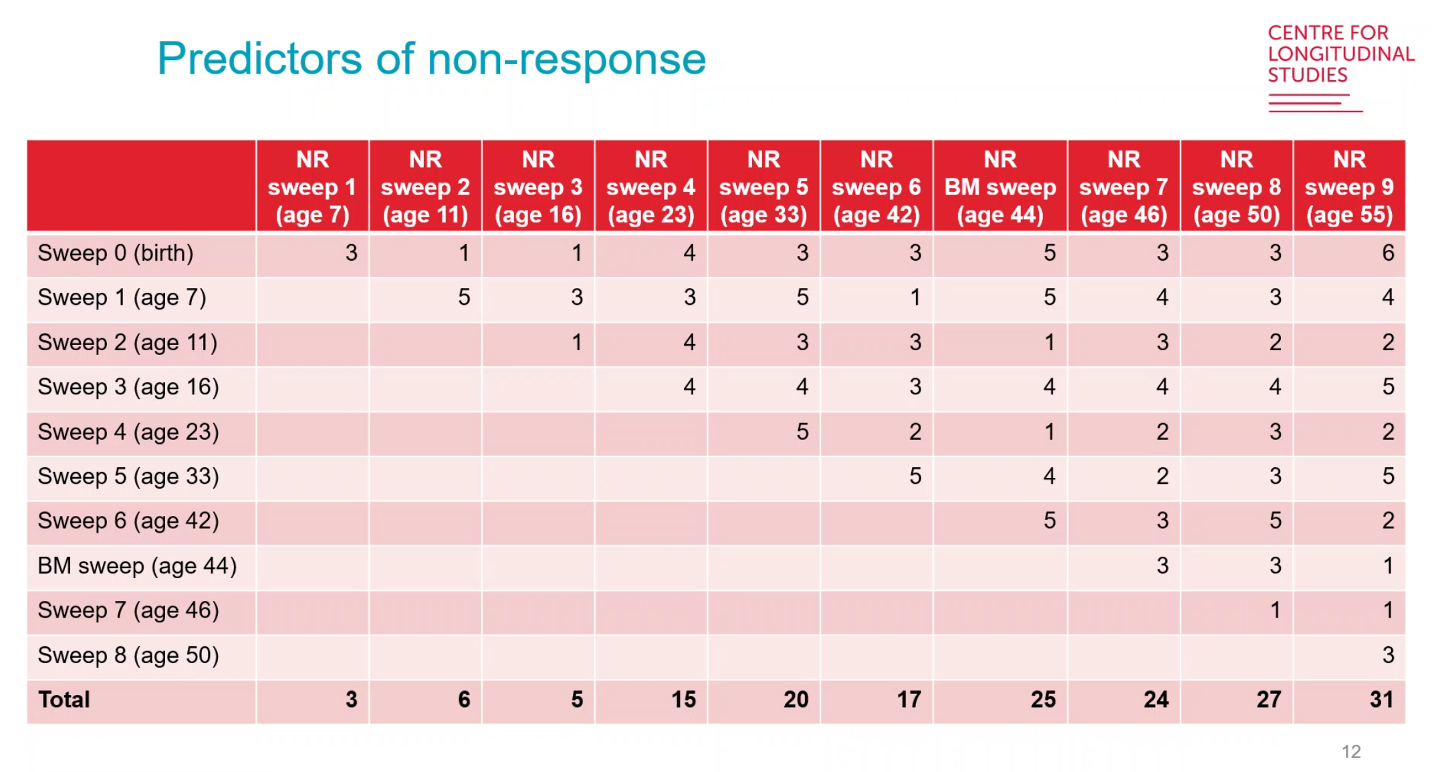
Predictors of Non-response (Silverwood et al 2021)
Table 4 – Q-Step Appendix
https://github.com/Scott0atley/YouthTransitions/tree/main/Q-Step
Notes:
Just a quick slide indicating that there are 15 indicators of non-response in the NCDS for the sweeps I am using. These are included as our auxiliary variables.

Slide 36
Substantive Findings
Table 4 – Q-Step Appendix
Substantively identical between CRA and MI models
https://github.com/Scott0atley/YouthTransitions/tree/main/Q-Step
Notes:
And the results are…
Suggestive of a MCAR mechanism at play – thank god.
Lots of work, but worth it

Slide 37
Concluding Remarks
How do Structural Inequalities influence choice and opportunities in the transition from school-to-work?
Different structural inequalities have varying levels of influence on an individual's transition from school-to-work dependent on the type of transitional category that individual enters.
Sensitivity analysis presents some interesting takeaways for further research
Handling missing data is important, but the ‘good’ methods you choose from are not so much
https://github.com/Scott0atley/YouthTransitions/tree/main/Q-Step

Slide 38
References
Beck, U., Giddens, A. and Lash, S. (1994) Reflexive modernization: Politics, tradition and aesthetics in the modern social order. Stanford University Press.
Devine, F. (2017) ‘The “new structuralism”: class politics and class analysis’, in Social Class and Marxism. Taylor & Francis.
Elder, G.H. (1994) ‘Time, Human Agency, and Social Change: Perspectives on the Life Course’, Social Psychology Quarterly, 57(1), p. 4. Available at: https://doi.org/10.2307/2786971.
Gayle, V., Lambert, P. and Murray, S. (2009) ‘School-to-Work in the 1990s: Modelling Transitions with Large-Scale Datasets’, in R. Brooks (ed.) Transitions from Education to Work. London: Palgrave Macmillan UK, pp. 17–41. Available at: https://doi.org/10.1057/9780230235403_2.
Mayer, K.U. (2004) ‘Whose Lives? How History, Societies, and Institutions Define and Shape Life Courses’, Research in Human Development, 1(3), pp. 161–187. Available at: https://doi.org/10.1207/s15427617rhd0103_3.
Power, C. and Elliott, J. (2006) ‘Cohort profile: 1958 British birth cohort (National Child Development Study)’, International Journal of Epidemiology, 35(1), pp. 34–41. Available at: https://doi.org/10.1093/ije/dyi183.
Silverwood, R. et al. (2021) ‘Handling missing data in the National Child Development Study: User guide (Version 2).’
https://github.com/Scott0atley/YouthTransitions/tree/main/Q-Step

Slide 39
Thank You
Any Questions?
https://github.com/Scott0atley/YouthTransitions/tree/main/Q-Step

