Slide 1
How should we handle missing data?
Scott Oatley
soatley@ed.ac.uk

Slide 2
What is Missing Data?
Item missing
Unit missing
https://github.com/Scott0atley/YouthTransitions/tree/main/Q-Step

Slide 3
What is Missing Data? (Theory)
MCAR
MAR
MNAR
https://github.com/Scott0atley/YouthTransitions/tree/main/Q-Step

Slide 4
Missing Completely At Random (MCAR)
Suppose that only one variable Y has missing data, and that another set of variables represented by the vector X, is always observed (Marsden and Wright, 2010). The data is MCAR if the probability that Y is missing does not depend on either X or Y itself.
Example: An example of MCAR is a weighing scale that ran out of batteries. Some of the data will be missing simply because of bad luck. (Van Buuren & Van Buuren 2012)
https://github.com/Scott0atley/YouthTransitions/tree/main/Q-Step

Slide 5
Missing At Random (MAR)
Data on Y is considered MAR if the probability that Y is missing does not depend on Y, once we control for X. MAR allows for missingness on Y to depend on other variables so long as it does not depend on Y itself.
Example: Women are less likely to report their incomes – regardless of what their income actually is.
https://github.com/Scott0atley/YouthTransitions/tree/main/Q-Step

Slide 6
Missing Not At Random (MNAR)
Means missingness depends on unobserved values (Silverwood et al. 2021), and that the probability that Y is missing depends on Y itself, after adjusting for X (Marsden and Wright, 2010). For example, people who have been arrested may be less likely to report their arrest status.
Example: People with low incomes do not answer the income question.
https://github.com/Scott0atley/YouthTransitions/tree/main/Q-Step

Slide 7
Why Should we care about Missing Data?
‘Flipping’ – where missingness flips the substantive significance of a finding from positive to negative or vice versa
‘Flopping’ – where missingness minimises or over-empahsises the size of the substantive finding
‘Flip-Flopping’ – where missingness flips the substantive significance and minimises/over emphasises the result
https://github.com/Scott0atley/YouthTransitions/tree/main/Q-Step

Slide 8
A quick working example
A simple bivariate regression model is simulated
The first model has a continuous dependent variable and a continuous independent variable with n=1000
Model is injected with both a MCAR and a MAR mechanism to demonstrate potential issues
https://github.com/Scott0atley/YouthTransitions/tree/main/Q-Step

Slide 9
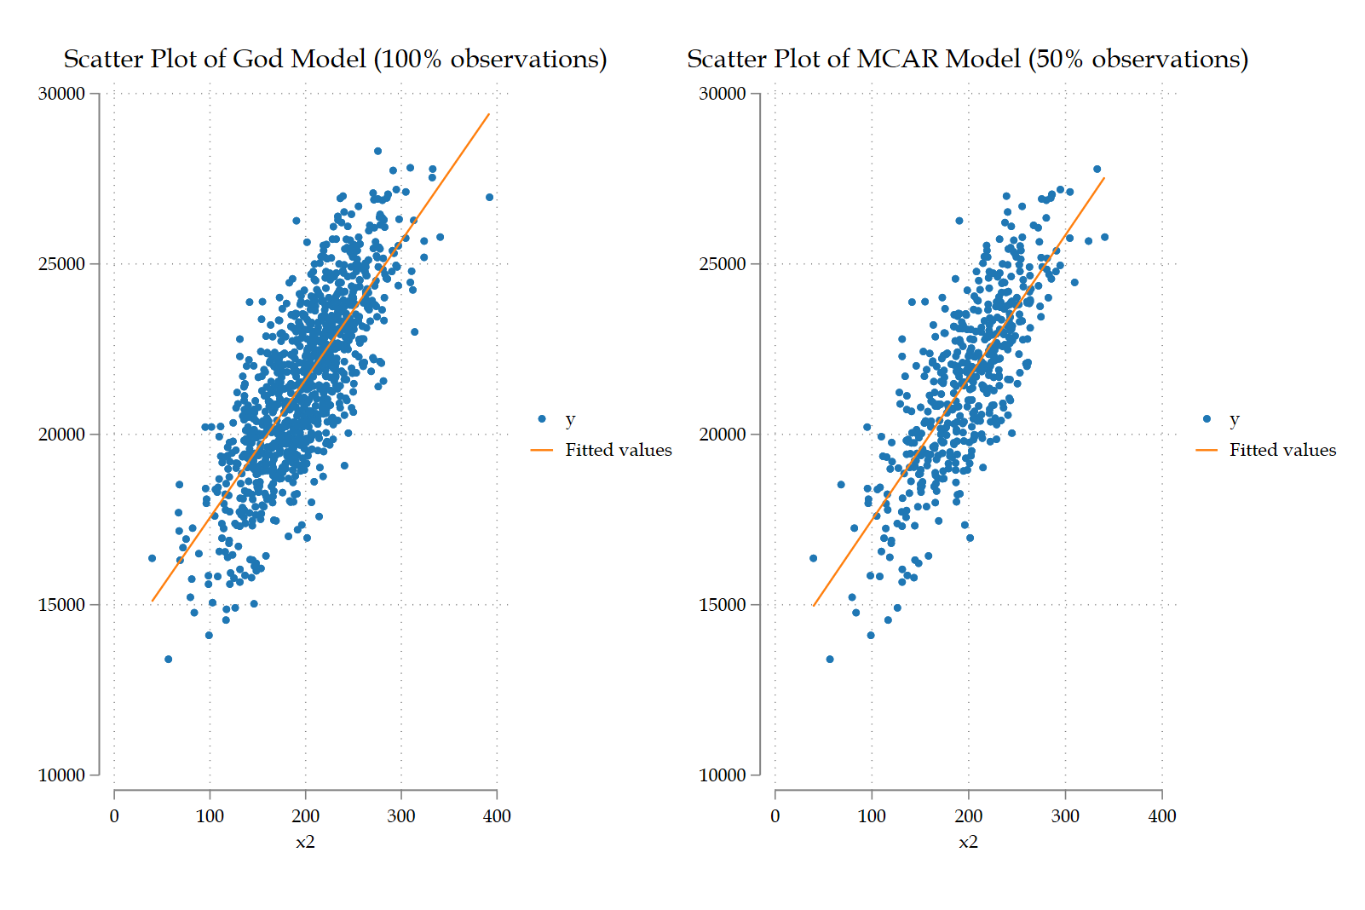
‘God’ Model versus MCAR
https://github.com/Scott0atley/YouthTransitions/tree/main/Q-Step

Slide 10
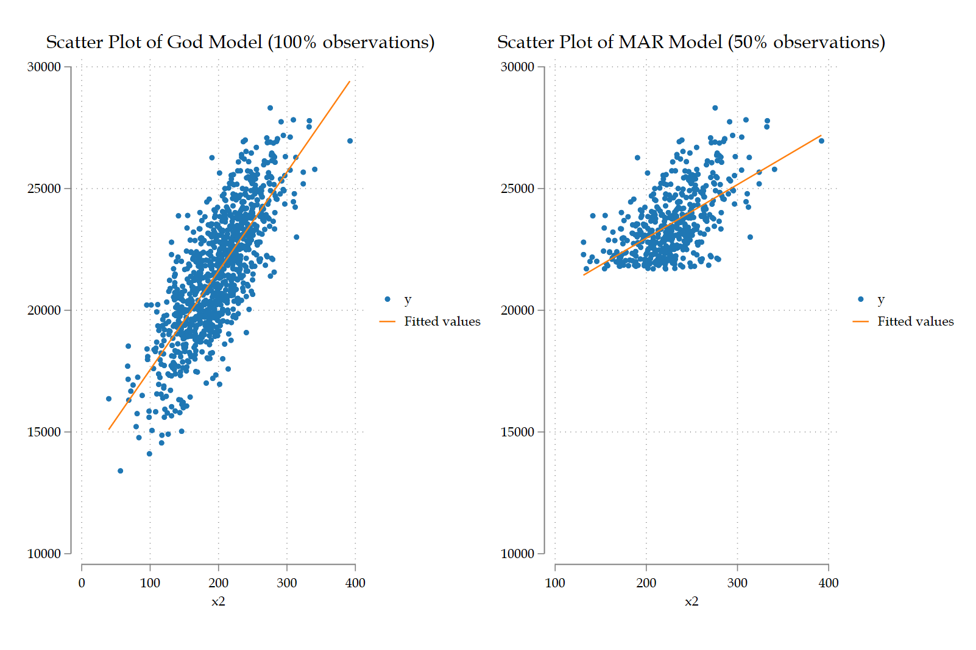
‘God’ Model versus MCAR
https://github.com/Scott0atley/YouthTransitions/tree/main/Q-Step

Slide 11
What does this all mean?
We can’t ignore missing data
And yet most studies do
‘’I’ve looked at the missingness in my data and confirmed there will be no bias…’’
https://github.com/Scott0atley/YouthTransitions/tree/main/Q-Step

Slide 12
How to handle missing data?
Several approaches
Some good
Some bad
Some ugly
https://github.com/Scott0atley/YouthTransitions/tree/main/Q-Step

Slide 13
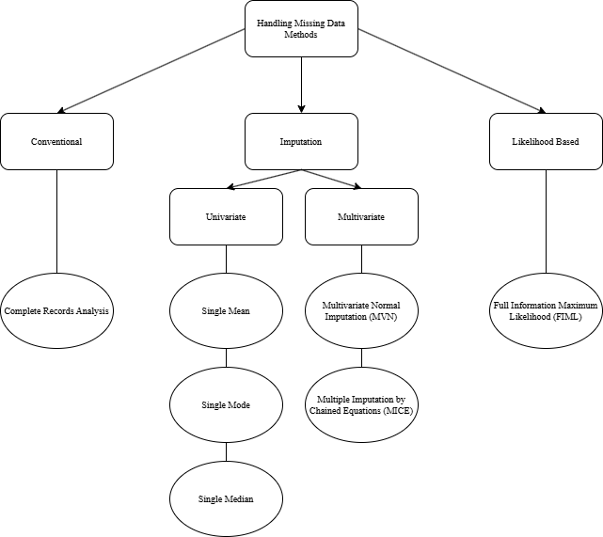
How to handle missing data?
https://github.com/Scott0atley/YouthTransitions/tree/main/Q-Step

Slide 14
The Bad
Listwise Deletion
This just ignores the issue
https://github.com/Scott0atley/YouthTransitions/tree/main/Q-Step

Slide 15
The Ugly
Recoding Missingness to a single value
Say you have a binary independent variable where all missingness occurs in model
Code all missingness = 0 in that variable
Code all missingness = 1 in that variable
https://github.com/Scott0atley/YouthTransitions/tree/main/Q-Step

Slide 16
The Ugly
Single mean/modal/median imputation
https://github.com/Scott0atley/YouthTransitions/tree/main/Q-Step

Slide 17
The Ugly
Multiple Imputation with zero auxiliary variables
https://github.com/Scott0atley/YouthTransitions/tree/main/Q-Step

Slide 18
The Good
Full Information Maximum Likelihood (FIML)
(Or MLMV in stata)
Uses SEM framework
Can’t use for non-linear models in Stata (Can in MPLUS)
https://github.com/Scott0atley/YouthTransitions/tree/main/Q-Step
Notes:
FIML is a method that takes into account all observed data, including missing data. It estimates the parameters of a model by maximizing the likelihood function of the observed data, given the model parameters, using all available information.
The basic premise is that instead of imputing the values of missing data, we try to estimate the value of some population parameter by determining the value that maximizes the likelihood function (actually the natural log of this function) based on the sample data that we have.

Slide 19
The Good
Multiple Imputation with auxiliary variables
https://github.com/Scott0atley/YouthTransitions/tree/main/Q-Step

Slide 20
Multiple good ways to handle missing data?
Multiple Imputation versus FIML
https://github.com/Scott0atley/YouthTransitions/tree/main/Q-Step
Notes:
Handling missing data measures just isn’t as widespread as it should be. Often times you will see in a paper ‘’we noticed there was missing data and concluded there was no bias introduced’’ – How?? Why?? What??
Two main statistical approaches – IPW weights are also an option but a different can of worms
Really you have FIML or MI
- very very limited discussion and debate on these two approaches together – tends to be that one discipline uses one method and another uses another, little to no communication. Allison is one example that is bucking this trend but is a tad wrong in their conclusions in my view.
Quick breakdown – FIML uses the sem command in stata with the (mlvm) estimation option whilst MI uses a semi-Bayesian approach with auxiliary variables – very short explanation but don’t have time here. All that is needed to be known is that both require the assumption of either a MCAR – missing completely at random or a MAR – missing at random assumption. The first assumes that the missingness is not associated with anything but the missingness itself – a hard assumption to prove. The second assumes that data missing is associated with the missingness as well as an underlying aspect of the model – think rich people not answering income questions on a survey etc.
Who knows if one is better than the other? Practically no one, because there is virtually no work on this. Some stuff by Allison but most research focuses soley on one instead of both compared.
I conducted an initial simulation – seen next slide – that simulated a seeded dataset with a OLS regression with 3 binary independent variabels, the third variable has a level of missingness introduced to it – two separate simulations were conducted, one under an mcar mechanism and one under a mar assumption. This then is used to assess if one method of handling missing data is better than another. This simulation was repeated 10 times with different seeds to test the underlying conclusions.

Slide 21
Simulation Study
N=1000
1 continuous dependent variable + 3 independent variables
Missingness introduced into x2 variable
Different handling missing data methods then assessed
https://github.com/Scott0atley/YouthTransitions/tree/main/Q-Step
Notes:
Handling missing data measures just isn’t as widespread as it should be. Often times you will see in a paper ‘’we noticed there was missing data and concluded there was no bias introduced’’ – How?? Why?? What??
Two main statistical approaches – IPW weights are also an option but a different can of worms
Really you have FIML or MI
- very very limited discussion and debate on these two approaches together – tends to be that one discipline uses one method and another uses another, little to no communication. Allison is one example that is bucking this trend but is a tad wrong in their conclusions in my view.
Quick breakdown – FIML uses the sem command in stata with the (mlvm) estimation option whilst MI uses a semi-Bayesian approach with auxiliary variables – very short explanation but don’t have time here. All that is needed to be known is that both require the assumption of either a MCAR – missing completely at random or a MAR – missing at random assumption. The first assumes that the missingness is not associated with anything but the missingness itself – a hard assumption to prove. The second assumes that data missing is associated with the missingness as well as an underlying aspect of the model – think rich people not answering income questions on a survey etc.
Who knows if one is better than the other? Practically no one, because there is virtually no work on this. Some stuff by Allison but most research focuses soley on one instead of both compared.
I conducted an initial simulation – seen next slide – that simulated a seeded dataset with a OLS regression with 3 binary independent variabels, the third variable has a level of missingness introduced to it – two separate simulations were conducted, one under an mcar mechanism and one under a mar assumption. This then is used to assess if one method of handling missing data is better than another. This simulation was repeated 10 times with different seeds to test the underlying conclusions.

Slide 22
Variables
X1=(1000) means(40) sds(12)
X2=n(1000) means(200) sds(50)
X3=n(1000) means(150) sds(5)
y = 30*x1 + 40*x2 + 50*x3 + rnormal(5000, 1500)
https://github.com/Scott0atley/YouthTransitions/tree/main/Q-Step
Notes:
Handling missing data measures just isn’t as widespread as it should be. Often times you will see in a paper ‘’we noticed there was missing data and concluded there was no bias introduced’’ – How?? Why?? What??
Two main statistical approaches – IPW weights are also an option but a different can of worms
Really you have FIML or MI
- very very limited discussion and debate on these two approaches together – tends to be that one discipline uses one method and another uses another, little to no communication. Allison is one example that is bucking this trend but is a tad wrong in their conclusions in my view.
Quick breakdown – FIML uses the sem command in stata with the (mlvm) estimation option whilst MI uses a semi-Bayesian approach with auxiliary variables – very short explanation but don’t have time here. All that is needed to be known is that both require the assumption of either a MCAR – missing completely at random or a MAR – missing at random assumption. The first assumes that the missingness is not associated with anything but the missingness itself – a hard assumption to prove. The second assumes that data missing is associated with the missingness as well as an underlying aspect of the model – think rich people not answering income questions on a survey etc.
Who knows if one is better than the other? Practically no one, because there is virtually no work on this. Some stuff by Allison but most research focuses soley on one instead of both compared.
I conducted an initial simulation – seen next slide – that simulated a seeded dataset with a OLS regression with 3 binary independent variabels, the third variable has a level of missingness introduced to it – two separate simulations were conducted, one under an mcar mechanism and one under a mar assumption. This then is used to assess if one method of handling missing data is better than another. This simulation was repeated 10 times with different seeds to test the underlying conclusions.

Slide 23
Missing Mechanisms
MCAR =
gen rmcar = rbinomial(1, 0.5) // MCAR: 50% chance of missingness (binary random)
replace x2 = . if rmcar == 0 // Set x to missing where rmcar == 0
MAR =
gen prob_mar = logistic(y-21791)
gen rmar = 0 if prob_mar==0
replace x2 = . if rmar == 0 // Set x to missing where rmar == 0
https://github.com/Scott0atley/YouthTransitions/tree/main/Q-Step
Notes:
Handling missing data measures just isn’t as widespread as it should be. Often times you will see in a paper ‘’we noticed there was missing data and concluded there was no bias introduced’’ – How?? Why?? What??
Two main statistical approaches – IPW weights are also an option but a different can of worms
Really you have FIML or MI
- very very limited discussion and debate on these two approaches together – tends to be that one discipline uses one method and another uses another, little to no communication. Allison is one example that is bucking this trend but is a tad wrong in their conclusions in my view.
Quick breakdown – FIML uses the sem command in stata with the (mlvm) estimation option whilst MI uses a semi-Bayesian approach with auxiliary variables – very short explanation but don’t have time here. All that is needed to be known is that both require the assumption of either a MCAR – missing completely at random or a MAR – missing at random assumption. The first assumes that the missingness is not associated with anything but the missingness itself – a hard assumption to prove. The second assumes that data missing is associated with the missingness as well as an underlying aspect of the model – think rich people not answering income questions on a survey etc.
Who knows if one is better than the other? Practically no one, because there is virtually no work on this. Some stuff by Allison but most research focuses soley on one instead of both compared.
I conducted an initial simulation – seen next slide – that simulated a seeded dataset with a OLS regression with 3 binary independent variabels, the third variable has a level of missingness introduced to it – two separate simulations were conducted, one under an mcar mechanism and one under a mar assumption. This then is used to assess if one method of handling missing data is better than another. This simulation was repeated 10 times with different seeds to test the underlying conclusions.

Slide 24
Models
1) God Model
2) SEM God Model
3) MCAR Model
4) MAR Model
5) Single Mean Imputation Model
6) FIML Model
7) 10 imputation no auxiliary Model
8) 10 imputation auxiliary Model
9) 100 imputation auxiliary Model
https://github.com/Scott0atley/YouthTransitions/tree/main/Q-Step
Notes:
Handling missing data measures just isn’t as widespread as it should be. Often times you will see in a paper ‘’we noticed there was missing data and concluded there was no bias introduced’’ – How?? Why?? What??
Two main statistical approaches – IPW weights are also an option but a different can of worms
Really you have FIML or MI
- very very limited discussion and debate on these two approaches together – tends to be that one discipline uses one method and another uses another, little to no communication. Allison is one example that is bucking this trend but is a tad wrong in their conclusions in my view.
Quick breakdown – FIML uses the sem command in stata with the (mlvm) estimation option whilst MI uses a semi-Bayesian approach with auxiliary variables – very short explanation but don’t have time here. All that is needed to be known is that both require the assumption of either a MCAR – missing completely at random or a MAR – missing at random assumption. The first assumes that the missingness is not associated with anything but the missingness itself – a hard assumption to prove. The second assumes that data missing is associated with the missingness as well as an underlying aspect of the model – think rich people not answering income questions on a survey etc.
Who knows if one is better than the other? Practically no one, because there is virtually no work on this. Some stuff by Allison but most research focuses soley on one instead of both compared.
I conducted an initial simulation – seen next slide – that simulated a seeded dataset with a OLS regression with 3 binary independent variabels, the third variable has a level of missingness introduced to it – two separate simulations were conducted, one under an mcar mechanism and one under a mar assumption. This then is used to assess if one method of handling missing data is better than another. This simulation was repeated 10 times with different seeds to test the underlying conclusions.

Slide 25
Notes:
Here is the exact same models using the exact same seed but with a MAR mechanism introduced instead of an MCAR mechanism.
What we can see is that after missignness is introduced the model substantive effects alter – just slightly however in this seed.
We can also see that the ‘bad’ ways to handle missing data are still bad – the coded = 0 does luck into a nearly correct result but that is simply due to the naïve nature of a binary variable – if this were a categorical variable it would have failed completely.
Moving on to all the ‘good’ approaches, all MI models do pretty well – even the no auxillary approach, the FIML does well but not as good as MI even the no auxiallry approach. Be careful – this could be a fluke, or it could be something exciting.
I replicated this simulation 10 times using different seeds. Results confirm that this was a fluke but the general conclusisons are the same – the ‘good’ ways to handle missing data are all ‘good’ and it doesn’t matter which to use.

Slide 26
What does this all mean?
1) God Model – perfect ideal model
2) SEM God Model – same as above
3) MCAR Model – inflated standard errors
4) MAR Model – big substantive issues
5) Single Mean Imputation Model – x2 issues, massive 95% CIs
6) FIML Model – Great!
7) 10 imputation no auxiliary Model – inflated x3 values
8) 10 imputation auxiliary Model – Great!
9) 100 imputation auxiliary Model – Great!
https://github.com/Scott0atley/YouthTransitions/tree/main/Q-Step
Notes:
Handling missing data measures just isn’t as widespread as it should be. Often times you will see in a paper ‘’we noticed there was missing data and concluded there was no bias introduced’’ – How?? Why?? What??
Two main statistical approaches – IPW weights are also an option but a different can of worms
Really you have FIML or MI
- very very limited discussion and debate on these two approaches together – tends to be that one discipline uses one method and another uses another, little to no communication. Allison is one example that is bucking this trend but is a tad wrong in their conclusions in my view.
Quick breakdown – FIML uses the sem command in stata with the (mlvm) estimation option whilst MI uses a semi-Bayesian approach with auxiliary variables – very short explanation but don’t have time here. All that is needed to be known is that both require the assumption of either a MCAR – missing completely at random or a MAR – missing at random assumption. The first assumes that the missingness is not associated with anything but the missingness itself – a hard assumption to prove. The second assumes that data missing is associated with the missingness as well as an underlying aspect of the model – think rich people not answering income questions on a survey etc.
Who knows if one is better than the other? Practically no one, because there is virtually no work on this. Some stuff by Allison but most research focuses soley on one instead of both compared.
I conducted an initial simulation – seen next slide – that simulated a seeded dataset with a OLS regression with 3 binary independent variabels, the third variable has a level of missingness introduced to it – two separate simulations were conducted, one under an mcar mechanism and one under a mar assumption. This then is used to assess if one method of handling missing data is better than another. This simulation was repeated 10 times with different seeds to test the underlying conclusions.

Slide 27
Conclusion
No missing data is always the dream
Dream is never reality
Have to check for missing mechanisms
If MCAR -> carry on, if MAR or MNAR -> look to handling missing data methods
Using ‘bad’ methods is sometimes as bad as doing nothing!
No difference in efficiency between FIML and MI approaches
Use the method that best suits your data
FIML is very restricted in most software, MICE is ubiquitous and easy to implement
https://github.com/Scott0atley/YouthTransitions/tree/main/Q-Step
Notes:
Handling missing data measures just isn’t as widespread as it should be. Often times you will see in a paper ‘’we noticed there was missing data and concluded there was no bias introduced’’ – How?? Why?? What??
Two main statistical approaches – IPW weights are also an option but a different can of worms
Really you have FIML or MI
- very very limited discussion and debate on these two approaches together – tends to be that one discipline uses one method and another uses another, little to no communication. Allison is one example that is bucking this trend but is a tad wrong in their conclusions in my view.
Quick breakdown – FIML uses the sem command in stata with the (mlvm) estimation option whilst MI uses a semi-Bayesian approach with auxiliary variables – very short explanation but don’t have time here. All that is needed to be known is that both require the assumption of either a MCAR – missing completely at random or a MAR – missing at random assumption. The first assumes that the missingness is not associated with anything but the missingness itself – a hard assumption to prove. The second assumes that data missing is associated with the missingness as well as an underlying aspect of the model – think rich people not answering income questions on a survey etc.
Who knows if one is better than the other? Practically no one, because there is virtually no work on this. Some stuff by Allison but most research focuses soley on one instead of both compared.
I conducted an initial simulation – seen next slide – that simulated a seeded dataset with a OLS regression with 3 binary independent variabels, the third variable has a level of missingness introduced to it – two separate simulations were conducted, one under an mcar mechanism and one under a mar assumption. This then is used to assess if one method of handling missing data is better than another. This simulation was repeated 10 times with different seeds to test the underlying conclusions.

Slide 28
Thank You
Any Questions?
https://github.com/Scott0atley/YouthTransitions/tree/main/Q-Step

Slide 29
Van Buuren, S. and Van Buuren, S., 2012. Flexible imputation of missing data (Vol. 10, p. b1182). Boca Raton, FL: CRC press.

