Slide 1
Software Citation
Daniel S. Katz
Assistant Director for Scientific Software & Applications, NCSA
Research Associate Professor, CS
Research Associate Professor, ECE
Research Associate Professor, iSchool
dskatz@illinois.edu, d.katz@ieee.org, @danielskatz

Slide 2
Purposes of software in research
Research Software
Infrastructure Software
Acquire Resources (e.g., Funding, Software, Data)
Create Hypothesis
Perform Research (Build Software & Data)
Gain Recognition
Publish Results (e.g., Paper, Book, Software, Data)

Slide 3
Software Citation Motivation
Scientific research is becoming:
More open – scientists want to collaborate; want/need to share
More digital – outputs such as software and data; easier to share
Significant time spent developing software & data
Efforts not recognized or rewarded
Citations for papers systematically collected, metrics built
But not for software & data
Hypothesis:
Better measurement of contributions (citations, impact, metrics)
—> Rewards (incentives)
—> Career paths, willingness to join communities
—> More sustainable software

Slide 4
How to better measure software contributions
Citation system was created for papers/books
We need to either/both
Jam software into current citation system
Rework citation system
Focus on 1 as possible; 2 is very hard.
Challenge: not just how to identify software in a paper
How to identify software used within research process

Slide 5
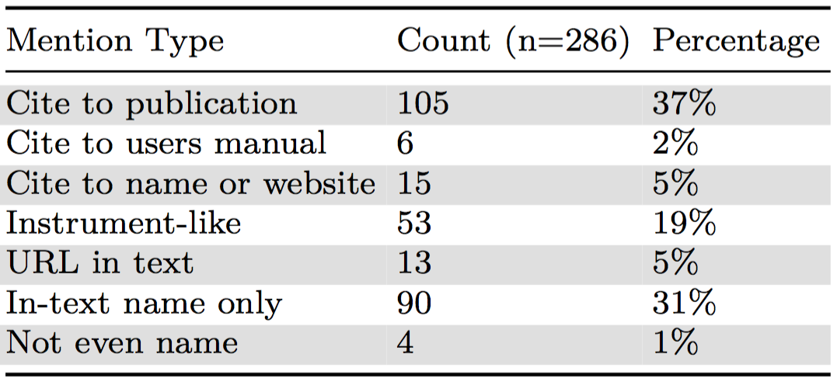
Software citation today
Software and other digital resources currently appear in publications in very inconsistent ways
Howison: random sample of 90 articles in the biology literature -> 7 different ways that software was mentioned
Studies on data and facility citation -> similar results
J. Howison and J. Bullard. Software in the scientific literature: Problems with seeing, finding, and using software mentioned in the biology literature. Journal of the Association for Information Science and Technology, 2015. In press. http://dx.doi.org/10.1002/asi.23538.

Slide 6
Software citation principles: People & Process
FORCE11 Software Citation group started July 2015
WSSSPE3 Credit & Citation working group joined September 2015
~55 members (researchers, developers, publishers, repositories, librarians)
Working on GitHub https://github.com/force11/force11-scwg & FORCE11 https://www.force11.org/group/software-citation-working-group
Reviewed existing community practices & developed use cases
Drafted software citation principles document
Started with data citation principles, updated based on software use cases and related work, updated based working group discussions, community feedback and review of draft, workshop at FORCE2016 in April
Discussion via GitHub issues, changes tracked
Contains 6 principles, motivation, summary of use cases, related work, discussion & recommendations
Submitted, reviewed and modified (many times), now published
Smith AM, Katz DS, Niemeyer KE, FORCE11 Software Citation Working Group.(2016) Software Citation Principles. PeerJ Computer Science 2:e86. DOI: 10.7717/peerj-cs.86 and https://www.force11.org/software-citation-principles

Slide 7
Principle 1. Importance
Software should be considered a legitimate and citable product of research. Software citations should be accorded the same importance in the scholarly record as citations of other research products, such as publications and data; they should be included in the metadata of the citing work, for example in the reference list of a journal article, and should not be omitted or separated. Software should be cited on the same basis as any other research product such as a paper or a book, that is, authors should cite the appropriate set of software products just as they cite the appropriate set of papers.

Slide 8
Principle 2. Credit and Attribution
Software citations should facilitate giving scholarly credit and normative, legal attribution to all contributors to the software, recognizing that a single style or mechanism of attribution may not be applicable to all software.

Slide 9
Principle 3. Unique Identification
A software citation should include a method for identification that is machine actionable, globally unique, interoperable, and recognized by at least a community of the corresponding domain experts, and preferably by general public researchers.

Slide 10
Principle 4. Persistence
Unique identifiers and metadata describing the software and its disposition should persist – even beyond the lifespan of the software they describe.

Slide 11
Principle 5. Accessibility
Software citations should facilitate access to the software itself and to its associated metadata, documentation, data, and other materials necessary for both humans and machines to make informed use of the referenced software.

Slide 12
Principle 6. Specificity
Software citations should facilitate identification of, and access to, the specific version of software that was used. Software identification should be as specific as necessary, such as using version numbers, revision numbers, or variants such as platforms.

Slide 13
Discussion
Does this make sense to you?
Will you “endorse” this?
Would your organization “endorse” this?
How would you apply this?
How would your organization?
How would you convince your organization?
For all the above, what are the problems?

Slide 14
Backup

Slide 15
Discussion: What to cite
Importance principle: “…authors should cite the appropriate set of software products just as they cite the appropriate set of papers”
What software to cite decided by author(s) of product, in context of community norms and practices
POWL: “Do not cite standard office software (e.g. Word, Excel) or programming languages. Provide references only for specialized software.”
i.e., if using different software could produce different data or results, then the software used should be cited
Purdue Online Writing Lab. Reference List: Electronic Sources (Web Publications). https://owl.english.purdue. edu/owl/resource/560/10/, 2015.

Slide 16
Discussion: What to cite (citation vs provenance & reproducibility)
Provenance/reproducibility requirements > citation requirements
Citation: software important to research outcome
Provenance: all steps (including software) in research
For data research product, provenance data includes all cited software, not vice versa
Software citation principles cover minimal needs for software citation for software identification
Provenance & reproducibility may need more metadata

Slide 17
Discussion: Software papers
Goal: Software should be cited
Practice: Papers about software (“software papers”) are published and cited
Importance principle (1) and other discussion: The software itself should be cited on the same basis as any other research product; authors should cite the appropriate set of software products
Ok to cite software paper too, if it contains results (performance, validation, etc.) that are important to the work
If the software authors ask users to cite software paper, can do so, in addition to citing to the software

Slide 18
Discussion: Derived software
Imagine Code A is derived from Code B, and a paper uses and cites Code A
Should the paper also cite Code B?
No, any research builds on other research
Each research product just cites those products that it directly builds on
Together, this give credit and knowledge chains
Science historians study these chains
More automated analyses may also develop, such as transitive credit
D. S. Katz and A. M. Smith. Implementing transitive credit with JSON-LD. Journal of Open Research Software, 3:e7, 2015. http://dx.doi.org/10.5334/jors.by.

Slide 19
Discussion: Software peer review
Important issue for software in science
Probably out-of-scope in citation discussion
Goal of software citation is to identify software that has been used in a scholarly product
Whether or not that software has been peer-reviewed is irrelevant
Possible exception: if peer-review status of software is part of software metadata
Working group opinion: not part of the minimal metadata needed to identify the software

Slide 20
Discussion: Citations in text
Each publisher/publication has a style it prefers
e.g., AMS, APA, Chicago, MLA
Examples for software using these styles published by Lipson
Citations typically sent to publishers as text formatted in that citation style, not as structured metadata
Recommendation: text citation styles should support:
a) a label indicating that this is software, e.g. [Computer program]
b) support for version information, e.g. Version 1.8.7
C. Lipson. Cite Right, Second Edition: A Quick Guide to Citation Styles–MLA, APA, Chicago, the Sciences, Professions, and More. Chicago Guides to Writing, Editing, and Publishing. University of Chicago Press, 2011.

Slide 21
Discussion: Citation limits
Software citation principles
–> more software citations in scholarly products
–> more overall citations
Some journals have strict limits on
Number of citations
Number of pages (including references)
Recommendations to publishers:
Add specific instructions regarding software citations to author guidelines to not disincentivize software citation
Don’t include references in content counted against page limits

Slide 22
Discussion: Unique identification
Recommend DOIs for identification of published software
However, identifier can point to
a specific version of a piece of software
the piece of software (all versions of the software)
the latest version of a piece of software
One piece of software may have identifiers of all 3 types
And maybe 1+ software papers, each with identifiers
Use cases:
Cite a specific version
Cite the software in general
Link multiple releases together, to understanding all citations

Slide 23
Discussion: Unique identification (cont.)
Principles intended to apply at all levels
To all identifiers types, e.g., DOIs, RRIDs, ARKS, etc.
Though again: recommend when possible use DOIs that identify specific versions of source code
RRIDs developed by the FORCE11 Resource Identification Initiative
Discussed for use to identify software packages (not specific versions)
FORCE11 Resource Identification Technical Specifications Working Group says “Information resources like software are better suited to the Software Citation WG”
Currently no consensus on RRIDs for software

Slide 24
Discussion: Types of software
Principles and discussion generally focus on software as source code
But some software is only available as an executable, a container, or a service
Principles intended to apply to all these forms of software
Implementation of principles will differ by software type
When software exists as both source code and another type, cite the source code

Slide 25
Discussion: Access to software
Accessibility principle: “software citations should permit and facilitate access to the software itself”
Metadata should provide access information
Free software: metadata includes UID that resolves to URL to specific version of software
Commercial software: metadata provides information on how to access the specific software
E.g., company’s product number, URL to buy the software
If software isn’t available now, it still should be cited along with information about how it was accessed
Metadata should persist, even when software doesn’t

Slide 26
Discussion: Identifier resolves to …
Identifier that points directly to software (e.g., GitHub repo) satisfies Unique Identification (3), Accessibility (5), and Specificity (6), but not Persistence (4)
Recommend that identifier should resolve to persistent landing page that contains metadata and link to the software itself, rather than directly to source code
Ensures longevity of software metadata, even beyond software lifespan
Point to figshare, Zenodo, etc., not GitHub

Slide 27
Example 1: Make your software citable
Publish it – if it’s on GitHub, follow steps in https://guides.github.com/activities/citable-code/
Otherwise, submit it to zenodo or figshare, with appropriate metadata (including authors, title, …, citations of … & software that you use)
Get a DOI
Create a CITATION file, update your README, tell people how to cite
Also, can write a software paper and ask people to cite that (but this is secondary, just since our current system doesn’t work well)

Slide 28
Example 2: Cite someone else’s software in a paper
Check for a CITATION file or README; if this says how to cite the software itself, do that
If not, do your best following the principles
Try to include all contributors to the software (maybe by just naming the project)
Try to include a method for identification that is machine actionable, globally unique, interoperable – perhaps a URL to a release, a company product number
If there’s a landing page that includes metadata, point to that, not directly to the software (e.g. the GitHub repo URL)
Include specific version/release information
If there’s a software paper, can cite this too, but not in place of citing the software

Slide 29
Software Citation vs Paper Citation
Three relevant steps for paper citation
Creator (aka author) submits paper to “publisher”
[review+], then publisher publishes paper & assigns identifier, often DOI
To refer to paper within another work, cite paper metadata, often including DOI
Fixed order, discrete steps
For software today
Creator develops software on GitHub, released at different stages (versions) during its development
Someone who uses that software will likely not cite it, but if they do, they will cite the repository
No step 2
Partial step 3, because there is no clear metadata or identifier for the software that was used
Software citation principles inserts step 2

Slide 30
Software Citation vs Paper Citation (cont.)
Software citation principles guidance may not work
Adds a step to the software developers workflow
They may not care enough to implement it
Even if we do get to a future time in which developers routinely published their software releases, what happens until then, or for existing software?
Real problem:
Steps (create, publish, cite) don’t match how open source is developed and used
Software is more fine-grained and iterative
Open source development mostly occurs in the open
No natural need for publish step, other than marketing and credit, which are not primary concerns in all projects

Slide 31
Software Citation vs Paper Citation (cont.)
Back to papers: what happens if the citer wants to refer to something that has not been published?
Students initially taught to avoid this situation, later taught to cite as “personal communication”
APA Publication Manual distinguishes between recoverable and unrecoverable data.
Recoverable data (that which can be accessed by the reader via the citation information) should be cited as a formal citation
Unrecoverable data should be referred to within the text as “(author, personal communication, date)”
This distinction between recoverable (published) and unrecoverable (not available) doesn’t work for software
All versions of software on GitHub, even if never published, are recoverable by default
Unless project is deleted from GitHub; could still be recovered from a local copy
Regarding credit, Software Citation Principles paper: “It is not that academic software needs a separate credit system from that of academic papers, but that the need for credit for research software underscores the need to overhaul the system of credit for all research products.”
The fact that the three-step model of distinct creator, publisher, and citer doesn’t really fit modern open source practices is another argument for that overhaul
APA Publication Manual: http://www.apastyle.org/manual/index.aspx

Slide 32
Working group status & next steps
Final version of principles document published in PeerJ CS
Considering endorsement period for both individuals and organizations (will suggest to FORCE11, might defer to implementation phase)
Want to endorse? Email/talk to me
Just created infographic
see next slide
Will create white paper that works through implementation of some use cases
Software Citation Working Group ends
Software Citation Implementation group starts
Works with institutions, publishers, funders, researchers, etc.,
Writes full implementation examples paper?
Want to join? Sign up on current FORCE11 group page
https://www.force11.org/group/software-citation-working-group

Slide 33
Credit: Laura Rueda, DataCite

Slide 34
Journal of Open Source Software (JOSS)
In the meantime, there’s JOSS
A developer friendly journal for research software packages
“If you've already licensed your code and have good documentation then we expect that it should take less than an hour to prepare and submit your paper to JOSS”
Everything is open:
Submitted/published paper: http://joss.theoj.org
Code itself: where is up to the author(s)
Reviews & process: https://github.com/openjournals/joss-reviews
Code for the journal itself: https://github.com/openjournals/joss
Zenodo archives JOSS papers and issues DOIs
First paper submitted May 4, 2016
As of 18 January: 62 accepted papers, 21 under review, 17 submitted (pre-review)

