Slide 1
Week 12: Term Project
Scott Breitbach
DSC530: Data Exploration and Analysis
Dr. Shankar Parajulee
17-November-2020

Slide 2
Question
What impact, if any, might having grandparents who weren't born in the US have on work and wealth?
Do those with grandparents who immigrated to the US make more money than those with all US-born grandparents?

Slide 3
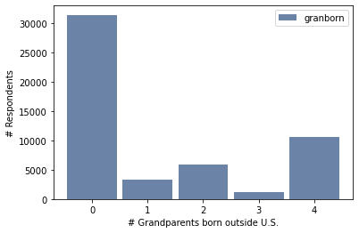
Variables
GRANBORN: How many grandparents were born outside the US?
0, 1, 2, 3, or 4
For most of the analysis, this is separated in to 0 and >0, to represent those with and without grandparents who immigrated.
Minimum: 0.0 Median: 0.0 Maximum: 4.0 Mean: 1.2 Std. Dev. 1.6

Slide 4
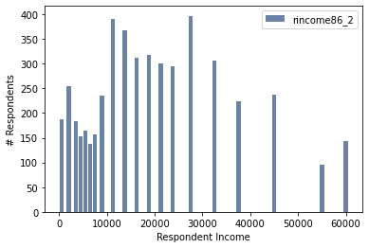
Variables
RINCOME86: Respondent's income
These data were provided in ranges (i.e. $1000 to 2999) so I averaged each range (2000 in this case) to get a value I could work with (RINCOME86_2)
Minimum: 500.0
Median: 16250.0
Maximum: 60000.0
Mean: 19491.2
Std. Dev. 14629.7

Slide 5
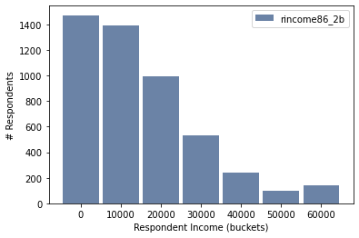
Variables
RINCOME86_2b: Respondent's income
Because there were more smaller groups at the low end, I created a new variable where I grouped income into equal-sized (10000), truncated buckets
Minimum: 0.0
Median: 10000.0
Maximum: 60000.0
Mean: 14924.9
Std. Dev. 14817.7

Slide 6
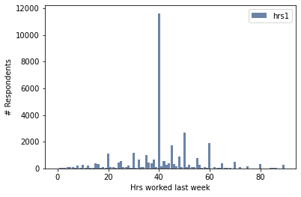
Variables
HRS1: Number of hours the respondent worked last week
The majority of people reported working 40 hours, which is a standard work week. There are also spikes at the 10 hour marks and even some 5 hour increments around 40.
Minimum: 0.0
Median: 40.0
Maximum: 89.0
Mean: 41.5
Std. Dev. 14.3

Slide 7
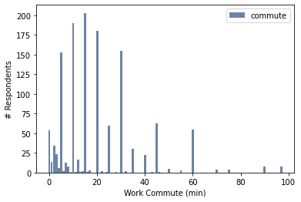
Variables
COMMUTE: Respondent's travel time to work
Commute times skew to the right and most reported times are in 5 minute increments. I may need to bucket these as well, but I'll leave them for now.
Minimum: 0.0
Median: 15.0
Maximum: 97.0
Mean: 20.2
Std. Dev. 17.1

Slide 8
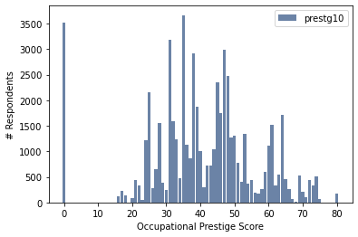
Variables
PRESTG10: Occupational Prestige Score
A score used to rate a job based on its deemed worthiness.
Minimum: 0
Median: 40.0
Maximum: 80
Mean: 40.5
Std. Dev. 16.3

Slide 9
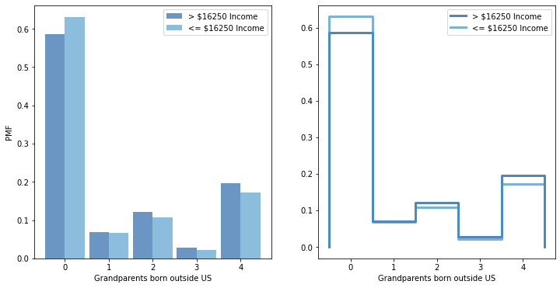
PMF
Dividing the data into two roughly equal groups divided at the median income, I compared income of individuals with different numbers of foreign grandparents.
The data suggests that individuals with all four grandparents born in the US are more likely to have a lower income. Those with even numbers of immigrant grandparents are more likely to have a higher income.
Presumably the even numbered immigrant grandparents are more likely to have come to the US together.
If one grandparent immigrates and marries someone from the US, it would appear there is little impact on income.

Slide 10
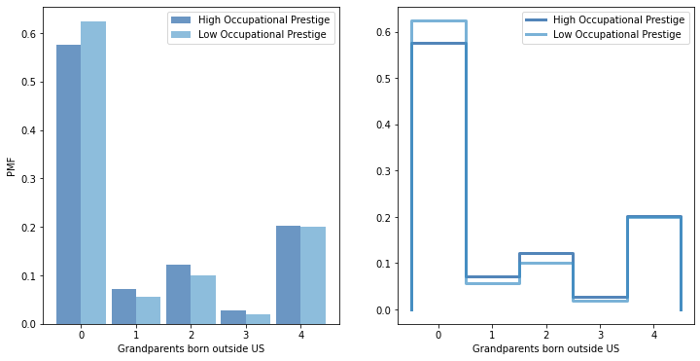
PMF (cont.)
I thought that occupational prestige would correspond pretty well with income, and to the extent that those with all US-born grandparents it is lower, this is true.
However, in this case we don't see as much difference between even and odd numbers of non-US born grandparents. Instead, it would appear that there is a larger effect with just 1, 2, or 3, but almost no effect when all 4 grandparents are not from the US.
This could be an interesting path to follow for further study.

Slide 11
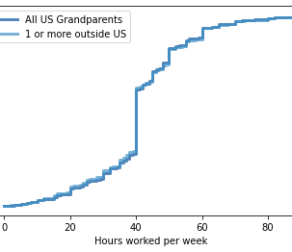
CDF
We can see the standard 40-hour work week indicated by the sharp incline at the 40-hour mark.
This CDF compares hours worked by individuals with all US native grandparents, compared to those with 1 or more grandparents not from the US.
Interestingly, it would appear that those with any immigrant grandparents are slightly more likely to work fewer than 40-hours in a work week, while there doesn't seem to be much difference above the 40-hour mark.

Slide 12
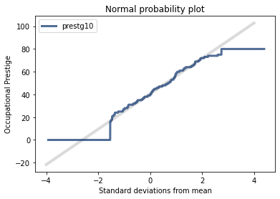
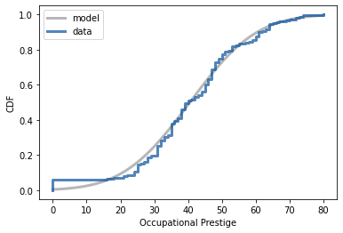
Analytical Distribution
Comparing the Occupational Prestige score to a normal distribution, we see that up until almost the 10th percentile there are more with very low occupational prestige, due to the large number of 0 scores. Then we see slightly fewer up until around the 40th percentile.
Except for the extreme lower and upper ends (0 and 80), the data for this variable seems to fit a normal distribution reasonably well.

Slide 13
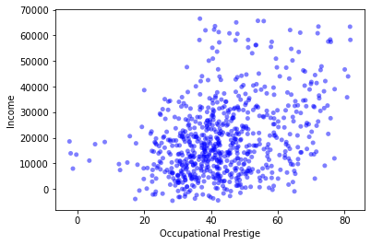
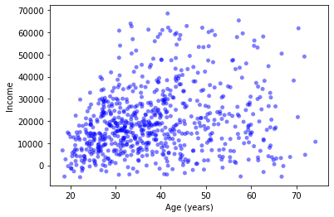
Scatter Plots
After trying several scatter plots with my data, the highest correlations I found were between Income and either Occupational Prestige or Age, both of which make sense because you would expect higher prestige jobs to pay more and you expect people to make more money the longer they are in the workforce.
For these two correlations, respectively:
Covariance: 73456 and 38241
Pearson's: 0.36 and 0.22
Spearman's: 0.32 and 0.22

Slide 14
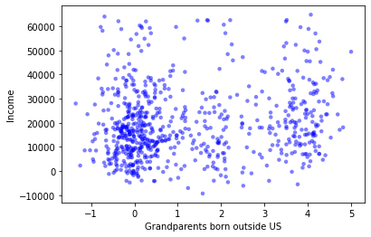
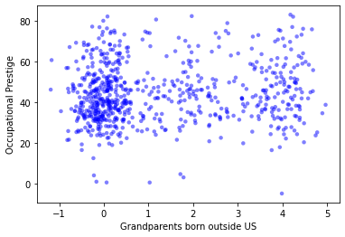
Scatter Plots (cont.)
The variable I am most interested in, Grandparents born Outside US, had less correlation overall. The highest correlations were with Income and Occupational Prestige.
This could be, in part, because the vast majority of the data had zero grandparents born outside the US.
For these two correlations, respectively:
Covariance: 3688 and 1.9
Pearson's: 0.15 and 0.081
Spearman's: 0.11 and 0.075

Slide 15
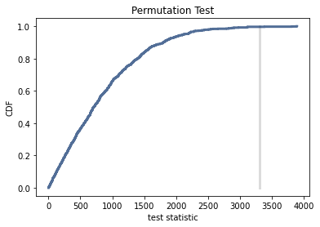
Hypothesis Testing
Testing a Difference in Means between the income of those whose grandparents were all born in the US and those with one or more grandparents born outside the US.
At < 0.5%, the p-value is significant, suggesting there is a legitimate difference between the groups.

Slide 16
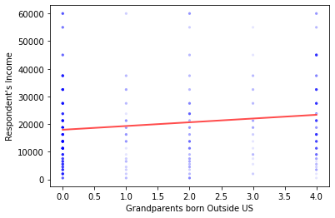
Regression Analysis
For each additional grandparent born outside the US, the mean income of respondent's increases by ~$1,350.00.
The difference in income between those with any granparents born outside the US and those whose grandparents were all born within the US is ~$3,300.00.
Intercept: 17955.31
Slope: 1351.37
P-value: 3.41 x 10⁻⁵
R²: 0.024
While the results are significant, where the grandparents are born does not explain much of the variation in income.

