Slide 1
Custom Correlation With AppDynamics

Slide 2
Transaction Correlation
Maintains the business transaction context across all java tiers and threads it travels through.
What does it take?
Decorating protocol headers to add transaction contextual information for remote calls
Saving transaction context against thread hand-offs to be picked up when the async segment starts
Will it change Application behavior?
If done the right way, absolutely not
Add only where there is extensibility – like HTTP headers, JMS properties etc.
Every ‘Transaction Segment’ reports its own metrics

Slide 3

Business Transaction – Fundamentally distributed
JMS/Messaging Bus
Tier4
First significant entry point on tier
Tier1
Tier2
Tier3
Definition extends through all tiers.

Slide 4
Every ‘thread’ of execution reports its own metrics
Originating Segment
Continuing Segment
External Web Services
JVM/CLR
JVM/CLR
Databases/Caches etc.
Continuing Segments
JVM/CLR
Messaging
JVM/CLR
Continuing Segment
Continuing Segment
onSegmentEnd – Report KPIs for ‘BT ID + Caller Chain’
Originating Segment – Caller Chain ‘null’
Continuing Segment – Inherits Caller chain from header or in-process map
Notes:
[appId=121*btid=8623*snapenable=True*guid=a78c8e82-482d-4449-81d5-1efeaee33b32*exitguid=1*cidfrom=224*etypeorder=WCF*cidto={[UNRESOLVED][17346]}]

Slide 5

Typical Cross JVM Calls
Application Protocol – JMS *
Transport Protocol/s
RMI / TCP / HTTP
.
Application Protocol – Web Services
Transport Protocol – HTTP *
.
Custom Backend Calls
Transport Protocol – HTTP *
.
* - Correlation Medium.

Slide 6
Correlation in HTTP.
Method | URL | Version
Request Line
Header Field-Name
Header Value
Headers –
Extensible by definition.
Do not Contain Application Data.
Header Field-Name
Header Value
Body
Request Body
Adding Custom Headers to carry transaction information is safe if
You don’t use any well-understood header names like ‘Accept-Language’.
The content of the header value is ‘HTTP-safe’.

Slide 7
How does it work? – HTTP.
Client
Application Protocol – Web Services
Transport Protocol – HTTP *
.
Carries forward the same transaction context.
HTTP call
AppDynamics Byte Code Interceptor on
The HTTP transport layer – adds a safe header which uniquely identifies this transaction. - The controller reconstructs the flow.
Use the decoration word
AppDynamics Byte Code Interceptor on the servlet – reads the header with the information.

Slide 8
Correlation in JMS
JMSDestination
Headers – Predefined – Not Extensible.
JMSPriority …
Property Name
Property Value
Message Properties–
Extensible by definition
Property Name
Property Value
Body
Message Body
Adding Custom Message Properties to carry transaction information is safe if
You don’t overwrite any existing property names and choose a unique name
The content of the property value is valid content.

Slide 9
How does it work? - JMS
Client
Application Protocol – JMS
Carries forward the same transaction context.
JMS call
AppDynamics Byte Code Interceptor on
The JMS Message sender – adds a safe header which uniquely identifies this transaction.
AppDynamics Byte Code Interceptor on the Message Receiver– reads the header with the information.

Slide 10
Correlation – Big Picture
Controller
2.Controller pieces together transaction flow from the agent data.
1.Upload information with the same transaction identifier

Slide 11
What about custom correlation?
There is an easily-defined method call to configure as an exit point (sending side).
There is a method call where one of the parameters or a return value exposes the payload object, and that method call occurs during execution of the exit point (sending side).
There is a method call where one of the parameters or a return value exposes the payload object, and that method call occurs before the entry point is executed (receiving side).
There is an easily-defined method call to configure as a POJO entry point (receiving side).

Slide 12
Steps to configure Custom Correlation
Identify Sender and Receiver methods
Configure a custom Exit Point and POJO Entry Point
Configure the Sender to Decorate the Exit Point
Configure and Identify Validation methods
Configure the Receiver to Read the Entry Point
Configure and Identify Validation methods
Put your feet up
To Consider?
Why not just copy config on all node?
Why do we need a validator?

Slide 13
Sending Method
See in IDE

Slide 14
Receiving Method
See in IDE

Slide 15
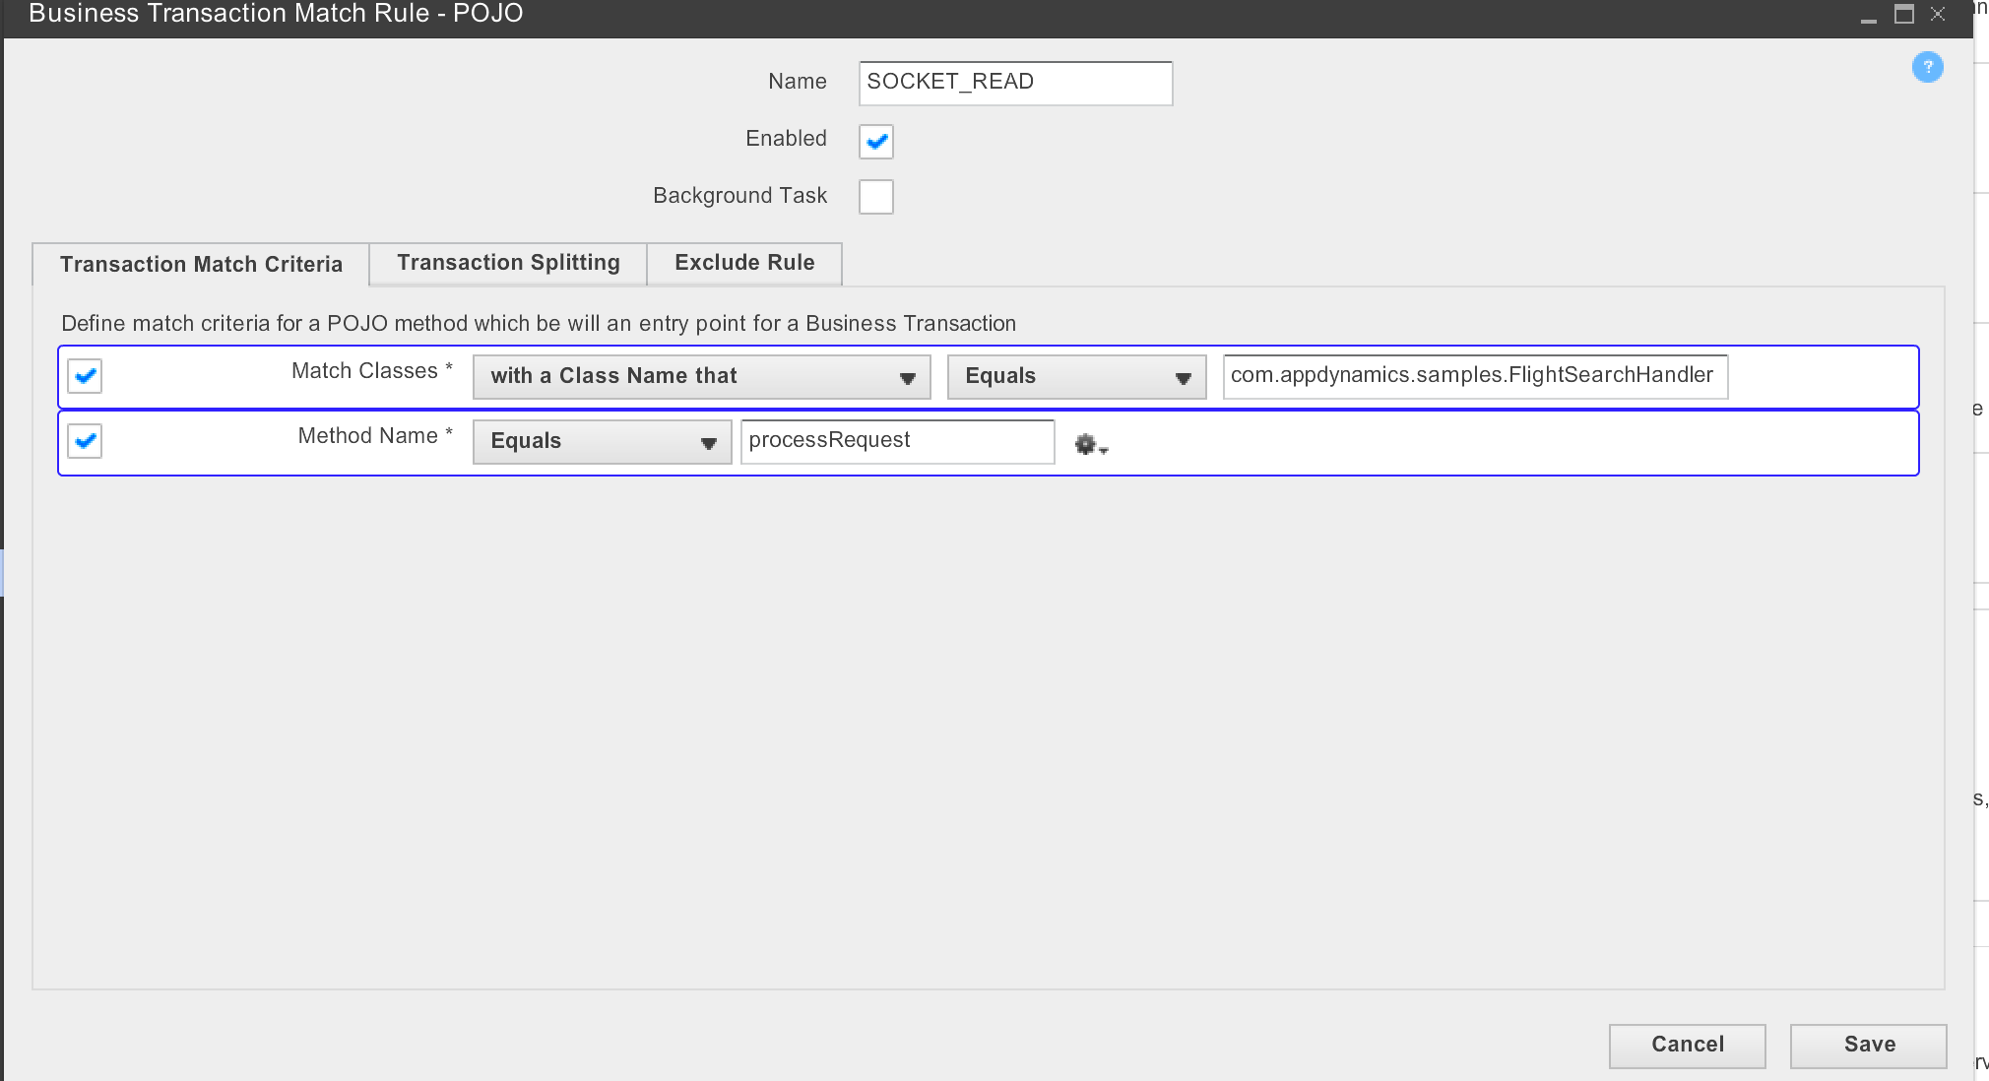
Configure Custom Exit Point
Create a POJO Rule on FlightSearchHandler.processRequest method

Slide 16
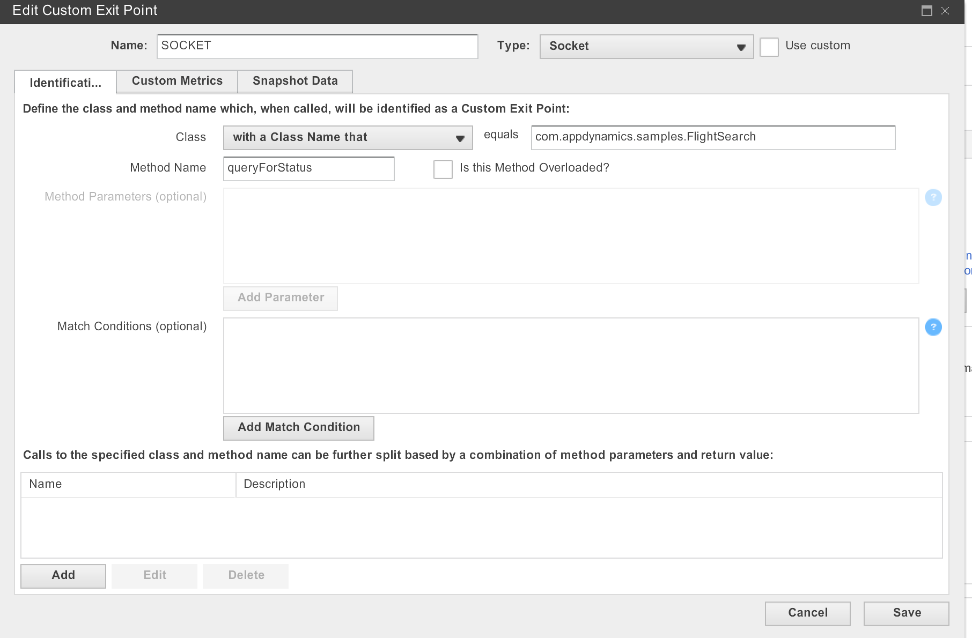
Configure Custom Entry Point
Create a custom Entry point for FlightSearchHandler.processRequest

Slide 17
Custom Receiver
<custom-correlation-config>
<custom-incoming>
<intercept-method match-class="matches-class" class-name="java.io.ObjectInputStream" method-name="readObject"/>
<correlation-payload-pointer type="return-type" operation="getter-chain" operation-config="this"/>
<correlation-payload-operation method="get" payload-class-name="java.util.HashMap" validation-key="RequestId" key-param-type="java.lang.Object" value-param-type="java.lang.Object"/>
</custom-incoming>
</custom-correlation-config>

Slide 18
Custom Correlation Sender
<custom-correlation-config>
<custom-outgoing>
<intercept-method match-class="matches-class" class-name="java.io.ObjectOutputStream" method-name="writeObject"/>
<correlation-payload-pointer type="param" param-index="0" operation="getter-chain" operation-config="this"/>
<correlation-payload-operation method="put" payload-class-name="java.util.HashMap" validation-key="RequestId" validation-method="get" key-param-type="java.lang.Object" value-param-type="java.lang.Object"/>
</custom-outgoing>
</custom-correlation-config>

Slide 19
Split Transaction and Marker Interceptors

Slide 20
Marker Interceptors
“Marks" the start of the timing for a transaction, but it doesn't actually correlate a transaction.
Custom correlation interceptors
Knows that if a transaction is "split" it should have been marked previously (first half of split) and therefore a transaction should be started when doing correlation (second half of split).

Slide 21
Example
public Map<String, String> receiveData() throws IOException, ClassNotFoundException {
getSomeEJB().doBusinessMethod();
getAnotherEJB().doBusinessMethod();
//start txn
ConcurrentMap<String, String> payload = (ConcurrentMap<String, String>)getInputStream().readObject();
getYetAnotherEJB().doBusinessMethod();
return payload;
}

Slide 22
Marked Interceptor (Split)
<marker-intercept-method match-class="matches-class" class-
name="com.appdynamics.sample.SocketReceiver" method-name="receiveData"/> <intercept-method match-class="matches-class" class-name="java.io.ObjectInputStream" method-
name="readObject"/>
<correlation-payload-pointer type="return-type" operation="getter-chain" operation-config="this"/>
<correlation-payload-operation method="get" payload-class-name="java.util.concurrent.ConcurrentHashMap"
split-transaction="true" validation-key="Custom-Header" key-param-type="java.lang.Object" value-param-type="java.lang.Object"/>
Notes:
In this example, the transaction time starts when the receiveData() method is called, but the transaction only starts when the readObject() method is intercepted and correlation is done. Thus no data from the first two EJB methods will be added to any snapshots. The split-transaction="true" attribute is necessary in this case, otherwise no transaction will be started and snapshots will not be correlated.

