Slide 1
Methods in Cultural Evolution
Part 2 – Spatial and cultural non-independence
Scott Claessens
August 2025

Slide 2
Part 1 – Introduction to causal inference
Part 2 – Spatial and cultural non-independence
Part 3 – Dynamic phylogenetic models

Slide 3
Agenda
Example: temperature and spicy food across cultures
Spatial non-independence
Cultural non-independence
Statistically controlling for non-independence

Slide 4
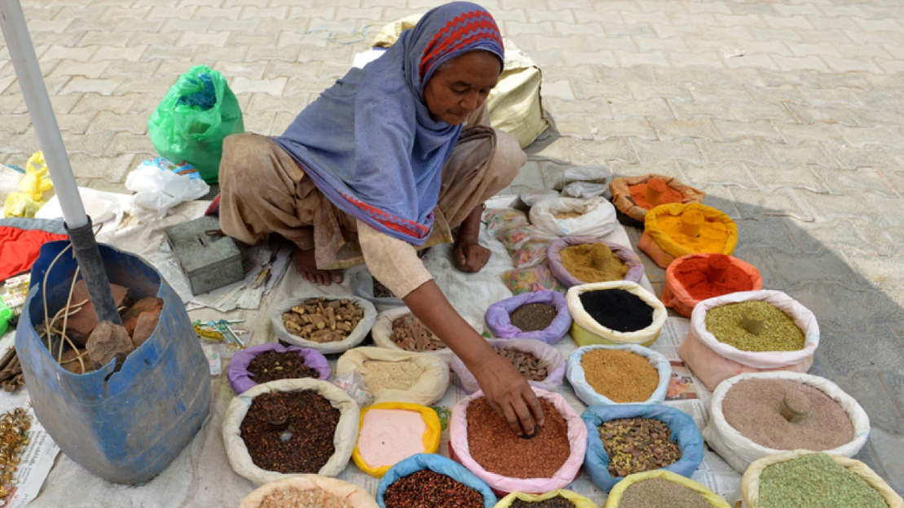

Slide 5
Adaptive cuisine hypothesis:
Cuisines from hot regions use more spices to counteract the greater risk of food spoilage

Slide 6
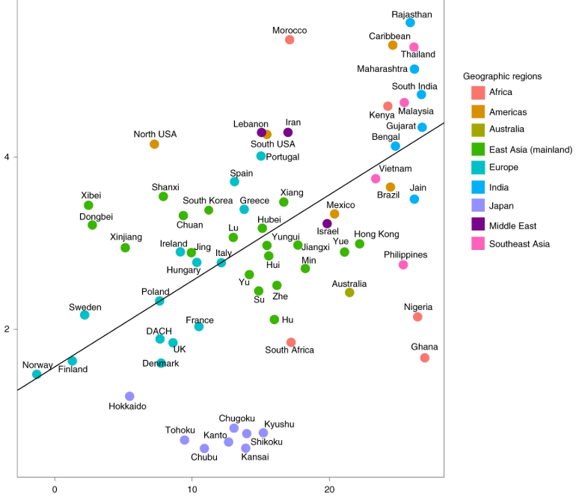
Spice use in recipes
Mean annual temperature

Slide 7
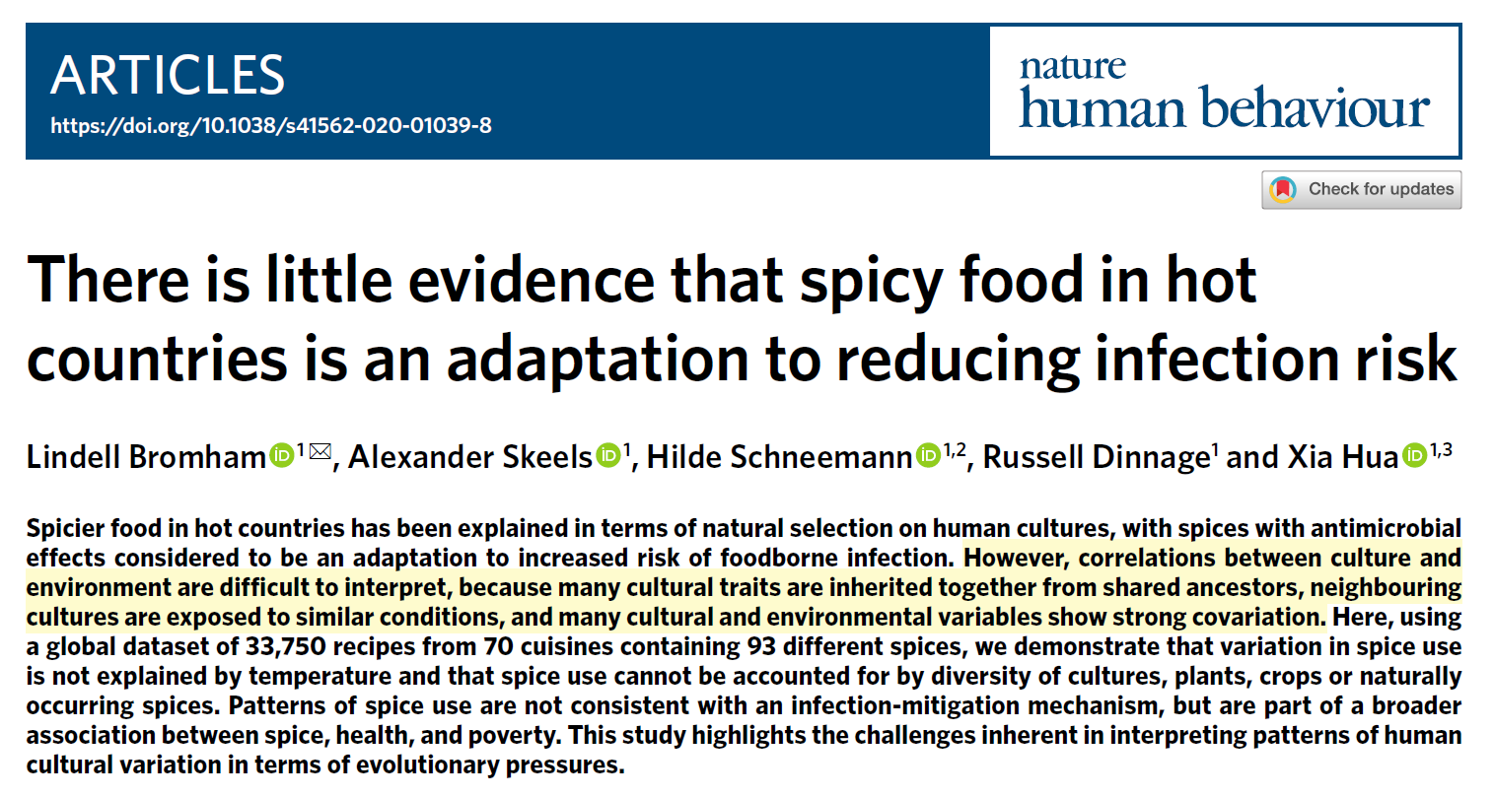

Slide 8
Temperature
Spice use
U
Spatial proximity

Slide 9
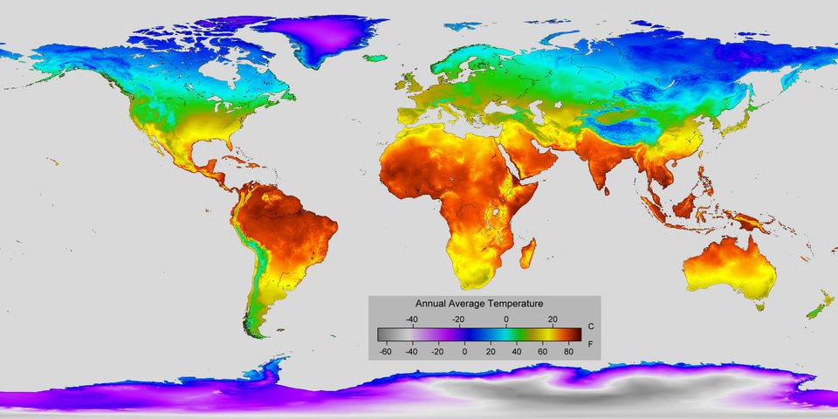
Spatial non-independence
Neighbouring regions are exposed to similar ecological conditions
Cultural traits can diffuse to neighbouring regions

Slide 10
Temperature
Spice use
U
Cultural relatedness

Slide 11
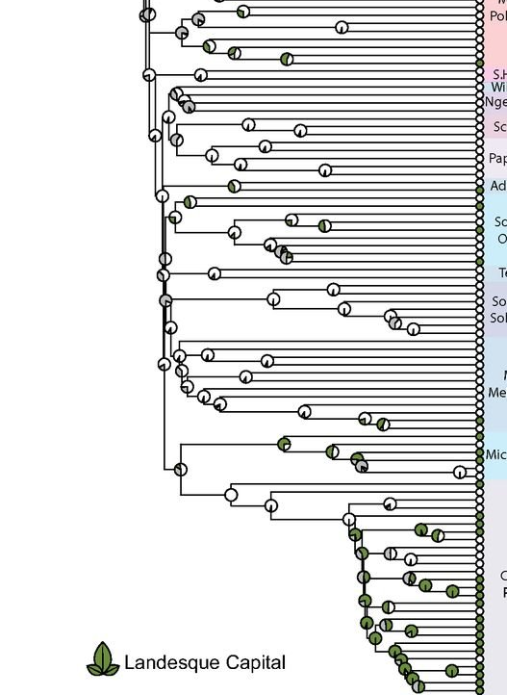
Cultural non-independence
Cultural traits can be inherited together from shared ancestors
More recently, similarities between colonial settlements and colonisers
Can create statistical associations even if variables are not functionally related

Slide 12
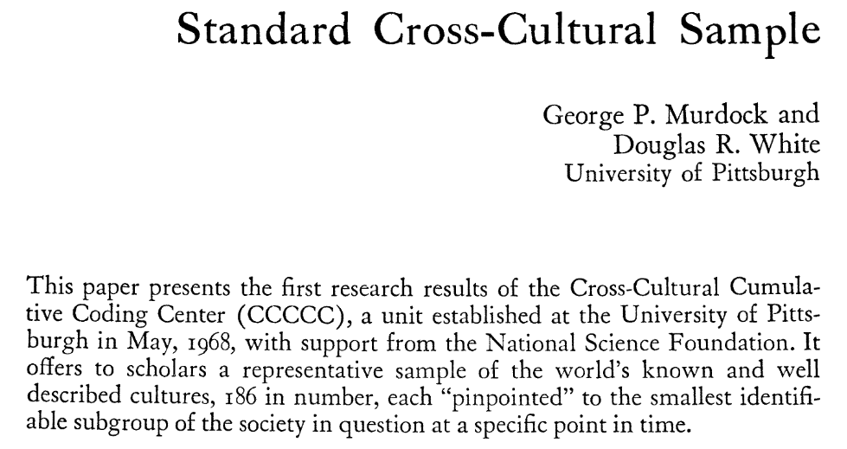

Slide 13
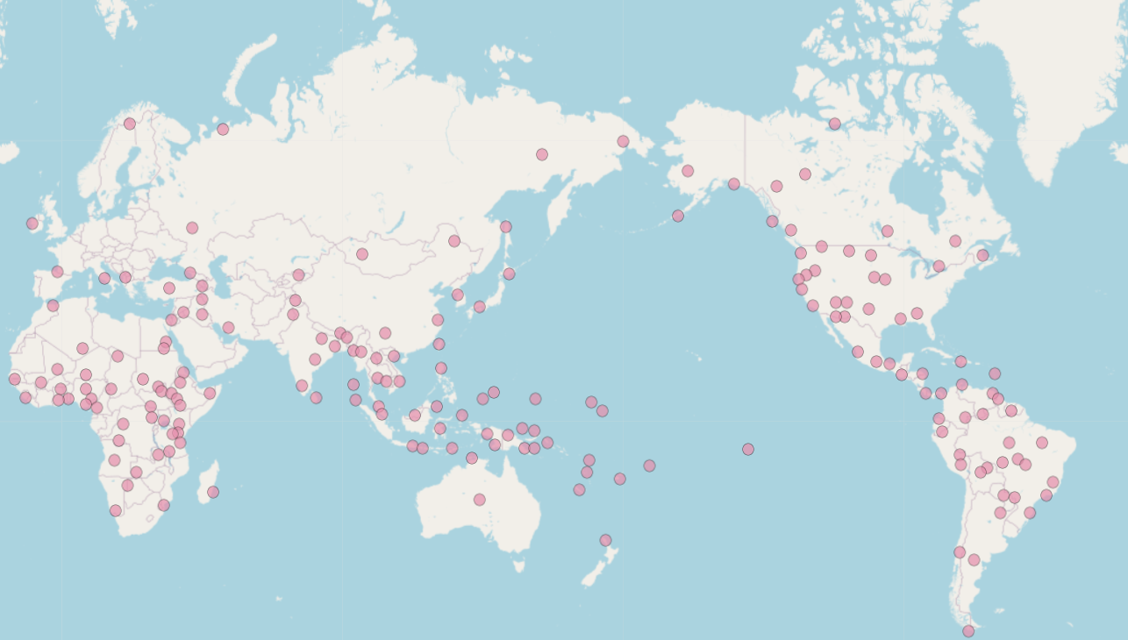

Slide 14
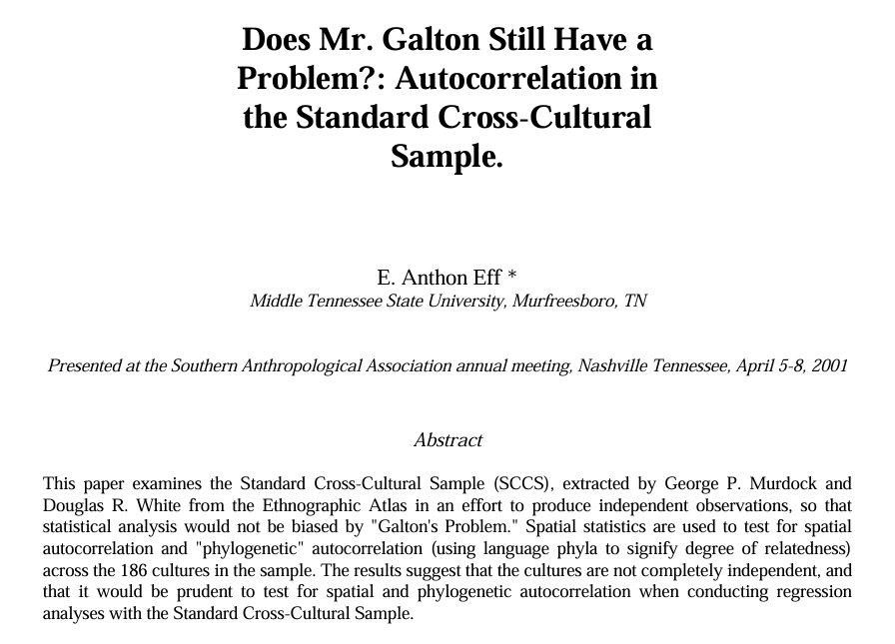

Slide 15
X
Y
U
Spatial proximity
Cultural relatedness

Slide 16
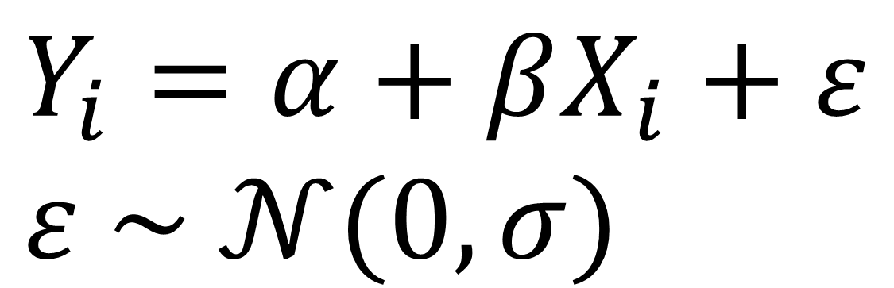
$$Y_{i}=α+βX_{i}+ε \\ ε \sim 𝒩(0, σ)$$

Slide 17
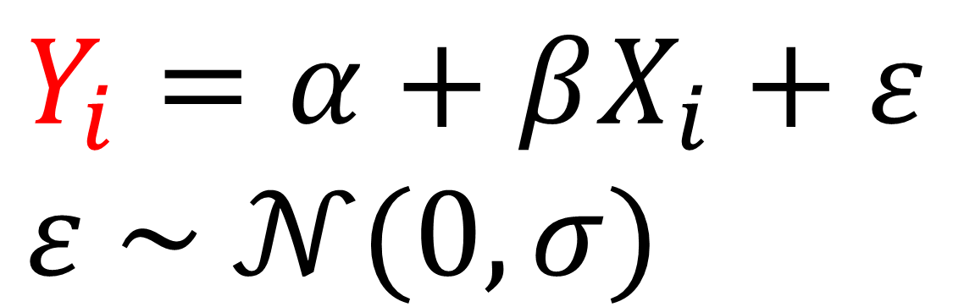
outcome variable
$$Y_{i}=α+βX_{i}+ε \\ ε \sim 𝒩(0, σ)$$

Slide 18
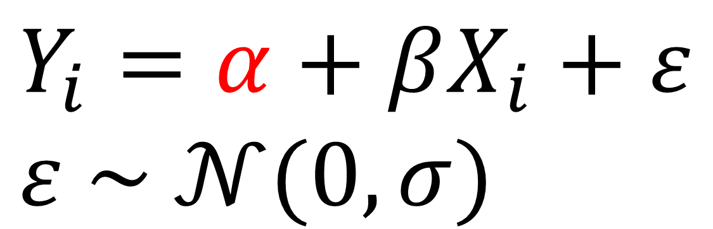
intercept
outcome variable
$$Y_{i}=α+βX_{i}+ε \\ ε \sim 𝒩(0, σ)$$

Slide 19
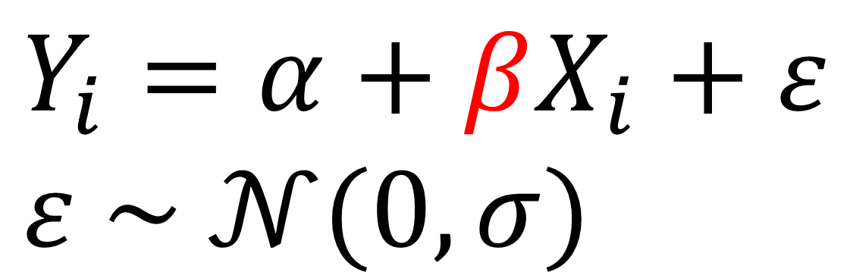
intercept
outcome variable
slope
$$Y_{i}=α+βX_{i}+ε \\ ε \sim 𝒩(0, σ)$$

Slide 20
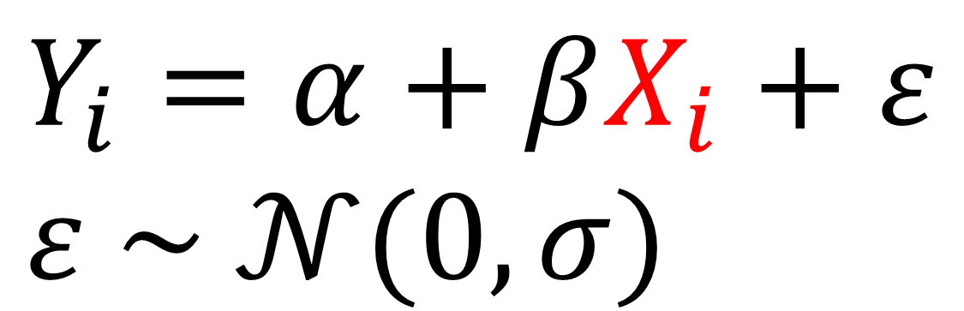
intercept
outcome variable
slope
predictor variable
$$Y_{i}=α+βX_{i}+ε \\ ε \sim 𝒩(0, σ)$$

Slide 21
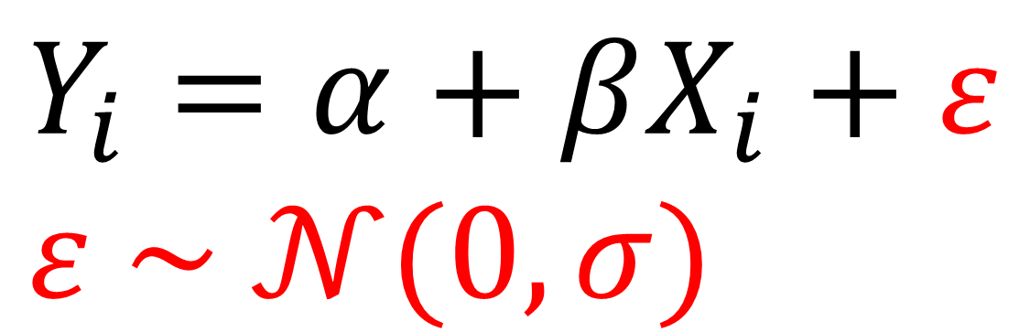
intercept
outcome variable
slope
predictor variable
$$Y_{i}=α+βX_{i}+ε \\ ε \sim 𝒩(0, σ)$$
error term

Slide 22
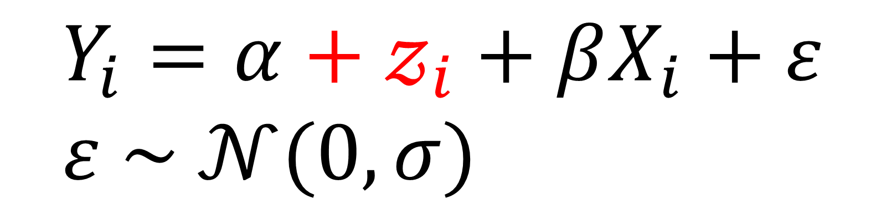
spatial / cultural
random intercept
$$Y_{i}=α+𝓏_{i}+βX_{i}+ε \\ ε \sim 𝒩(0, σ)$$

Slide 23
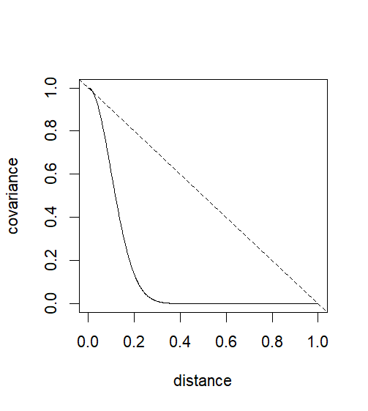

From distance to covariance…
Need to make assumptions about how spatial or cultural distances map onto covariance
e.g., exponentiated quadratic kernel for spatial distances
e.g., linear decay for phylogenetic distances (Brownian motion)
$$\text{exp}\text{(}{−x}^{2}∗50\text{)}$$

Slide 24
Spice use in recipes
Mean annual temperature

Slide 25
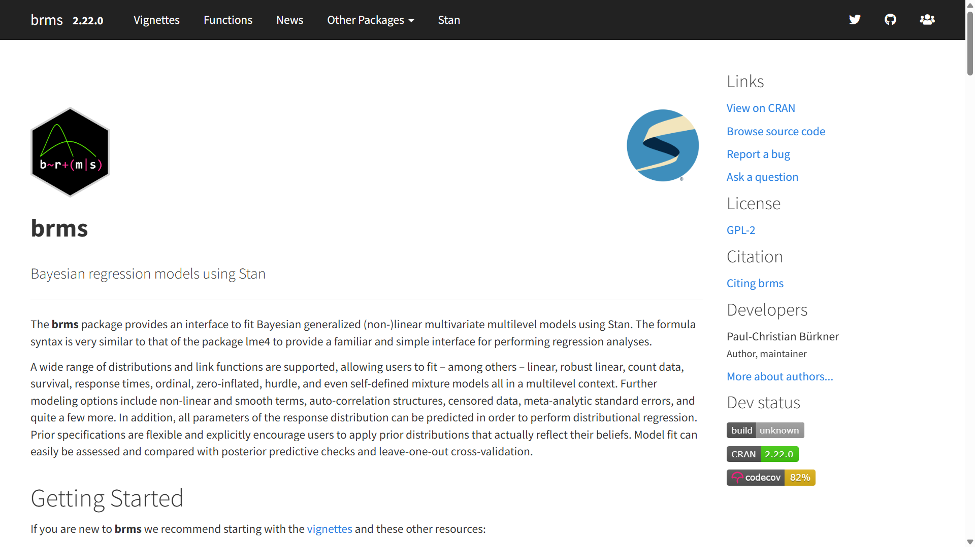

Slide 26
References
Bromham, L., Skeels, A., Schneemann, H., Dinnage, R., & Hua, X. (2021). There is little evidence that spicy food in hot countries is an adaptation to reducing infection risk. Nature Human Behaviour, 5(7), 878-891.
Eff, E. A. (2004). Does Mr. Galton still have a problem? Autocorrelation in the standard cross-cultural sample. World Cultures, 15(2), 153-170.
Murdock, G. P., & White, D. R. (1969). Standard cross-cultural sample. Ethnology, 8(4), 329-369.

