Slide 1
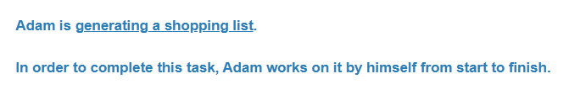


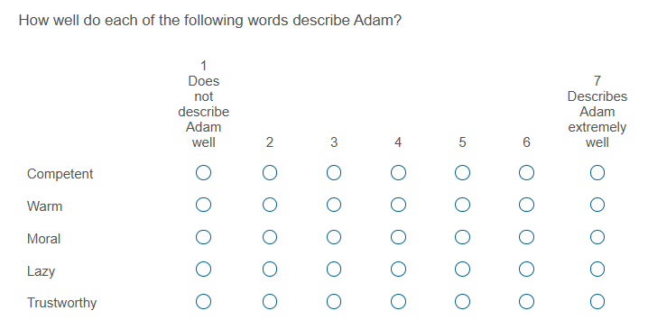
Control condition
AI outsourcing condition
Human outsourcing condition

