Slide 1
test

Slide 2
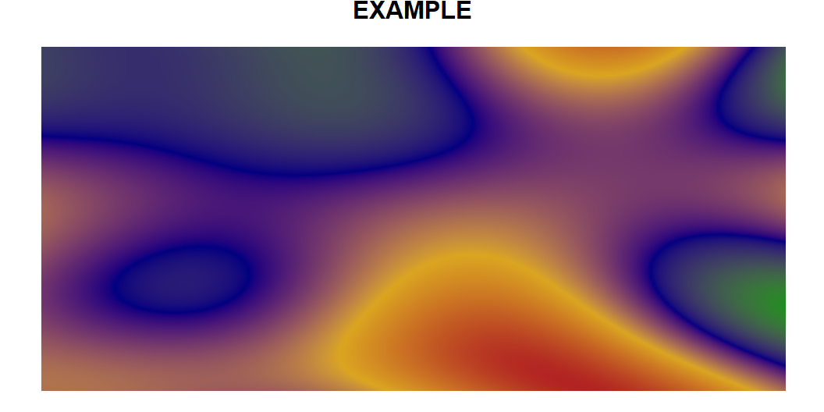
EXAMPLE
Here’s a simple example

Slide 3
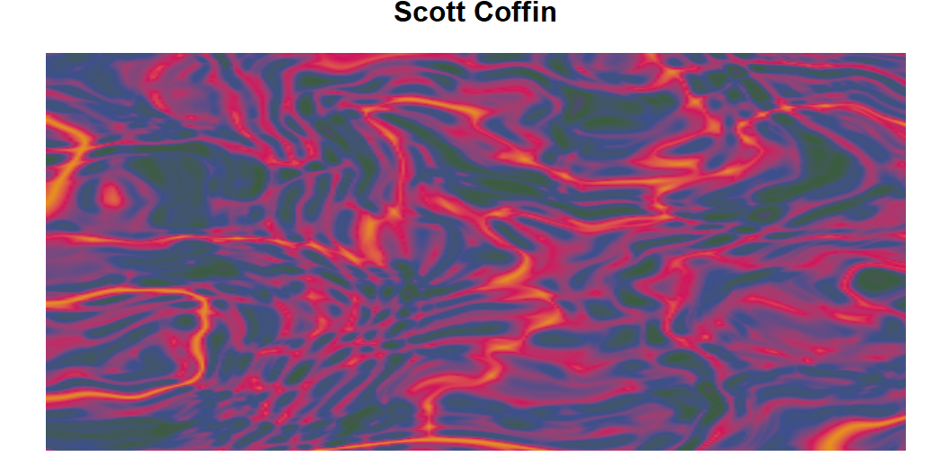
Scott Coffin
Here’s my contribution

Slide 4
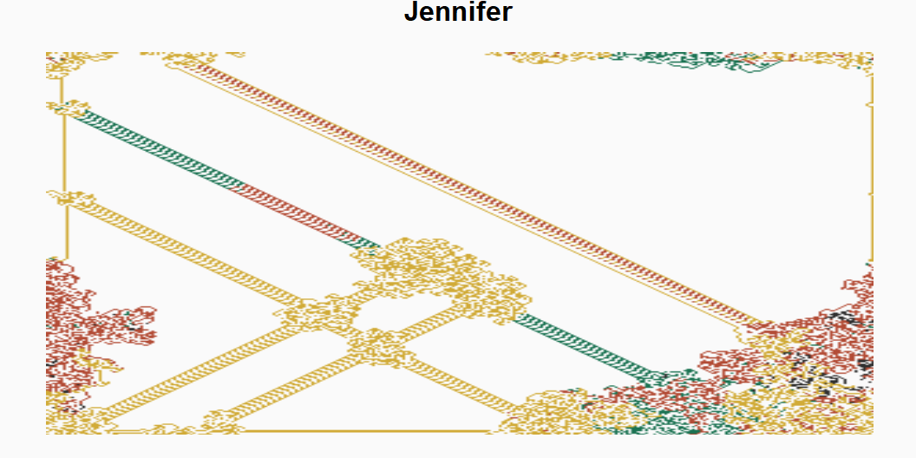
Paint smoke
You can simply replace the following with your personalized selections

Slide 5
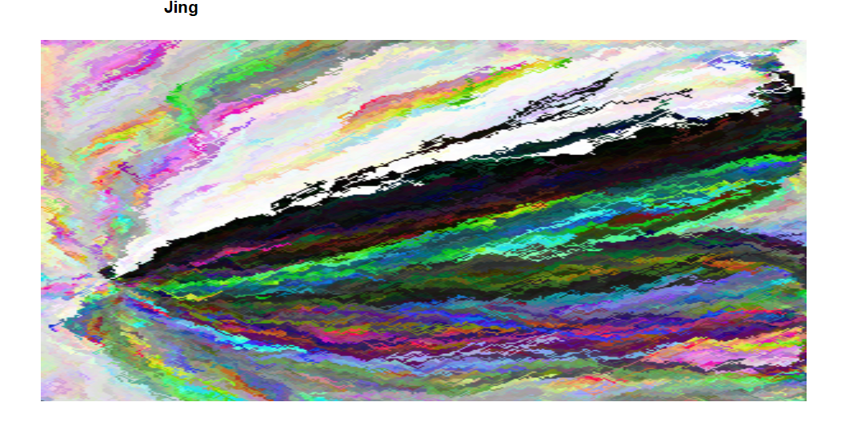

Slide 6
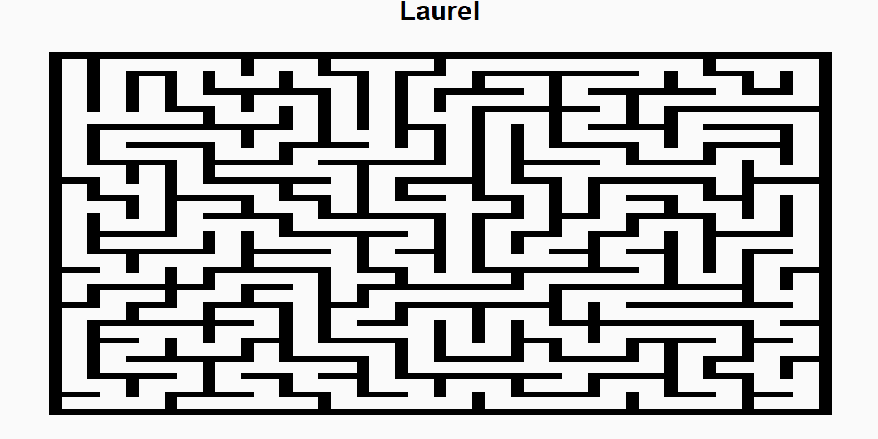

Slide 7
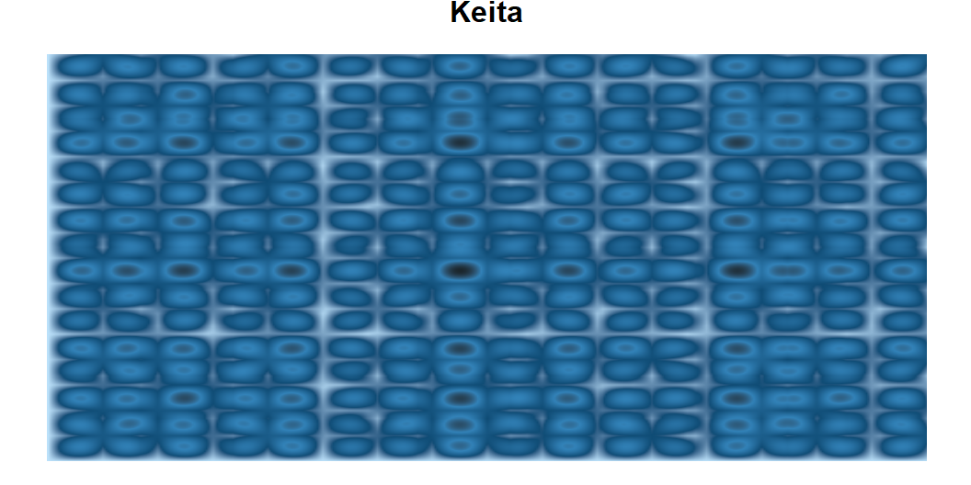

Slide 8
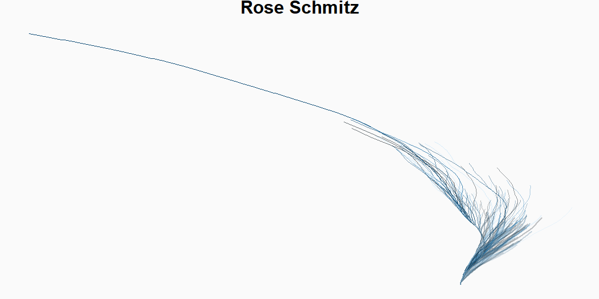

Slide 9
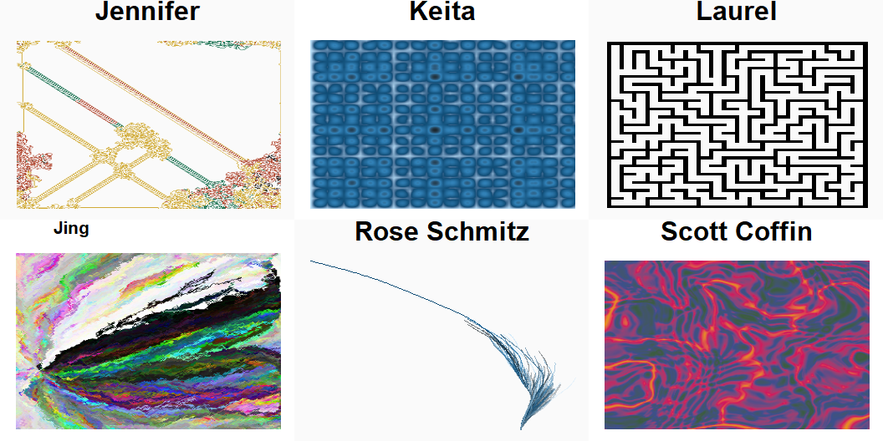
Our Mosaic

