Slide 1
Walmart Delivery Segmentation
Business Intelligence
September 2015
Kesavaraj Annadorai
Scott Davis

Slide 2
Walmart Store Segmentation
Objective
Goals
Approach
Find stores with opportunities to reduce the OOS Rate to 3%
Separate data into groups
Look at characteristics
Narrow down stores with greater priority
Segment data based on these variables:
- Average cases delivered per week
- Total footage
- OOS rate %
Characteristics:
- Predominant delivery schedule days
- Store number
- Store region
- Store type
- Average number of deliveries per mo/week

Slide 3
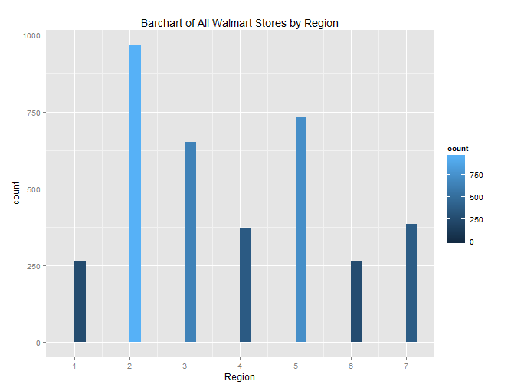
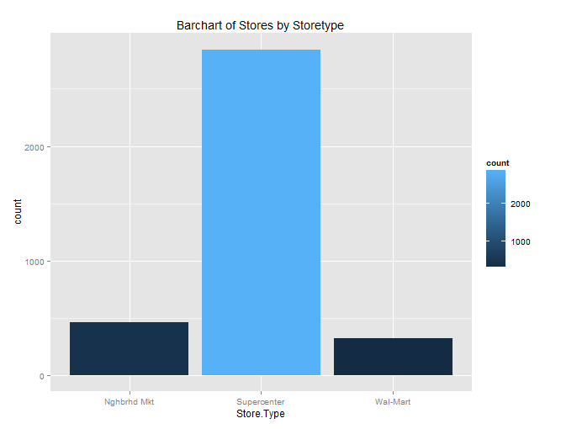
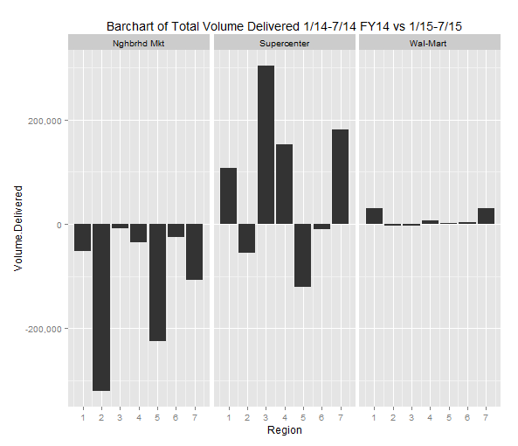
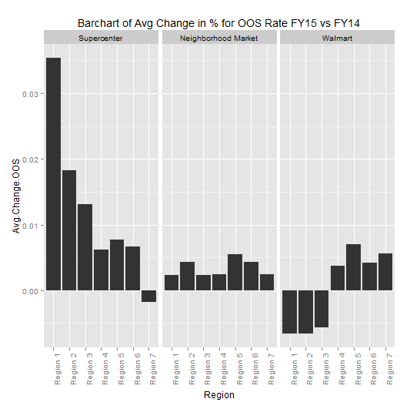
Problematic Behavior
Supercenters:
- Less cases delivered in two regions
-Avg change in oos rate increased

Slide 4
Segmentation Level 1
Cluster 1 - Priority
Cluster 2 – Non Priority
1296 out of 2831 stores
46%
1535 out of 2831 stores
54%
Segmentation #1
Segmentation Level 2
Areas of opportunity
- Priority and non-priority
Problematic Stores
Non-Problematic Stores
Stores with OOS Rate > 3% and Avg Cases Del > 400
394 stores
All other stores in cluster 1 besides problematic
902 stores
Segmentation #2
First action in cluster 1
- Problematic vs. Nonproblematic
Segmentation #3
Identify biggest action in cluster 1
- Feet constraint
Compare Wholesalers
Identify top wholesalers to work with
Segmentation Level 3
Total footage 70-100
126 stores

Slide 5
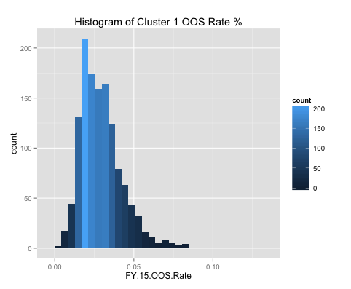
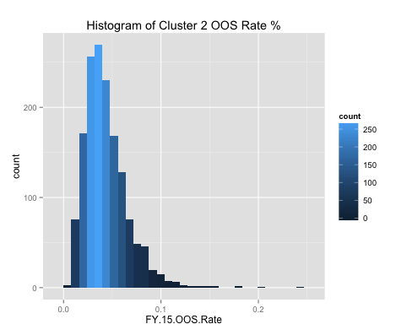
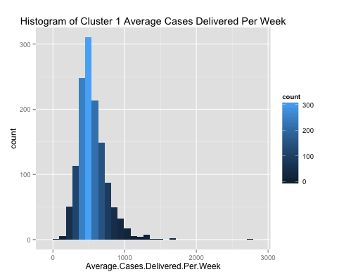
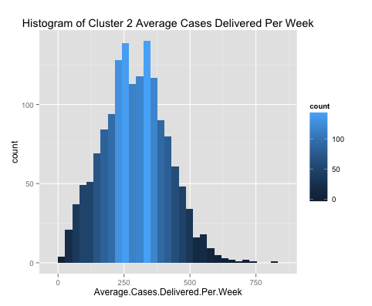
Segment Level 1
Clustering Method
Clustering Results
Focus
Not Focus
Clustering experiment for optimal number of clusters, variables, and algorithm type
- Step 1: Choose optimal number of clusters for two different clustering algorithms
- Step 2: Compared results between the two algorithms with evaluation metrics
Result:
- 2 clusters.
- Three variables: OOS rate%, average cases delivered per week, and total footage
- K-Medoid algorithm in cluster package from R’s CRAN library
Cluster 1 has higher percentage of stores with OOS Rates %’s and Average Cases Delivered
Focus:
- Cluster 1
40% of stores have OOS Rate > 3%
79% of stores have > 400 average cases delivered per week
30% of stores have an OOS Rate over 3% AND average cases delivered per week > 400
Not Focus:
- Cluster 2
69% of stores in cluster 2 have an OOS Rate over 3%
19% of stores have > 400 stores
14% of stores have an OOS Rate over 3% AND average cases delivered per week > 400
Opportunity to decrease OOS Rate
Opportunity to decrease OOS Rate
Stores > 400 cases
Stores > 400 cases
3% Threshold
3% Threshold
400 Store Threshold
400 Store Threshold

Slide 6
Segment Level 2
Cluster 1
Segment 2
Problematic Stores
Non-Problematic Stores
Purpose: Identifying first action area in cluster 1
Method: constrained OOS Rate and Average Cases Delivered
OOS Rate > 3% and Average Cases Delivered > 400
394 stores out of 1296
Characteristics:
- Region:
37% in 2
- Average deliveries per week:
68% 2 times a week
- Average deliveries per month
50% 9 times a month
- Delivery schedule
40% Tu/Fr deliveries
- 29% Footage 100 and under
All other stores
902 stores out of 1296
Characteristics:
- Region:
25% in 2
- Average deliveries per week
74% 2 times a week
- Average deliveries per month
54% 9 times a month
- Delivery schedule
38% Tu/Fr deliveries
- 66% Footage 100 and under

Slide 7
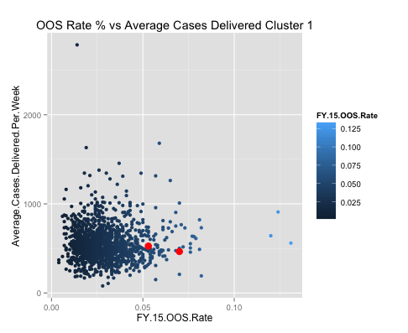
Low OOS Rate %, high volume
High OOS Rate %, high volume
Opportunity Area
Store.Nbr | Avg.Del.Per.Week | Avg.Del.Per.Mo | Total.Footage | Region | Del.Sch
3226 | 3 | 11 | 57 | 5 | Tu/Fr
Store.Nbr | Avg.Del.Per.Week | Avg.Del.Per.Mo | Total.Footage | Region | Del.Sch
442 | 2 | 9 | 68 | 5 | Tu/Fr
Low OOS Rate %, low volume
High OOS Rate %, low volume
Prioritize Stores In Cluster 1
30% of stores in cluster 1 have an OOS Rate over 3% AND average cases delivered per week over 400
Label - problematic stores

Slide 8
Top 5 Wholesalers By Volume In Segment Level 2
Cluster 1 Segment Level 2 - Top 5 Wholesalers In Problematic Stores By Volume
Store.Nbr | Whlsr.Nbr | Whlsr.Name | Region | FY.15.OOS.Rate | Total.Footage | Avg.Deli.Per.Week | Avg.Cases.Deli.Per.Week | Deli.Sch | Avg.Deli.Per.Month
1936 | 72175 | MARCHETTI DISTRIBUTING | 3 | 0.059 | 100 | 5 | 1680 | MoFr | 21
1859 | 30414 | ALFORD DISTRIBUTING | 7 | 0.037 | 48 | 2 | 1455 | TuFr | 9
1565 | 73394 | DELANEY DISTRIBUTORS | 4 | 0.049 | 89 | 4 | 1344 | We | 17
1909 | 33107 | TRY-IT DISTRIBUTING CO | 1 | 0.057 | 144 | 4 | 1314 | Mo | 17
5299 | 10922 | CITY BEVERAGES | 2 | 0.039 | 72 | 3 | 1310 | MoWeFr | 14

Slide 9
Segment 3
Same as segment 2
Segment 3
First Action Area In Problematic Stores
Non-Problematic Stores
Purpose: Identifying biggest action area in cluster 1
Method: constrain the Total Feet between 70-100
126 stores out of 394
Characteristics:
- Region:
34% Region 2
- Average deliveries per week:
72% 2 times a week
- Average deliveries per month
52% 9 times a month
- Delivery schedule
41% Tu/Fr deliveries
All other stores
902 stores out of 1296
Characteristics:
- Region:
25% in 2
- Average deliveries per week
74% 2 times a week
- Average deliveries per month
54% 9 times a month
- Delivery schedule
38% Tu/Fr deliveries
- 66% Footage 100 and under

Slide 10
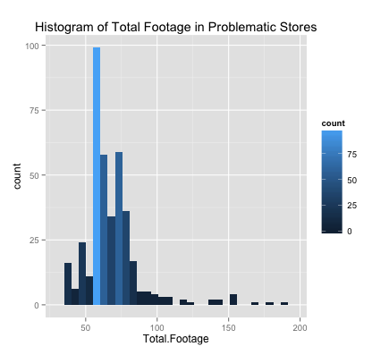
Prioritize Stores In Segment 2
32% of stores in segment level two have Total Foot range between 70-100
Footage Range 70 - 100

Slide 11
Wholesaler in Segment Level 3
Cluster 1 Segment Level 3 - Wholesaler in Problematic Stores Between 70-100ft. By Volume
Store.Nbr | Whlsr.Nbr | Whlsr.Name | Region | FY.15.OOS.Rate | Total.Footage | Avg.Deli.Per.Wk | Avg.Cases.Deli.Per.Wk | Del.Sch | Avg.Deli.Per.Month | Rank out of 125
5299 | 10922 | CITY BEVERAGES | 2 | 0.039 | 72 | 3 | 1310 | MoWeFr | 14 | 3
4332 | 10922 | CITY BEVERAGES | 2 | 0.05 | 76 | 3 | 791 | TuSa | 13 | 20
Cluster 1 Segment Level 2 - Wholesalers in Non-Problematic Stores By Volume
Store.Nbr | Whlsr.Nbr | Whlsr.Name | Region | FY.15.OOS.Rate | Total.Footage | Avg.Deli.Per.Wk | Avg.Cases.Deli.Per.Wk | Del.Sch | Avg.Deli.Per.Month | Rank out of 125
5420 | 10922 | CITY BEVERAGES | 2 | 0.016 | 203 | 3 | 1180 | MoWeFr | 14 | 7
817 | 10922 | CITY BEVERAGES | 2 | 0.029 | 197 | 3 | 803 | TuSa | 13 | 79
Opportunity
Compared Segment level 3 vs 2
Ranked top 125 wholesalers by volume
Same wholesaler has different OOS Rate % for four stores:
- Differs in delivery pattern only by predominant delivery schedule for FY15

