Slide 1
Google News Evaluation
Group 17

Slide 2
Overview of System
The interface that we decided to improve on is the Google news site, which can be found at https://news.google.ie. Google news beta was launched in 2002 and became officially available to everyone in 2006.
Currently the layout is very cluttered and doesn’t draw the users attention.

Slide 3
System Requirements
To name a few requirements currently in the system, the ability to sort news categorically depending on the topic and also the ability to update the latest news into the website for users to see.

Slide 4
User Group, Interaction Style, i/o devices
User Group - Anyone interested in latest news about current affairs, business, sports, politics and technology to name a few.
Interaction Style - Direct manipulation. Objects of interest are visible and user actions involve selecting, opening, closing and zooming actions on virtual actions.
Input Devices – Keyboard, Mouse, Touchpads
Output Devices – Computers, Tablets, Mobile Phones

Slide 5
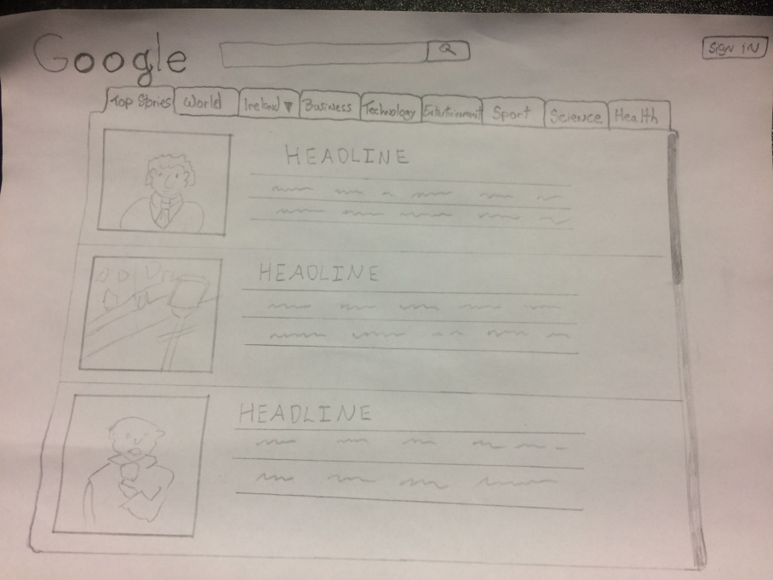
Low Fidelity Prototype
Good way to hammer out features
Current prototype doesn’t have much details

