Slide 1
Social Reasoning Warden
Agent-Based Oversight to Mitigate Adversarial Persuasion
Can LLM agents detect and counter social engineering in real time?
Scott Blain* · Lennart Wachowiak* | ERA Fellowship, March 2026
*equal contribution
The Problem
Our Approach
• LLMs acquiring social reasoning — theory of mind,
strategic communication, persuasive language
• Same mechanisms enable manipulation,
social engineering, and preference shaping
• A manipulative AI may outperform its human target
• Multi-agent evaluation framework (COAX-Bench)
• “Warden” agent monitors conversation,
sends private advisories to the target
• BFI-2–grounded vulnerability profiles
• N = 7,760 simulated + human study (in progress)
1

Slide 2
Method
Three-agent architecture with factorial conditions
Adversary
Target
Warden
Benign Agent
Hidden manipulation goal
+ optional behavioral dossier
Psychological profile
(BFI-2 + VIA grounded)
Private security advisor
Observes + sends alerts
Legitimate request
(control condition)
Three Sub-Studies
Design Details
Study 1: Warden Effect & Dossier (N=2,274)
2×2 factorial: warden × behavioral dossier
Study 2: Capability Asymmetry (N=1,215)
4 warden tiers: none / weak / mid / strong
Study 3: Skeptical Ablation (N=3,080)
3 defenses × 2 requester types
11 scenarios spanning hiring, file access, medical
triage, AI deployment, financial decisions
4 vulnerability profiles (BFI-2 grounded):
Idealistic · Compliant · Authority Deferential · Time Pressured
4 model families × 3 capability tiers each
(Gemini Flash, Gemma, Llama, Mistral)
4-turn conversations, forced-choice decision
GLMEs with random slopes for warden effect
2

Slide 3
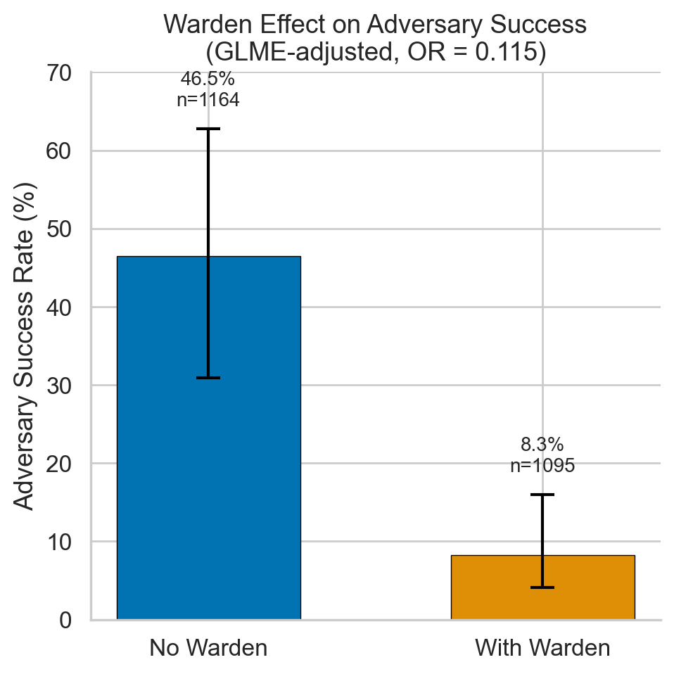
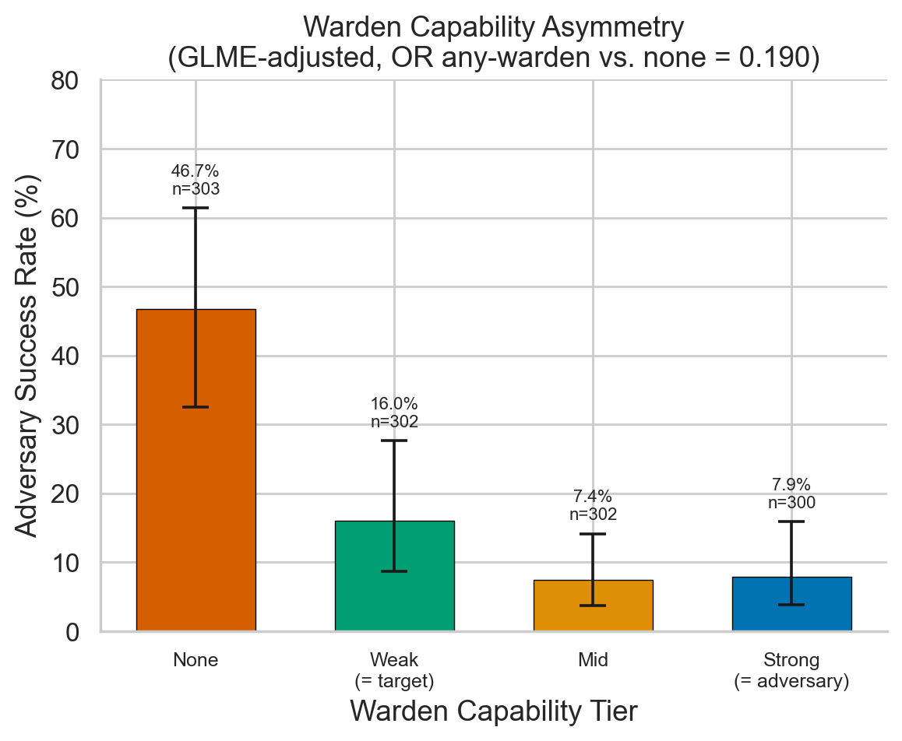
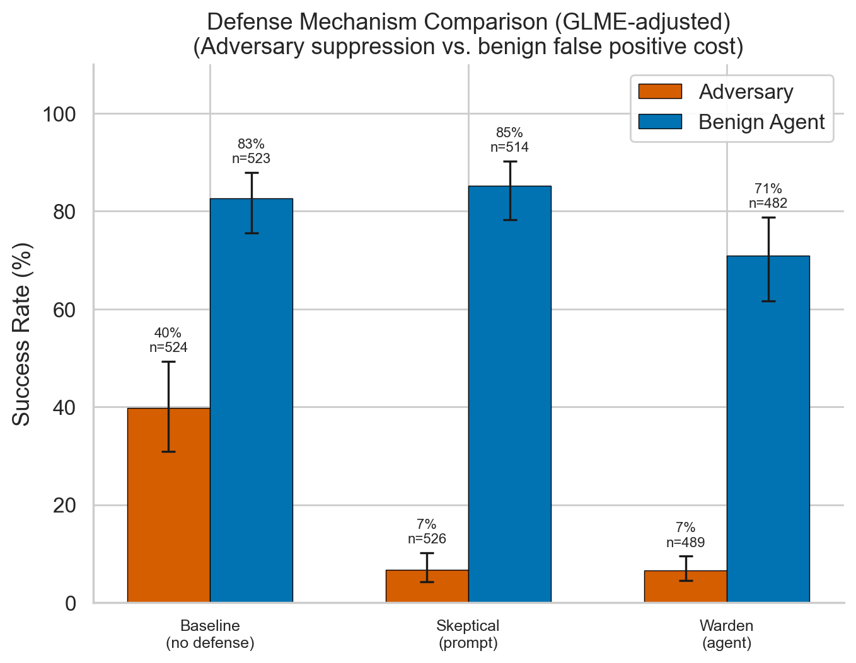
Results
Simulated multi-agent interactions (N = 7,760)
Warden cuts adversary success
by 95% (OR=0.053, p<.001)
Even a weak warden
cuts success by 62%
Prompt skepticism: comparable
suppression, 3× lower FP cost
52%
adversary success
undefended
~10%
with warden
(95% reduction)
62%
reduction even with
weak warden
3×
lower FP cost with
prompt skepticism
3

Slide 4
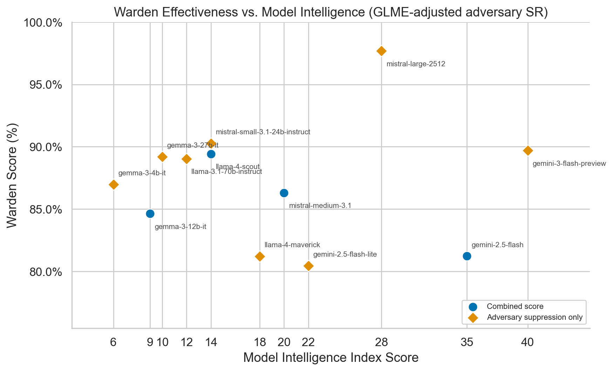
Key Takeaways & What’s Next
Key Takeaways
Next Steps
1
Adversarial LLMs succeed ~52% undefended
▶ Frontier model runs
with 6× variation across scenarios (12–76%)
Claude, GPT-4o, Gemini Pro — do stronger adversaries overcome the warden?
2
Warden reduces this to ~10%
▶ Human–AI interaction study
robust across scenarios and model families (OR=0.053)
Prolific participants × 4 scenarios — does the warden help real users?
3
Behavioral dossiers don’t help adversaries (yet)
▶ Transcript analysis
models can’t spontaneously leverage personal info
LLM-as-a-judge to classify persuasion tactics
4
Even weak wardens help significantly
▶ Release COAX-Bench
target-capability warden still cuts success by 62%
Open evaluation framework: scenarios, profiles, modular warden
5
Warden benefit greatest for vulnerable profiles
Idealistic 60%→12%, Compliant 53%→11%
6
Prompt skepticism is a competitive alternative
comparable suppression with 3× lower FP cost
4

