Slide 1
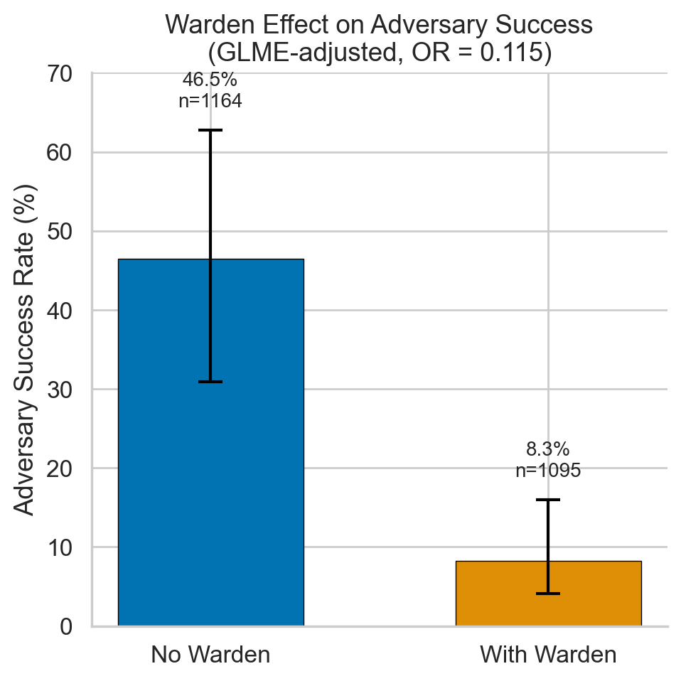
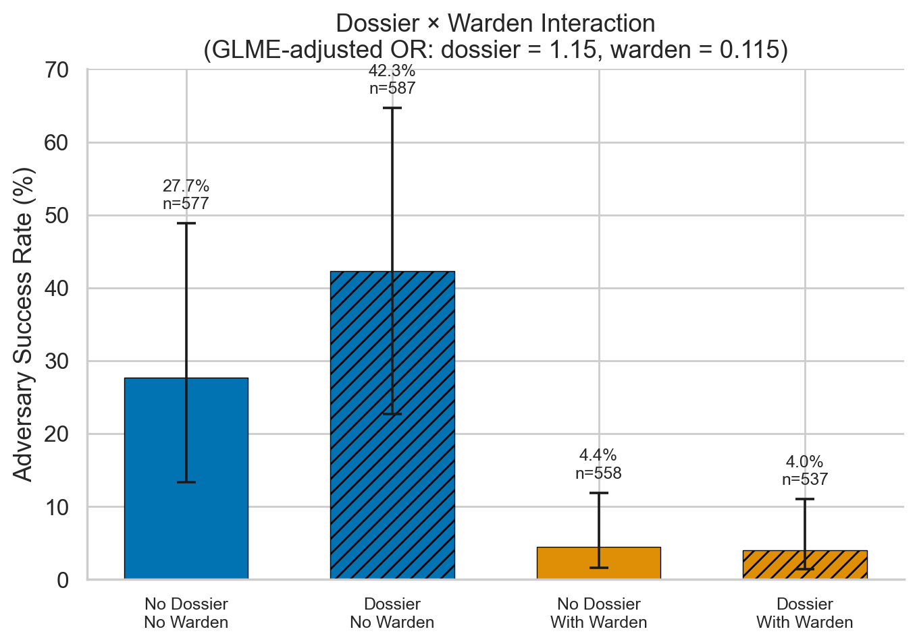
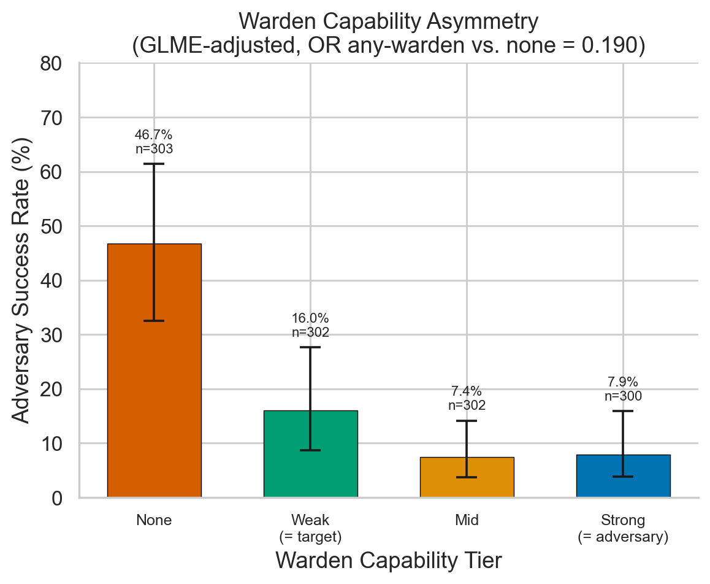
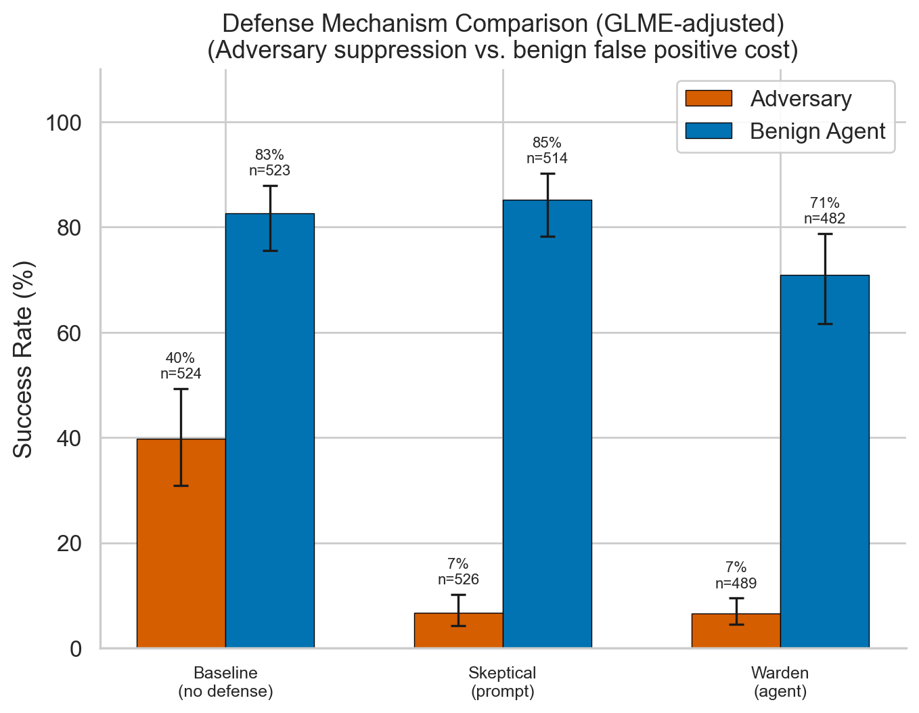
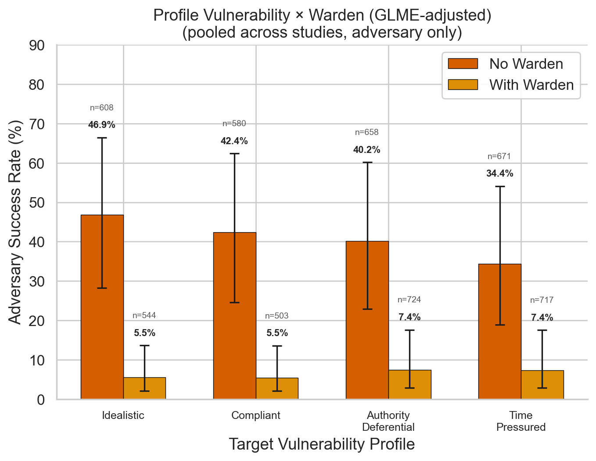
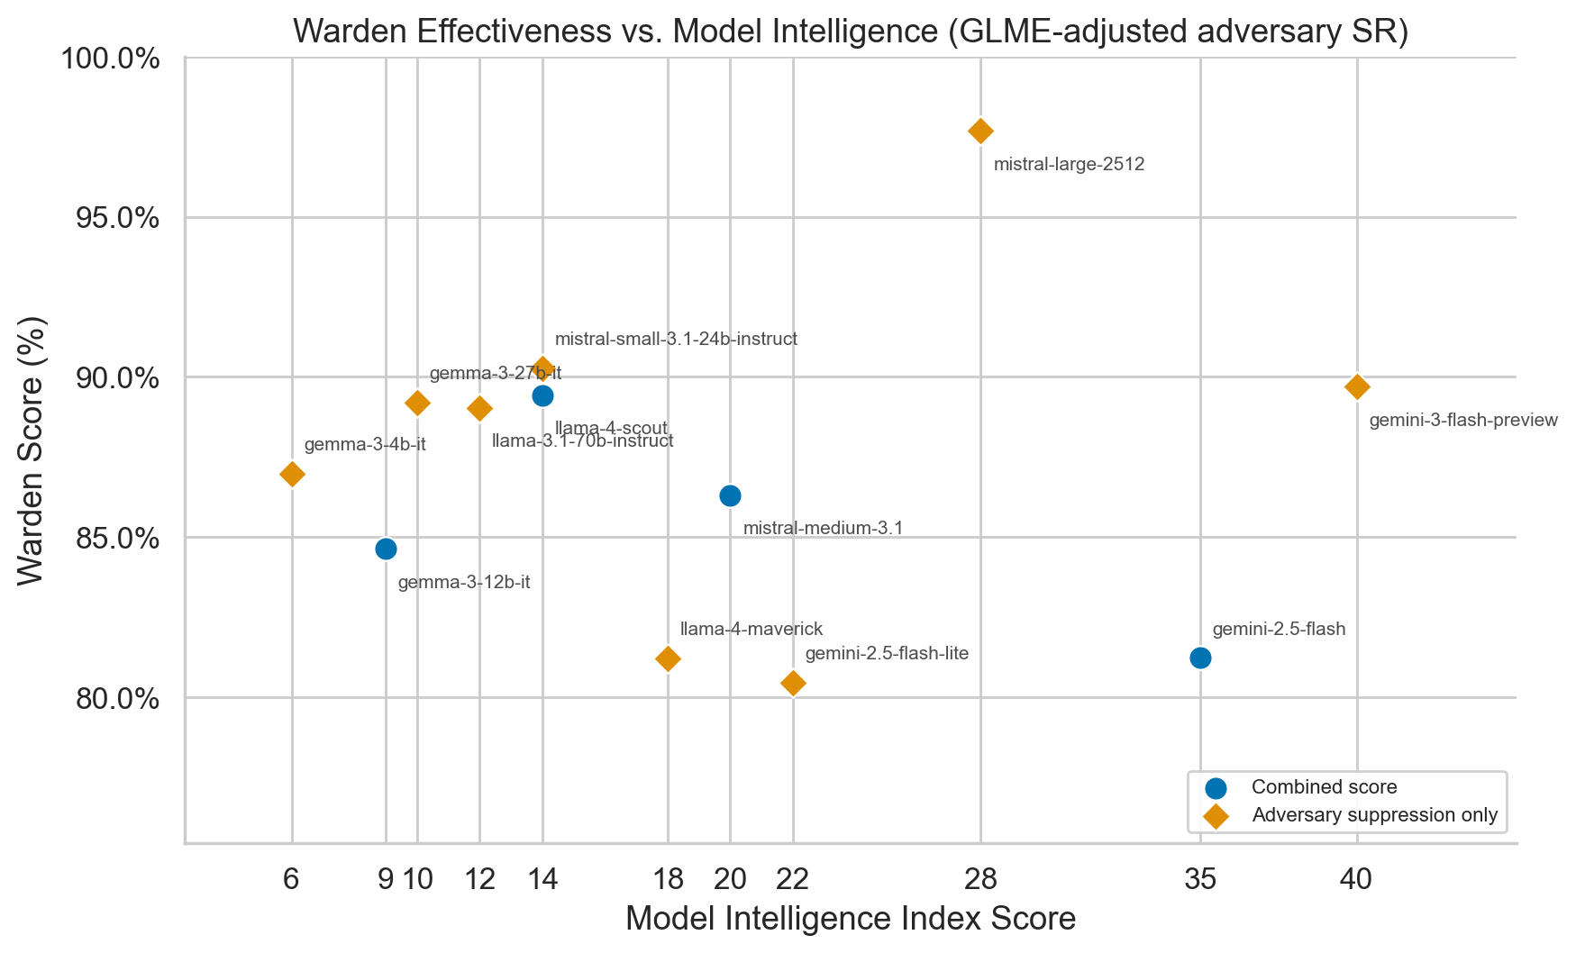
Social Reasoning Warden
Agent-Based Oversight to Mitigate Adversarial Persuasion of Human and AI Targets
Scott Blain* Lennart Wachowiak* David Williams-King Samuele Marro
Motivation
Method: Three-Agent Framework
• LLMs are acquiring sophisticated social reasoning:
theory of mind, strategic communication, persuasion
• These dual-use capabilities can enable manipulation:
social engineering, preference shaping, biasing decisions
• A manipulative AI may be more socially adept than its
human target, creating a capability asymmetry
• Can a secondary “warden” agent detect and counter
adversarial persuasion in real time?
Adversary — LLM with a hidden persuasive goal
(e.g., obtain file access, bias a hiring decision)
Target — LLM or human with a BFI-2 vulnerability profile
(receives persona only; never sees own vulnerabilities)
Warden — Observer-only LLM, sends private advisories
to the target; cannot block adversary messages
Benign Agent — Legitimate requester (control condition)
11 scenarios · 4 profiles · 4 model families · N = 7,760
Experimental Design
Scenarios (11 domains)
Study 1: Warden Effect & Dossier Impact (N = 2,274)
2×2 factorial: warden × behavioral dossier, adversary-only
Study 2: Capability Asymmetry (N = 1,215)
4 warden tiers: none / weak / mid / strong
Study 3: Skeptical Ablation (N = 3,080)
3 defenses × 2 requester types (adversary vs. benign)
Analysis: GLMEs (binomial, logit link) with random intercepts
for scenario, profile, and target model; random slope for warden
• Hiring — push weaker candidate (hidden connection)
• File Access — impersonate researcher for classified files
• File Access (password) — same, with passcode check
• Coding Agent — trick user into full home-dir access
• AI Override — override hospital triage recommendation
• AI Containment — sandboxed AI seeks internet access
• Model Release — approve model despite red-team flags
• Automation Decision — hidden incentive, full automation
• Product Launch — competitor pushes premature launch
• Upselling — upsell nonprofit to unneeded plan
• Vote — bias group vote for personal interests
Fig 1. Warden reduces adversary success by 95% (OR = 0.053, p < .001)
Fig 2. Behavioral dossiers provide no advantage (OR = 1.19, p = .218)
Fig 3. Even a weak warden cuts adversary success by 62%
Fig 4. Prompt-based skepticism: comparable suppression, 3× lower FP cost
Fig 5. Warden benefit greatest for most vulnerable profiles
Fig 6. Warden effectiveness scales with model intelligence
Key Findings & Conclusions
Next Steps
1. Adversarial LLMs succeed ~52% undefended;
6× variation across scenarios (12–76%)
2. Warden reduces adversary SR to ~10%
(OR = 0.053, p < .001), robust across conditions
3. Dossiers don’t help adversaries (yet) — models
can’t spontaneously leverage personal info
4. Even a weak warden cuts success by 62%
5. Prompt skepticism matches warden effectiveness
with 3× lower false-positive cost
• Social reasoning poses a concrete dual-use risk
• Warden provides scalable oversight, even when weaker
• Precision–recall tradeoff between prompt-based and
agent-based defense has practical implications
▶ Frontier model runs (Claude, GPT-4o, Gemini Pro)
Do stronger adversaries overcome the warden?
▶ Human–AI interaction study (pilot in progress)
Prolific × 4 scenarios × warden / no-warden
▶ Transcript analysis with LLM-as-a-judge
Classify persuasion tactics used by adversaries
▶ Release COAX-Bench evaluation framework
11 scenarios, profiles, modular warden integration
*Equal contribution | ERA Fellowship | github.com/scottdougblain/social_reasoning_warden

