Slide 1


HEARTS AND MINDS · HOMETEST OPERATING MODEL · CLINICIAN JOURNEY
Adam.
The patients
he cannot see
stay in surveillance.
Adam is a consultant urologist running a PSA Active Surveillance cohort at a large acute trust. He sees his patients on a quarterly cycle. Some miss appointments because of work, travel or caring responsibilities. Some drop out of surveillance entirely. The drop-outs are the patients he worries about most. This is the story of how the model lets him keep more patients in surveillance without his clinic growing.
Adam
A clinician's story through the operating model
Consultant urologist · PSA Active Surveillance
HomeTest Operating Model · Hearts and Minds
Commercial positions are agreed in principle and remain subject to the live procurement.

Slide 2
HEARTS AND MINDS · CLINICIAN JOURNEY
Adam's journey at a glance
1
The cohort
2
The drop-outs
3
The model's offer
4
First home prescriptions
5
Surveillance in flight
6
The clinic shape now
The patients in front of him
The clinic-only model's blind spot
Kit out, result back to him
Right patient, right cycle
Trends, not appointments
Time for the patients who need it
THE CLINICAL NORTH STAR
WHY THIS WORKS FOR HIM
Clinical accountability preserved. Reach extended. Clinic time freed for the patients who need it.
Reach, adherence, capacity. Three clinical wins in the same move.
Adam is not interested in a model that quietly removes him from the loop or sends raw numbers to patients without clinical interpretation. The result comes back to him first. He reads it against the PSA trajectory he is tracking. He decides what happens next. The model that earns clinician adoption is the one that protects clinical accountability rather than routing around it.
Reach. Patients the in-clinic service misses, rural travellers, shift workers, carers, the gradual drop-outs. Adherence. A kit at home does not get missed because of work, weather, transport or childcare. Capacity. Every routine quarterly monitoring done at home frees the slot for the patient who clinically needs the room. The pattern does not displace the clinical role. It changes which patients reach the clinic and why.
Adam · Hearts and Minds
Commercial positions are agreed in principle and remain subject to the live procurement.
2

Slide 3
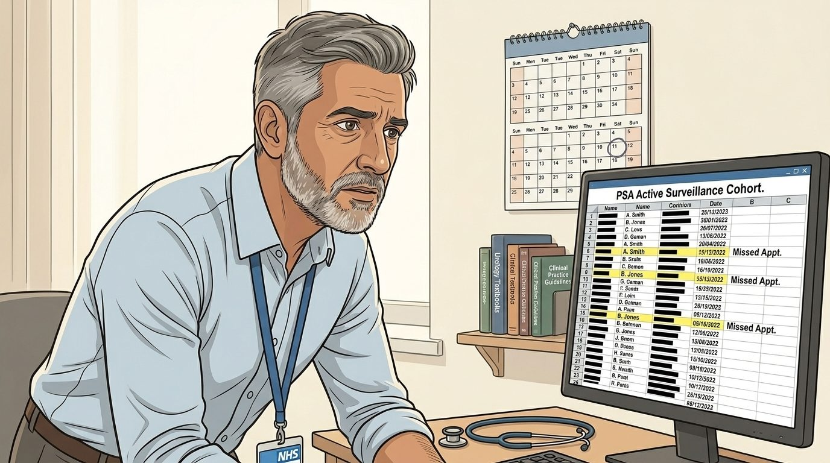
HEARTS AND MINDS · ADAM'S JOURNEY · STAGE 1 OF 6
The cohort · the patients in front of him
01
WHAT THE MODEL IS DOING UNDERNEATH
A PSA Active Surveillance cohort growing year on year as more men are eligible. A quarterly clinic cycle. A list of patients who repeatedly miss appointments and a smaller list of patients who have stopped attending altogether. NICE NG131 surveillance guidance in his head. The clinical question is: how do I keep these men in surveillance without my clinic capacity being the limit?
Adam runs a PSA Active Surveillance clinic at a large acute trust. The cohort grows, the clinic doesn't. Some patients live far from the hospital, some work shifts, some care for someone at home. The drop-outs are the patients he worries about most.
THE OLD WAY
Quarterly in-clinic phlebotomy and consultant review. The patient comes to the hospital, has a PSA drawn, and waits to be seen. The cohort that drops out is the cohort that loses surveillance. The clinical risk lands on the dropped patients, not on the model.
“I do not need a new tool. I need the patients I cannot see in clinic to stay in surveillance. Give me a reliable way to monitor them at home and put the result back in front of me, and I will use it.”
Adam
WHAT THE CARE TEAM SEES
His clinical nurse specialist on the cohort. His MDT. His Trust's outpatient lead on capacity. The radiologist on the imaging follow-on. The patient.
Adam · Hearts and Minds
Commercial positions are agreed in principle and remain subject to the live procurement.
3
Notes:
The cohort · the patients in front of him
Adam runs a PSA Active Surveillance clinic at a large acute trust. The cohort grows, the clinic doesn't. Some patients live far from the hospital, some work shifts, some care for someone at home. The drop-outs are the patients he worries about most.
Quote: I do not need a new tool. I need the patients I cannot see in clinic to stay in surveillance. Give me a reliable way to monitor them at home and put the result back in front of me, and I will use it.
What the model is doing underneath: A PSA Active Surveillance cohort growing year on year as more men are eligible. A quarterly clinic cycle. A list of patients who repeatedly miss appointments and a smaller list of patients who have stopped attending altogether. NICE NG131 surveillance guidance in his head. The clinical question is: how do I keep these men in surveillance without my clinic capacity being the limit?
The old way: Quarterly in-clinic phlebotomy and consultant review. The patient comes to the hospital, has a PSA drawn, and waits to be seen. The cohort that drops out is the cohort that loses surveillance. The clinical risk lands on the dropped patients, not on the model.
What the care team sees: His clinical nurse specialist on the cohort. His MDT. His Trust's outpatient lead on capacity. The radiologist on the imaging follow-on. The patient.

Slide 4
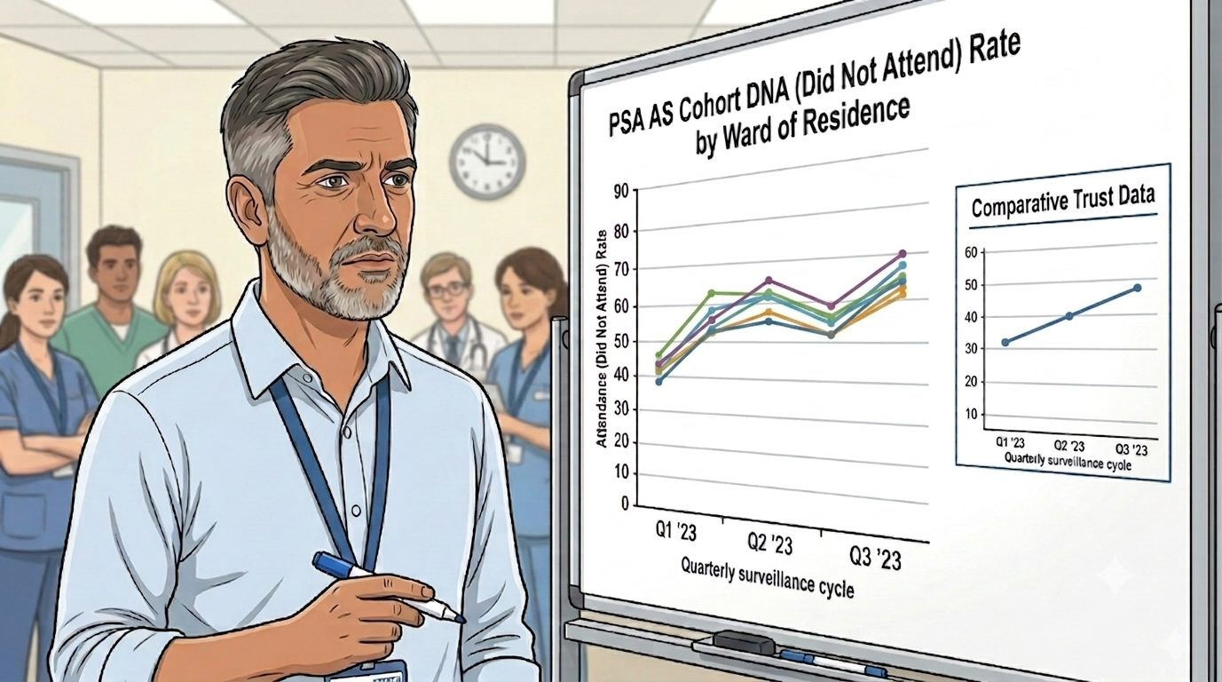
HEARTS AND MINDS · ADAM'S JOURNEY · STAGE 2 OF 6
The drop-outs · the clinic-only model's blind spot
02
WHAT THE MODEL IS DOING UNDERNEATH
Follow-up appointments account for around 54% of NHS outpatient activity. Eight million outpatient appointments went unattended in England in 2023/24. The PSA-AS quarterly review is precisely the kind of follow-up that, done remotely, releases clinic capacity for the patients who clinically need clinic time. Surveillance attrition is a known clinical problem in active surveillance cohorts.
Follow-up appointments are fifty-four per cent of NHS outpatient activity. The PSA-AS quarterly review is exactly the kind of follow-up that never needed a room. The patients who drop out are the ones the clinic-only model was never going to hold.
THE OLD WAY
Patients who fall out of surveillance lose the safety net the surveillance provides. PSA trends are not detected. Disease progression is found later, sometimes too late. The clinical risk is invisible to the clinic and lands on the patient.
“The patients who miss the appointment are not refusing care. They are keeping their jobs, getting their kids to school, looking after a parent. The clinic was always the wrong venue for routine bloods. The risk was always in the model, not in them.”
WHAT THE CARE TEAM SEES
Adam
Catherine, the Acute Trust commissioner who pays for the outpatient capacity Adam burns. The MDT colleagues with the same drop-out curve in their cohorts. The patient who stopped coming.
Adam · Hearts and Minds
Commercial positions are agreed in principle and remain subject to the live procurement.
4
Notes:
The drop-outs · the clinic-only model's blind spot
Follow-up appointments are fifty-four per cent of NHS outpatient activity. The PSA-AS quarterly review is exactly the kind of follow-up that never needed a room. The patients who drop out are the ones the clinic-only model was never going to hold.
Quote: The patients who miss the appointment are not refusing care. They are keeping their jobs, getting their kids to school, looking after a parent. The clinic was always the wrong venue for routine bloods. The risk was always in the model, not in them.
What the model is doing underneath: Follow-up appointments account for around 54% of NHS outpatient activity. Eight million outpatient appointments went unattended in England in 2023/24. The PSA-AS quarterly review is precisely the kind of follow-up that, done remotely, releases clinic capacity for the patients who clinically need clinic time. Surveillance attrition is a known clinical problem in active surveillance cohorts.
The old way: Patients who fall out of surveillance lose the safety net the surveillance provides. PSA trends are not detected. Disease progression is found later, sometimes too late. The clinical risk is invisible to the clinic and lands on the patient.
What the care team sees: Catherine, the Acute Trust commissioner who pays for the outpatient capacity Adam burns. The MDT colleagues with the same drop-out curve in their cohorts. The patient who stopped coming.

Slide 5
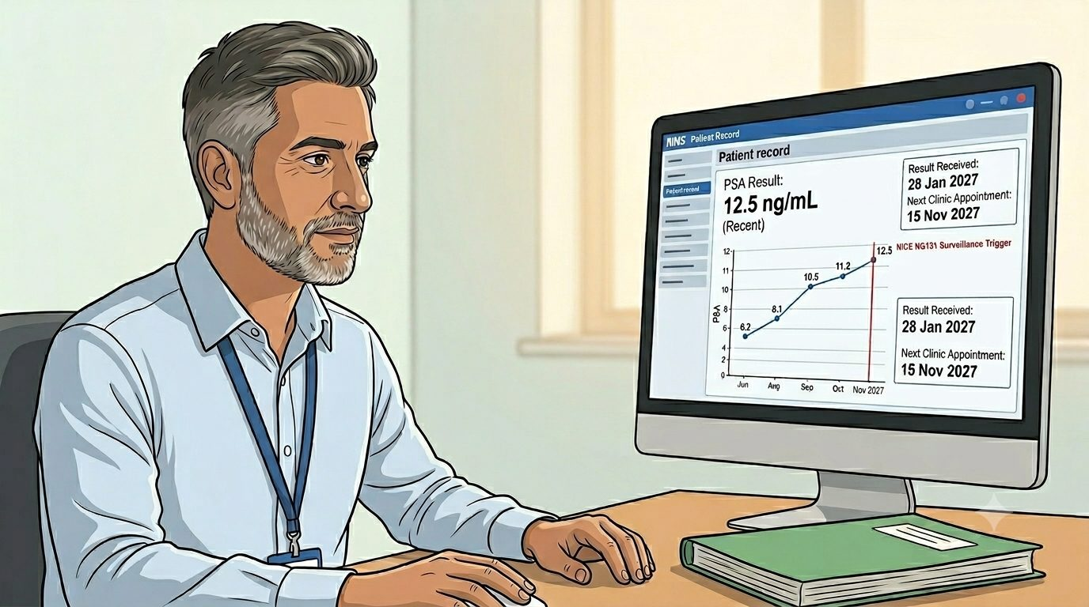
HEARTS AND MINDS · ADAM'S JOURNEY · STAGE 3 OF 6
The model's offer · kit out, result back to him
03
WHAT THE MODEL IS DOING UNDERNEATH
The PSA result returns to Adam first, in trend, not to the patient as a raw number. The clinical review remains his. Threshold alerts (built on NICE NG131 surveillance guidance) escalate to him; routine in-range results are reviewed in the same MDT rhythm he uses now. The kit changes where the blood is drawn. It does not change who reads the trend.
The home pathway sends the kit to the patient. The sample comes back to the lab. The PSA result lands on Adam's desk before the next clinic, in trend with everything that came before. The clinical role is preserved, the venue is not.
THE OLD WAY
A model that bypasses the consultant, sends results direct to the patient, and removes the clinical interpretation step. Adam would not have adopted that. Most of his consultant colleagues would not have either. Clinician-initiated only works if the clinician's role is held.
“I am not interested in a model that sends raw numbers to a patient without clinical interpretation. I am interested in a model where the kit changes the venue and the clinical accountability does not move. That is what this is.”
Adam
WHAT THE CARE TEAM SEES
Aisha, the Clinical Safety Group lead, owning the safety case and the threshold-alert rules. The MHRA-cleared kit supplier on lab assurance. The Trust's clinical governance lead on local sign-off.
Adam · Hearts and Minds
Commercial positions are agreed in principle and remain subject to the live procurement.
5
Notes:
The model's offer · kit out, result back to him
The home pathway sends the kit to the patient. The sample comes back to the lab. The PSA result lands on Adam's desk before the next clinic, in trend with everything that came before. The clinical role is preserved, the venue is not.
Quote: I am not interested in a model that sends raw numbers to a patient without clinical interpretation. I am interested in a model where the kit changes the venue and the clinical accountability does not move. That is what this is.
What the model is doing underneath: The PSA result returns to Adam first, in trend, not to the patient as a raw number. The clinical review remains his. Threshold alerts (built on NICE NG131 surveillance guidance) escalate to him; routine in-range results are reviewed in the same MDT rhythm he uses now. The kit changes where the blood is drawn. It does not change who reads the trend.
The old way: A model that bypasses the consultant, sends results direct to the patient, and removes the clinical interpretation step. Adam would not have adopted that. Most of his consultant colleagues would not have either. Clinician-initiated only works if the clinician's role is held.
What the care team sees: Aisha, the Clinical Safety Group lead, owning the safety case and the threshold-alert rules. The MHRA-cleared kit supplier on lab assurance. The Trust's clinical governance lead on local sign-off.

Slide 6
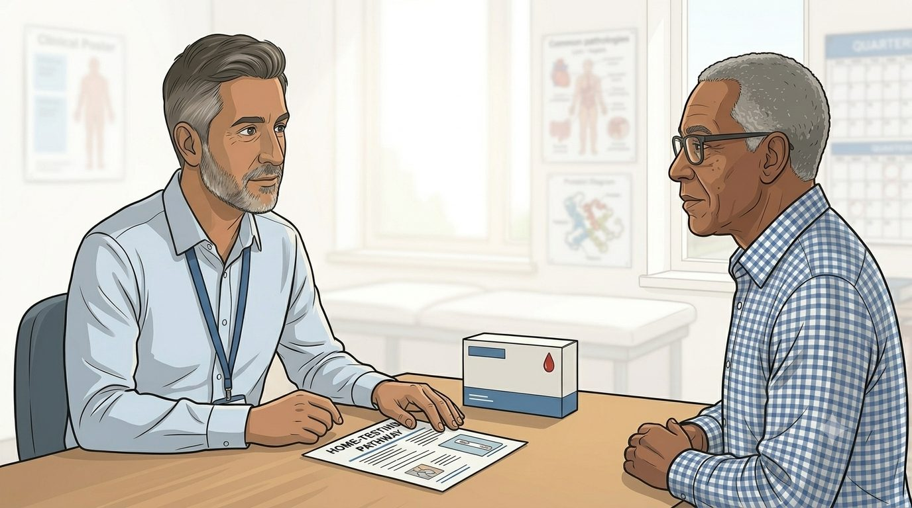
HEARTS AND MINDS · ADAM'S JOURNEY · STAGE 4 OF 6
First home prescriptions · right patient, right cycle
04
WHAT THE MODEL IS DOING UNDERNEATH
A short conversation at the end of the in-clinic appointment: would you be comfortable doing the next blood at home? Almost every patient says yes. The kit ships from the supplier. The patient takes the sample on the date the clinic would have happened. The lab processes it. The result lands in Adam's system before he would have seen the patient. The clinic visit that did not happen is one he did not have capacity for anyway.
Adam picks the first patients carefully. Stable surveillance trajectory. Comfortable with the kit. Comfortable with the clinical safety net behind it. Mark is one of the first. The kit goes home, the result comes back, the next clinic does not.
THE OLD WAY
Every patient comes in every quarter. No tier of patients reading their trend remotely. No clinic time freed for the patients whose disease behaviour means clinic is the right venue. The clinic-only model treats every patient as if they need clinic time, regardless of whether they clinically do.
“I am picking patients I would already trust with their own monitoring if the tooling existed. Stable trend, comfortable with the kit, family at home who can help if needed. The model meets them where they already are.”
Adam
WHAT THE CARE TEAM SEES
The clinical nurse specialist coordinating onboarding. The supplier shipping the kit. The lab processing the sample. The platform delivering the result back. The patient.
Adam · Hearts and Minds
Commercial positions are agreed in principle and remain subject to the live procurement.
6
Notes:
First home prescriptions · right patient, right cycle
Adam picks the first patients carefully. Stable surveillance trajectory. Comfortable with the kit. Comfortable with the clinical safety net behind it. Mark is one of the first. The kit goes home, the result comes back, the next clinic does not.
Quote: I am picking patients I would already trust with their own monitoring if the tooling existed. Stable trend, comfortable with the kit, family at home who can help if needed. The model meets them where they already are.
What the model is doing underneath: A short conversation at the end of the in-clinic appointment: would you be comfortable doing the next blood at home? Almost every patient says yes. The kit ships from the supplier. The patient takes the sample on the date the clinic would have happened. The lab processes it. The result lands in Adam's system before he would have seen the patient. The clinic visit that did not happen is one he did not have capacity for anyway.
The old way: Every patient comes in every quarter. No tier of patients reading their trend remotely. No clinic time freed for the patients whose disease behaviour means clinic is the right venue. The clinic-only model treats every patient as if they need clinic time, regardless of whether they clinically do.
What the care team sees: The clinical nurse specialist coordinating onboarding. The supplier shipping the kit. The lab processing the sample. The platform delivering the result back. The patient.

Slide 7
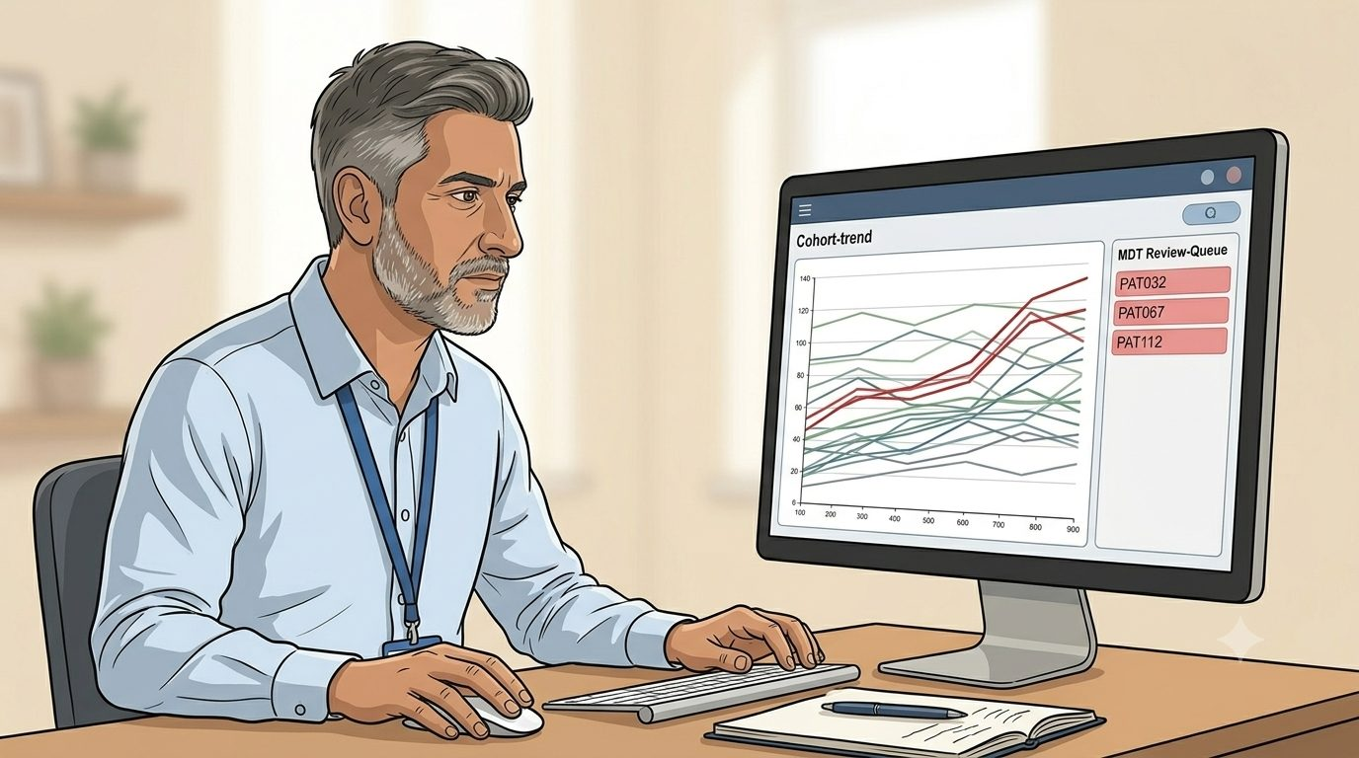
HEARTS AND MINDS · ADAM'S JOURNEY · STAGE 5 OF 6
Surveillance in flight · trends, not appointments
05
WHAT THE MODEL IS DOING UNDERNEATH
Routine in-range PSA results are reviewed in trend by Adam in the same MDT rhythm. Threshold breaches (rate of change, absolute value) trigger an alert and an MDT discussion within a defined window. Patients who would benefit from clinic are seen in clinic. Patients whose disease is stable stay home for the next quarterly cycle. The model surfaces clinical signal, not appointment volume.
The cohort settles into a new rhythm. Results arrive on Adam's desk in trend. Stable patients stay in surveillance. Threshold breaches escalate. The clinic now sees the patients who clinically need to be seen, not every patient by default.
THE OLD WAY
Every quarter, every patient, in clinic regardless of trend. The signal-to-noise ratio of in-clinic surveillance was poor because most appointments confirmed stability rather than detecting change. The clinically interesting patients shared clinic time with the clinically uneventful ones.
“The silence is doing clinical work. Every result is reviewed in trend, and escalation happens when the line moves. Safety is the review, not the appointment. That is what surveillance was supposed to be all along.”
Adam
WHAT THE CARE TEAM SEES
The MDT, holding the trend review. The CNS, coordinating between routine surveillance and escalation. Priya on the data layer, ensuring the result writes back to the Trust EPR cleanly. The patient, getting on with their life between cycles.
Adam · Hearts and Minds
Commercial positions are agreed in principle and remain subject to the live procurement.
7
Notes:
Surveillance in flight · trends, not appointments
The cohort settles into a new rhythm. Results arrive on Adam's desk in trend. Stable patients stay in surveillance. Threshold breaches escalate. The clinic now sees the patients who clinically need to be seen, not every patient by default.
Quote: The silence is doing clinical work. Every result is reviewed in trend, and escalation happens when the line moves. Safety is the review, not the appointment. That is what surveillance was supposed to be all along.
What the model is doing underneath: Routine in-range PSA results are reviewed in trend by Adam in the same MDT rhythm. Threshold breaches (rate of change, absolute value) trigger an alert and an MDT discussion within a defined window. Patients who would benefit from clinic are seen in clinic. Patients whose disease is stable stay home for the next quarterly cycle. The model surfaces clinical signal, not appointment volume.
The old way: Every quarter, every patient, in clinic regardless of trend. The signal-to-noise ratio of in-clinic surveillance was poor because most appointments confirmed stability rather than detecting change. The clinically interesting patients shared clinic time with the clinically uneventful ones.
What the care team sees: The MDT, holding the trend review. The CNS, coordinating between routine surveillance and escalation. Priya on the data layer, ensuring the result writes back to the Trust EPR cleanly. The patient, getting on with their life between cycles.

Slide 8
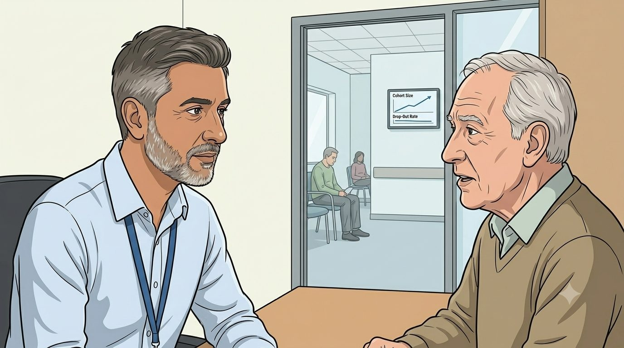
HEARTS AND MINDS · ADAM'S JOURNEY · STAGE 6 OF 6
The clinic shape now · time for the patients who need it
06
WHAT THE MODEL IS DOING UNDERNEATH
PSA-AS cohort size up; surveillance attrition down (drop-out curve flatter across cycles); clinic capacity reallocated from routine PSA reviews to active concerns and imaging follow-on. Outpatient slots returned to the Trust's elective recovery target. The same consultant team holds more patients in surveillance than the clinic-only model could have, with no extra clinic time. The model passes the test that mattered to him: clinical accountability preserved, reach extended, capacity released.
More patients in surveillance. Fewer drop-outs. The same consultant cohort. The clinic now sees the patients whose disease behaviour says clinic is the right venue. Capacity goes where the clinical need is, not where the diary template said.
THE OLD WAY
Cohort capped by clinic capacity. Drop-outs growing with cohort age. Routine bloods consuming consultant time. The clinically interesting patients waiting for an appointment behind the clinically uneventful ones. Surveillance failing the patients it was designed to protect.
“The patients I worried about are still in surveillance. The clinic is full of the patients who clinically belong there. Same team, more reach, less attrition. That was the only version of this worth doing.”
Adam
WHAT THE CARE TEAM SEES
Adam and his MDT, running a larger surveillance cohort with no clinic-capacity penalty. Catherine, his Trust commissioner, seeing released outpatient slots flow into elective recovery. Mark and the other men in the cohort, staying in surveillance, getting on with their lives.
Adam · Hearts and Minds
Commercial positions are agreed in principle and remain subject to the live procurement.
8
Notes:
The clinic shape now · time for the patients who need it
More patients in surveillance. Fewer drop-outs. The same consultant cohort. The clinic now sees the patients whose disease behaviour says clinic is the right venue. Capacity goes where the clinical need is, not where the diary template said.
Quote: The patients I worried about are still in surveillance. The clinic is full of the patients who clinically belong there. Same team, more reach, less attrition. That was the only version of this worth doing.
What the model is doing underneath: PSA-AS cohort size up; surveillance attrition down (drop-out curve flatter across cycles); clinic capacity reallocated from routine PSA reviews to active concerns and imaging follow-on. Outpatient slots returned to the Trust's elective recovery target. The same consultant team holds more patients in surveillance than the clinic-only model could have, with no extra clinic time. The model passes the test that mattered to him: clinical accountability preserved, reach extended, capacity released.
The old way: Cohort capped by clinic capacity. Drop-outs growing with cohort age. Routine bloods consuming consultant time. The clinically interesting patients waiting for an appointment behind the clinically uneventful ones. Surveillance failing the patients it was designed to protect.
What the care team sees: Adam and his MDT, running a larger surveillance cohort with no clinic-capacity penalty. Catherine, his Trust commissioner, seeing released outpatient slots flow into elective recovery. Mark and the other men in the cohort, staying in surveillance, getting on with their lives.

Slide 9
HEARTS AND MINDS · ADAM'S JOURNEY · THE OUTCOME
Adam's win
More patients in surveillance. Fewer drop-outs. Same team. Clinic time for the patients who clinically need it.
The patients did not see a model. They saw a kit at home and a result that landed with a clinician who knew them. The clinic that did not happen is the clinic Adam did not have capacity for anyway. The cohort he worried about most is still in surveillance, and the patients who clinically belong in clinic now find a slot when they need one.
THE MONEY IN THIS STORY
No money passes through Adam's hands, which is the point. The tests his cohort needs are funded upstream at a cost per activity, so his surveillance list stops competing with his clinics for phlebotomy. What the model buys from Adam is the thing only he can do: the trend review and the escalation call. The economics free his time for exactly that, and the cohort is easier to hold without his job getting worse.
Commercial positions are agreed in principle and remain subject to the live procurement. See the Money Loop and How Commissioners Buy pages of the operating model.
Adam · Hearts and Minds
Commercial positions are agreed in principle and remain subject to the live procurement.
9

