Slide 1

HEARTS AND MINDS · COMMISSIONER EDITION · No.1
Testing that finds the people your clinics can’t.
HomeTest: patient-centric micro-sampling, at scale. 24/7 access through the NHS App, for the populations you commission for.
Live today: patient-initiated HIV testing through the NHS App, in Beta with two local authorities.
Hearts and Minds · audience deck No.1 · Commissioner edition · proof-of-concept draft ⚑ · updated September 2026
Notes:
Open on the promise, not the product. The one-line truth: clinic-based testing only reaches people who can get to clinics; this service reaches the rest, and it is live now, not a vision. Two LA areas in Beta gives instant credibility.

Slide 2
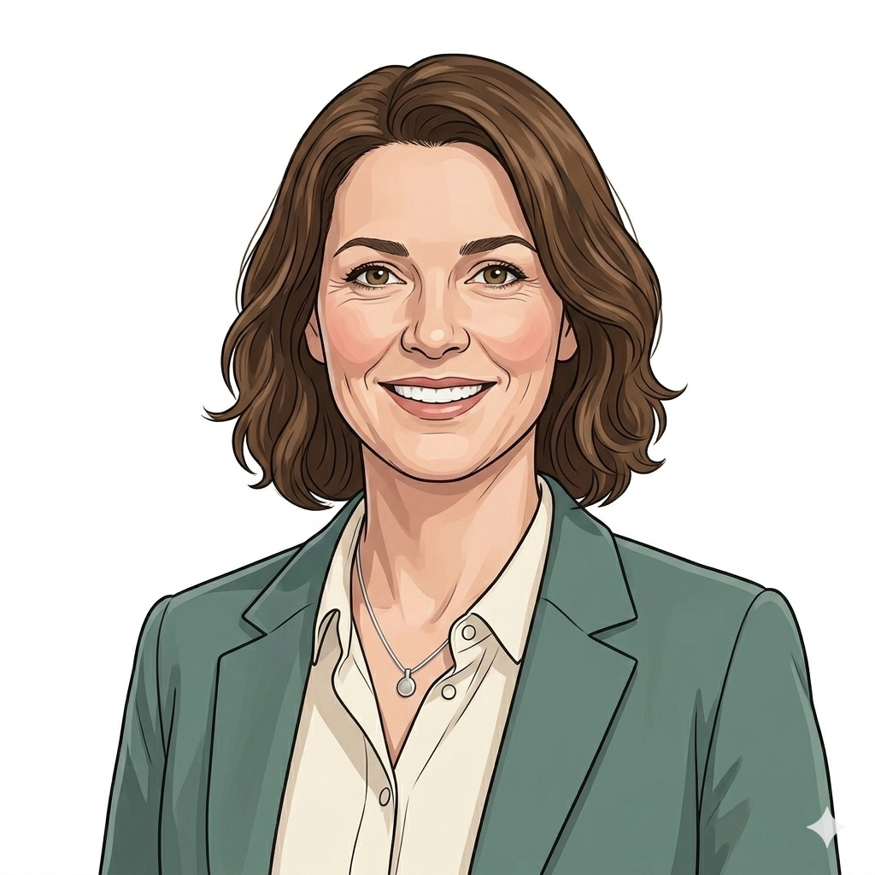

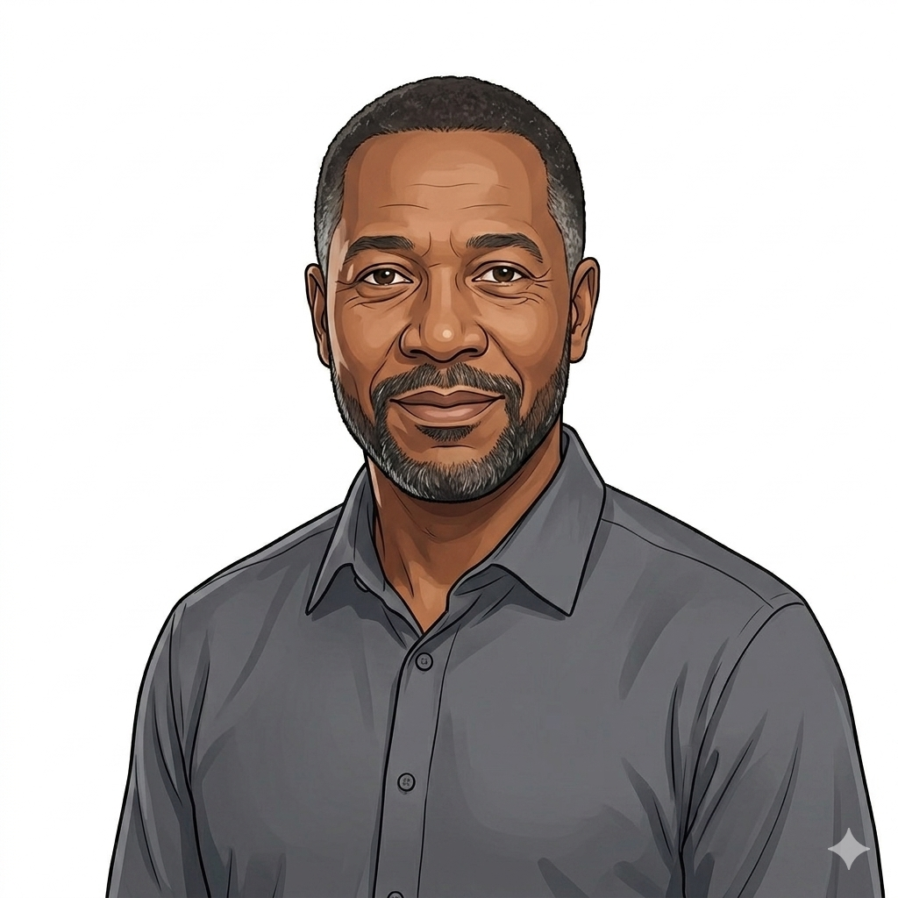
We build around people. Start with someone in your seat.
“I need these services to save my budget, not strain it. Give me ready-made templates and a clear route to buy. I haven’t got the headcount to bespoke this for every supplier or every product.”
Sarah
LA sexual health commissioner
Every service in this programme is designed around named people, the patients it must reach and the person who has to buy it. Three of them carry today’s story.
Sarah
Sean
Errol
the buyer
the patient the system fails
where it all goes
Hearts and Minds · audience deck No.1 · Commissioner edition · proof-of-concept draft ⚑ · updated September 2026
Notes:
The Hearts and Minds conceit, stated openly: we design around named people. Sarah IS the audience - acknowledge it with a smile; the quote usually lands because it is verbatim what commissioners say. Introduce the weave: Sean and Errol will return.

Slide 3
The people testing misses are the people you most need to reach.
Clinic-hours testing reaches the people who can attend clinics. It quietly misses:
DNA
The time-poor
Shift workers and single parents for whom a clinic slot costs half a day’s income. The bloods slip, not from neglect, from arithmetic.
≠ disengaged
The stigma-wary
People who will do a test at their own kitchen table but will never sit in certain waiting rooms, whatever the condition.
A “did not attend” code cannot tell would not from could not, and the could-nots are exactly who late diagnosis finds.
The system-failed
People with learning disabilities, serious mental illness, needle phobia, for whom the appointment itself is the wall.
Hearts and Minds · audience deck No.1 · Commissioner edition · proof-of-concept draft ⚑ · updated September 2026
Notes:
Do not invent local statistics - invite hers. Ask: where do your late diagnoses come from? The answer is almost always the three groups on the left. The DNA card reframes non-attendance as system failure rather than patient failure - this is the deck's moral pivot and sets up Sean.

Slide 4
The system you are buying against is running out of road.
TEST REQUESTS P.A.
1.25bn
1.25bn
1.12bn
730m
NHS pathology test requests projected for 2025/26, growing 5.5% every year. Phlebotomy services are under major strain, and every routine draw still assumes a building, a rota and a patient who can attend.
2013/14
2021/22
2025/26
“The NHS App will transform how patients access care online and offline, 24 hours a day, and help people manage their own health as easily as they bank or shop online.”, 10 Year Health Plan for England, July 2025
Hearts and Minds · audience deck No.1 · Commissioner edition · proof-of-concept draft ⚑ · updated September 2026
Notes:
National programme figures: 730m (2013/14), 1.12bn (2021/22), 1.25bn projected (2025/26), 5.5% annual growth. The point for Sarah: demand grows whether she buys or not - the question is whether the next tranche of tests needs buildings. The Plan quote anchors this as national policy direction, not vendor enthusiasm.

Slide 5

HOMETEST · THE SERVICE
Tests that come to the patient, not the other way round.
Kit through the door → sample to an accredited lab → result into the record, with the care pathway attached. Ordered by the patient, their clinician or their GP, one platform serving all three patterns.
Live now: patient-initiated HIV testing through the NHS App, in Beta with two local authorities, the proof the platform works
Coming through: clinician-initiated PSA Active Surveillance (the selected acute use case) and a four-test STI panel (leading discovery candidate) on the same rails
Clinically wrapped: UKAS-accredited labs, clinical safety case, IG executed before go-live, carried by the platform, every pathway
Hearts and Minds · audience deck No.1 · Commissioner edition · proof-of-concept draft ⚑ · updated September 2026
Notes:
The image is deliberate: a kit being handed over a real front door. HomeTest is the platform; HIV is the live proof, PSA surveillance and anaemia monitoring follow on the same rails. If asked which areas: two LA areas in the HIV Beta, happy to arrange a conversation with them.

Slide 6
Five steps. One wrapper. Nothing for your team to assemble.
1
→
2
→
3
→
4
→
5
Ordered
Kit arrives
Sample back
Lab reports
Result + care
in the NHS App
through the door
by post
UKAS-accredited
pathway attached
The wrapper carries the hard part. Clinical safety (DCB0129/0160), information governance (DPIA, DSA, DPA executed before go-live) and the assurance gateway travel with the service, your team inherits them, it doesn’t build them.
Patient route choice preserved. Clinic routes stay open. This adds a front door; it closes none.
Hearts and Minds · audience deck No.1 · Commissioner edition · proof-of-concept draft ⚑ · updated September 2026
Notes:
The wrapper line answers her quote from slide 2 - templates, not bespoke work. The choice banner pre-empts the equity objection: nobody is forced online; this widens access rather than narrowing it. That sentence matters to elected members.

Slide 7
You pay for activity that happens. Not for buildings, rotas or empty slots.
Cost per activity
The DNA asymmetry
The pattern agreed in principle: a set price for the activity that happens, against a national ceiling your local volume beats. A pathway that runs at seventy percent pays seventy percent.
A missed appointment still costs the slot, the room and the rota. An unreturned kit doesn’t burn a clinic minute, and the reminder to return it costs a message, not a booking.
Zero estate
Aggregated demand
Volume scales with kit-and-post logistics and lab capacity, not with waiting rooms. The next thousand tests need no building.
A national framework of quality-assured suppliers with a published ceiling price. Every commissioner’s volume pushes every commissioner’s price further below it.
The Beta areas are generating the sexual-health unit economics now, early partners see them first.
Hearts and Minds · audience deck No.1 · Commissioner edition · proof-of-concept draft ⚑ · updated September 2026
Notes:
This is the slide a finance colleague will photograph. Per-completed-test is how the live service is actually bought - not a proposal. The DNA asymmetry is the structural saving: her DNA rate currently buys empty rooms. Do not quote unit prices - the catalogue and Beta evidence carry that conversation later.

Slide 8
What stops costing you money.
−
Procurement months: One call-off on national terms replaces a locally designed procurement, and the headcount it consumes.
4 to 6
−
Duplicated assurance: DPIA, DSA, clinical safety case and accreditation are carried once, nationally, not rebuilt by every commissioner, every time.
appointments saved per patient, per year
−
Routine phlebotomy slots: Tests that never needed a building move to kit-and-post; clinic capacity returns to treatment and complex care.
up to 6 to 8 on a fully digital journey, national home-first journey modelling. Lower delivery cost, lower CO₂, services working people can actually use.
−
DNA waste: The could-not-attends stop costing empty rooms and start returning samples.
Structural savings first, cashable savings as volume moves, the ledger compounds with every pathway added.
Hearts and Minds · audience deck No.1 · Commissioner edition · proof-of-concept draft ⚑ · updated September 2026
Notes:
Four structural lines plus the journey arithmetic. Be honest about cashable vs structural: capacity returned is real but realising cash needs pathway volume - which is exactly what the defined starter cohort in the close is for.

Slide 9

A REAL STORY, TOLD WITH HIS FAMILY’S BLESSING
Sean, 46. The test was never the hard part. Everything before it was.
Sean has a learning disability; he is autistic and lives with OCD. For him the walls were attending (the journey, the waiting room, the strangers), understanding (advice at speed, nothing to take away in a form that works) and committing (the gap between agreeing in a room and a test actually happening). The system recorded each wall as his failure.
The test that comes home changes all three: his own table, easy-read instructions, someone he trusts beside him.
A journey designed so Sean can complete it is a calmer, clearer journey for every resident you serve.
Hearts and Minds · audience deck No.1 · proof-of-concept draft ⚑ · updated September 2026
Notes:
Slow down here. Sean is real - a family member of someone on the programme, shared with their blessing. He is the answer to slide 3's DNA card. The curb-cut close is the policy point: inclusive design is not a side-quest, it is how the whole service gets better. This slide is why the deck is called Hearts and Minds.

Slide 10
What this buys you.
Reach
Capacity
Testing for the residents your clinics never see, the time-poor, the stigma-wary, the system-failed.
Clinic and phlebotomy time concentrates on treatment and complex care, not routine bloods that never needed a building.
−1 visit
One wrapper
Per test completed: the journey that didn’t need a building, parking, or a waiting room.
Assurance, IG and clinical safety pre-carried. Templates, not bespoke work, budget saved, not strained.
“Save my budget, not strain it.”, that was the brief. This is the answer.
Hearts and Minds · audience deck No.1 · Commissioner edition · proof-of-concept draft ⚑ · updated September 2026
Notes:
Keep claims qualitative and structural - the Beta exists to generate her numbers. If pressed for figures, the honest line: the Beta areas are measuring uptake and clinic displacement now, and we will share what they find.

Slide 11
PROVIDED ALONGSIDE · SAME RAILS, SAME WRAPPER, SAME RECORD
HomeTest is the front door. Two sister services follow it.
HealthStore
HealthSync
NHS-assured digital therapeutics, prescribed like medication, in COPD Alpha now. Published real-world results: 19% fewer GP appointments (COPD), 70% reduction in anxiety symptoms (digital sleep therapy), 40% fewer non-elective admissions under remote monitoring.
Consumer wearable and device data flowing into the NHS record with consent, monitoring between appointments instead of by appointment. In design; first configuration being shaped now.
Why it matters to a HomeTest buyer: the test tells you about a moment; the streams cover the months in between.
Sources: published RWE and trial data; ICB internal evaluation.
Nothing here changes the HomeTest decision, it compounds it. One front door, growing.
Hearts and Minds · audience deck No.1 · Commissioner edition · proof-of-concept draft ⚑ · updated September 2026
Notes:
One slide, deliberately. This is a HomeTest pitch; the sisters exist to show the front door grows in value after she buys. The DTx stats are cited as in the national exec deck. Do not let the meeting drift here - Errol carries the destination emotionally on the next slide.

Slide 12
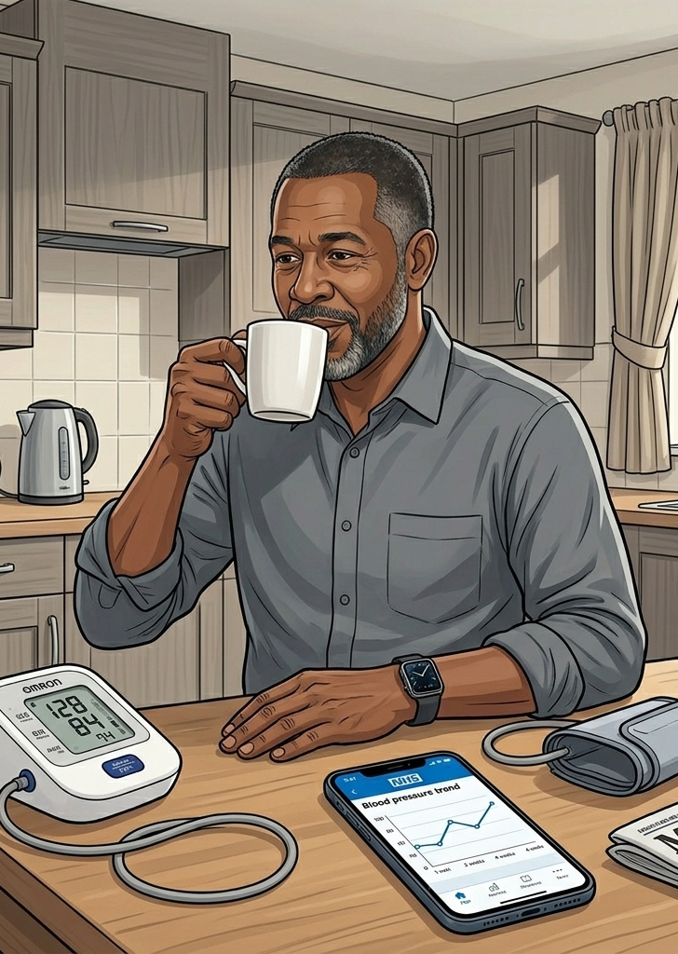
WHERE IT ALL GOES · ONE STORY ACROSS ALL THREE
Errol. Intervention before crisis.
His wearable flags the change weeks before the clinical event would have announced itself. The home diagnostic confirms it. The therapeutic supports the response.
● HealthSync: the signal that saw it coming
● HomeTest: the diagnostic that confirmed it at home
● HealthStore: the therapeutic that carried the response
Three signal streams. One record. Clinical time freed for the patients who genuinely need to be in the room.
Notes:
Errol is the category-4 story - the destination that makes the family coherent. Tell it in one breath: signal, test, treatment, no crisis. Then the kicker for a commissioner: every Errol is an admission that never happened.

Slide 13
And the buying is designed for your headcount, not against it.
One front door
configurations and suppliers pre-assured on a national framework
6 wks
National terms
standard call-off templates, reviewed once by your legal and IG, not per supplier
not eighteen months
the promise the model is built to keep
A call-off, not a procurement
the integration, safety case and assurance were done before you walked in
Status, honestly: HIV is live in Beta today on interim arrangements. The national open framework is being stood up now, targeting April 2028, with an interim route for commissioners who buy before then. Early partners shape it.
Hearts and Minds · audience deck No.1 · Commissioner edition · proof-of-concept draft ⚑ · updated September 2026
Notes:
Six weeks not eighteen months is the design target the model is built around - say it as ambition with a straight face, then the honesty line: today's route is interim arrangements that already work (the Beta proves it), and early partners get to shape the destination framework.

Slide 14
What happens next.
1
2
3
A scoping conversation
The assurance pack
A defined cohort to start
Your population picture and testing gaps; our journey maps and Beta learning. One hour, no homework.
Clinical safety case, IG framework and call-off shape, reviewed once with your legal and IG teams.
Small, measured, reported, then expanded on evidence, not optimism.
The Beta areas took step one. Their residents are testing at home today.
Hearts and Minds · audience deck No.1 · Commissioner edition · proof-of-concept draft ⚑ · updated September 2026
Notes:
The ask is deliberately small: one conversation. The closing line does the selling - two of her peers already moved.

Slide 15
Sarah
Sean
Errol
the buyer it saves time for
the patient it finally reaches
the future it makes ordinary
Built around people. Bought without pain. Live today.
Hearts and Minds · audience deck No.1 · Commissioner edition · proof of concept ⚑
Notes:
Close on the three faces and stop talking. The line under them is the whole programme in nine words.

