Slide 1


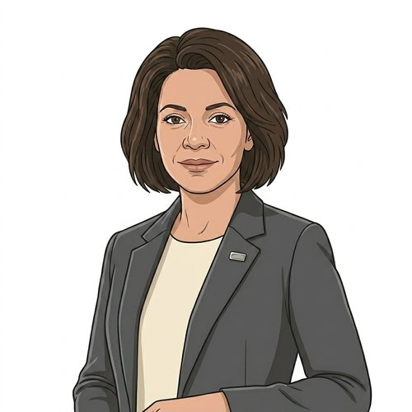
HEARTS AND MINDS · HOMETEST OPERATING MODEL · COMMISSIONER JOURNEY
Catherine.
Catherine commissions the pathway.
Not each patient.
Catherine commissions the PSA active-surveillance pathway across her Integrated Care Board. Consultant urologists across her acute Trusts follow the NICE NG131 monitoring cadence for men on AS; the patient volume runs into hundreds annually across her ICB. Today the pathway sits on outpatient tariff and phlebotomy access, both of which are pinching against post-pandemic clinic capacity. She has the budget envelope, an NHS-mandate route into her Trust partners, and no existing framework to lean on for home-collected sampling at scale. This is the story of one ICB commissioner, one platform, one national arrangement, and an operating model that lets her commission the pathway rather than each patient.
Catherine
ICB commissioner · HomeTest PSA active surveillance
An ICB commissioner's story through the operating model
HomeTest Operating Model · Hearts and Minds
Commercial positions are agreed in principle and remain subject to the live procurement.

Slide 2

HEARTS AND MINDS · COMMISSIONER JOURNEY
Catherine’s journey at a glance
1
The brief
2
One front door
3
Fit for HER cohort
4
One call-off
5
Live operation
6
The board paper
A gap on the dashboard
The framework opens
The questions standard answers don't solve
Signing, not procuring
Kits out, results back
What the members see
THE NORTH STAR
WHY ONE PLATFORM MATTERS TO HER
Commission the pathway, not the patient. So the ICB buys once and the AS caseload holds together across Trusts.
One national arrangement. One pathway. One platform every AS patient in her ICB can flow through.
ICB commissioners do not want a separate contract per Trust. They want one pathway-level arrangement that every AS patient in their system can flow through, regardless of which Trust is doing their monitoring. The operating model exists so the ICB commissions the AS pathway once at pathway level and each Trust plugs in against a common national arrangement. Pathway-level commissioning is the North Star, because effort spent stitching Trust-by-Trust deals is effort not spent on the caseload.
A bespoke PSA-AS deal with one Trust would buy one deployment. The next Trust in her ICB (or the next AS-adjacent pathway) would mean another arrangement, another assurance set, another contract, another integration. The national arrangement means Catherine commissions the pathway once, every Trust in her ICB plugs into the same call-off, the same MI feed answers the same questions, and the next AS-adjacent pathway is an extension. The integration was done before she walked in.
Catherine · Hearts and Minds
Commercial positions are agreed in principle and remain subject to the live procurement.
2

Slide 3

HEARTS AND MINDS · CATHERINE’S JOURNEY · STAGE 1 OF 6
The brief · an AS caseload, a monitoring gap, a pathway to commission
01
WHAT THE MODEL IS DOING UNDERNEATH
NICE NG131 CPG 1-2 monitoring guidance, ICB caseload data across the AS register, outpatient tariff cost per follow-up, phlebotomy waiting times across her Trust footprint. Consultant urologist views on which points in the pathway are safe to shift to home-collected sampling. The clinical case sits on capillary PSA testing accredited to UKAS ISO 15189 with an AS-appropriate CV and MU. What's in front of her is a pathway-level commissioning arrangement, integration with each Trust's pathology workflow, and a call-off mechanism that doesn't require every Trust to negotiate separately.
Catherine has an AS monitoring cohort of several hundred men across her ICB, held on active surveillance under NICE NG131 clinical pathway guidance. The monitoring cadence is quarterly to six-monthly PSA testing for the first two years, then annual. Her acute Trusts run the reviews through consultant urologists; the phlebotomy step is currently in-clinic and eating outpatient capacity. Her Chief Medical Officer wants the monitoring cadence to hold without pulling more urology capacity into the room. She has the budget envelope, the mandate route into her Trust partners, and no existing framework to lean on.
THE OLD WAY
“The AS cohort is holding steady but the phlebotomy step is eating clinic slots. If I don't solve the sample-collection question, the monitoring cadence slips and the caseload starts falling out of surveillance.”
A bilateral Trust-by-Trust negotiation for each partner in her ICB. Six to nine months per Trust. Clinical safety assurance and IG per Trust variation. Bespoke pathway design per Trust. Twelve to fifteen months from Board paper to first kit at the first Trust, longer to reach caseload coverage across the ICB. By the time the second Trust is live, the first Trust's pathway has drifted. Fragmentation over speed.
Catherine
WHAT THE CARE TEAM SEES
Her ICB Chief Medical Officer. Consultant urologists from her Trust partners running AS clinics. Her ICB IG lead. The clinical safety lead from her acute Trust pathology network. Her ICB commercial team, looking at NHS-mandate routing rather than external procurement.
Catherine · Hearts and Minds
Commercial positions are agreed in principle and remain subject to the live procurement.
3
Notes:
The brief · an AS caseload, a monitoring gap, a pathway to commission
Catherine has an AS monitoring cohort of several hundred men across her ICB, held on active surveillance under NICE NG131 clinical pathway guidance. The monitoring cadence is quarterly to six-monthly PSA testing for the first two years, then annual. Her acute Trusts run the reviews through consultant urologists; the phlebotomy step is currently in-clinic and eating outpatient capacity. Her Chief Medical Officer wants the monitoring cadence to hold without pulling more urology capacity into the room. She has the budget envelope, the mandate route into her Trust partners, and no existing framework to lean on.
Quote: The AS cohort is holding steady but the phlebotomy step is eating clinic slots. If I don't solve the sample-collection question, the monitoring cadence slips and the caseload starts falling out of surveillance.
What the model is doing underneath: NICE NG131 CPG 1-2 monitoring guidance, ICB caseload data across the AS register, outpatient tariff cost per follow-up, phlebotomy waiting times across her Trust footprint. Consultant urologist views on which points in the pathway are safe to shift to home-collected sampling. The clinical case sits on capillary PSA testing accredited to UKAS ISO 15189 with an AS-appropriate CV and MU. What's in front of her is a pathway-level commissioning arrangement, integration with each Trust's pathology workflow, and a call-off mechanism that doesn't require every Trust to negotiate separately.
The old way: A bilateral Trust-by-Trust negotiation for each partner in her ICB. Six to nine months per Trust. Clinical safety assurance and IG per Trust variation. Bespoke pathway design per Trust. Twelve to fifteen months from Board paper to first kit at the first Trust, longer to reach caseload coverage across the ICB. By the time the second Trust is live, the first Trust's pathway has drifted. Fragmentation over speed.
What the care team sees: Her ICB Chief Medical Officer. Consultant urologists from her Trust partners running AS clinics. Her ICB IG lead. The clinical safety lead from her acute Trust pathology network. Her ICB commercial team, looking at NHS-mandate routing rather than external procurement.

Slide 4

HEARTS AND MINDS · CATHERINE’S JOURNEY · STAGE 2 OF 6
One front door · the framework opens
02
WHAT THE MODEL IS DOING UNDERNEATH
The framework page. Admitted suppliers with UKAS-accredited capillary PSA analytical performance. Standard ICB call-off terms. DSA, DPIA, privacy notice and clinical safety case starter templates pre-built. GP-record and Trust EPR integration patterns published. NICE NG131 alignment documented. Consultant urologist workflow overlay for the AS pathway. The route is published; Catherine just has to choose to take it.
She opens the framework. The HomeTest platform is admitted. The PSA-AS configuration is live under UKAS ISO 15189:2022 accredited capillary PSA testing. Suppliers listed against published call-off terms. Clinical safety case starter template ready. IG templates ready. National pricing visible. No pathway to design from scratch.
THE OLD WAY
A clean-sheet negotiation with the first Trust to volunteer. Bespoke clinical safety case per Trust. Bespoke IG per Trust. Bespoke MI per Trust. Three months per Trust before the first contract draft. Six Trusts equals eighteen months of stitching.
“I expected to be writing a Trust-by-Trust spec. I'm looking at a national arrangement I can call off at ICB level. The heavy lifting was done before I logged in.”
Catherine
WHAT THE CARE TEAM SEES
The platform's commissioner-engagement contact for the PSA-AS configuration. Her ICB commercial team, sense-checking the NHS-mandate call-off route. Her Trust partners' consultant urology leads, sense-checking how the pathway plugs into their AS clinics.
Catherine · Hearts and Minds
Commercial positions are agreed in principle and remain subject to the live procurement.
4
Notes:
One front door · the framework opens
She opens the framework. The HomeTest platform is admitted. The PSA-AS configuration is live under UKAS ISO 15189:2022 accredited capillary PSA testing. Suppliers listed against published call-off terms. Clinical safety case starter template ready. IG templates ready. National pricing visible. No pathway to design from scratch.
Quote: I expected to be writing a Trust-by-Trust spec. I'm looking at a national arrangement I can call off at ICB level. The heavy lifting was done before I logged in.
What the model is doing underneath: The framework page. Admitted suppliers with UKAS-accredited capillary PSA analytical performance. Standard ICB call-off terms. DSA, DPIA, privacy notice and clinical safety case starter templates pre-built. GP-record and Trust EPR integration patterns published. NICE NG131 alignment documented. Consultant urologist workflow overlay for the AS pathway. The route is published; Catherine just has to choose to take it.
The old way: A clean-sheet negotiation with the first Trust to volunteer. Bespoke clinical safety case per Trust. Bespoke IG per Trust. Bespoke MI per Trust. Three months per Trust before the first contract draft. Six Trusts equals eighteen months of stitching.
What the care team sees: The platform's commissioner-engagement contact for the PSA-AS configuration. Her ICB commercial team, sense-checking the NHS-mandate call-off route. Her Trust partners' consultant urology leads, sense-checking how the pathway plugs into their AS clinics.

Slide 5
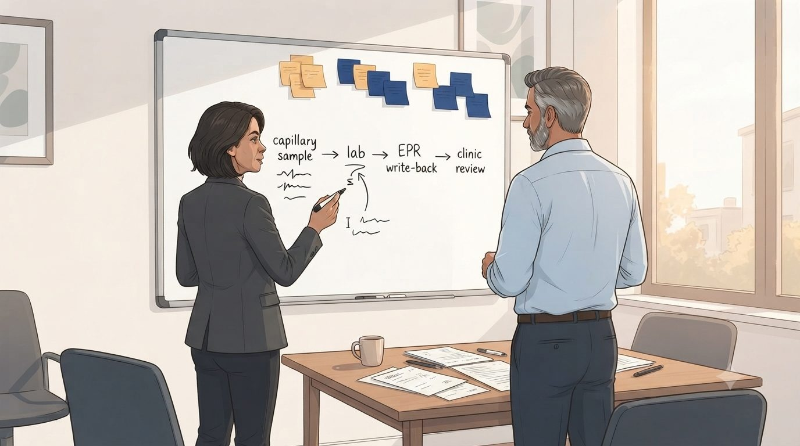
HEARTS AND MINDS · CATHERINE’S JOURNEY · STAGE 3 OF 6
Fit for the AS cohort · the questions the pathway has to answer
03
WHAT THE MODEL IS DOING UNDERNEATH
Her AS-cohort questions against the framework's clinical documentation. UKAS ISO 15189:2022 accredited capillary PSA analytical performance sheet with declared CV and MU at the clinical decision concentrations. NICE NG131 cadence mapped to the platform's ordering rhythm. Consultant-urologist-led escalation pathway documented. Re-biopsy trigger workflow with GP-record write-back. Clinical safety case addendum for the AS-specific pathway. The framework either answers these or it doesn't. Catherine finds out before signing.
Catherine runs her AS-cohort-specific questions against the framework. Do we have a defensible analytical performance for capillary PSA at the AS clinical decision points? What happens with the small proportion of men whose PSA trend triggers re-biopsy? Who holds the pathway-adjustment decision when the trend moves the wrong way? Does the clinical safety case cover the escalation from AS into active treatment? She runs her list against the framework, expecting friction.
THE OLD WAY
“The AS cohort has clinical trigger points. I need to know that home-collected PSA doesn't soften the trend detection. If the analytical performance is fit for the AS decision points, the pathway works. If it isn't, the pathway is dangerous.”
Six rounds of meetings with each supplier to interrogate analytical performance and clinical safety per Trust. Bespoke pathway design per Trust. Pilot phase running into year two. Or, in the worst case, skip the AS-specific interrogation and assume the general framework covers it. The pattern from bespoke deployments: analytical performance not fit for the AS decision points, trend detection softens, escalations missed.
Catherine
WHAT THE CARE TEAM SEES
Her ICB clinical lead for cancer pathways. Consultant urologists from her Trust partners running AS clinics. The platform's clinical safety case lead. Her ICB IG lead reviewing the AS-specific data flow.
Catherine · Hearts and Minds
Commercial positions are agreed in principle and remain subject to the live procurement.
5
Notes:
Fit for the AS cohort · the questions the pathway has to answer
Catherine runs her AS-cohort-specific questions against the framework. Do we have a defensible analytical performance for capillary PSA at the AS clinical decision points? What happens with the small proportion of men whose PSA trend triggers re-biopsy? Who holds the pathway-adjustment decision when the trend moves the wrong way? Does the clinical safety case cover the escalation from AS into active treatment? She runs her list against the framework, expecting friction.
Quote: The AS cohort has clinical trigger points. I need to know that home-collected PSA doesn't soften the trend detection. If the analytical performance is fit for the AS decision points, the pathway works. If it isn't, the pathway is dangerous.
What the model is doing underneath: Her AS-cohort questions against the framework's clinical documentation. UKAS ISO 15189:2022 accredited capillary PSA analytical performance sheet with declared CV and MU at the clinical decision concentrations. NICE NG131 cadence mapped to the platform's ordering rhythm. Consultant-urologist-led escalation pathway documented. Re-biopsy trigger workflow with GP-record write-back. Clinical safety case addendum for the AS-specific pathway. The framework either answers these or it doesn't. Catherine finds out before signing.
The old way: Six rounds of meetings with each supplier to interrogate analytical performance and clinical safety per Trust. Bespoke pathway design per Trust. Pilot phase running into year two. Or, in the worst case, skip the AS-specific interrogation and assume the general framework covers it. The pattern from bespoke deployments: analytical performance not fit for the AS decision points, trend detection softens, escalations missed.
What the care team sees: Her ICB clinical lead for cancer pathways. Consultant urologists from her Trust partners running AS clinics. The platform's clinical safety case lead. Her ICB IG lead reviewing the AS-specific data flow.

Slide 6
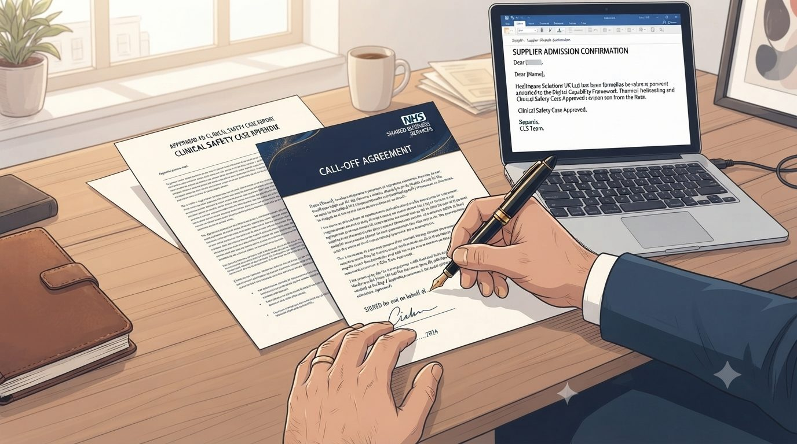
HEARTS AND MINDS · CATHERINE’S JOURNEY · STAGE 4 OF 6
The NHS mandate · commissioning the pathway
04
WHAT THE MODEL IS DOING UNDERNEATH
The ICB-level call-off itself. Suppliers admitted to the platform under the PSA-AS configuration. Each Trust partner brought into the arrangement via a common commissioning schedule. DSAs executed against the framework's template. Clinical safety case approved by each Trust CSO using the framework's AS-specific starter case as the spine. First batch of kits ordered against the AS caseload at the pilot Trust. GP-record and Trust EPR integration switched on. Every step has a published template. Nothing is being designed in the moment.
Catherine commissions the AS pathway at ICB level via an NHS mandate route. Not an external procurement. Not a bespoke tender. A pathway-level commissioning arrangement under which each Trust in her ICB partners into a common national platform. Six weeks from brief to first live Trust, not eighteen months. Payment via published call-off terms. The procurement scar she carried in is not the arrangement she signed.
THE OLD WAY
“I've commissioned pathways that took eighteen months of Trust-by-Trust negotiation. The eighteen months I didn't spend stitching is the eighteen months my AS cohort didn't drift.”
A multi-year bilateral contract with each Trust plus each supplier. Bespoke pricing schedule per Trust. Bespoke clinical safety case per Trust. Bespoke IG per Trust. Each adding months to the deployment timeline. Each reducing the budget left for the actual monitoring.
Catherine
WHAT THE CARE TEAM SEES
Her ICB commercial team handling the mandate route. Each Trust partner's Chief Medical Officer and clinical safety lead. The platform's engagement contact handling the ICB-level call-off. The supplier's clinical operations lead.
Catherine · Hearts and Minds
Commercial positions are agreed in principle and remain subject to the live procurement.
6
Notes:
The NHS mandate · commissioning the pathway
Catherine commissions the AS pathway at ICB level via an NHS mandate route. Not an external procurement. Not a bespoke tender. A pathway-level commissioning arrangement under which each Trust in her ICB partners into a common national platform. Six weeks from brief to first live Trust, not eighteen months. Payment via published call-off terms. The procurement scar she carried in is not the arrangement she signed.
Quote: I've commissioned pathways that took eighteen months of Trust-by-Trust negotiation. The eighteen months I didn't spend stitching is the eighteen months my AS cohort didn't drift.
What the model is doing underneath: The ICB-level call-off itself. Suppliers admitted to the platform under the PSA-AS configuration. Each Trust partner brought into the arrangement via a common commissioning schedule. DSAs executed against the framework's template. Clinical safety case approved by each Trust CSO using the framework's AS-specific starter case as the spine. First batch of kits ordered against the AS caseload at the pilot Trust. GP-record and Trust EPR integration switched on. Every step has a published template. Nothing is being designed in the moment.
The old way: A multi-year bilateral contract with each Trust plus each supplier. Bespoke pricing schedule per Trust. Bespoke clinical safety case per Trust. Bespoke IG per Trust. Each adding months to the deployment timeline. Each reducing the budget left for the actual monitoring.
What the care team sees: Her ICB commercial team handling the mandate route. Each Trust partner's Chief Medical Officer and clinical safety lead. The platform's engagement contact handling the ICB-level call-off. The supplier's clinical operations lead.

Slide 7

HEARTS AND MINDS · CATHERINE’S JOURNEY · STAGE 5 OF 6
Live operation · kits out, results back
05
WHAT THE MODEL IS DOING UNDERNEATH
The MI dashboard. Kits ordered. Kits delivered. Results returned. AS-review-cycle completion rate. Trend movements and re-biopsy triggers. Outpatient clinic minutes released per patient. Trust-level utilisation of the framework across her ICB. Equity reach across her deprived wards. Reactive support paths for out-of-range PSA results. The numbers are visible in real time. Catherine doesn't need to wait for the annual return.
First quarter live at the pilot Trust. Kits going out to AS patients on their monitoring cadence. Capillary PSA results returning into consultant urologist review lists ahead of AS clinic follow-ups. Trend analysis running against each patient's AS baseline. The pathway holds. Second and third Trusts due to activate over the next two quarters against the same call-off.
THE OLD WAY
Trust-by-Trust MI. Manual reconciliation across her partners to see the ICB-level picture. Manual chasing of AS clinic completion rates. No comparable view across her Trusts until the annual report. The risk: finding out a year late that the pilot Trust's AS drift was masking a system-level issue.
“Patients don't see commissioning. They see a kit in the post and their consultant urologist opening the AS review with the number already in front of them. The pathway holds.”
Catherine
WHAT THE CARE TEAM SEES
Trust consultant urologists running AS clinics. The supplier running the kit logistics. The platform running the data layer with GP-record and Trust EPR write-back. Each Trust's clinical governance running local safety oversight. Catherine looking at the ICB-level MI feed weekly.
Catherine · Hearts and Minds
Commercial positions are agreed in principle and remain subject to the live procurement.
7
Notes:
Live operation · kits out, results back
First quarter live at the pilot Trust. Kits going out to AS patients on their monitoring cadence. Capillary PSA results returning into consultant urologist review lists ahead of AS clinic follow-ups. Trend analysis running against each patient's AS baseline. The pathway holds. Second and third Trusts due to activate over the next two quarters against the same call-off.
Quote: Patients don't see commissioning. They see a kit in the post and their consultant urologist opening the AS review with the number already in front of them. The pathway holds.
What the model is doing underneath: The MI dashboard. Kits ordered. Kits delivered. Results returned. AS-review-cycle completion rate. Trend movements and re-biopsy triggers. Outpatient clinic minutes released per patient. Trust-level utilisation of the framework across her ICB. Equity reach across her deprived wards. Reactive support paths for out-of-range PSA results. The numbers are visible in real time. Catherine doesn't need to wait for the annual return.
The old way: Trust-by-Trust MI. Manual reconciliation across her partners to see the ICB-level picture. Manual chasing of AS clinic completion rates. No comparable view across her Trusts until the annual report. The risk: finding out a year late that the pilot Trust's AS drift was masking a system-level issue.
What the care team sees: Trust consultant urologists running AS clinics. The supplier running the kit logistics. The platform running the data layer with GP-record and Trust EPR write-back. Each Trust's clinical governance running local safety oversight. Catherine looking at the ICB-level MI feed weekly.

Slide 8

HEARTS AND MINDS · CATHERINE’S JOURNEY · STAGE 6 OF 6
The ICB paper · what the CMO sees
06
WHAT THE MODEL IS DOING UNDERNEATH
AS-monitoring cadence hold rate against the ICB baseline. Re-biopsy trigger detection versus the in-clinic comparator. Outpatient minutes released per AS patient per year. Cost per AS patient per year against the pre-framework baseline. Patient-reported experience. Reactive-pathway performance for out-of-range PSA results. The recommendation for year two: extend to the next AS-adjacent pathway the platform admits. Same framework. Same call-off shape. Same MI feed.
First-year outcomes across the ICB. AS-cohort monitoring cadence hold rate. Re-biopsy trigger detection at the same or better rate than in-clinic phlebotomy. Outpatient clinic minutes released. Trust-by-Trust adoption curve. The ICB paper writes itself. The next year's ask is for the next AS-adjacent pathway, not the next procurement.
THE OLD WAY
A ICB paper hedged with per-Trust data still maturing. Three years before an ICB-level pattern could be evaluated. By which time the pilot Trust's executive had rotated, the funding envelope had shifted, and the AS cohort had drifted.
“The Chief Medical Officer wanted to know whether the cadence held. The numbers do most of the talking. The pathway-level commissioning behind them is what made the numbers possible.”
Catherine
WHAT THE CARE TEAM SEES
The ICB Chief Medical Officer. The ICB executive committee. Trust chief execs across her partners. The ICB finance team setting the next year's pathway envelope.
Catherine · Hearts and Minds
Commercial positions are agreed in principle and remain subject to the live procurement.
8
Notes:
The ICB paper · what the CMO sees
First-year outcomes across the ICB. AS-cohort monitoring cadence hold rate. Re-biopsy trigger detection at the same or better rate than in-clinic phlebotomy. Outpatient clinic minutes released. Trust-by-Trust adoption curve. The ICB paper writes itself. The next year's ask is for the next AS-adjacent pathway, not the next procurement.
Quote: The Chief Medical Officer wanted to know whether the cadence held. The numbers do most of the talking. The pathway-level commissioning behind them is what made the numbers possible.
What the model is doing underneath: AS-monitoring cadence hold rate against the ICB baseline. Re-biopsy trigger detection versus the in-clinic comparator. Outpatient minutes released per AS patient per year. Cost per AS patient per year against the pre-framework baseline. Patient-reported experience. Reactive-pathway performance for out-of-range PSA results. The recommendation for year two: extend to the next AS-adjacent pathway the platform admits. Same framework. Same call-off shape. Same MI feed.
The old way: A ICB paper hedged with per-Trust data still maturing. Three years before an ICB-level pattern could be evaluated. By which time the pilot Trust's executive had rotated, the funding envelope had shifted, and the AS cohort had drifted.
What the care team sees: The ICB Chief Medical Officer. The ICB executive committee. Trust chief execs across her partners. The ICB finance team setting the next year's pathway envelope.

Slide 9
HEARTS AND MINDS · CATHERINE’S JOURNEY · THE OUTCOME
Catherine's win
AS cadence held across her Trusts. Outpatient minutes released. Re-biopsy triggers detected earlier.
The AS patients didn't see commissioning. They saw a kit in the post and their consultant urologist opening the review with the number already in front of them. The eighteen months Catherine didn't spend stitching Trust deals is the eighteen months her AS cohort didn't drift out of surveillance. The next AS-adjacent pathway is an extension of the same signature, not a new arrangement from a clean sheet.
THE MONEY IN THIS STORY
Catherine buys the pathway once for her whole system: a call-off at a cost per activity, mandated into her acute partners, rather than a contract per Trust. The national ceiling gives her the worst case in writing; local volume competes the real price below it. She pays the supplier direct from the budget she already holds for the cohort.
The return her Trusts feel is capacity: every home draw is a phlebotomy slot handed back to clinics that are short of them.
Commercial positions are agreed in principle and remain subject to the live procurement. See the Money Loop and How Commissioners Buy pages of the operating model.
Catherine · Hearts and Minds
Commercial positions are agreed in principle and remain subject to the live procurement.
9

