Slide 1



HEARTS AND MINDS · HOMETEST OPERATING MODEL · PATIENT JOURNEY
Devi.
A Saturday,
not a sick day.
Devi is 47, works full-time as a care coordinator, has two children and a mother she helps care for. Her GP, Hannah, holds her on the practice at-risk register. Family history of type 2 diabetes and her ethnicity put her HbA1c on annual review. Her last result sat at 44 mmol/mol, comfortably below diagnosis but firmly in the pre-diabetes band. The Tuesday-morning slot to get the next blood was never going to happen. This is the story of how she stays in surveillance without staying out of work.
Devi
A patient's story through the operating model
At-risk register · HbA1c annual review · Primary-care surveillance cohort
HomeTest Operating Model · Hearts and Minds
Commercial positions are agreed in principle and remain subject to the live procurement.

Slide 2

HEARTS AND MINDS · PATIENT JOURNEY
Devi’s journey at a glance
1
Stratification
2
Identification
3
Testing
4
Response
5
Long-term optimisation
the cohort the clinic finds hardest to keep
Hannah's practice flags her
the HbA1c on a Saturday morning
the plan adjusted on the trend
the cycle that fits her life
THE PATIENT NORTH STAR
WHY THIS WORKS FOR HER
The bloods need doing. The clinic visit never needed to be the way to do them.
No half-day off. No childcare juggle. No DNA letter saying she is the problem.
Devi is on the at-risk register. The register needs an annual HbA1c or the cohort drifts. The clinic has always been the venue for the annual bloods, but the clinic is exactly the venue that does not work for her life. Move the venue. Keep the surveillance.
A Saturday-morning sample. The result back in Hannah's system on time. The next twelve months either continuing the same lifestyle plan or triggering a DPP referral if the trend shifts. The system stops blaming her for the venue being wrong.
Devi · Hearts and Minds
Commercial positions are agreed in principle and remain subject to the live procurement.
2

Slide 3

HEARTS AND MINDS · DEVI’S JOURNEY · STAGE 1 OF 5
Stratification, the cohort the clinic finds hardest to keep
01
WHAT THE MODEL IS DOING UNDERNEATH
NICE NG28 sets the T2D management framework once diagnosis lands; ahead of diagnosis, the practice at-risk register is the surveillance mechanism. The cadence is an annual HbA1c review while HbA1c sits in the 42 to 47 mmol/mol pre-diabetes band. The cohort is well-defined; the access problem is the failure to attend appointments at clinic-friendly hours.
Around one in six UK adults sits on a diabetes at-risk register, weighted heavily to South Asian, Black African and Black Caribbean populations and to those with a family history of type 2 diabetes. The people the register serves worst are the ones already carrying too many obligations to add a mid-week clinic visit. The clinical framework is settled. The venue mismatch is structural.
THE OLD WAY
Treat the working-age at-risk register the same as a 9-to-5 retired patient cohort. Watch DNA rates climb. Send rebooking letters. Drop patients off the review cycle. Meet them again at the point of diagnosis with an HbA1c well above 48.
“Every year, the reminder letter arrives. Every year, I mean to book it. Every year, the week I meant to do it disappears into something else. It is not the test that is the problem.”
WHAT THE CARE TEAM SEES
Devi
Hannah, GP. Practice nurse running the at-risk register. Anita on the ICB / GP commissioner side.
Devi · Hearts and Minds
Commercial positions are agreed in principle and remain subject to the live procurement.
3
Notes:
Stratification, the cohort the clinic finds hardest to keep
Around one in six UK adults sits on a diabetes at-risk register, weighted heavily to South Asian, Black African and Black Caribbean populations and to those with a family history of type 2 diabetes. The people the register serves worst are the ones already carrying too many obligations to add a mid-week clinic visit. The clinical framework is settled. The venue mismatch is structural.
Quote: Every year, the reminder letter arrives. Every year, I mean to book it. Every year, the week I meant to do it disappears into something else. It is not the test that is the problem.
What the model is doing underneath: NICE NG28 sets the T2D management framework once diagnosis lands; ahead of diagnosis, the practice at-risk register is the surveillance mechanism. The cadence is an annual HbA1c review while HbA1c sits in the 42 to 47 mmol/mol pre-diabetes band. The cohort is well-defined; the access problem is the failure to attend appointments at clinic-friendly hours.
The old way: Treat the working-age at-risk register the same as a 9-to-5 retired patient cohort. Watch DNA rates climb. Send rebooking letters. Drop patients off the review cycle. Meet them again at the point of diagnosis with an HbA1c well above 48.
What the care team sees: Hannah, GP. Practice nurse running the at-risk register. Anita on the ICB / GP commissioner side.

Slide 4
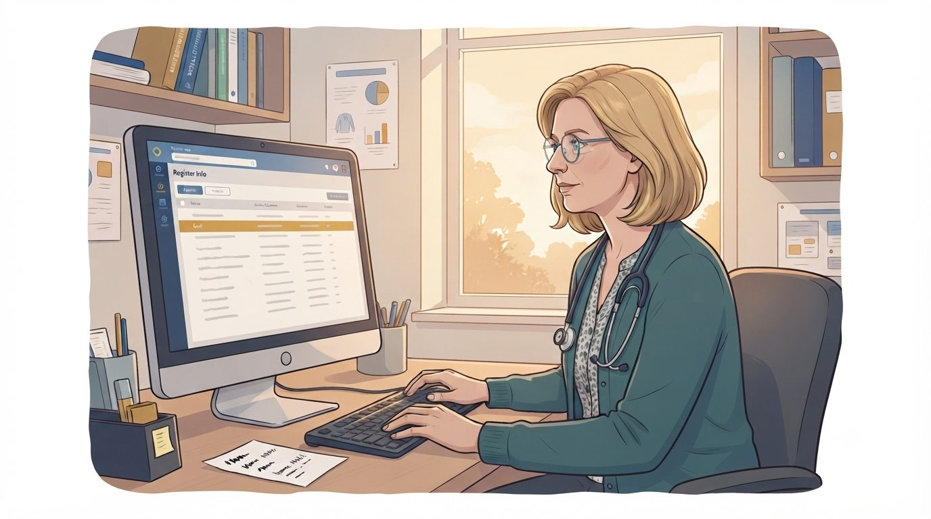
HEARTS AND MINDS · DEVI’S JOURNEY · STAGE 2 OF 5
Identification, Hannah's practice flags her
02
WHAT THE MODEL IS DOING UNDERNEATH
Around 15 million general-practice appointments are missed each year, costing the NHS £216 million. The cohort that misses annual reviews is the cohort the clinic-only model fails by design. The home pathway is the structural answer, not a service-recovery patch.
Hannah is reviewing the at-risk register. Devi is overdue her annual HbA1c, with a flag on the record for previously missed appointments. The practice opens the conversation about doing the next blood at home. The friction was always the venue; the offer changes the venue.
THE OLD WAY
Re-book, re-book, re-book, miss, drop out of the review cycle, and meet her again a year later at diagnosis with a lifestyle-change window already closed.
“Hannah said: do you want to try doing the next HbA1c at home? I said yes before she finished the sentence.”
WHAT THE CARE TEAM SEES
Devi
Hannah. Practice nurse running the register. Practice manager. Anita.
Devi · Hearts and Minds
Commercial positions are agreed in principle and remain subject to the live procurement.
4
Notes:
Identification, Hannah's practice flags her
Hannah is reviewing the at-risk register. Devi is overdue her annual HbA1c, with a flag on the record for previously missed appointments. The practice opens the conversation about doing the next blood at home. The friction was always the venue; the offer changes the venue.
Quote: Hannah said: do you want to try doing the next HbA1c at home? I said yes before she finished the sentence.
What the model is doing underneath: Around 15 million general-practice appointments are missed each year, costing the NHS £216 million. The cohort that misses annual reviews is the cohort the clinic-only model fails by design. The home pathway is the structural answer, not a service-recovery patch.
The old way: Re-book, re-book, re-book, miss, drop out of the review cycle, and meet her again a year later at diagnosis with a lifestyle-change window already closed.
What the care team sees: Hannah. Practice nurse running the register. Practice manager. Anita.

Slide 5
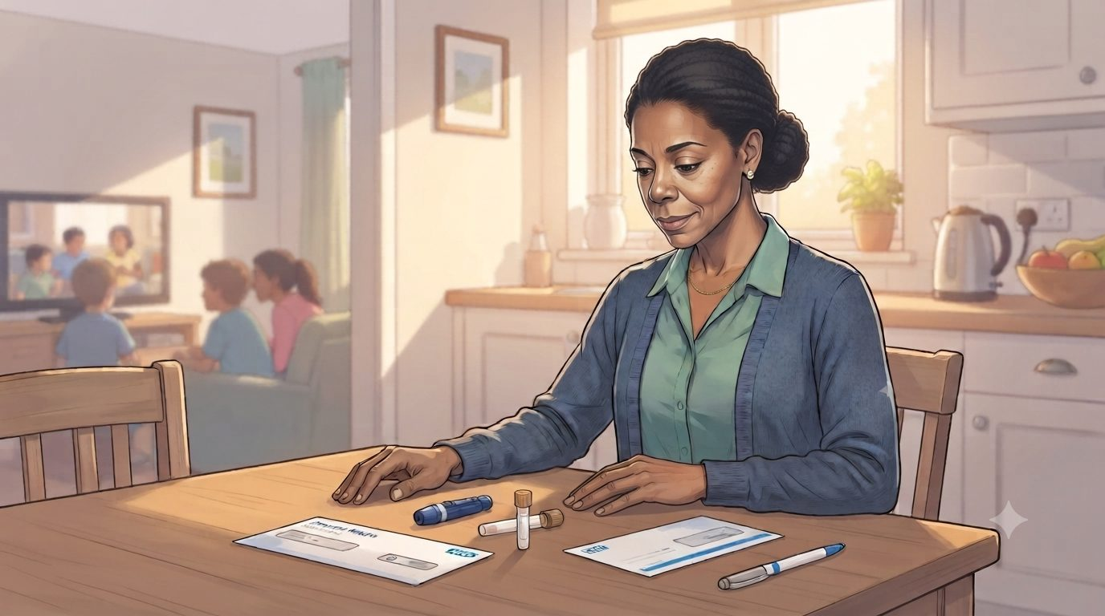
HEARTS AND MINDS · DEVI’S JOURNEY · STAGE 3 OF 5
Testing, the HbA1c on a Saturday morning
03
WHAT THE MODEL IS DOING UNDERNEATH
The home capillary HbA1c is a recognised pathway for annual review. The sample is processed at a UKAS-accredited lab on a DCCT-aligned assay platform, the same performance standard applied to in-clinic samples. The result writes back to the practice EPR via the framework integration.
The kit arrives. Devi takes the capillary sample at the kitchen table on a Saturday morning while the kids are watching TV. She posts it back. The lab processes it on a DCCT-aligned assay platform, the same performance standard the practice's venous samples are held to. The result lands in Hannah's GP system in time for the annual review the clinic would have run.
THE OLD WAY
Take a half-day off work. Find childcare. Sit in the waiting room. Get the blood drawn in 90 seconds. Drive home. The friction is the day, not the test.
“It was a Saturday job. I did it before the kids were up. I posted it on the way to the shops. I forgot about it until the result came through on the app.”
WHAT THE CARE TEAM SEES
The supplier shipping the kit. The lab. The platform writing the result back. Devi.
Devi
Devi · Hearts and Minds
Commercial positions are agreed in principle and remain subject to the live procurement.
5
Notes:
Testing, the HbA1c on a Saturday morning
The kit arrives. Devi takes the capillary sample at the kitchen table on a Saturday morning while the kids are watching TV. She posts it back. The lab processes it on a DCCT-aligned assay platform, the same performance standard the practice's venous samples are held to. The result lands in Hannah's GP system in time for the annual review the clinic would have run.
Quote: It was a Saturday job. I did it before the kids were up. I posted it on the way to the shops. I forgot about it until the result came through on the app.
What the model is doing underneath: The home capillary HbA1c is a recognised pathway for annual review. The sample is processed at a UKAS-accredited lab on a DCCT-aligned assay platform, the same performance standard applied to in-clinic samples. The result writes back to the practice EPR via the framework integration.
The old way: Take a half-day off work. Find childcare. Sit in the waiting room. Get the blood drawn in 90 seconds. Drive home. The friction is the day, not the test.
What the care team sees: The supplier shipping the kit. The lab. The platform writing the result back. Devi.

Slide 6
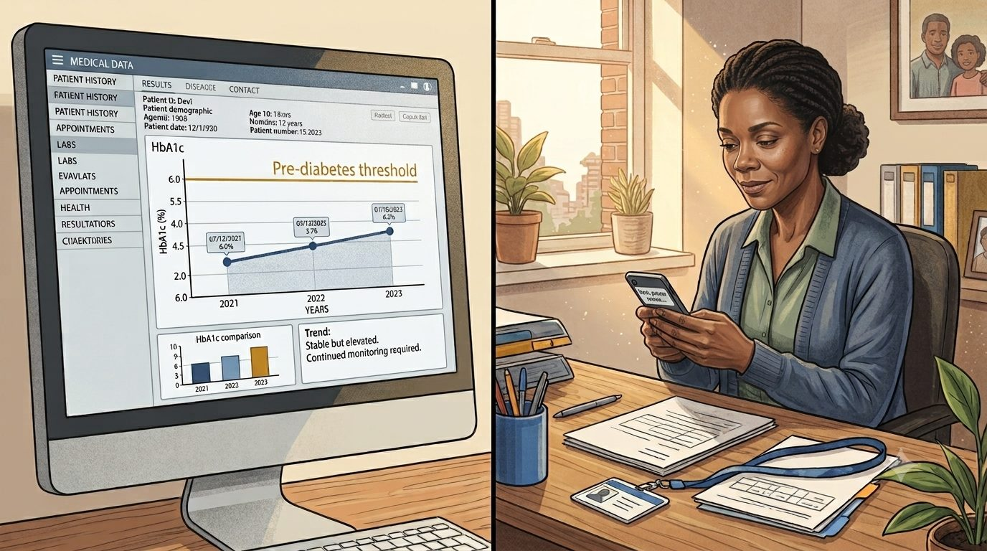
HEARTS AND MINDS · DEVI’S JOURNEY · STAGE 4 OF 5
Response, the plan adjusted on the trend
04
WHAT THE MODEL IS DOING UNDERNEATH
The response pathway is NICE-guideline-aligned and unchanged by the home venue. Continued lifestyle support while HbA1c holds; NHS DPP referral if the trend moves; formal diagnosis conversation if two consecutive samples cross the 48 mmol/mol threshold. The GP holds the clinical accountability.
The result confirms her HbA1c trend. Hannah reviews it alongside the prior years. HbA1c holding steady at 44 mmol/mol means the lifestyle plan stands and the next review lands in twelve months. A shift into the mid-40s triggers a targeted conversation and a possible NHS Diabetes Prevention Programme referral. A shift past 48 on a repeat sample triggers the diagnosis conversation, exactly as it would have from an in-clinic sample. The clinical conversation, when needed, happens by phone or message.
THE OLD WAY
Drag the patient back into clinic to discuss a result that was always going to be a continuation of the same plan. The visit was the cost; the message was the value.
“Hannah sent me a message. Same plan, see you in twelve months. That was the entire appointment. I was at work.”
WHAT THE CARE TEAM SEES
Devi
Hannah. NHS DPP referral pathway if HbA1c drifts. NICE NG28 if diagnosis lands.
Devi · Hearts and Minds
Commercial positions are agreed in principle and remain subject to the live procurement.
6
Notes:
Response, the plan adjusted on the trend
The result confirms her HbA1c trend. Hannah reviews it alongside the prior years. HbA1c holding steady at 44 mmol/mol means the lifestyle plan stands and the next review lands in twelve months. A shift into the mid-40s triggers a targeted conversation and a possible NHS Diabetes Prevention Programme referral. A shift past 48 on a repeat sample triggers the diagnosis conversation, exactly as it would have from an in-clinic sample. The clinical conversation, when needed, happens by phone or message.
Quote: Hannah sent me a message. Same plan, see you in twelve months. That was the entire appointment. I was at work.
What the model is doing underneath: The response pathway is NICE-guideline-aligned and unchanged by the home venue. Continued lifestyle support while HbA1c holds; NHS DPP referral if the trend moves; formal diagnosis conversation if two consecutive samples cross the 48 mmol/mol threshold. The GP holds the clinical accountability.
The old way: Drag the patient back into clinic to discuss a result that was always going to be a continuation of the same plan. The visit was the cost; the message was the value.
What the care team sees: Hannah. NHS DPP referral pathway if HbA1c drifts. NICE NG28 if diagnosis lands.

Slide 7

HEARTS AND MINDS · DEVI’S JOURNEY · STAGE 5 OF 5
Long-term optimisation, the cycle that fits her life
05
WHAT THE MODEL IS DOING UNDERNEATH
Sustained engagement with the annual review is what closes the pre-diabetes window. The home cycle holds the patient in the cohort, surfaces threshold breaches on time, and frees the practice nurse slot for the patients who clinically need clinic.
Devi stays in the cycle. The next HbA1c is on a calendar reminder in twelve months. The kit will arrive. The Saturday morning will happen. The trend will be reviewed. Devi stays on surveillance to the same clinical standard she would have had from clinic bloods, and the practice no longer carries her DNA history.
THE OLD WAY
Drift out of the cycle. Re-present in a year or two with an HbA1c already past 48 and the pre-diabetes lifestyle-change window closed. The clinical risk was always in the model, not the patient.
“I do not feel like the patient who keeps letting them down anymore. I just feel like a patient.”
WHAT THE CARE TEAM SEES
Devi
Devi. Hannah. The practice nurse holding the at-risk register. The platform holding the cycle reminder.
Devi · Hearts and Minds
Commercial positions are agreed in principle and remain subject to the live procurement.
7
Notes:
Long-term optimisation, the cycle that fits her life
Devi stays in the cycle. The next HbA1c is on a calendar reminder in twelve months. The kit will arrive. The Saturday morning will happen. The trend will be reviewed. Devi stays on surveillance to the same clinical standard she would have had from clinic bloods, and the practice no longer carries her DNA history.
Quote: I do not feel like the patient who keeps letting them down anymore. I just feel like a patient.
What the model is doing underneath: Sustained engagement with the annual review is what closes the pre-diabetes window. The home cycle holds the patient in the cohort, surfaces threshold breaches on time, and frees the practice nurse slot for the patients who clinically need clinic.
The old way: Drift out of the cycle. Re-present in a year or two with an HbA1c already past 48 and the pre-diabetes lifestyle-change window closed. The clinical risk was always in the model, not the patient.
What the care team sees: Devi. Hannah. The practice nurse holding the at-risk register. The platform holding the cycle reminder.

Slide 8
HEARTS AND MINDS · DEVI’S JOURNEY · THE OUTCOME
Devi's win
On the register. In work. In the cohort the system actually holds, not the cohort the system quietly drops.
Devi does not see commissioning, frameworks or platforms. She sees a kit through the door, a Saturday morning sample, and a message from Hannah saying see you in twelve months. The half-day off she did not take is the half-day she got with her family instead. The cycle holds.
THE MONEY IN THIS STORY
Devi's review is paid for when it happens. The at-risk register funds a cost per activity for each completed test, so the Tuesday appointment she could never make stops being the unit the system pays for. A kit through the door costs a few pounds; the booked slot, the recall letters and the missed morning cost more. Money that used to buy clinic time that did not happen now buys results that did.
Commercial positions are agreed in principle and remain subject to the live procurement. See the Money Loop and How Commissioners Buy pages of the operating model.
Devi · Hearts and Minds
Commercial positions are agreed in principle and remain subject to the live procurement.
8

