Slide 1


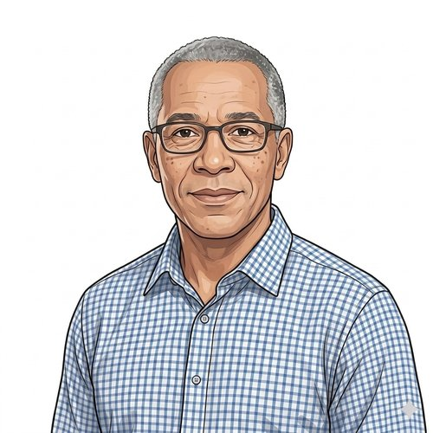
HEARTS AND MINDS · HOMETEST OPERATING MODEL · PATIENT JOURNEY
Mark.
His consultant
still reads
the trend.
Mark is 65. Diagnosed with low-risk prostate cancer and placed on active surveillance under Adam at the local trust. The quarterly PSA is supposed to be routine. The clinic trip to get it is anything but. This is the story of how the surveillance happens at home and the clinical accountability stays in clinic.
Mark
A patient's story through the operating model
Patient on active surveillance · PSA-AS cohort
HomeTest Operating Model · Hearts and Minds
Commercial positions are agreed in principle and remain subject to the live procurement.

Slide 2

HEARTS AND MINDS · PATIENT JOURNEY
Mark’s journey at a glance
1
Stratification
2
Identification
3
Diagnosis
4
Treatment
5
Long-term optimisation
the cohort eligible for active surveillance
Adam's clinic shortlists him
kit out, sample back, result to the consultant first
the surveillance itself
the surveillance that keeps him in surveillance
THE PATIENT NORTH STAR
WHY THIS WORKS FOR HIM
His consultant still holds the cohort. The quarterly visit just does not need to be in clinic.
Travel saved. Half-days saved. The same surveillance, on time.
Mark trusts Adam. The active-surveillance cohort works because the clinician is reading the trend. The home pathway preserves the clinical role and removes the clinic visit that did nothing but draw the blood.
Mark has worked through it, taken his kids to school, looked after a parent. The hospital is an hour's drive. The clinic visit was always the friction; the blood result was always the point. The kit moves the friction; the clinical decision-making stays exactly where it was.
Mark · Hearts and Minds
Commercial positions are agreed in principle and remain subject to the live procurement.
2

Slide 3

HEARTS AND MINDS · MARK’S JOURNEY · STAGE 1 OF 5
Stratification, the cohort eligible for active surveillance
01
WHAT THE MODEL IS DOING UNDERNEATH
NICE NG131 sets the framework for active surveillance in low-risk prostate cancer: regular PSA, MRI at intervals, repeat biopsy as triggered by trend. The cohort is well-defined. The challenge is holding the cohort in surveillance without burning the clinic.
More than 64,000 men a year are diagnosed with prostate cancer in the UK. Around 6,500 a year choose active surveillance; up to 5,000 more could. Mark sits in that cohort: low-risk disease, watch-and-wait, quarterly PSA. The surveillance is the treatment.
THE OLD WAY
An expanding AS cohort funnelled through fixed clinic capacity. Patients drop out, present later, get treated harder.
“I am sixty-five and I have prostate cancer. They told me it is the kind that does not need treating, just watching. That is the bit nobody warns you about, what the watching actually costs.”
WHAT THE CARE TEAM SEES
Adam, consultant urologist. The MDT. Catherine on the Trust commissioner side. Mark.
Mark
Mark · Hearts and Minds
Commercial positions are agreed in principle and remain subject to the live procurement.
3
Notes:
Stratification, the cohort eligible for active surveillance
More than 64,000 men a year are diagnosed with prostate cancer in the UK. Around 6,500 a year choose active surveillance; up to 5,000 more could. Mark sits in that cohort: low-risk disease, watch-and-wait, quarterly PSA. The surveillance is the treatment.
Quote: I am sixty-five and I have prostate cancer. They told me it is the kind that does not need treating, just watching. That is the bit nobody warns you about, what the watching actually costs.
What the model is doing underneath: NICE NG131 sets the framework for active surveillance in low-risk prostate cancer: regular PSA, MRI at intervals, repeat biopsy as triggered by trend. The cohort is well-defined. The challenge is holding the cohort in surveillance without burning the clinic.
The old way: An expanding AS cohort funnelled through fixed clinic capacity. Patients drop out, present later, get treated harder.
What the care team sees: Adam, consultant urologist. The MDT. Catherine on the Trust commissioner side. Mark.

Slide 4

HEARTS AND MINDS · MARK’S JOURNEY · STAGE 2 OF 5
Identification, Adam's clinic shortlists him
02
WHAT THE MODEL IS DOING UNDERNEATH
The first patients are picked by the consultant, in clinic, with consent and clinical judgement. The cohort is bounded carefully. The conversation is short because the model preserves the clinical role.
Adam reviews the cohort. Mark fits the profile for the first wave of home PSA: stable trend, comfortable with the kit idea, no clinical concerns. The shortlist of first patients is small and chosen carefully. Mark gets the conversation at the next clinic.
THE OLD WAY
Bring everyone in for everything, because there is no other model on offer. The cohort is held by clinic capacity, not clinical judgement.
“Adam asked me whether I would be comfortable doing the next PSA at home. I said yes before he had finished the sentence.”
WHAT THE CARE TEAM SEES
Adam. Clinical nurse specialist. Mark.
Mark
Mark · Hearts and Minds
Commercial positions are agreed in principle and remain subject to the live procurement.
4
Notes:
Identification, Adam's clinic shortlists him
Adam reviews the cohort. Mark fits the profile for the first wave of home PSA: stable trend, comfortable with the kit idea, no clinical concerns. The shortlist of first patients is small and chosen carefully. Mark gets the conversation at the next clinic.
Quote: Adam asked me whether I would be comfortable doing the next PSA at home. I said yes before he had finished the sentence.
What the model is doing underneath: The first patients are picked by the consultant, in clinic, with consent and clinical judgement. The cohort is bounded carefully. The conversation is short because the model preserves the clinical role.
The old way: Bring everyone in for everything, because there is no other model on offer. The cohort is held by clinic capacity, not clinical judgement.
What the care team sees: Adam. Clinical nurse specialist. Mark.

Slide 5
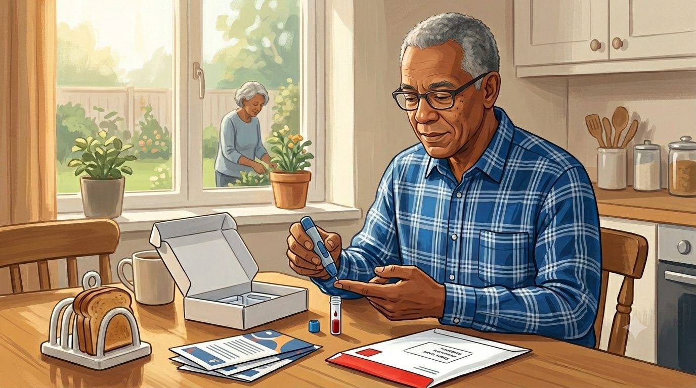
HEARTS AND MINDS · MARK’S JOURNEY · STAGE 3 OF 5
Diagnosis, kit out, sample back, result to the consultant first
03
WHAT THE MODEL IS DOING UNDERNEATH
1.25 billion NHS pathology test requests per year, growing ~5.5% annually. Home capillary PSA is the same biochemical assay run on the same lab platform. The clinical interpretation is preserved.
The kit arrives. Mark takes the sample at home on the day the clinic would have happened. The lab processes it. The result lands in Adam's system before the next clinic, in trend, with the threshold-alert logic wired in. Mark sees the result only after Adam has read it.
THE OLD WAY
Two trips to the hospital, phlebotomy for the blood, second trip for the result. Or, on a bad cycle, a missed appointment and a quietly delayed surveillance round.
“The kit came in the post. I did it on the Saturday morning. By the following Tuesday I knew Adam had seen the result. Same answer I would have got at the hospital. None of the driving.”
WHAT THE CARE TEAM SEES
The supplier shipping the kit. UKAS-accredited lab. Platform writing the result back to the Trust EPR. Adam reading the trend.
Mark
Mark · Hearts and Minds
Commercial positions are agreed in principle and remain subject to the live procurement.
5
Notes:
Diagnosis, kit out, sample back, result to the consultant first
The kit arrives. Mark takes the sample at home on the day the clinic would have happened. The lab processes it. The result lands in Adam's system before the next clinic, in trend, with the threshold-alert logic wired in. Mark sees the result only after Adam has read it.
Quote: The kit came in the post. I did it on the Saturday morning. By the following Tuesday I knew Adam had seen the result. Same answer I would have got at the hospital. None of the driving.
What the model is doing underneath: 1.25 billion NHS pathology test requests per year, growing ~5.5% annually. Home capillary PSA is the same biochemical assay run on the same lab platform. The clinical interpretation is preserved.
The old way: Two trips to the hospital, phlebotomy for the blood, second trip for the result. Or, on a bad cycle, a missed appointment and a quietly delayed surveillance round.
What the care team sees: The supplier shipping the kit. UKAS-accredited lab. Platform writing the result back to the Trust EPR. Adam reading the trend.

Slide 6
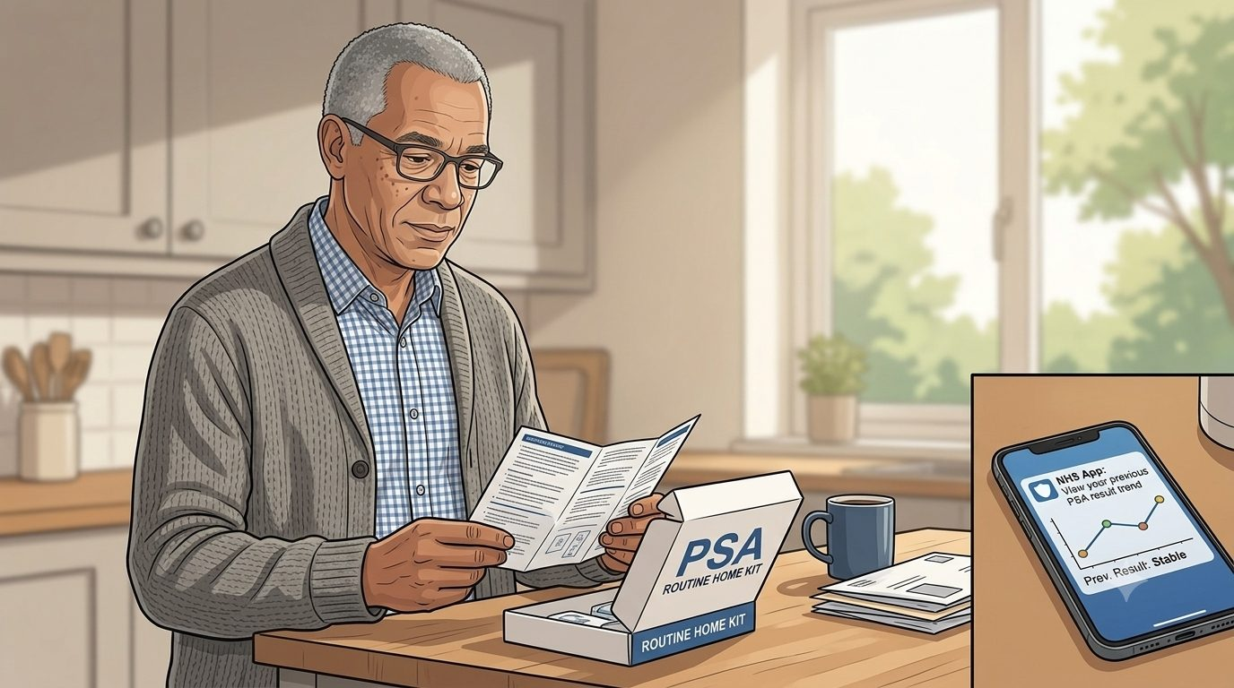
HEARTS AND MINDS · MARK’S JOURNEY · STAGE 4 OF 5
Treatment, the surveillance itself
04
WHAT THE MODEL IS DOING UNDERNEATH
The surveillance protocol per NICE NG131 is unchanged. Threshold breaches escalate to MDT review and additional imaging. Stable trends roll through routine review without consuming clinic time.
Active surveillance IS the treatment. The clinical work is the trend interpretation. Adam reads Mark's PSA in the context of every prior reading and the imaging cycle. Most cycles, nothing changes. The model has not removed the clinical decision; it has removed the unnecessary clinical visit.
THE OLD WAY
Every patient in clinic every quarter, regardless of trend. The signal-to-noise of clinic visits was always poor; routine stability was confirmed in person at the cost of the patients who clinically needed clinic.
“I felt a bit guilty at first that I had not been in to see him. Then I realised the visit was never the bit that mattered. He was always reading the number, not me.”
WHAT THE CARE TEAM SEES
Adam. The MDT. The radiologist on the imaging cycle.
Mark
Mark · Hearts and Minds
Commercial positions are agreed in principle and remain subject to the live procurement.
6
Notes:
Treatment, the surveillance itself
Active surveillance IS the treatment. The clinical work is the trend interpretation. Adam reads Mark's PSA in the context of every prior reading and the imaging cycle. Most cycles, nothing changes. The model has not removed the clinical decision; it has removed the unnecessary clinical visit.
Quote: I felt a bit guilty at first that I had not been in to see him. Then I realised the visit was never the bit that mattered. He was always reading the number, not me.
What the model is doing underneath: The surveillance protocol per NICE NG131 is unchanged. Threshold breaches escalate to MDT review and additional imaging. Stable trends roll through routine review without consuming clinic time.
The old way: Every patient in clinic every quarter, regardless of trend. The signal-to-noise of clinic visits was always poor; routine stability was confirmed in person at the cost of the patients who clinically needed clinic.
What the care team sees: Adam. The MDT. The radiologist on the imaging cycle.

Slide 7

HEARTS AND MINDS · MARK’S JOURNEY · STAGE 5 OF 5
Long-term optimisation, the surveillance that keeps him in surveillance
05
WHAT THE MODEL IS DOING UNDERNEATH
Active surveillance retention is the metric that matters: holding patients in the protocol so disease progression is caught early. Home PSA flattens the drop-out curve and keeps the cohort visible to the clinical team.
Mark stays in the cohort. The quarterly PSA happens at home. The annual imaging happens in clinic. The trend stays stable. The cohort grows. Adam holds more patients in surveillance than the clinic-only model could have, and Mark is one of them.
THE OLD WAY
Drop out of surveillance, progress unmonitored, present later with a different staging and a different prognosis. The clinical risk was always in the venue, not the patient.
“It is just part of life now. The kit comes when it is supposed to, I do it, I get on with my week. The hospital is for when something actually needs me there.”
WHAT THE CARE TEAM SEES
Adam. The MDT. Mark.
Mark
Mark · Hearts and Minds
Commercial positions are agreed in principle and remain subject to the live procurement.
7
Notes:
Long-term optimisation, the surveillance that keeps him in surveillance
Mark stays in the cohort. The quarterly PSA happens at home. The annual imaging happens in clinic. The trend stays stable. The cohort grows. Adam holds more patients in surveillance than the clinic-only model could have, and Mark is one of them.
Quote: It is just part of life now. The kit comes when it is supposed to, I do it, I get on with my week. The hospital is for when something actually needs me there.
What the model is doing underneath: Active surveillance retention is the metric that matters: holding patients in the protocol so disease progression is caught early. Home PSA flattens the drop-out curve and keeps the cohort visible to the clinical team.
The old way: Drop out of surveillance, progress unmonitored, present later with a different staging and a different prognosis. The clinical risk was always in the venue, not the patient.
What the care team sees: Adam. The MDT. Mark.

Slide 8
HEARTS AND MINDS · MARK’S JOURNEY · THE OUTCOME
Mark's win
The same surveillance, on time, on a Saturday morning. Adam still holding the cohort. The hospital saved for the moment it is actually needed.
Mark does not see procurement or pathways. He sees a kit through the door and a result his consultant has already read. The clinic visit that did not happen is the clinic visit Adam did not have capacity for anyway. Mark stays in surveillance. The cohort grows.
THE MONEY IN THIS STORY
Nobody invoices Mark for staying at home. Each surveillance test is bought at a cost per activity by the ICB that funds his pathway, paid direct to the supplier that processes it. The hospital loses nothing when he stops travelling in: the money follows the completed test, not the building, and the phlebotomy slot he used four times a year goes to a patient who needs an in-person appointment. His consultant's review is unchanged, and still where the clinical value sits.
Commercial positions are agreed in principle and remain subject to the live procurement. See the Money Loop and How Commissioners Buy pages of the operating model.
Mark · Hearts and Minds
Commercial positions are agreed in principle and remain subject to the live procurement.
8

