Slide 1



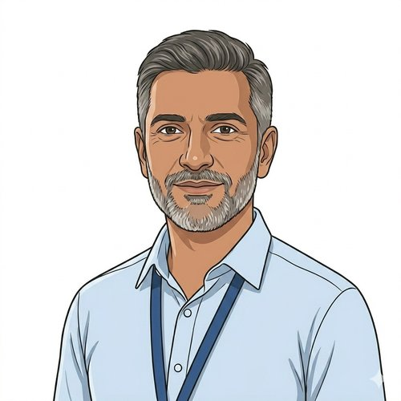
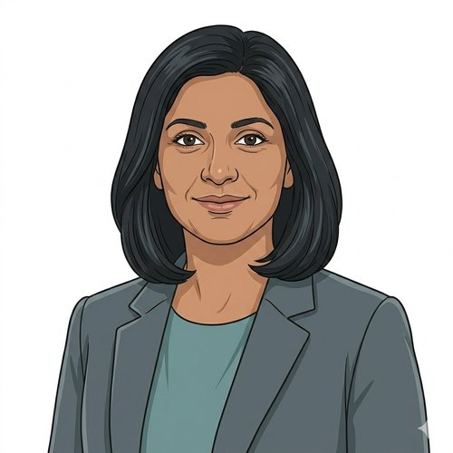
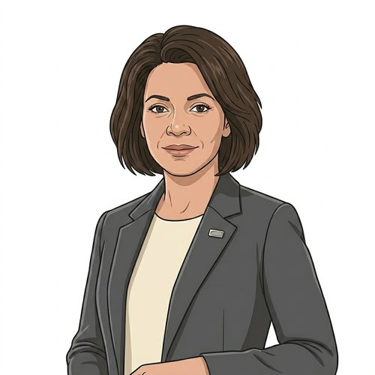

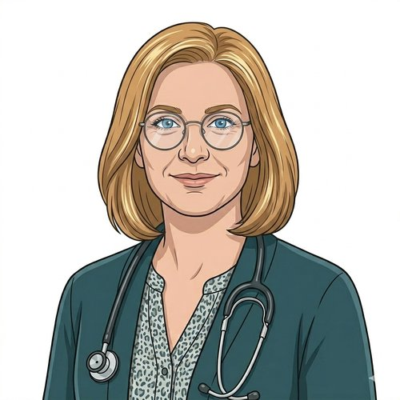
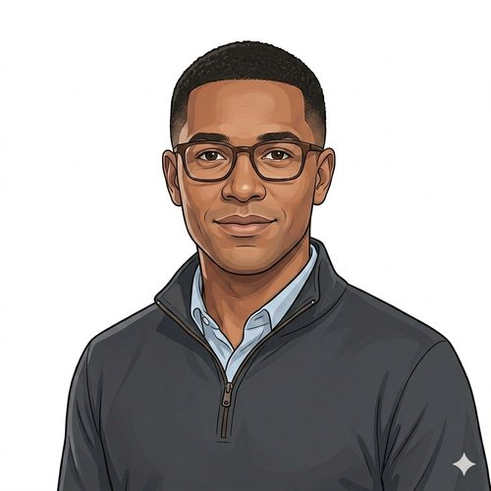

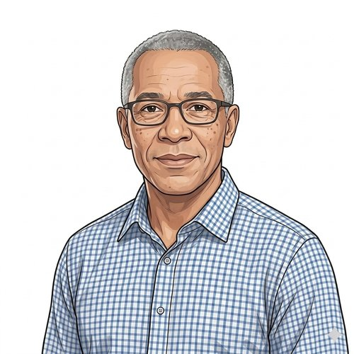
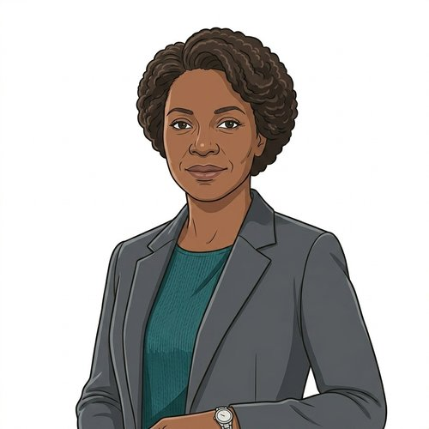
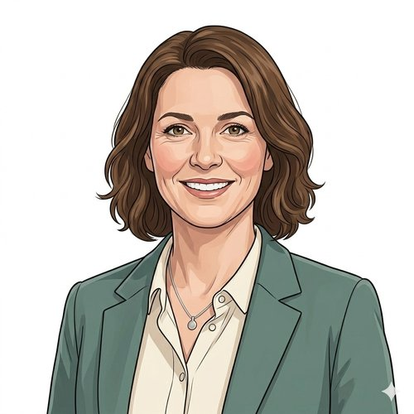
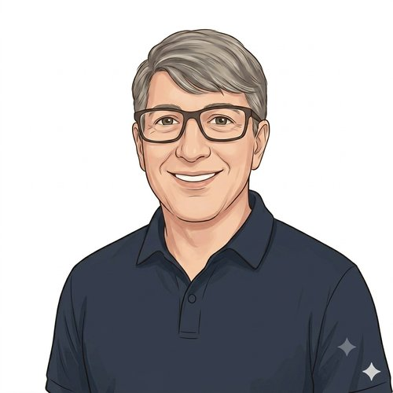
HEARTS AND MINDS · HOMETEST OPERATING MODEL
Twelve people.
One operating model.
Each journey follows one person the HomeTest operating model has to work for: five patients, four commissioners, two clinicians and one supplier. The same platform, the same accredited register and the same commercial mechanics, seen from twelve seats. Every journey has its own deck; this one introduces the cast and gives each journey at a glance.
Abdul
Adam
Anita
Catherine
Devi
Hannah
Joe
Layla
Mark
Ruth
Sarah
Sean
HomeTest Operating Model · Hearts and Minds
Commercial positions are agreed in principle and remain subject to the live procurement.

Slide 2

HEARTS AND MINDS · THE CAST
The patients and the first commissioners
Abdul
Devi
Layla
Self-initiated patient · CVKM cohort
At-risk register · HbA1c annual review · Primary-care surveillance cohort
GP-initiated patient · Iron deficiency anaemia · held configuration
Hidden risk, found by his app.
A Saturday, not a sick day.
Three years on the tablets. The trend is the treatment.
A patient's story through the operating model
A patient's story through the operating model
A patient's story through the operating model, GP-initiated, told as an illustration
Mark
Sean
Anita
Patient on active surveillance · PSA-AS cohort
Horizontal cohort patient · The access story
ICB / GP commissioner · HomeTest HbA1c
His consultant still reads the trend.
Reaching him.
Anita commissions the register. Not each appointment.
A patient's story through the operating model
A patient's story through the operating model
An ICB/GP commissioner's story through the operating model
The cast · Hearts and Minds
Commercial positions are agreed in principle and remain subject to the live procurement.
2

Slide 3
HEARTS AND MINDS · THE CAST
The commissioners, the clinicians and the supplier
Catherine
Ruth
Sarah
ICB commissioner · HomeTest PSA active surveillance
Monitoring-gap commissioner · HomeTest PSA active surveillance · TBC
LA sexual health commissioner · HomeTest HIV
Catherine commissions the pathway. Not each patient.
The cohort between two budgets, and the commissioner who has to own it.
Sarah signs once. Not once a quarter.
An ICB commissioner's story through the operating model
A monitoring-gap commissioner's story through HomeTest, held open as a working hypothesis
A commissioner's story through the operating model
Adam
Hannah
Joe
Consultant urologist · PSA Active Surveillance
GP partner · Primary-care monitoring
Self-sample supplier · Framework-admitted
The patients he cannot see stay in surveillance.
The bloods that never needed a clinic.
Admitted once. Reused everywhere.
A clinician's story through the operating model
A clinician's story through the operating model
A supplier's story through the operating model
The cast · Hearts and Minds
Commercial positions are agreed in principle and remain subject to the live procurement.
3

Slide 4
HEARTS AND MINDS · PATIENT JOURNEY
Abdul’s journey at a glance
1
Stratification
2
Identification
3
Diagnosis
4
Treatment
5
Long-term optimisation
the cohort the system cannot see yet
the NHS App finds him
kit out, sample back
the conversation the result triggers
the cycle that fits his life
THE PATIENT NORTH STAR
WHY THIS WORKS FOR HIM
The system finds him before the symptoms find him.
The NHS App is the front door. The kit is the test. The result is in his record.
Abdul does not feel ill. He has never been to the GP about his heart. The cohort he belongs to, middle-aged men with family-history risk, is exactly the cohort the in-clinic system finds last. The home pathway finds him first.
No clinic visit to book. No phlebotomist to find a slot with. No half-day off work. The kit arrives. He takes the sample. The result lands in the system he already uses for everything else.
Abdul · Hearts and Minds
Commercial positions are agreed in principle and remain subject to the live procurement.
4

Slide 5
HEARTS AND MINDS · PATIENT JOURNEY
Devi’s journey at a glance
1
Stratification
2
Identification
3
Testing
4
Response
5
Long-term optimisation
the cohort the clinic finds hardest to keep
Hannah's practice flags her
the HbA1c on a Saturday morning
the plan adjusted on the trend
the cycle that fits her life
THE PATIENT NORTH STAR
WHY THIS WORKS FOR HER
The bloods need doing. The clinic visit never needed to be the way to do them.
No half-day off. No childcare juggle. No DNA letter saying she is the problem.
Devi is on the at-risk register. The register needs an annual HbA1c or the cohort drifts. The clinic has always been the venue for the annual bloods, but the clinic is exactly the venue that does not work for her life. Move the venue. Keep the surveillance.
A Saturday-morning sample. The result back in Hannah's system on time. The next twelve months either continuing the same lifestyle plan or triggering a DPP referral if the trend shifts. The system stops blaming her for the venue being wrong.
Devi · Hearts and Minds
Commercial positions are agreed in principle and remain subject to the live procurement.
5

Slide 6
HEARTS AND MINDS · PATIENT JOURNEY
Layla’s journey at a glance
1
Stratification
2
Identification
3
Diagnosis
4
Treatment
5
Long-term optimisation
a treated condition, a cycle nobody can see slipping
the practice system orders, nobody has to ask
a sample between shifts
the dose follows the ferritin
silence as the good result
THE PATIENT NORTH STAR
WHY THIS WORKS FOR HER
Known, treated, and never quietly lost.
Her hours change every week. The kit does not care.
Layla is not a diagnosis waiting to happen. She is a patient the system already knows and already treats. The failure mode for someone like her is not a missed screen but a missed check: a six-month cycle that slips to nine, then twelve, while the iron dose that was right three years ago quietly stops being right. Hold the cycle and you hold the treatment.
Two part-time jobs, one on a rota that moves, mean a fixed clinic slot is a bet against her own timetable, and an hour in a waiting room is an hour she is not paid for. A kit that arrives when the cycle is due and gets taken between shifts costs her nothing she cannot spare. The result goes to Hannah. Layla hears from the practice only if the dose needs to change.
Layla · Hearts and Minds
Commercial positions are agreed in principle and remain subject to the live procurement.
6

Slide 7
HEARTS AND MINDS · PATIENT JOURNEY
Mark’s journey at a glance
1
Stratification
2
Identification
3
Diagnosis
4
Treatment
5
Long-term optimisation
the cohort eligible for active surveillance
Adam's clinic shortlists him
kit out, sample back, result to the consultant first
the surveillance itself
the surveillance that keeps him in surveillance
THE PATIENT NORTH STAR
WHY THIS WORKS FOR HIM
His consultant still holds the cohort. The quarterly visit just does not need to be in clinic.
Travel saved. Half-days saved. The same surveillance, on time.
Mark trusts Adam. The active-surveillance cohort works because the clinician is reading the trend. The home pathway preserves the clinical role and removes the clinic visit that did nothing but draw the blood.
Mark has worked through it, taken his kids to school, looked after a parent. The hospital is an hour's drive. The clinic visit was always the friction; the blood result was always the point. The kit moves the friction; the clinical decision-making stays exactly where it was.
Mark · Hearts and Minds
Commercial positions are agreed in principle and remain subject to the live procurement.
7

Slide 8
HEARTS AND MINDS · PATIENT JOURNEY
Sean’s journey at a glance
1
Stratification
2
Identification
3
Diagnosis
4
Treatment
5
Long-term optimisation
on every list, never quite reached
the offer reaches the people who can act on it
a test on his terms, at his kitchen table
the result lands with people who can act
the chain that doesn't break
THE ACCESS NORTH STAR
WHY THIS WORKS FOR HIM
Identification has never been the problem. The chain after it is.
A test at the kitchen table. A family member in the loop. An appointment that doesn't fight the rest of his life.
Sean's cohort lives 19.5 years shorter than the rest of the population. Thirty-nine per cent of those deaths are judged avoidable. The flags, the registers and the legal duty to provide accessible information have all been in place for years. The home pathway is the first venue where the system finally reaches the person it has been carrying on a list.
The clinic appointment fights every other thing in Sean's day: the OCD-driven late nights, the handwashing routines, the missed bus, the lost letter, the family that doesn't know it was even happening. Move the venue, register the family as authorised, and almost all of that friction disappears. The independence Sean fights for stays whole.
Sean · Hearts and Minds
Commercial positions are agreed in principle and remain subject to the live procurement.
8

Slide 9
HEARTS AND MINDS · COMMISSIONER JOURNEY
Anita’s journey at a glance
1
The brief
2
One front door
3
Fit for HER cohort
4
One call-off
5
Live operation
6
The board paper
A gap on the dashboard
The framework opens
The questions standard answers don't solve
Signing, not procuring
Kits out, results back
What the members see
THE NORTH STAR
WHY ONE PLATFORM MATTERS TO HER
Commission at register scale. So the annual HbA1c review cadence holds across the at-risk cohort without pulling clinic slots.
One national arrangement. One register-level call-off. One platform every at-risk register patient in her ICB can flow through.
ICB/GP commissioners do not want a separate deal per GP practice. They want one register-level arrangement that every at-risk patient across their ICB flows through, regardless of which practice they attend. The operating model exists so the ICB commissions the annual HbA1c review at register level and each practice plugs in against a common national arrangement. Register-level commissioning is the North Star, because effort spent stitching practice-by-practice deals is effort not spent holding the cadence.
A bespoke HbA1c deal with one practice federation would buy one deployment. The next federation (or the next annual-review test the register carries) would mean another arrangement, another assurance set, another contract, another integration. The national arrangement means Anita commissions the register once, every practice in her ICB plugs into the same call-off, the same GP-record write-back answers the same questions, and the next primary-care annual-review test is an extension. The integration was done before she walked in.
Anita · Hearts and Minds
Commercial positions are agreed in principle and remain subject to the live procurement.
9

Slide 10
HEARTS AND MINDS · COMMISSIONER JOURNEY
Catherine’s journey at a glance
1
The brief
2
One front door
3
Fit for HER cohort
4
One call-off
5
Live operation
6
The board paper
A gap on the dashboard
The framework opens
The questions standard answers don't solve
Signing, not procuring
Kits out, results back
What the members see
THE NORTH STAR
WHY ONE PLATFORM MATTERS TO HER
Commission the pathway, not the patient. So the ICB buys once and the AS caseload holds together across Trusts.
One national arrangement. One pathway. One platform every AS patient in her ICB can flow through.
ICB commissioners do not want a separate contract per Trust. They want one pathway-level arrangement that every AS patient in their system can flow through, regardless of which Trust is doing their monitoring. The operating model exists so the ICB commissions the AS pathway once at pathway level and each Trust plugs in against a common national arrangement. Pathway-level commissioning is the North Star, because effort spent stitching Trust-by-Trust deals is effort not spent on the caseload.
A bespoke PSA-AS deal with one Trust would buy one deployment. The next Trust in her ICB (or the next AS-adjacent pathway) would mean another arrangement, another assurance set, another contract, another integration. The national arrangement means Catherine commissions the pathway once, every Trust in her ICB plugs into the same call-off, the same MI feed answers the same questions, and the next AS-adjacent pathway is an extension. The integration was done before she walked in.
Catherine · Hearts and Minds
Commercial positions are agreed in principle and remain subject to the live procurement.
10

Slide 11
HEARTS AND MINDS · COMMISSIONER JOURNEY
Ruth’s journey at a glance
1
The brief
2
One front door
3
Fit for this cohort
4
The buy
5
Live operation
6
The case for funding
A cohort between two budgets
What the framework has already settled
The protocol has to exist first
A call-off once the owner is clear
The gap closes
Early detection, shown
WHAT RUTH IS TRYING TO DO
WHAT THE MODEL ALREADY GIVES HER
Close a monitoring gap that nobody currently owns
A configuration that exists, and five questions it cannot answer for her
Men referred to Urology with a raised PSA and no cancer found go back to their GP with an instruction to keep an eye on it. Some are monitored well. Some drift. The cohort has no single budget holder, no agreed cadence and no one measuring whether the monitoring happens. Ruth's job is to make that cohort someone's responsibility, with a supplier behind it that has already been assured.
PSA active surveillance is the board-selected acute use case, scored Priority 2 (35/45) under the Prioritisation Framework. The kit, the labs, the NHS App journey and the supplier assurance are the same ones Mark's cohort uses. What the model deliberately holds open is who Ruth is: her institution, her budget source, the clinical owner, the protocol cadence and the contract shape. Those come from the cohort discovery, not from the operating model.
Ruth · Hearts and Minds
Commercial positions are agreed in principle and remain subject to the live procurement.
11

Slide 12
HEARTS AND MINDS · COMMISSIONER JOURNEY
Sarah’s journey at a glance
1
The brief
2
One front door
3
Fit for HER cohort
4
One call-off
5
Live operation
6
The board paper
A gap on the dashboard
The framework opens
The questions standard answers don't solve
Signing, not procuring
Kits out, results back
What the members see
THE NORTH STAR
WHY ONE PLATFORM MATTERS TO HER
Easy buying. So the buying gets out of the way and the population outcome stays in focus.
One framework. One signature. One platform she can come back to as her cohorts and questions change.
Commissioners do not buy home testing for the joy of running procurements. They buy it to close a detection gap, reduce late diagnoses, or get more out of a stretched service. The operating model exists so the buying stops being the work. Easy buying is the North Star, not because procurement should be lazy, but because effort spent on procurement is effort not spent on population health.
A bespoke HIV-only procurement would buy a single deployment. The next cohort (chlamydia, syphilis, the next configuration the platform admits) would mean another procurement, another assurance set, another contract, another integration. The framework means Sarah signs once, the same NHS Login carries her cohorts, the same MI feed answers the same questions, and the next configuration is an extension, not a new programme. The integration was done before she walked in.
Sarah · Hearts and Minds
Commercial positions are agreed in principle and remain subject to the live procurement.
12

Slide 13
HEARTS AND MINDS · CLINICIAN JOURNEY
Adam’s journey at a glance
1
The cohort
2
The drop-outs
3
The model's offer
4
First home prescriptions
5
Surveillance in flight
6
The clinic shape now
The patients in front of him
The clinic-only model's blind spot
Kit out, result back to him
Right patient, right cycle
Trends, not appointments
Time for the patients who need it
THE CLINICAL NORTH STAR
WHY THIS WORKS FOR HIM
Clinical accountability preserved. Reach extended. Clinic time freed for the patients who need it.
Reach, adherence, capacity. Three clinical wins in the same move.
Adam is not interested in a model that quietly removes him from the loop or sends raw numbers to patients without clinical interpretation. The result comes back to him first. He reads it against the PSA trajectory he is tracking. He decides what happens next. The model that earns clinician adoption is the one that protects clinical accountability rather than routing around it.
Reach. Patients the in-clinic service misses, rural travellers, shift workers, carers, the gradual drop-outs. Adherence. A kit at home does not get missed because of work, weather, transport or childcare. Capacity. Every routine quarterly monitoring done at home frees the slot for the patient who clinically needs the room. The pattern does not displace the clinical role. It changes which patients reach the clinic and why.
Adam · Hearts and Minds
Commercial positions are agreed in principle and remain subject to the live procurement.
13

Slide 14
HEARTS AND MINDS · CLINICIAN JOURNEY
Hannah’s journey at a glance
1
The list
2
The missed appointment
3
The model's offer
4
First home prescriptions
5
Routine monitoring in flight
6
The practice shape now
The patients she keeps rebooking
15m a year, £216m, every practice in England
Kit out, result back to her record
Layla and the early cohort
FBCs in the record, not in the diary
Slots for the patients who need clinic
THE CLINICAL NORTH STAR
WHY THIS WORKS FOR HER PRACTICE
The clinical accountability does not move. The venue does.
Phlebotomy load lifted. DNA cycle broken. Capacity returned to the patients who need clinic.
Hannah is not interested in a model that bypasses her record or sends raw numbers to a patient. The FBC result lands in her GP system as if it had been drawn at the practice. The kit changes where the blood is taken. It does not change who reads the trend or who decides what happens next.
Practice-nurse phlebotomy is a scarce resource, and the routine monitoring cycle consumes a lot of it. DNA-driven rework compounds the problem: missed appointment, rebook, miss again. The home-test cycle removes the venue constraint, returns the practice nurse slot to acute or complex patients, and surfaces the trend on Hannah's screen on time.
Hannah · Hearts and Minds
Commercial positions are agreed in principle and remain subject to the live procurement.
14

Slide 15
HEARTS AND MINDS · SUPPLIER JOURNEY
Joe’s journey at a glance
1
Find the framework
2
Self-assess
3
Submit the EOI
4
Through the gate
5
First commissioner calls off
6
Reuse across the cohort
Public criteria pack
No NHSE meeting needed yet
Structured, evidenced
Triage, review, conformance
No re-assurance
One certificate, many deployments
THE SUPPLIER-SIDE NORTH STAR
WHY THIS WORKS FOR HIS BUSINESS
Assure once. Reuse nationally.
No per-commissioner negotiation. One conformance certificate, fifty deployments.
A supplier evidences core compliance once per API they connect to. Adding a new test under an onboarded API is a lightweight check, not a full repeat. The clinical safety case, the IG package and the lab assurance are then portable across every commissioner who calls them off. The local body acts as the deployment authority. Not as a re-assurer.
Bespoke per-LA contracting historically takes 3-6 months per call-off. Per-deployment DPIA and DSA reassessment burns clinical and IG capacity Joe does not have. The framework publishes the templates once and admits the supplier once. Every call-off that follows lands on the same artefact stack, the same contract template, the same conformance certificate.
Joe · Hearts and Minds
Commercial positions are agreed in principle and remain subject to the live procurement.
15

