Slide 1
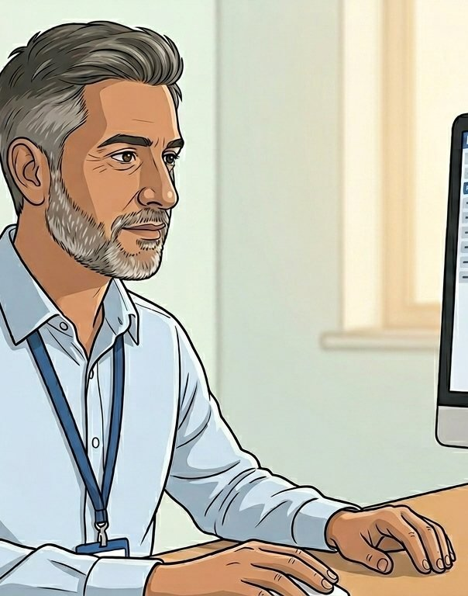

HEARTS AND MINDS · CLINICIAN EDITION · NO.2
The test moves. The medicine does not.
HomeTest takes routine and surveillance bloods out of the building and leaves every clinical decision exactly where it is: with you.
Live today: patient-initiated HIV testing through the NHS App, in Private Beta with two local authority areas. Coming through: clinician-initiated PSA active surveillance, the board-selected acute use case.
Hearts and Minds · audience deck No.2 · Clinician edition · proof-of-concept draft · September 2026
Commercial positions are agreed in principle and remain subject to the live procurement.
Notes:
Open on the promise, not the product. HomeTest takes routine and surveillance bloods out of the building and leaves every clinical decision exactly where it is: with you.

Slide 2
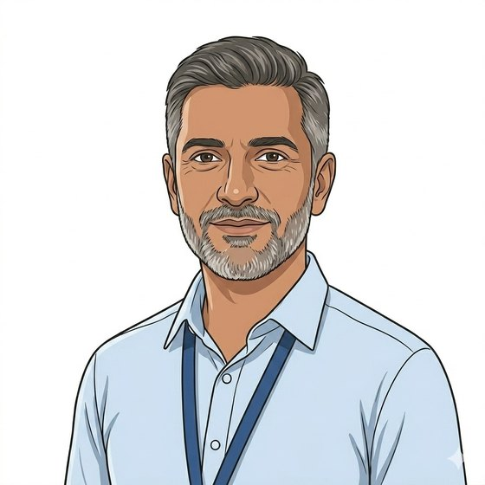
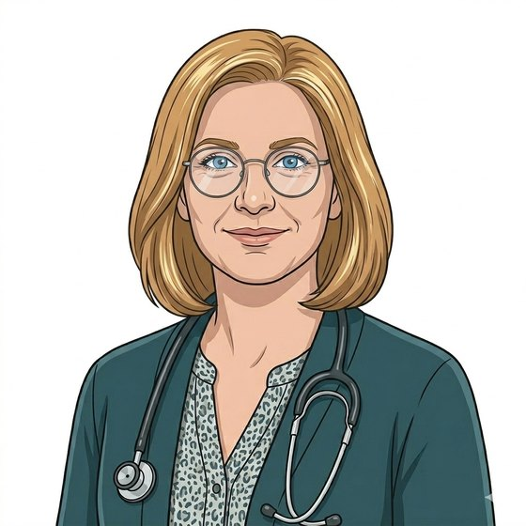
WE BUILD AROUND PEOPLE. TWO OF THEM ARE YOU.
Adam holds a list that grows. Hannah holds a cycle that slips.
“The patients I worry about are the ones who stop coming. The list grows. My clinic does not.”
Adam
Consultant urologist, PSA active surveillance
“Every quarter the same patients miss, get rebooked and miss again. It has nothing to do with the bloods.”
Hannah
GP partner, primary-care monitoring
Every configuration in this programme is designed around named clinicians and named patients. These two carry the clinical case: one in secondary care holding a surveillance cohort, one in primary care holding a recall cycle. If the model does not work for them, it does not work.
Hearts and Minds · audience deck No.2 · Clinician edition · proof-of-concept draft · September 2026
Commercial positions are agreed in principle and remain subject to the live procurement.
2
Notes:
Open by naming the room. Clinicians expect to be sold a product; instead show them we started from their workload. Adam and Hannah are composites built from the discovery work, not real individuals, and it is fine to say so. The point of the slide is that the design started with the clinical problem, not the technology.

Slide 3
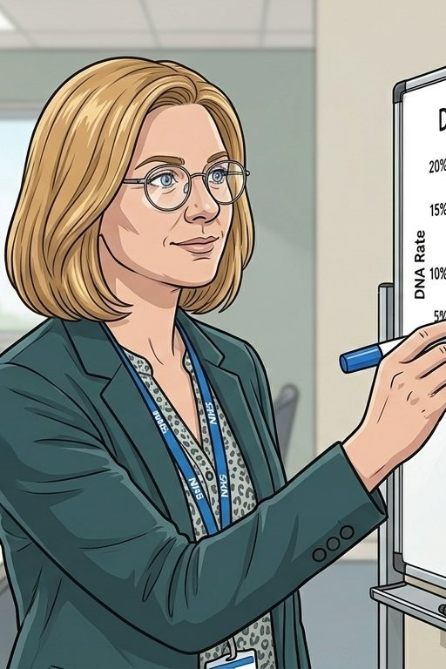
THE PROBLEM YOU ALREADY HAVE
The appointment is the bottleneck. It was never the blood.
54%
of NHS outpatient activity in England is follow-up, much of it judged of limited clinical value.
GIRFT / NHS England outpatient improvement guide, 2024
8.0m
1.25bn
outpatient appointments went unattended in 2023/24, of 135.4m booked, at around £120 each.
pathology test requests projected for 2025/26, up from 730m in 2013/14 and growing about 5.5% a year.
NHS Digital, Hospital Outpatient Activity 2023-24; NHS England DNA costings
Programme analysis, 2026
The patients who miss are not the patients who need it least. They are the shift workers, the carers, the people for whom a clinic slot costs half a day of pay. The clinic-only model selects against them.
Hearts and Minds · audience deck No.2 · Clinician edition · proof-of-concept draft · September 2026
Commercial positions are agreed in principle and remain subject to the live procurement.
3
Notes:
Do not labour the numbers. The line that lands in a clinical room is the last one: non-attendance is a design problem, not a compliance problem. If someone challenges the 54%, it is GIRFT and it is their own figure.

Slide 4

WHAT ACTUALLY HAPPENS
Five steps. Your order, their kitchen table, your record.
1
→
2
→
3
→
4
→
5
Ordered
Delivered
Sampled
Analysed
Returned
From your system or the NHS App, on the cohort and cadence you set.
Kit through the door, with instructions written for the patient in front of you.
At home, at a time that fits the patient, and posted back.
At a UKAS-accredited laboratory, on the same assay platform as your in-clinic samples.
Into the record you already use, in time for the decision you were going to make anyway.
One wrapper around all five: the assurance, the logistics, the notifications and the safety net are the platform’s job, not the clinic’s.
Hearts and Minds · audience deck No.2 · Clinician edition · proof-of-concept draft · September 2026
Commercial positions are agreed in principle and remain subject to the live procurement.
4
Notes:
Keep this quick. The only line that matters clinically is step 5: the result comes back into the record on time. If they ask about failed samples, that is the next slide but one.

Slide 5
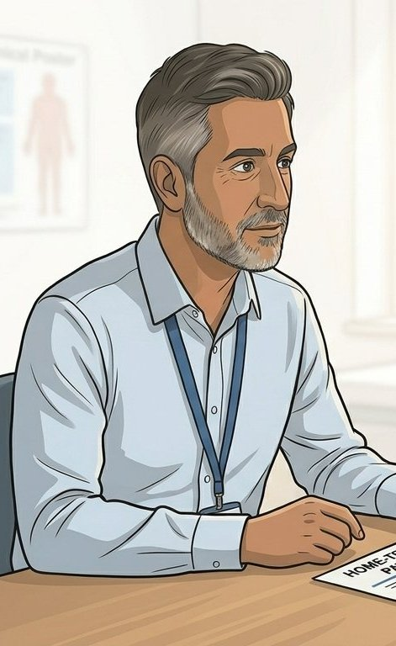
THE OBJECTION, ANSWERED FIRST
What changes, and what does not.
What changes
What does not change
Where the sample is taken. Kitchen table, not phlebotomy chair.
When it is taken. The patient’s time, not a slot in your week.
Who carries the logistics, the reminders and the chasing. The platform does.
How many people in your cohort actually complete the test.
Who orders. The clinician, on the clinical indication.
Who is accountable for the result and the decision that follows.
The thresholds, the guideline pathway and the escalation route.
The record. The result lands in the same place, with the same governance.
The kit changes the venue of the blood. It does not change the medicine, and it does not move clinical accountability anywhere.
Hearts and Minds · audience deck No.2 · Clinician edition · proof-of-concept draft · September 2026
Commercial positions are agreed in principle and remain subject to the live procurement.
5
Notes:
This is the slide the room came for. Say the kicker slowly. Most clinical resistance is a fear of accountability drifting to a supplier or an app; the honest answer is that it does not, and the design deliberately keeps it with them.

Slide 6
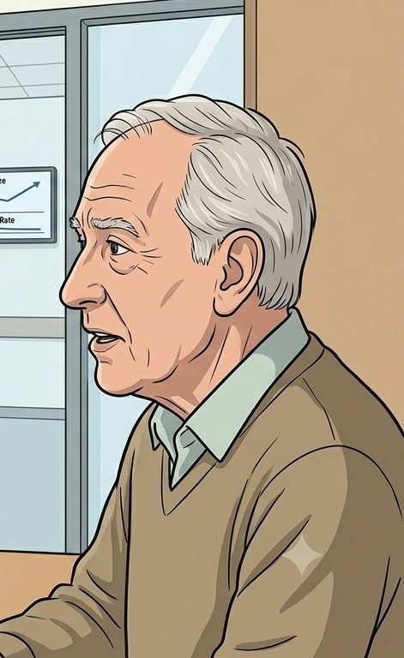
WHAT SITS BEHIND THE KIT
The assurance was done nationally, before anyone asked you to trust it.
The company, once
The test, per category
Tier 1 assurance through the Master SCAL: corporate standing, cyber, information governance, clinical safety governance, plus financial standing added by the framework. Passed once, reused by every commissioner.
Tier 2 at the category gate: clinical evidence including non-inferiority, UKAS accreditation for the named test, MHRA-conformant kit, and API and journey conformance for that test.
The safety case
The clinical bar
DCB0129 and DCB0160 executed before go-live for each configuration, with the hazard log and clinical safety officer named. IG artefacts, DPIA and data-sharing agreements executed before the first kit ships.
Judged by a clinician panel, not by a procurement scorecard. A test category only opens when enough of the market can serve it; a category one laboratory could serve stays shut.
Hearts and Minds · audience deck No.2 · Clinician edition · proof-of-concept draft · September 2026
Commercial positions are agreed in principle and remain subject to the live procurement.
6
Notes:
The four cards are the answer to "who checked this". The last one is the one clinicians remember: the clinical bar is set by clinicians and a category does not open just because a single supplier is keen.

Slide 7
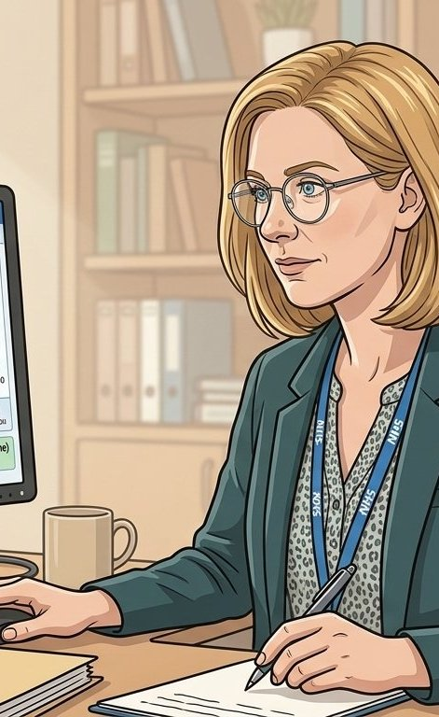
THE UNHAPPY PATH
What happens when it does not go right.
A sample that fails
A result that needs action
Insufficient or degraded samples are detected at the laboratory, the patient is notified and a replacement kit is issued against the same order. The clinician sees the exception, not a silence.
Results above the threshold you set route back through the escalation rule in the configuration, to the named clinical owner, in the timeframe the safety case specifies.
A patient who does not return the kit
A supplier that fails
Performance is managed against the framework, with commercial recourse built into the contract; service credits are the worked example. The cohort moves to another accredited supplier on the register.
Non-return surfaces as an exception on the cohort view with the recall date attached. Today, a missed appointment surfaces as nothing at all.
Hearts and Minds · audience deck No.2 · Clinician edition · proof-of-concept draft · September 2026
Commercial positions are agreed in principle and remain subject to the live procurement.
7
Notes:
Clinicians test a service by asking what happens when it breaks. Answer plainly. The fourth card is also the commercial answer: multi-supplier accreditation is what makes an exit possible without a re-procurement.

Slide 8
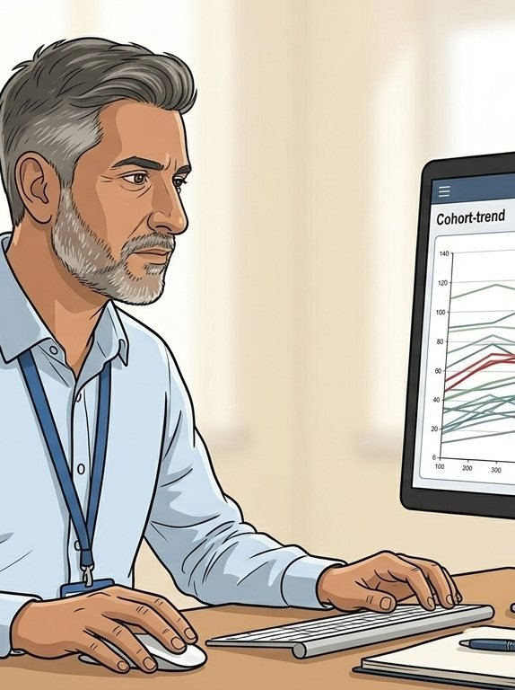
A CLINICIAN’S STORY
Adam keeps more of his cohort in surveillance without his clinic growing.
Adam
The cohort. Men on active surveillance for low-risk prostate cancer, on a NICE NG131 monitoring cadence. Around 64,000 men are diagnosed with prostate cancer in the UK each year; roughly 6,500 a year choose active surveillance, with up to 5,000 more who could.
The change. The quarterly PSA happens at home. The trend arrives in the same place, on time, and Adam reviews it as he always did. Clinic time concentrates on the men whose numbers have moved.
The clinical accountability. Unmoved. Adam sets the cadence and the threshold, Adam reads the trend, Adam decides. The platform carries the kit, the laboratory and the exception list.
“The patients I cannot see are still in surveillance. That is the whole point.”
Hearts and Minds · audience deck No.2 · Clinician edition · proof-of-concept draft · September 2026
Commercial positions are agreed in principle and remain subject to the live procurement.
8
Notes:
Tell it as a working week, not a case study. If there is a urologist in the room, ask what proportion of their surveillance clinic is a normal result being read aloud.

Slide 9
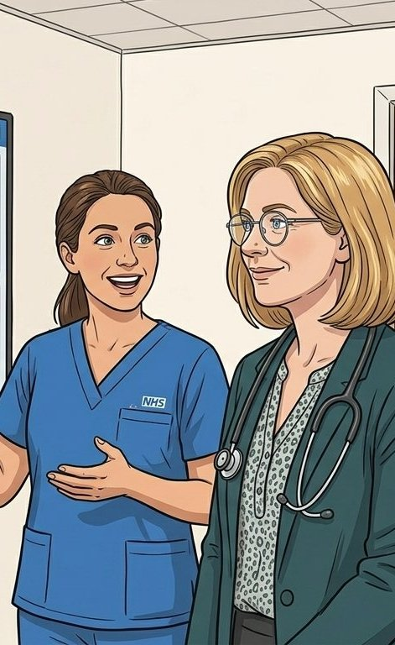
WHAT YOU GET BACK
Three things worth having.
Clinic time
A cohort that holds
An audit trail
Routine and surveillance bloods stop competing with treatment and complex care for the same room, the same nurse and the same hour.
Completion goes up in exactly the groups that miss appointments today, and non-completion becomes visible instead of silent.
Protocol, compliance against it and outcomes in one place, per cohort. What you can currently only estimate, you can show.
Honest limit: the Private Beta exists to produce these numbers. We are not asking you to accept a business case, we are asking you to help generate the evidence.
Hearts and Minds · audience deck No.2 · Clinician edition · proof-of-concept draft · September 2026
Commercial positions are agreed in principle and remain subject to the live procurement.
9
Notes:
Do not overclaim. Clinicians spot a business case dressed as a clinical claim instantly. The kicker buys credibility for everything else in the deck.

Slide 10
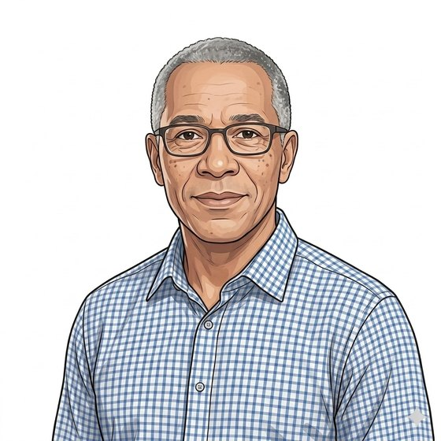
WHAT WE NEED FROM CLINICIANS
Three asks, none of them a procurement.
1
2
3
One conversation to start: your cohort, our journey maps and what the Beta is already showing.
Name the cohort
Set the protocol
Sit on the panel
Which of your patients should be in this, and which should not. The eligibility rule is a clinical decision and we will not write it for you.
Cadence, thresholds and the escalation route. The platform can run annual, biannual, risk-stratified or symptom-led. It should not choose.
The clinical bar for each test category is judged by clinicians. We need practising ones, not a proxy.
Hearts and Minds · audience deck No.2 · Clinician edition · proof-of-concept draft · September 2026
Commercial positions are agreed in principle and remain subject to the live procurement.
10
Notes:
The ask is deliberately small and deliberately clinical. Nobody in this room is being asked to buy anything, and saying so releases the tension.

Slide 11
HEARTS AND MINDS · CLINICIAN EDITION
Adam
Hannah
Mark
the consultant holding the list
the GP holding the recall cycle
the patient on surveillance
The venue moves. The medicine, and the accountability, stay where they are.
Built around people. Bought without pain. Live today.
Hearts and Minds · audience deck No.2 · Clinician edition · proof-of-concept draft · September 2026
Commercial positions are agreed in principle and remain subject to the live procurement.
11

