Slide 1


HEARTS AND MINDS · ACUTE TRUST EDITION · NO.3
Surveillance that does not need the building.
An NHS-to-NHS case: move routine surveillance and follow-up bloods out of outpatients, keep the clinical ownership in the Trust, and give the estate back to the patients who need to be in it.
Royal Devon University Healthcare is the selected acute partner for PSA active surveillance, mobilising from June 2026. HIV self-testing is live in Private Beta with two local authority areas.
Hearts and Minds · audience deck No.3 · Acute trust edition · proof-of-concept draft · September 2026
Commercial positions are agreed in principle and remain subject to the live procurement.
Notes:
Open on the promise, not the product. An NHS-to-NHS case: move routine surveillance and follow-up bloods out of outpatients, keep the clinical ownership in the Trust, and give the estate back to the patients who need to be in it.

Slide 2
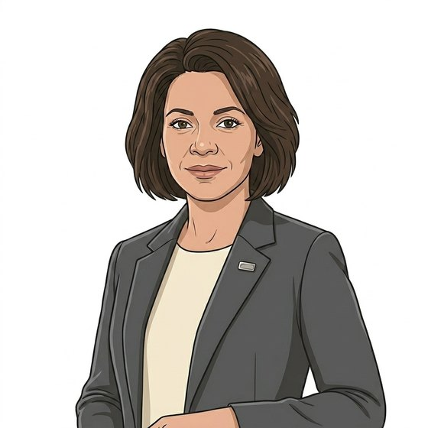
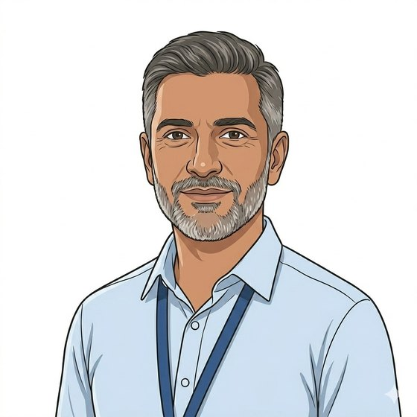
BUILT AROUND THE PEOPLE WHO CARRY IT
A commissioner with a pathway to protect, a consultant with a list that grows.
“I commission the pathway, not each patient. I need it to hold across every Trust in my patch.”
Catherine
ICB commissioner, PSA active surveillance
“The monitoring caseload is real men on my list. The clinic cannot hold all of them in a room.”
Adam
Consultant urologist
The acute case has two buyers in the room: the commissioner who funds the pathway and the clinical service that runs it. This deck is written for the conversation where both are present.
Hearts and Minds · audience deck No.3 · Acute trust edition · proof-of-concept draft · September 2026
Commercial positions are agreed in principle and remain subject to the live procurement.
2
Notes:
Establish early that this is NHS to NHS. Nobody is selling the Trust a product; the Trust is being offered a way to move a cohort off its own estate while keeping the clinical relationship.

Slide 3

THE PRESSURE ON THE ESTATE
The follow-up burden is the outpatient problem.
135.4m
outpatient appointments booked in England in 2023/24. Routine surveillance bloods need not be among them.
NHS England, Hospital Outpatient Activity 2023-24
54%
£120
of outpatient activity is follow-up; standardised and remote models could unlock one to two million slots.
the cost of a missed outpatient appointment, on 8.0m unattended appointments: roughly £1bn a year of clinical time.
GIRFT, Further Faster programme
NHS Digital 2023-24; NHS England DNA costings
A missed appointment still costs the slot, the room and the rota. An unreturned kit costs a kit. That asymmetry is the whole financial argument.
Hearts and Minds · audience deck No.3 · Acute trust edition · proof-of-concept draft · September 2026
Commercial positions are agreed in principle and remain subject to the live procurement.
3
Notes:
The DNA asymmetry is the line a finance director writes down. Say it once, clearly, and move on.

Slide 4

THE STARTING COHORT
PSA active surveillance: a defined group, an agreed cadence, a national configuration.
The cohort
The cadence
Men on active monitoring for low-risk prostate cancer. Around 64,000 men a year are diagnosed in the UK; roughly 6,500 choose active surveillance, with up to 5,000 more who could.
The NICE NG131 monitoring schedule, unchanged. The platform runs the recall; the Trust sets the interval and the thresholds.
The status
The proof
Scored 35 out of 45 under the HomeTest Prioritisation Framework and endorsed in principle as the board-selected acute use case at the HomeTest Programme Board on 9 June 2026.
An acute partner is mobilising now. The first configuration is designed with a Trust, not designed for one and offered afterwards.
Hearts and Minds · audience deck No.3 · Acute trust edition · proof-of-concept draft · September 2026
Commercial positions are agreed in principle and remain subject to the live procurement.
4
Notes:
If the Trust in the room is not a urology centre, name the pattern instead of the cohort: any routine surveillance blood on a fixed cadence fits this shape.

Slide 5

THE DIVISION OF LABOUR
What moves off the Trust, and what stays inside it.
Moves to the platform
Stays with the Trust
Kit fulfilment, return logistics and the laboratory contract.
Patient notifications, reminders and the recall schedule.
Supplier assurance, clinical safety artefacts and information governance.
The exception list: who has not completed, and when they were due.
The clinical relationship with the patient, and the consultant of record.
Eligibility, cadence, thresholds and the escalation rule.
Reading the result and the decision that follows it.
The cohort. These remain your patients throughout.
The Trust is not outsourcing a cohort. It is outsourcing the logistics of getting blood out of that cohort on time.
Hearts and Minds · audience deck No.3 · Acute trust edition · proof-of-concept draft · September 2026
Commercial positions are agreed in principle and remain subject to the live procurement.
5
Notes:
Trusts fear losing sight of patients. The right of this slide is the reassurance; the kicker is the sentence to repeat if the conversation drifts.

Slide 6
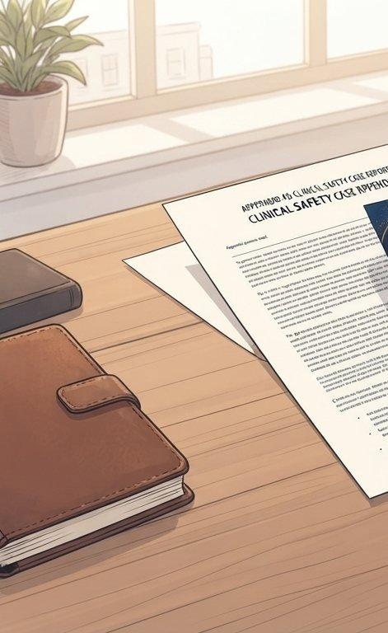
HOW THE TRUST BUYS IT
A call-off, not a procurement.
Who buys
How
Local authority, Trust, ICB or pathology network, depending on where the budget for that cohort sits. Where a pathway crosses budgets, the buyer follows the budget holder.
Direct award or mini-competition against the accredited register, on published call-off terms. The assurance, integration and safety case were completed before you started.
Price
Status
A cost per activity for each completed test, at or below a national maximum price that local competition can beat. Volume tiers are still open.
Agreed in principle and being tested with buyers before the sourcing strategy is finalised. Good enough for planning, not a tender document.
Hearts and Minds · audience deck No.3 · Acute trust edition · proof-of-concept draft · September 2026
Commercial positions are agreed in principle and remain subject to the live procurement.
6
Notes:
Be scrupulous about the last card. Overstating commercial certainty in an NHS-to-NHS conversation is how you lose the relationship later.

Slide 7

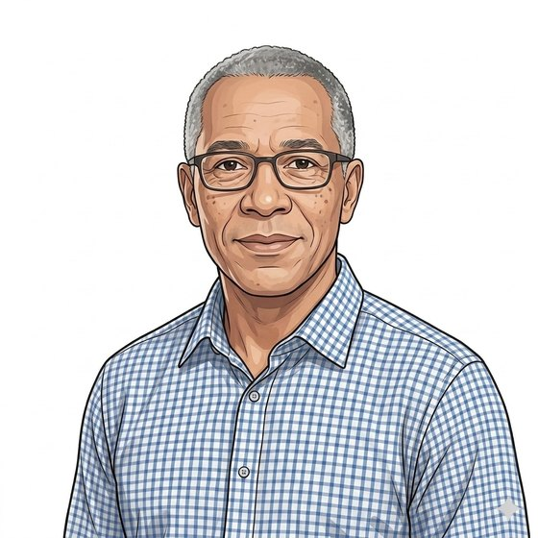
WHAT IT LOOKS LIKE FOR A PATIENT ON YOUR LIST
Mark, 65, on active surveillance. His consultant still reads the trend.
Mark
Before. A half-day for a fifteen-minute blood test: parking, the wait, the walk back. Three or four times a year, on a cadence he is expected to keep for years.
After. The kit arrives on schedule, the sample goes back by post, the result reaches Adam in time for the review that was going to happen anyway.
The Trust’s side of it. The surveillance cohort stops occupying phlebotomy slots that acute demand needs, and the men who quietly dropped out of the cadence become visible again.
“The quarterly test is routine. Getting to the hospital for it never was.”
Hearts and Minds · audience deck No.3 · Acute trust edition · proof-of-concept draft · September 2026
Commercial positions are agreed in principle and remain subject to the live procurement.
7
Notes:
Mark is the patient the Trust already knows. The value to the Trust is in the third paragraph: capacity plus retention, not one or the other.

Slide 8
WHAT WE ARE ASKING A TRUST FOR
Three steps, in this order.
1
2
3
The ask is one cohort and one conversation, not a transformation programme.
Name one cohort
Agree the protocol
Run one call-off
One surveillance or routine-monitoring group where the venue, not the test, is the problem. Small enough to run, big enough to measure.
Your clinicians set eligibility, cadence, thresholds and escalation. We configure to it and execute the safety case against it.
On published terms against the accredited register, with the measurement built in from day one so the second cohort argues for itself.
Hearts and Minds · audience deck No.3 · Acute trust edition · proof-of-concept draft · September 2026
Commercial positions are agreed in principle and remain subject to the live procurement.
8
Notes:
Close on proportionality. Trusts are being asked for pilots constantly; the differentiator is that the assurance and the buying route already exist.

Slide 9
HEARTS AND MINDS · ACUTE TRUST EDITION
Catherine
Adam
Mark
the commissioner of the pathway
the consultant of record
the man on the list
One cohort. One protocol. One call-off. The capacity you get back is yours.
Built around people. Bought without pain. Live today.
Hearts and Minds · audience deck No.3 · Acute trust edition · proof-of-concept draft · September 2026
Commercial positions are agreed in principle and remain subject to the live procurement.
9

