Slide 1


HEARTS AND MINDS · NATIONAL PLATFORM EDITION · NO.4
One integration. Every test that follows.
HomeTest rides the national rails rather than building beside them. What we need from the platform is stable interfaces; what the platform gets back is a high-frequency, clinically useful reason for people to open the App.
NHS Login and NHS Notify integrations are live. HIV self-testing runs through the NHS App in Private Beta with two local authority areas.
Hearts and Minds · audience deck No.4 · National platform edition · proof-of-concept draft · September 2026
Commercial positions are agreed in principle and remain subject to the live procurement.
Notes:
Open on the promise, not the product. HomeTest rides the national rails rather than building beside them. What we need from the platform is stable interfaces; what the platform gets back is a high-frequency, clinically useful reason for people to open the App.

Slide 2

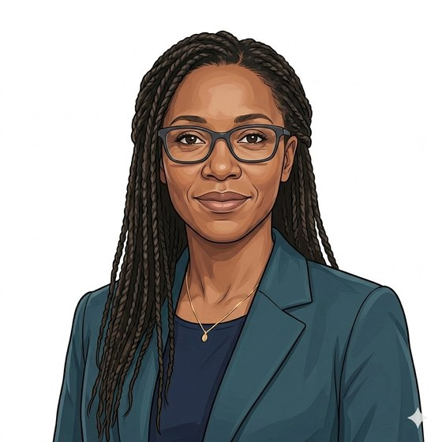
BUILT AROUND THE PEOPLE WHO RUN THE RAILS
Priya keeps the connective tissue standing.
“I do not need another service building its own front door. I need the ones we have to carry more that is worth carrying.”
Priya
Senior product manager, NHS England Digital
“Controllership, lawful basis and the DPIA are settled before go-live, or there is no go-live.”
Ngozi
Information governance
The platform view of a new service is usually a support burden. This one is designed the other way round: integrate once nationally, then reuse that integration for every test category that opens afterwards.
Hearts and Minds · audience deck No.4 · National platform edition · proof-of-concept draft · September 2026
Commercial positions are agreed in principle and remain subject to the live procurement.
2
Notes:
Platform teams are pitched at constantly. Lead with restraint: we are asking to consume, not to be given something new to run.

Slide 3

THE FRONT DOOR ALREADY EXISTS
The reach is there. The reason to open the App is what we add.
39m
people registered on the NHS App, with 62.3m logins in a single month.
NHS England, December 2025
1.25bn
3
pathology test requests projected for 2025/26, growing about 5.5% a year: demand that will land somewhere.
foundation services consumed: NHS App as the patient surface, NHS Login for identity, NHS Notify for communications.
Programme analysis, 2026
HomeTest operating model, Ecosystem: Consumed
A diagnostic result is a high-value reason to return to the App. Testing gives the front door something to be a front door for.
Hearts and Minds · audience deck No.4 · National platform edition · proof-of-concept draft · September 2026
Commercial positions are agreed in principle and remain subject to the live procurement.
3
Notes:
The kicker is the persuasion. Platform partners measure engagement; a test result is a genuine reason to open an app, unlike most notifications.

Slide 4

THE BOUNDARY, STATED PLAINLY
What we consume, and what we build.
Consumed, owned by you
Built and run by HomeTest
NHS App as the patient surface.
NHS Login for identity and authentication.
NHS Notify for patient communications.
FHIR routing, and the record destinations that follow it.
The supplier onboarding gateway and the accredited register.
The pattern catalogue: initiation, fulfilment, result handling per configuration.
Kit logistics, laboratory routing and the exception model.
The commercial layer: call-offs, ceiling, levy and MI.
The line is deliberate. Where a national service exists we use it; where it does not, we build inside the framework rather than asking the platform to absorb new scope.
Hearts and Minds · audience deck No.4 · National platform edition · proof-of-concept draft · September 2026
Commercial positions are agreed in principle and remain subject to the live procurement.
4
Notes:
Draw the line explicitly before they draw it for you. Platform teams respond well to a service that knows what it is not asking for.

Slide 5
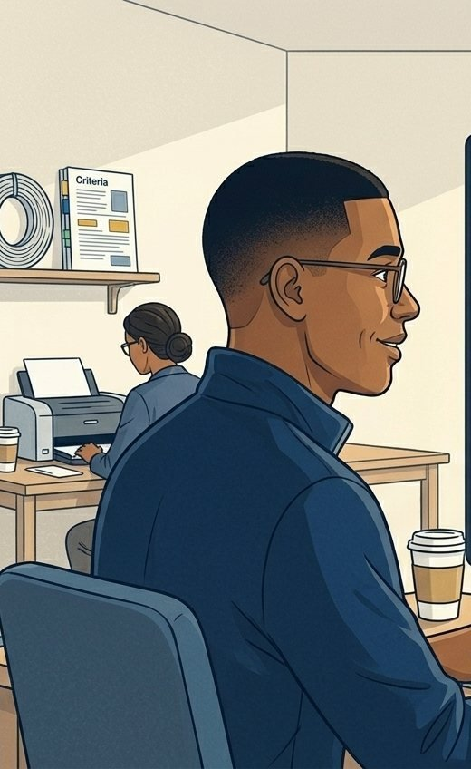
WHY THIS INTEGRATION IS WORTH DOING ONCE
The gate model means the integration does not repeat per test.
Integrate once
Conform per test
A supplier makes the one-off platform connection at Tier 1: connection agreement, HSCN, service management and incident routes. That is the only time the plumbing is built.
Tier 2 is API and journey conformance against published, versioned specifications for that test category, with performance evidence. Configuration, not new integration.
Grow by gates
Scale without estate
New test categories open on a published roadmap at reopening windows, annual as the working assumption. The platform plans against a calendar, not a queue of requests.
Volume scales with kit logistics and laboratory capacity. It does not scale with anything the platform has to house.
Hearts and Minds · audience deck No.4 · National platform edition · proof-of-concept draft · September 2026
Commercial positions are agreed in principle and remain subject to the live procurement.
5
Notes:
This is the slide that answers "what will you keep asking us for". The answer is a calendar, not a stream of one-off requests.

Slide 6

GOVERNANCE AND DATA
The information governance position, as it stands.
Federated controllership
Executed before go-live
NHS England as controller for the foundation, the commissioner as controller for the testing purpose, the supplier as processor. Joint controller arrangements have been ruled out; the exact split per configuration is still being scoped.
DPIA, data-sharing and processing agreements are executed before the first kit ships, under the inherited IG artefact stack, with existing controllership intact.
Lawful basis
The record
Private Beta is system delivery: data moved to enable care, with no NHS England analysis for its own purposes, so no legal Direction is required. Public Beta likely needs a Direction if that changes.
The NHS holds the record. Results flow to the destination the configuration specifies, not into a supplier silo.
Hearts and Minds · audience deck No.4 · National platform edition · proof-of-concept draft · September 2026
Commercial positions are agreed in principle and remain subject to the live procurement.
6
Notes:
Do not soften the open items. The Direction timing question is real and the platform IG team will already know it; showing you know it is what buys trust.

Slide 7

WHAT WE NEED FROM THE PLATFORM
Three things, none of them new scope.
1
2
3
In return: a service that consumes what exists, brings its own assurance, and gives the front door a clinically useful reason to be opened.
Stable, versioned interfaces
Roadmap alignment
A named counterpart
Published specifications we can hold suppliers to at Tier 2 conformance, with a deprecation policy we can plan around.
Our gate calendar set against yours, so a category opens when the platform can carry it rather than when a supplier is ready.
One person per foundation service for integration, incident routes and uptime, on the RACI that already exists in the model.
Hearts and Minds · audience deck No.4 · National platform edition · proof-of-concept draft · September 2026
Commercial positions are agreed in principle and remain subject to the live procurement.
7
Notes:
End on the trade. Platform partners are being asked for three specific, unglamorous things, and are getting engagement and a self-contained assurance model in return.

Slide 8
HEARTS AND MINDS · NATIONAL PLATFORM EDITION
Priya
Ngozi
Abdul
the product owner of the rails
the IG lead who says go
the patient the App reaches
Consume what exists. Assure what does not. Integrate once.
Built around people. Bought without pain. Live today.
Hearts and Minds · audience deck No.4 · National platform edition · proof-of-concept draft · September 2026
Commercial positions are agreed in principle and remain subject to the live procurement.
8

