Slide 1


HEARTS AND MINDS · SUPPLIER EDITION · NO.5
Assured once. Sold many times.
One national framework, one assurance pass at company level, one approval per test category, and then every commissioner in England buying from the same register on the same terms.
An open framework under the Procurement Act 2023, around £250m over its life, a term of up to five years (three plus one plus one), targeting go-live in Q1 2028. Agreed in principle and subject to the live procurement.
Hearts and Minds · audience deck No.5 · Supplier edition · proof-of-concept draft · September 2026
Commercial positions are agreed in principle and remain subject to the live procurement.
Notes:
Open on the promise, not the product. One national framework, one assurance pass at company level, one approval per test category, and then every commissioner in England buying from the same register on the same terms.

Slide 2


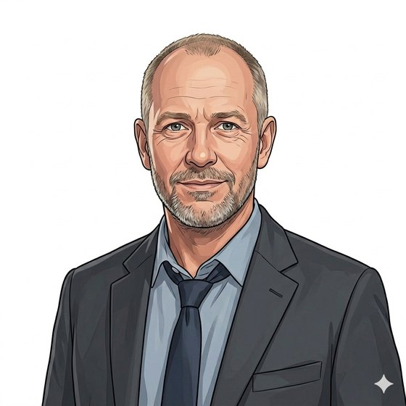
BUILT AROUND THE SUPPLIER WHO HAS TO MAKE IT WORK
Joe has the kit, the lab and the paperwork. What he does not have is a route.
“Every commissioner wants their own DPIA, their own contract, their own assurance pack. I pay to find out what they want, then I do it again next door.”
Joe
Self-sample diagnostics, twenty staff, two laboratories
The market is fragmented and the cost of selling into it falls hardest on the suppliers the NHS most needs: the ones with a good test and a small commercial function. This framework is built to remove the repetition, not to remove the standard.
Joe
Sarah
David
the supplier with a good test
the commissioner who calls off
the commercial lead who sets the terms
Hearts and Minds · audience deck No.5 · Supplier edition · proof-of-concept draft · September 2026
Commercial positions are agreed in principle and remain subject to the live procurement.
2
Notes:
Say the quiet part first. Suppliers expect an NHS pitch to be about NHS needs; opening on their cost of sale buys attention for the rest of the deck.

Slide 3

THE PRIZE
A single national route into a growing market.
~£250m
the indicative value of the framework over its life, with a term of up to five years, three plus one plus one.
HomeTest commercial model, agreed in principle
Q1 2028
1.25bn
the targeted go-live for the enduring open framework under the Procurement Act 2023.
pathology test requests projected for 2025/26, growing about 5.5% a year. The demand is not in question.
HomeTest commercial model, in principle and subject to procurement
Programme analysis, 2026
Live today, not a paper market: patient-initiated HIV self-testing is running in Private Beta with two local authority areas, and an acute partner is mobilising for PSA active surveillance.
Hearts and Minds · audience deck No.5 · Supplier edition · proof-of-concept draft · September 2026
Commercial positions are agreed in principle and remain subject to the live procurement.
3
Notes:
Suppliers have been burned by NHS frameworks that never opened. The kicker is the credibility line: there is a live service with real kits and real patients already.

Slide 4

HOW YOU GET IN
Two tiers. The company once, then each test at its gate.
Tier 1: framework entry
Tier 2: test approval
Company assurance, passed once. Corporate structure, technical and operational readiness including the one-off platform connection, cyber, information governance and clinical safety governance, mostly through the Master SCAL, plus financial standing added by the framework.
Per test category, when its gate is open. Clinical evidence including non-inferiority, UKAS accreditation for the named test, MHRA-conformant kit, and API and journey conformance for that category.
Reusable everywhere
Tier 1 does not expire
Both approvals are reusable with every commissioner who calls off. The local body deploys; it does not re-assure you. One pass, not one per buyer.
Miss a gate and you apply at the next one. Company approval stands; you are not sent back to the start of the queue.
Hearts and Minds · audience deck No.5 · Supplier edition · proof-of-concept draft · September 2026
Commercial positions are agreed in principle and remain subject to the live procurement.
4
Notes:
This is the core of the pitch. The sentence that matters commercially: the local body deploys and does not re-assure. That is the cost of sale disappearing.

Slide 5

THE GATE MODEL
Categories open on a published roadmap, not on request.
1
→
2
→
3
→
4
→
5
Roadmap publishes
Gate opens
Suppliers accredit
Register updates
Commissioners call off
Categories and gate dates land far enough ahead for a laboratory to book and win the accreditation it needs.
The category joins the catalogue. Any supplier with Tier 1 can apply for one category or several.
A clinician panel judges the clinical bar; automated conformance takes the technical one.
The accredited register shows who can sell what. About three suppliers per test is the working floor.
Local call-offs run against the register, at or below the national ceiling.
A category only one laboratory can serve does not open. It stays closed until competition can exist, which is also the guarantee that a gate you win is a market and not a monopoly you are bidding into.
Hearts and Minds · audience deck No.5 · Supplier edition · proof-of-concept draft · September 2026
Commercial positions are agreed in principle and remain subject to the live procurement.
5
Notes:
The kicker cuts both ways and suppliers know it: the floor of about three suppliers protects the NHS from lock-in and protects them from opening a category nobody can serve.

Slide 6
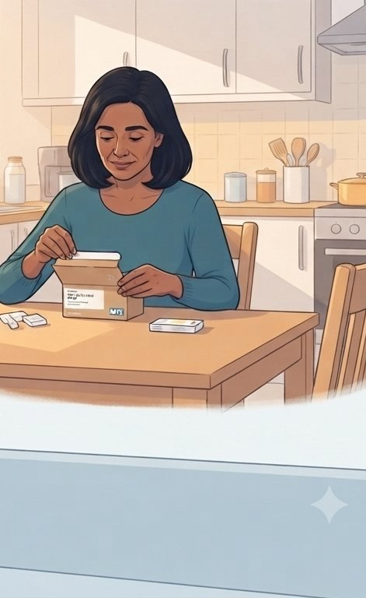
HOW YOU GET PAID
Cost per activity, direct from the commissioner.
The payment
The ceiling
A cost per activity for each completed test, paid by the commissioner direct to the supplier that processed it. No intermediary taking a cut of the delivery.
A national maximum price per test, which local competition can beat. More accredited suppliers in a category means more price tension, and that is the design intent.
The levy
Demand
A levy on throughput funds the platform, with a share returned to NHS England for clinical validation, NHS App eligibility and pathway transformation. The route the levy takes back is still being resolved.
Aggregated national demand against one route, instead of a bespoke sale per commissioner. Volume tiers are still open.
Hearts and Minds · audience deck No.5 · Supplier edition · proof-of-concept draft · September 2026
Commercial positions are agreed in principle and remain subject to the live procurement.
6
Notes:
Be honest that the levy mechanism has open questions on nomenclature, VAT, legal and competition. Suppliers respect a straight answer and will find the gap anyway.

Slide 7

THE DEAL, BOTH WAYS
What you get, and what we hold you to.
What you get
What we hold you to
One assurance pass, reusable with every commissioner.
A published roadmap you can plan laboratory capacity against.
A place on the accredited register, visible to every buyer.
Routes in that suit your size: prime, consortium, NHS-led or partnering.
Clinical evidence, including non-inferiority for the named test.
UKAS accreditation and MHRA conformity, maintained not just achieved.
Conformance to the published API and journey specifications.
Service performance, with commercial recourse in the contract; service credits are the worked example.
The standard does not move. What moves is how many times you have to prove you meet it.
Hearts and Minds · audience deck No.5 · Supplier edition · proof-of-concept draft · September 2026
Commercial positions are agreed in principle and remain subject to the live procurement.
7
Notes:
Suppliers hear "framework" and expect a race to the bottom on price with no floor on quality. The right-hand column is deliberately hard, and the kicker is the sentence to land.

Slide 8

A SUPPLIER’S STORY
Joe is admitted once and reused everywhere.
Joe
Before. Three months of clarifications per commissioner, a bespoke DPIA each time, a clinical safety case rewritten for every deployment, and a pilot that ended without a route to scale.
Now. Company assurance once through the Master SCAL. Category approval when the gate opens. Every commissioner who calls off inherits that work rather than repeating it.
The commercial shape. Predictable volume against a published roadmap, payment per completed test, and a market with a floor of about three suppliers per category, so winning the category means winning a market rather than a monopoly.
“The old price of bidding for NHS work was paying to find out what was wanted. Now I read the criteria and decide whether I fit.”
Hearts and Minds · audience deck No.5 · Supplier edition · proof-of-concept draft · September 2026
Commercial positions are agreed in principle and remain subject to the live procurement.
8
Notes:
Joe is the composite supplier the framework is designed for. If the room is a large incumbent, the same slide reads as a warning that scale alone will not carry them past the clinical bar.

Slide 9
WHAT HAPPENS NEXT
What we want from suppliers now, before the framework goes live.
1
2
3
Everything commercial here is agreed in principle and subject to the live procurement. Nothing in this conversation confers any advantage in it.
Tell us what breaks this
Tell us what you can serve
Come to the Supplier Forum
The assurance burden, the gate cadence, the ceiling, the levy. If it does not work commercially, we would rather hear it now than at tender.
Which test categories you could accredit for, and how long the laboratory accreditation would take you. That shapes the roadmap.
A standing forum with a monthly cadence: structured information sharing, non-evaluative and non-decision-making. Being in the room now is not an advantage at tender, and it is where the design gets tested.
Hearts and Minds · audience deck No.5 · Supplier edition · proof-of-concept draft · September 2026
Commercial positions are agreed in principle and remain subject to the live procurement.
9
Notes:
The closing line is not a disclaimer, it is a probity requirement. Say it out loud in the room, every time.

Slide 10
HEARTS AND MINDS · SUPPLIER EDITION
Joe
Sarah
David
the supplier with a good test
the commissioner who calls off
the commercial lead who sets the terms
One assurance pass. Every commissioner in England, on the same terms.
Built around people. Bought without pain. Live today.
Hearts and Minds · audience deck No.5 · Supplier edition · proof-of-concept draft · September 2026
Commercial positions are agreed in principle and remain subject to the live procurement.
10

