Slide 1
Projecting uncertainty through nonlinear ODEs
These slides are animated. Please press F5.
Youdong Lin¹, Mark Stadherr¹, George Corliss², Scott Ferson³
¹University of Notre Dame
²Marquette University
³Applied Biomathematics

Slide 2
Uncertainty usually explodes
The explosion can be traced to numerical instabilities
x
Time

Slide 3
Uncertainty
Artifactual uncertainty
Perhaps too few polynomial terms
Numerical instability
Can be reduced by a better analysis
Authentic uncertainty
Genuine unpredictability due to input uncertainty
Cannot be reduced by a better analysis
Only by more information, data or assumptions

Slide 4
Uncertainty propagation
We want the prediction to ‘break down’ if that’s what should happen
But we don’t want artifactual uncertainty
Numerical instabilities
Wrapping effect
Dependence problem
Repeated parameters

Slide 5
Problem
Nonlinear ordinary differential equation (ODE)
dx/dt = f(x, θ)
with uncertain θ and uncertain initial state x₀
Information about θ and x₀ comes as
Interval ranges
Probability distributions
Probability boxes

Slide 6
Model
Initial states (range)
Parameters (range)
Notre Dame
List of constants plus remainder

Slide 7
Inside VSPODE
Interval Taylor series (à la VNODE)
Dependence on time
Taylor model
Dependence of parameters
(Comparable to COSY and VNODE)

Slide 8
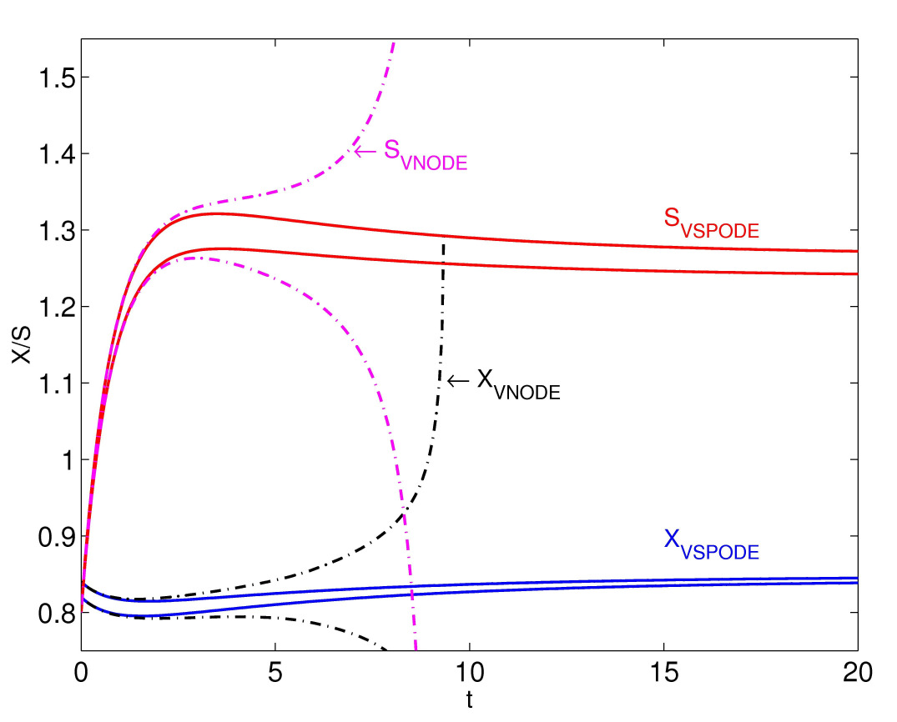
The software VSPODE delays the explosion much longer than VNODE
S_{VNODE}
http://www.nsc.ru/interval/Library/Thematic/IntvalDEs/Nedialkov.pdf

Slide 9
Representing uncertainty
Cumulative distribution function (CDF)
Gives the probability that a random variable is smaller than or equal to any specified value
F is the CDF of θ, if F(z) = Prob(θ ≤ z)
We write: θ ~ F

Slide 10
Example: uniform
1
Prob(θ ≤ 2.5) = 0.75
Cumulative probability
0
0.0
1.0
2.0
3.0
θ

Slide 11
Another example: normal
Prob(θ ≤ 2.5) = 0.90
1
Cumulative probability
0
0.0
1.0
2.0
3.0
θ

Slide 12
P-box (probability box)
Interval bounds on an CDF
1
Cumulative probability
0
0.0
1.0
X
2.0
3.0

Slide 13
Marriage of two approaches
Point value
Interval
Distribution
P-box

Slide 14
Probability bounds analysis
All standard mathematical operations
Arithmetic (+, −, ×, ÷, ^, min, max)
Transformations (exp, ln, sin, tan, abs, sqrt, etc.)
Other operations (and, or, ≤, envelope, etc.)
Quicker than Monte Carlo
Guaranteed (automatically verified)

Slide 15
Probability bounds arithmetic
P-box for random variable A
P-box for random variable B
1
1
Cumulative Probability
Cumulative Probability
0
0
0
1
2
3
4
5
6
0
2
4
6
8
10
12
14
Value of random variable A
Value of random variable B
What are the bounds on the distribution of the sum of A+B?

Slide 16
Cartesian product
A+B
independence
A∈[1,3]
p₁ = 1/3
A∈[2,4]
p₂ = 1/3
A∈[3,5]
p₃ = 1/3
B∈[2,8]
q₁ = 1/3
A+B∈[3,11]
prob=1/9
A+B∈[4,12]
prob=1/9
A+B∈[5,13]
prob=1/9
B∈[6,10]
q₂ = 1/3
A+B∈[7,13]
prob=1/9
A+B∈[8,14]
prob=1/9
A+B∈[9,15]
prob=1/9
B∈[8,12]
q₃ = 1/3
A+B∈[9,15]
prob=1/9
A+B∈[10,16]
prob=1/9
A+B∈[11,17]
prob=1/9

Slide 17
A+B under independence
1.00
0.75
0.50
Cumulative probability
0.25
0.00
0
3
6
9
12
15
18
A+B

Slide 18
When independence is untenable
Frank, Nelson and Sklar 1987
If X and Y are independent, then the distribution of X+Y is
Suppose X ~ F and Y ~ G. The distribution of X+Y is bounded by
whatever the dependence between X and Y
Similar formulas for operations besides addition

Slide 19
Example ODE
dx₁/dt = θ₁ x₁(1 – x₂)
dx₂/dt = θ₂ x₂(x₁–1)
What are the states at t = 10?
x₀ = (1.2, 1.1)^{T}
θ₁ ∈[2.99, 3.01]
θ₂ ∈[0.99, 1.01]
VSPODE
Constant step size h = 0.1, Order of Taylor model q = 5,
Order of interval Taylor series k = 17, QR factorization

Slide 20
VSPODE tells how to compute x₁
tt = env(uniform1(0, 0.004), uniform1(0, 0.005))
t1 = tt+3
t2 = tt + 1
t1 = t1 - 3
t2 = t2 - 1
1.916037656181642 |*| 1 |*| t2^1 + 0.689979149231081 |*| t1^1 |*| 1 + -4.690741189299572 |*| 1 |*| t2^2 + -2.275734193378134 |*| t1^1 |*| t2^1 + -0.450416914564394 |*| t1^2 |*| 1 + -29.788252573360062 |*| 1 |*| t2^3 + -35.200757076497972 |*| t1^1 |*| t2^2 + -12.401600707197074 |*| t1^2 |*| t2^1 + -1.349694561113611 |*| t1^3 |*| 1 + 6.062509834147210 |*| 1 |*| t2^4 + -29.503128650484253 |*| t1^1 |*| t2^3 + -25.744336555602068 |*| t1^2 |*| t2^2 + -5.563350070358247 |*| t1^3 |*| t2^1 + -0.222000132892585 |*| t1^4 |*| 1 + 218.607042326120308 |*| 1 |*| t2^5 + 390.260443722081675 |*| t1^1 |*| t2^4 + 256.315067368131281 |*| t1^2 |*| t2^3 + 86.029720297509172 |*| t1^3 |*| t2^2 + 15.322357274648443 |*| t1^4 |*| t2^1 + 1.094676837431721 |*| t1^5 |*| 1 + [ 1.1477537620811058, 1.1477539164945061 ]
1.916037656181642 × θ₁⁰ × θ₂¹ + 0.689979149231081 × θ₁¹ × θ₂⁰ +
-4.690741189299572 × θ₁⁰ × θ₂² + -2.275734193378134 × θ₁¹ × θ₂¹ +
-0.450416914564394 × θ₁² × θ₂⁰ + -29.788252573360062 × θ₁⁰ × θ₂³ +
-35.200757076497972 × θ₁¹ × θ₂² + -12.401600707197074 × θ₁² × θ₂¹ +
-1.349694561113611 × θ₁³ × θ₂⁰ + 6.062509834147210 × θ₁⁰ × θ₂⁴ +
-29.503128650484253 × θ₁¹ × θ₂³ + -25.744336555602068 × θ₁² × θ₂² +
-5.563350070358247 × θ₁³ × θ₂¹ + -0.222000132892585 × θ₁⁴ × θ₂⁰ +
218.607042326120308 × θ₁⁰ × θ₂⁵ + 390.260443722081675 × θ₁¹ × θ₂⁴ +
256.315067368131281 × θ₁² × θ₂³ + 86.029720297509172 × θ₁³ × θ₂² +
15.322357274648443 × θ₁⁴ × θ₂¹ + 1.094676837431721 × θ₁⁵ × θ₂⁰ +
[ 1.1477537620811058, 1.1477539164945061 ]
where θ ’s are centered forms of the parameters; θ₁ = θ₁ − 3, θ₂ = θ₂ − 1

Slide 21
Input parameters θ₁ and θ₂
A parameter could have any characterisation
Constant
Interval
Probability distribution
Distributional p-box
Distribution-free p-box

Slide 22
Inputs
t1 = env(uniform1(0, 0.004), uniform1(0, 0.005))
tt = t1+3
show tt in red
tt = t1+1
tt = N(3, [.002,.0038])
tt = N(1, [.002,.0038])
tt = mmms(2.99, 3.0099999999, 3, .005)
tt = mmms(.99, 1.0099999999, 1, .005)
tt = U(2.99,3.0099999999)
tt = U(.99,1.0099999999)
1
1
θ₁
uniform
Probability
θ₂
0
0
2.99
3
3.01
0.99
1
1.01
1
1
θ₁
normal
θ₂
0
0
2.99
3
3.01
0.99
1
1.01

Slide 23
Inputs
1
1
min, max, mean, var
θ₁
θ₂
0
0
2.99
3
3.01
0.99
1
1.01
1
1
θ₁
precise
θ₂
0
0
2.99
3
3.01
0.99
1
1.01

Slide 24
Outputs
x₁
x₂
1
1
Probability
normals
0
0
1.12
1.14
1.16
1.18
0.87
0.88
0.89
0.9
x₁
x₂
1
1
min, max, mean, var
0
0
1.12
1.14
1.16
1.18
0.87
0.88
0.89
0.9

Slide 25
Results for uniform p-boxes
t1 = env(uniform1(0, 0.004), uniform1(0, 0.005))
t2 = t1
o = MY1map2(t1,t2)
clear; show o in red
o = MY2map2(t1,t2)
t1 = N(3, [.002,.0038]) - 3
t2 = N(1, [.002,.0038]) - 1
o = MY1map2(t1,t2)
o = MY2map2(t1,t2)
t1 = mmms(2.99, 3.0099999999, 3, .005) - 3
t2 = mmms(.99, 1.0099999999, 1, .005) - 1
o = MY1map2(t1,t2)
o = MY2map2(t1,t2)
t1 = U(2.99,3.0099999999) - 3
t2 = U(.99,1.0099999999) - 1
o = MY1map2(t1,t2)
o = MY2map2(t1,t2)
x₁
x₂
1
1
Probability
0
0
1.12
1.14
1.16
1.18
0.87
0.88
0.89
0.9
These results are unnecessarily wide with artefactual uncertainty

Slide 26
Still repeated uncertainties
1.916037656181642 × θ₁⁰ × θ₂¹ + 0.689979149231081 × θ₁¹ × θ₂⁰ +
-4.690741189299572 × θ₁⁰ × θ₂² + -2.275734193378134 × θ₁¹ × θ₂¹ +
-0.450416914564394 × θ₁² × θ₂⁰ + -29.788252573360062 × θ₁⁰ × θ₂³ +
-35.200757076497972 × θ₁¹ × θ₂² + -12.401600707197074 × θ₁² × θ₂¹ +
-1.349694561113611 × θ₁³ × θ₂⁰ + 6.062509834147210 × θ₁⁰ × θ₂⁴ +
-29.503128650484253 × θ₁¹ × θ₂³ + -25.744336555602068 × θ₁² × θ₂² +
-5.563350070358247 × θ₁³ × θ₂¹ + -0.222000132892585 × θ₁⁴ × θ₂⁰ +
218.607042326120308 × θ₁⁰ × θ₂⁵ + 390.260443722081675 × θ₁¹ × θ₂⁴ +
256.315067368131281 × θ₁² × θ₂³ + 86.029720297509172 × θ₁³ × θ₂² +
15.322357274648443 × θ₁⁴ × θ₂¹ + 1.094676837431721 × θ₁⁵ × θ₂⁰ +
[ 1.1477537620811058, 1.1477539164945061 ]

Slide 27
Subinterval reconstitution
Subinterval reconstitution (SIR)
Partition the inputs into subintervals
Apply the function to each subinterval
Form the union of the results
Still rigorous, but often tighter
The finer the partition, the tighter the union
Many strategies for partitioning
Apply to each cell in the Cartesian product

Slide 28
Example: (u + v)^{u}, u = [0.1, 1], v = [0,1]
m U(ui+v)^{ui}
1 [ 0.1, 2]
2 [ 0.282, 2]
3 [ 0.398, 2]
4 [ 0.473, 2]
5 [ 0.525, 2]
10 [ 0.624, 2]
100 [ 0.686, 2]
1,000 [ 0.692, 2]
10,000 [ 0.692, 2]
m U(ui+v)^{ui}
1 [ 0.1, 2]
2 [ 0.282, 2]
3 [ 0.398, 2]
4 [ 0.473, 2]
5 [ 0.525, 2]
10 [ 0.624, 2]
100 [ 0.686, 2]
1,000 [ 0.692, 2]
10,000 [ 0.692, 2]
Partition the repeated uncertain u:
u_{i} = [(i − 1)w/m + u, iw/m + u]
where i = 1,2,…, m, and m is the
number of subintervals, w is the
width of u, and u is its lower bound
u
0
0.5
1

Slide 29
Contraction from SIR
clear
show Y1.4 in blue
show Y1.6 in blue; show Y1.4 in gray
show Y1.7 in blue; show Y1.6 in gray
show Y1.8 in blue; show Y1.7 in gray
clear
show Y2.4 in blue
show Y2.6 in blue; show Y2.4 in gray
show Y2.7 in blue; show Y2.6 in gray
show Y2.8 in blue; show Y2.7 in gray
import Y2.8
Importing variable from Y2-8.prn
1
1
Probability
Best possible bounds reveal the authentic uncertainty
0
0
1.12
1.14
1.16
0.87
0.88
0.89
0.9
x₁
x₂

Slide 30
Precise distributions
Uniform distributions (iid)
Can be estimated with Monte Carlo simulation
5000 replications
Result is a p-box even though inputs are precise

Slide 31
Results are (narrow) p-boxes
X1, another 5000 reps is slightly different
1
1
Probability
X2
0
0
1.12
1.13
1.14
1.15
1.16
1.17
0.876
0.88
0.884
0.888
0.892
X₁
X₂

Slide 32
Monte Carlo is more limited
Monte Carlo cannot propagate incertitude
Monte Carlo cannot produce validated results
Though can be checked by repeating simulation
Validated results from distributions can be obtained by modeling inputs with (narrow) p-boxes and applying probability bounds analysis
Results converge to narrow p-boxes obtained from infinitely many Monte Carlo replications

Slide 33
Conclusions
VSPODE is useful for bounding solutions of parametric nonlinear ODEs
P-boxes and Risk Calc software are useful when distributions are known imprecisely
Together, they rigorously propagate general uncertainty through a nonlinear ODE
Intervals
Distributions
P-boxes
Epistemic + Aleatory
Initial states
Parameters

Slide 34
What are these distributions?
“bouquet”
x
time
“tangle”
x
time

Slide 35
To do
Subinterval reconstitution accounts for the remaining repeated quantities
Integrate it more intimately into VSPODE
Customize Taylor models for each cell
Generalize to stochastic case (“tangle”) when inputs are given as intervals or p-boxes

Slide 36
On-going work in intervals
http://www.nsc.ru/interval/Library/Thematic/IntvalDEs/Nedialkov.pdf
P-boxes can usually be handled if intervals can
See “Interval Tools for ODEs and DAEs” by Nedialko S. Nedialkov
http://www.nsc.ru/interval/Library/Thematic/IntvalDEs/Nedialkov.pdf

Slide 37
Acknowledgments
U.S. Department of Energy (YL, MS)
NASA and Sandia National Labs (SF)

Slide 38
More information
Mark Stadtherr (markst@nd.edu)
Scott Ferson (scott@ramas.com)

Slide 39
end

Slide 41
Input p-boxes
t1 = env(uniform1(0, 0.004), uniform1(0, 0.005))
tt = t1+3
show tt in red
tt = t1+1
tt = N(3, [.002,.0038])
tt = N(1, [.002,.0038])
tt = mmms(2.99, 3.0099999999, 3, .005)
tt = mmms(.99, 1.0099999999, 1, .005)
tt = U(2.99,3.0099999999)
tt = U(.99,1.0099999999)
θ₁
θ₂
p-box
1
precise
Probability
0
2.99
3
3.01
0.99
1
1.01

Slide 42
Results
t1 = env(uniform1(0, 0.004), uniform1(0, 0.005))
t2 = t1
o = MY1map2(t1,t2)
clear; show o in red
o = MY2map2(t1,t2)
t1 = N(3, [.002,.0038]) - 3
t2 = N(1, [.002,.0038]) - 1
o = MY1map2(t1,t2)
o = MY2map2(t1,t2)
t1 = mmms(2.99, 3.0099999999, 3, .005) - 3
t2 = mmms(.99, 1.0099999999, 1, .005) - 1
o = MY1map2(t1,t2)
o = MY2map2(t1,t2)
t1 = U(2.99,3.0099999999) - 3
t2 = U(.99,1.0099999999) - 1
o = MY1map2(t1,t2)
o = MY2map2(t1,t2)
x₁
x₂
p-box
1
precise
Probability
0
1.12
1.14
1.16
1.18
0.87
0.88
0.89
0.9

Slide 43
Discretizations
1
0
2.99
3
3.01

