Slide 1
Functional Check Flights
Presented by
Wally Istchenko
Chief Flight Test
Transport Canada
Functional Check Flight Symposium
February 8-9, 2011
Vancouver, British Columbia, Canada

Slide 2
Overview
Issue under discussion
Current regulatory framework
Assessment of the risks
Options
Follow-up

Slide 3
Issue
Non-Revenue flights conducted for the purposes of aircraft assessment pursuant to Lease termination/handover agreements, post maintenance validation or troubleshooting of systems when procedures that consider training, crew suitability and planning have not been established

Slide 4
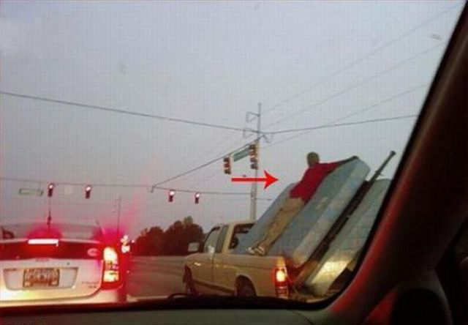
It seemed like a good idea!

Slide 5
Current Regulations
Flight Test Operations Manual (CAR 521.46)
Production Flight Test Procedures (CAR Standard 561.08 and AC 561.003)
Post Maintenance Test Flight (CAR 571.10 (4) and 605.85 (2) and (3)

Slide 6
Current Regulations
Flight Test Operations Manual (CAR 521.46)
Introduced in 2009
Provides an oversight mechanism for Flight Test activities supporting the aircraft certification process
Currently applicable to Type Certificate applicants but will be applied to all applicants for a design approval document through an amendment to the current wording
Draft Advisory Circular introduces definitions of flight test (similar to definitions introduced by the the EASA NPA 2008-20)

Slide 7
Definitions relative to Flight Testing
Category 1 Flight Test (Experimental flight test)
Initial flight(s) of a new type of aircraft
Flights to determine or expand the flight envelope
Initial flight(s) of an aircraft for which performance, flight characteristics, handling qualities or systems operating characteristics must be determined or may have been significantly modified

Slide 8
Definitions relative to Flight Testing
Category 2 Flight Test (Engineering Flight Test)
Flights (including certification flights) done within the operational envelope that include manoeuvres and systems operating assessments which are not expected to encounter performance, flight characteristics, handling qualities or system characteristics significantly different from those already known
Display flights and demonstration flights of non Type Certified aircraft
Flights conducted for the purpose of Function and Reliability testing

Slide 9
Definitions relative to Flight Testing
Category 3 Flight Test (Production Flight Test)
Flights performed in support of aircraft production prior to the issuance or re-issuance of a certificate of airworthiness, in order to establish conformity with the approved type design

Slide 10
Definitions relative to Flight Testing
Category 4 Flight Test (Avionics/Systems Flight Test)
Flights (including certification flights) performed to assess a system design change or installation which does not need a performance, flight characteristics or handling qualities assessment or an assessment of the impact on crew procedures when the new or modified system is operating

Slide 11
Definitions relative to Flight Testing
Functional Check Flight/Maintenance Test Flight
Flights performed after maintenance or at other times as determined by operational/contract considerations for the purpose of verifying the correct airborne function of aircraft systems using only approved data and procedures

Slide 12
Current Regulations
Production Flight Test Procedures (CAR Standard 561.08)
Production Control System for an aircraft must include flight test procedures and checklists
Production Flight Test Procedures and all subsequent amendments will be reviewed and accepted by the Minister

Slide 13
Current Regulations
Post Maintenance Test Flights (CAR 571.10 (4) and CAR 605.85(2) and (3))
…the maintenance release shall be made conditional on the satisfactory completion of a test flight carried out by the inclusion of the phrase “subject to satisfactory test flight”.
Essential crew only and pilot-in-command shall enter results of the test flight in the journey log

Slide 14
Risk Assessment
Hazard
Flights conducted to assess condition of the aircraft:
End of a leasing agreement
Post maintenance
Trouble shooting
Detailed procedures including training, crew suitability and planning are not always available
Crews may improvise and conduct maneuvers in inappropriate airspace and/or at inappropriate phases of flight (ie. high workload)

Slide 15
Risk Assessment
Likelihood (L) that a sequence of events will occur and result in a specific consequence
Severity (S) of the consequence to the decision maker
Exposure (E) to the opportunity for the sequence of events to occur
Risk Index = L x S x E

Slide 16
Risk Assessment
Risk Index (16)
Likelihood: Remote (2)
Has occurred rarely (Known to have happened but a statistically credible frequency cannot be determined)
Severity: Catastrophic (4)
Loss of aircraft, fatal injuries, public exposed to a life threatening hazard
Exposure: Occasionally exposed (2)
Occasionally exposed to the opportunity for the event sequence to occur
Seldom Exposed (1) could be applied
Moderate level of risk (11-30)
Notes:
FAA Safety Alert for Operators (SAFO) issued in late 2008 (SAFO 08 024) indicated that approximately 25% of accidents involving turbine powered aircraft during the past decade occurred during non-revenue flights (e.g. flights for maintenance purposes or re-positioning flights to pick up passengers)
Two common factors found by the NTSB to have been contributory in non-revenue flight accidents are:
(1) the flightcrew’s failure to adhere to standard operating procedures (SOPs); and
(2) the flightcrew’s failure to operate the airplane within its performance limitations
Canadian Transportation Safety Board data from the last 10 years also indicates that there have been a number of accidents while conducting activities which would fall into the category of Functional Check Flights:
-post maintenance
-trouble shooting serviceability issues
-initial acceptance and lease handover check flights
Detailed analysis was not done to confirm the root cause of these accidents

Slide 17
Risk Assessment
Options for Controlling the Risk
Promote awareness through education
Establish expectations through the publication of guidance material (Advisory Circulars and Staff Instructions)
Regulate and enforce

Slide 18
Initial Approach
Promote Awareness through education
Use the Aviation Safety Letter and other publications to highlight the issues and provide recommendations to mitigate the risks
Use the Safety Management Systems that have been implemented by Canadian Operators to address the hazards associated with Functional Check Flights
Consultation with stakeholders and other regulatory agencies
Will includes Operators (large and small), Original Equipment Manufacturers (OEMs),
Initial discussions may broaden the stakeholder base

Slide 19
Follow-up
Continue discussion with stakeholders and other regulatory agencies
Program Validation Inspections
Monitor accident/incidents reports

Slide 20


