Slide 1
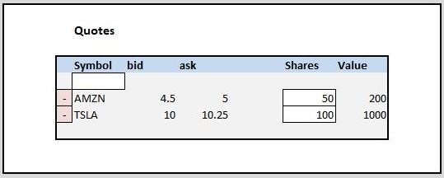
Porfolio
List of Quotes
Max: 5 quotes
Quote
Symbol
Bid
Ask
LastPrice
Portfolio Controller
Get Portfolio
Add Security
Del Security
[Get ShareValue?]
Build View Model
Return View Model
View
HTML
Thymeleaf
ViewModel
PorfolioRequestModel
Portfolio
Service
Get Portfolio
Add Security to Portfolio
Delete Security from
Portfolio
Portfolio Repository
Get All Securities
Add Security
Delete Security
HTTP GET/PUT/POST/DELETE
Portfolio
User
List: Quotes
PorfolioResponseModel
ViewModel
Title
Headers
Details Text
Details Styling
Input…
Quote
Service
Get Quote for Symbol
Get Quotes for List of
Symbols
EIX
REST API

