Slide 1
Spaceship Titanic

Slide 2
Introduction
Spaceship Titanic is an online Machine Learning / AI challenge.
The premise is a space emigration ship that went through a spacetime anomaly.
Almost half of its passengers were transported to an alternate dimension. The
computer was partially damaged, and data for which passengers were transported
was not complete. A set of data is given to train the ML / AI in order to predict
which passengers were Transported from the list of passengers with unknown
status.
More details: https://www.kaggle.com/competitions/spaceship-titanic/overview
In this presentation, I provide some insight into the known data set. I do NOT provide
a model for predicting additional passengers that were Transported. I did not use
AI or Machine Learning in my analysis. Only simple calculations and plots using
the R programming / analysis language.

Slide 3
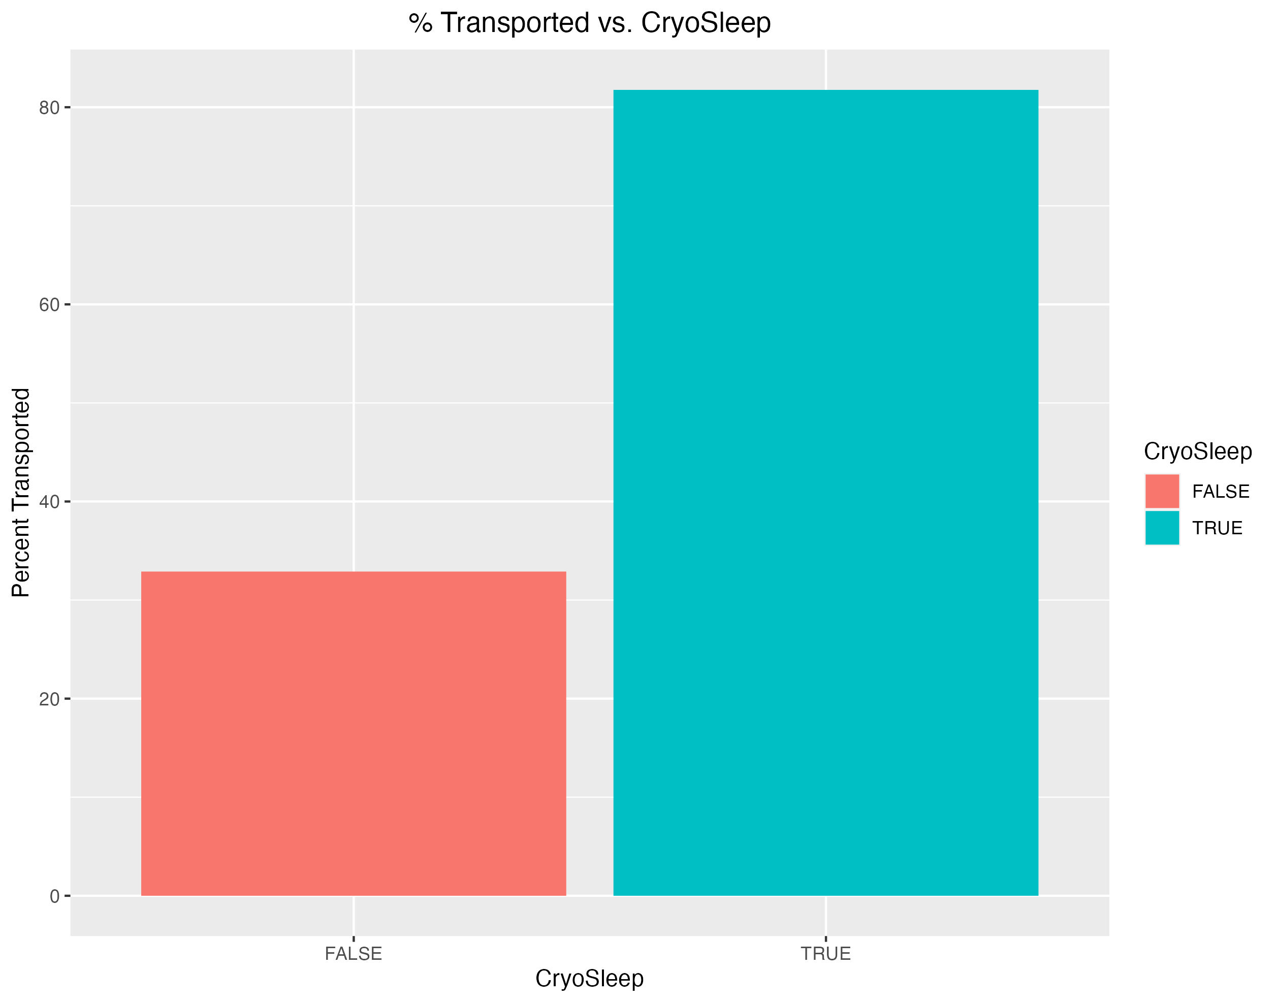
CryoSleep
The strongest correlation is with those in Cryo Sleep. Nearly 82% of those in
CryoSleep were Transported, as opposed to only 33% of those that were awake.

Slide 4
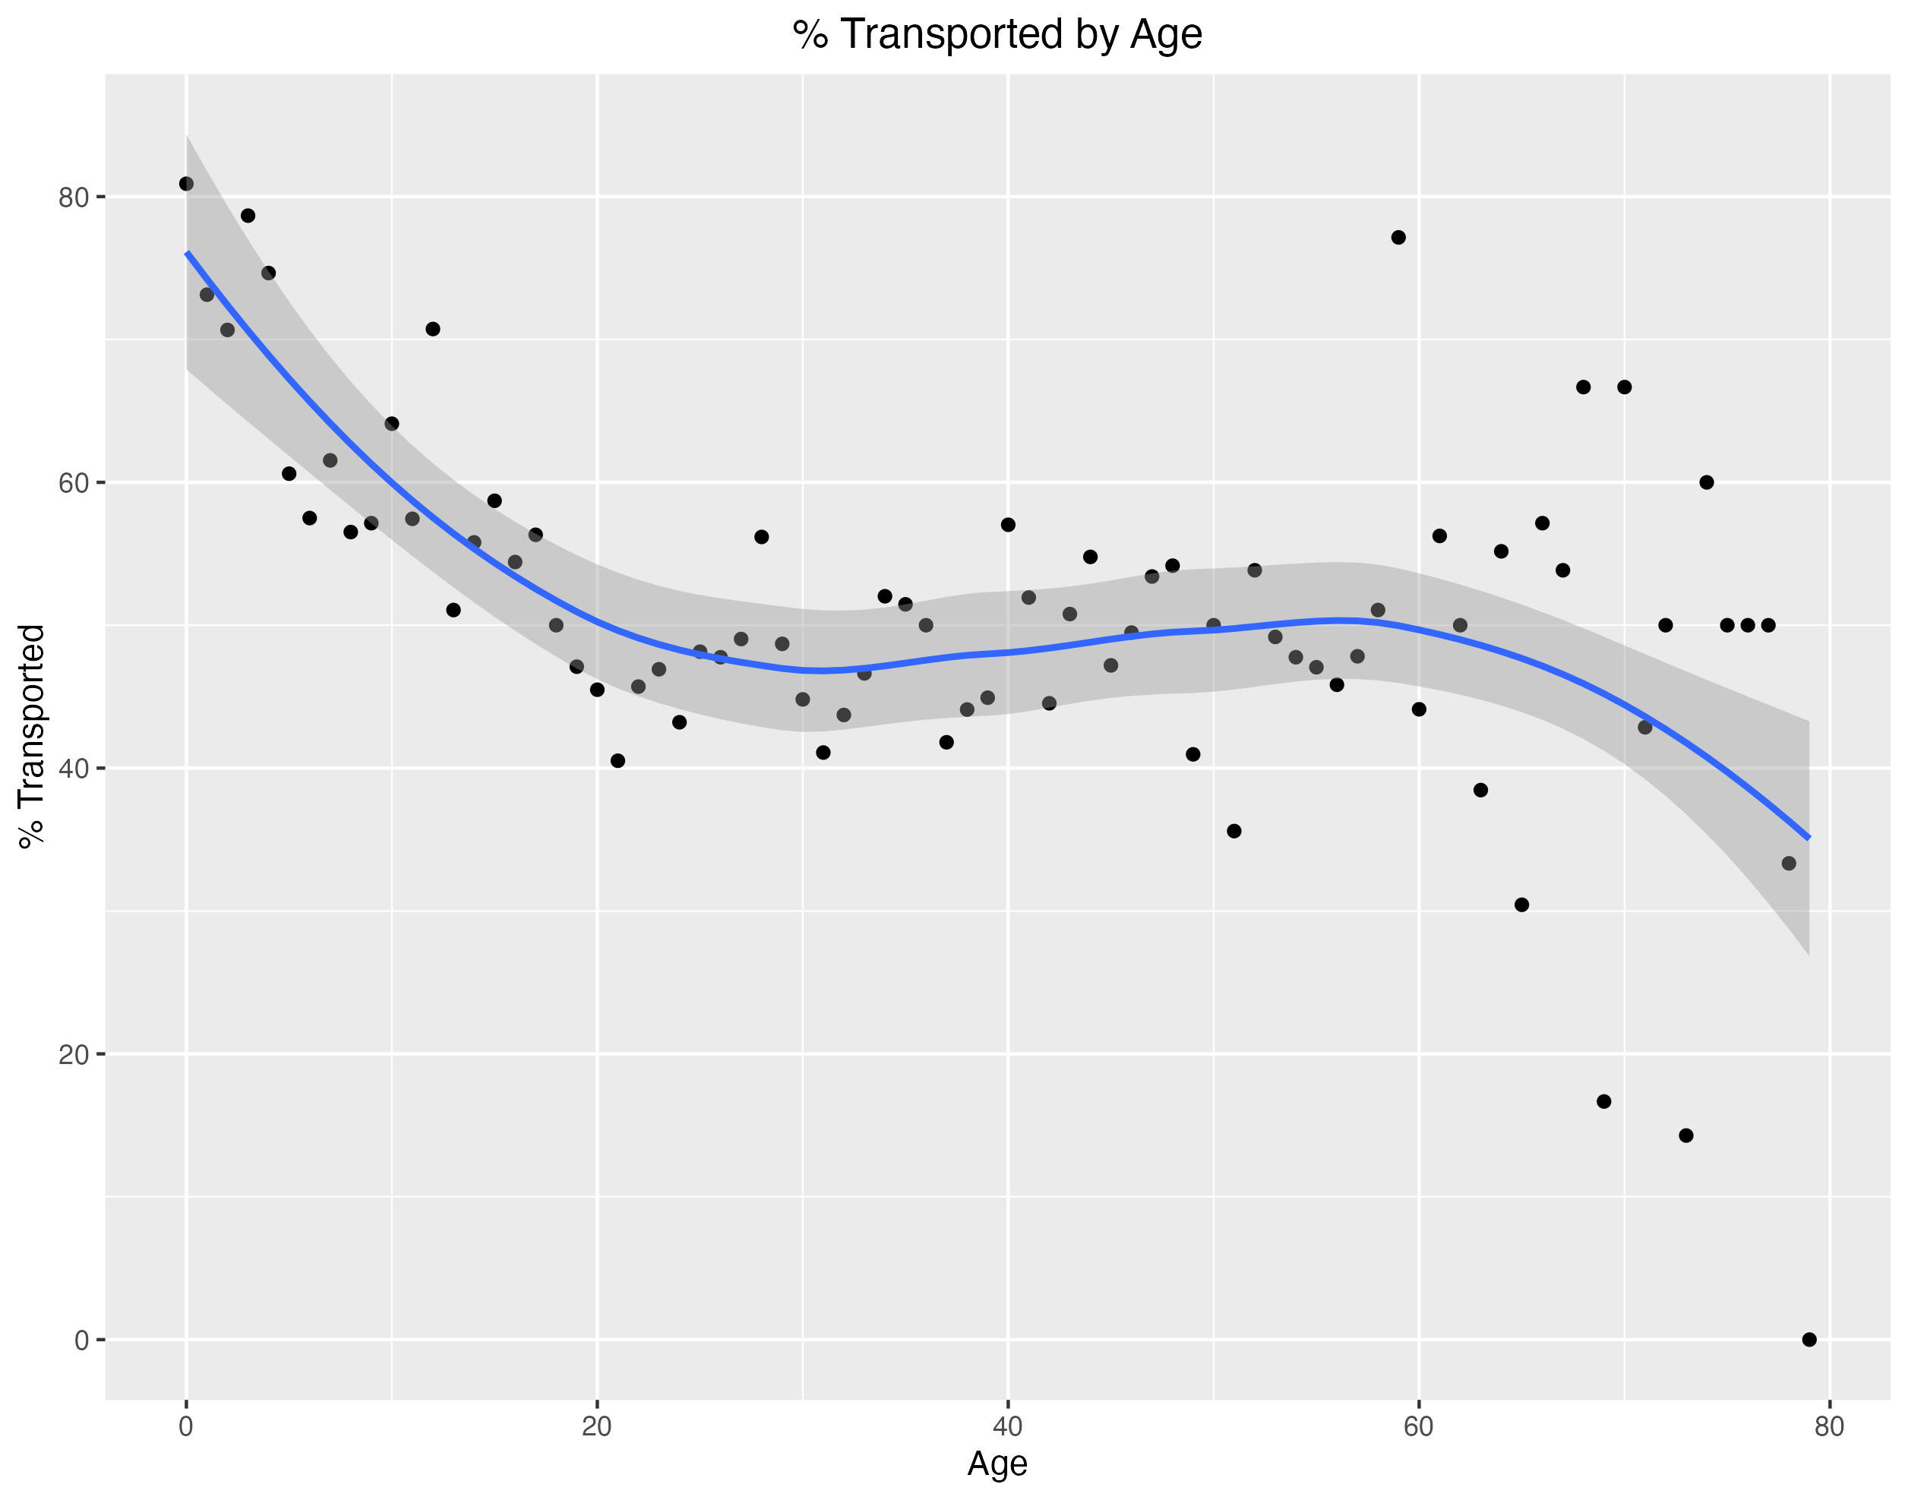
Age
There was a weak but valid correspondence to age. Those below
10 years old were more likely to have been Transported, with the rate increasing
as age decreased, starting at around 20.

Slide 5
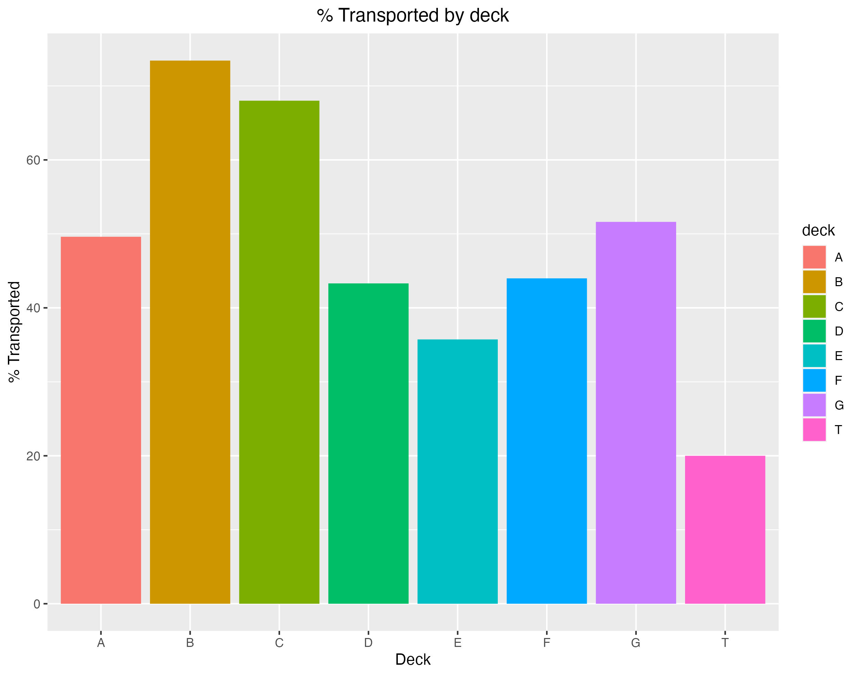

Deck Level
There is a weaker correspondence to the deck passengers were on.
Decks B & C had the highest rate, but the other decks still had significant rates.
Deck | Number on Deck | Count Transported | % Transported
A | 256 | 127 | 49.6%
B | 779 | 572 | 73.4%
C | 747 | 508 | 68.0%
D | 478 | 207 | 43.3%
E | 876 | 313 | 35.7%
F | 2794 | 1229 | 44.0%
G | 2559 | 1321 | 51.6%
T | 5 | 1 | 20.0%

Slide 6
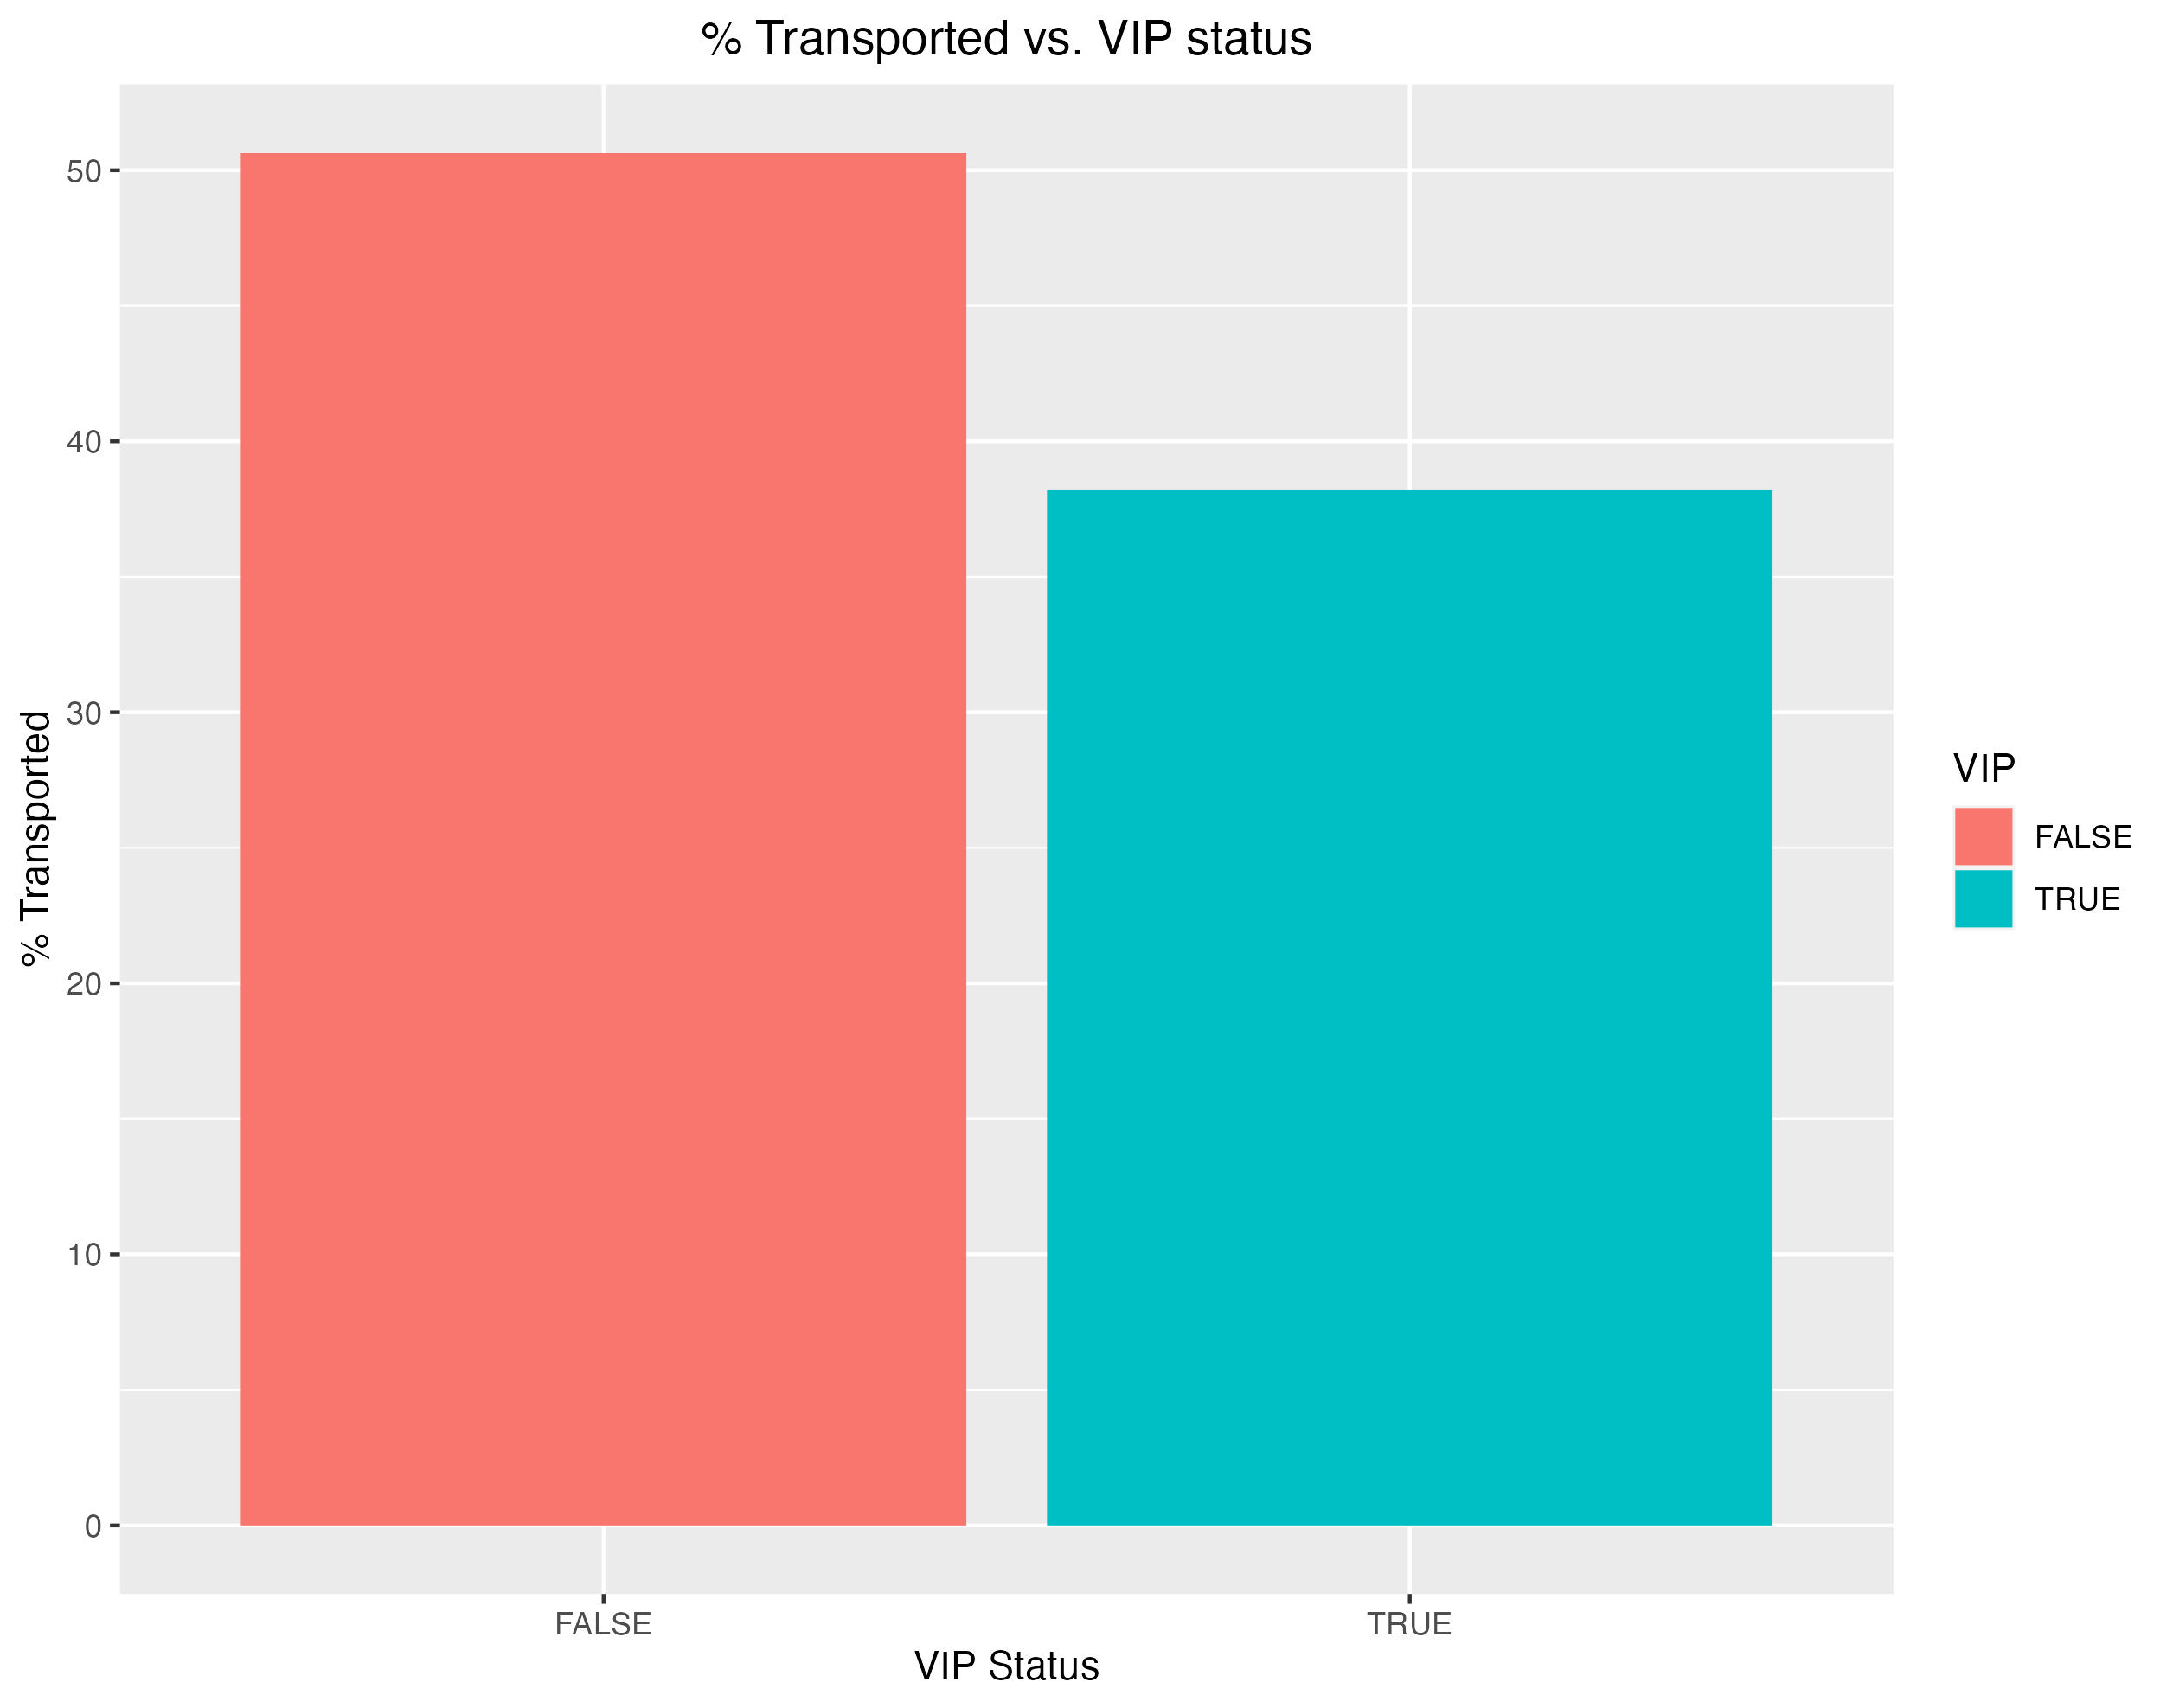
VIP Status
The weakest correlation was with VIP Status. This may be a factor of sample
size, but the relationship is significant enough to mention for further study.
Ticket | Sample Size | Count Transported | Percent Loss
Standard | 8291 | 4198 | 50.6%
VIP | 199 | 76 | 38.2%

Slide 7
Conclusion
Insights shown here indicate the most likely to be transported are
young passengers in Cryo-sleep, on Decks B & C, who are not VIP’s. This
conclusion is not a strong correlation, but requires further analysis beyond the
scope of this work.

