Slide 1
Universal Adversarial Attacks on Graph Neural Networks
Liao Chang
11/05/2021
Notes:
Good morning Prof Tay and Prof Chen. I am Liao Chang. I am excited to be here sharing my Final Year Project, Universal adversarial attacks on graph neural networks to you.

Slide 2
Agenda
Project Overview
Previous Approaches
Project Settings
Proposed Algorithms
Results and Discussion
Conclusion
Notes:
This is the agenda for my presentation today. I’ll brief go thru my project first, then introduce previous algos that inspired this research. Followed by settings and algos in this project. Finally, I’ll end this presentation with results, discussions and conclusion.

Slide 3
Project Overview
Research Gap & Background:
Widely used but vulnerable GNNs
No opponent to study & improve robustness
Data-free
Graph-level
Universal
Notes:
First of all, why do we conduct this research? The research gap we trying to fill is that GNNs are widely used but shown to be very vulnerable under adversarial attacks. To study and improve the robustness of GNNs, adversarial attack algorithms are needed to act as opponents, however, there’s no data-free graph-level universal attack algorithms yet. Out project is proposed in this circumstances aiming to propose such algorithm for further defence studies.

Slide 4
Project Overview
After Optimization Become
Project Breakdown:
Surrogate data generation algorithm
Graph-level universal adversarial attack algorithm
Attack Pipeline
Random Data
Update
Surrogate Data
Feed into
Universal Attack Algorithm
Generate
Victim model
Optimization
Produce
Universal Adversarial
nodes
Feed into
Predicted Logits
Target Class
Feed into
Append to
Test Data

Slide 5
Project Overview
General Results:
Benign state-of-the-art model: 80.13%
With actual data: 52.63%
With surrogate data: 55.36%

Slide 6
Previous Researches: Adversarial Attacks
Definition:
Maliciously crafted perturbations, leading to high misclassification rate
Universal adversarial Attack:
One single perturbation for all the data in a dataset (possibly applies to other datasets as well due to transferability)
NLP: hot-flip inspired, gradient-guided search on discrete tokens
Image:
Data-dependent: direct optimization based on model output
Data-free: generative model; optimization based on interior logits;

Slide 7
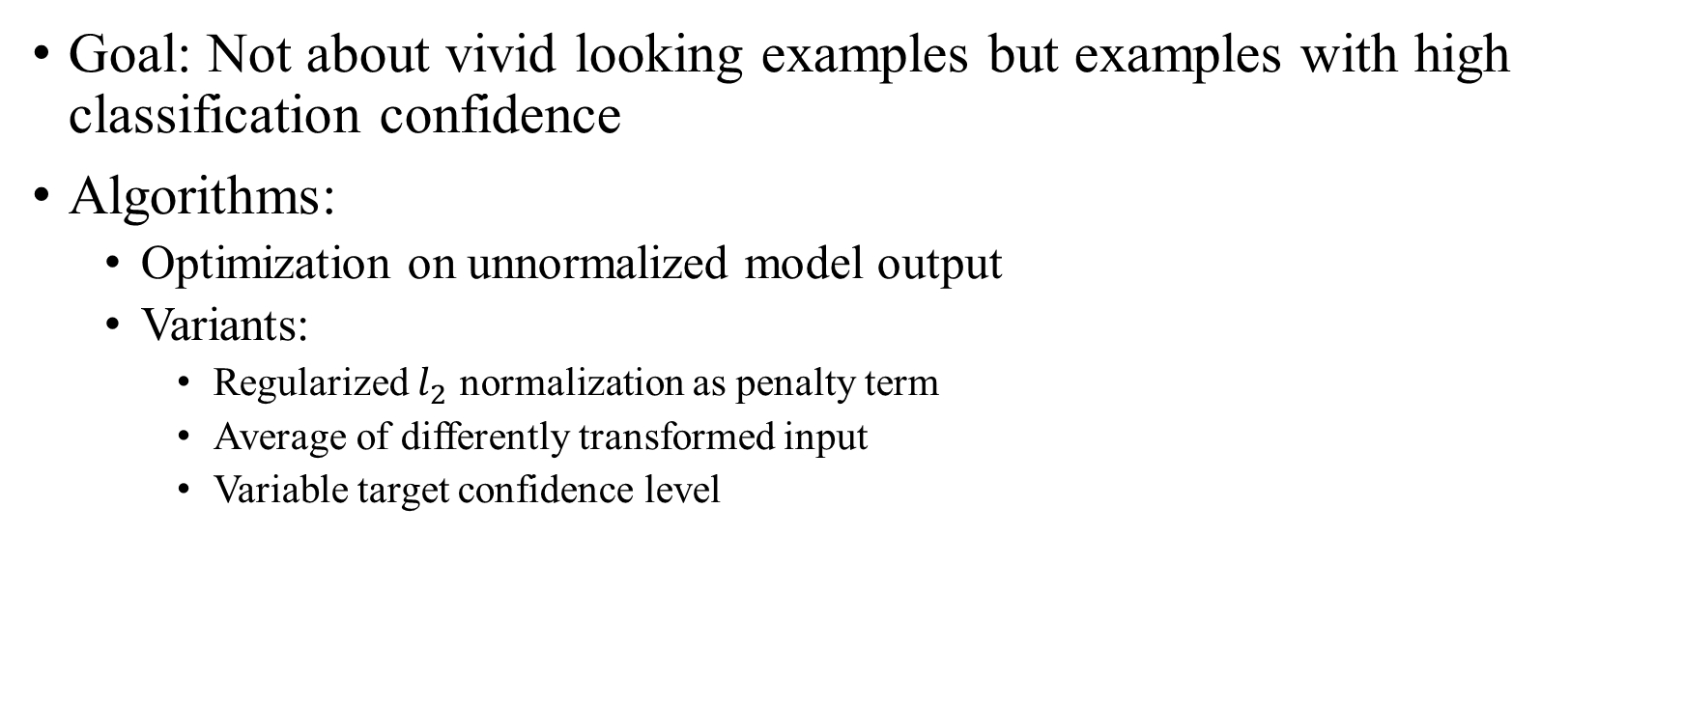
Previous Researches: Feature Visualization
Goal: Not about vivid looking examples but examples with high classification confidence
Algorithms:
Optimization on unnormalized model output
Variants:
Regularized $l_{2}$ normalization as penalty term
Average of differently transformed input
Variable target confidence level

Slide 8
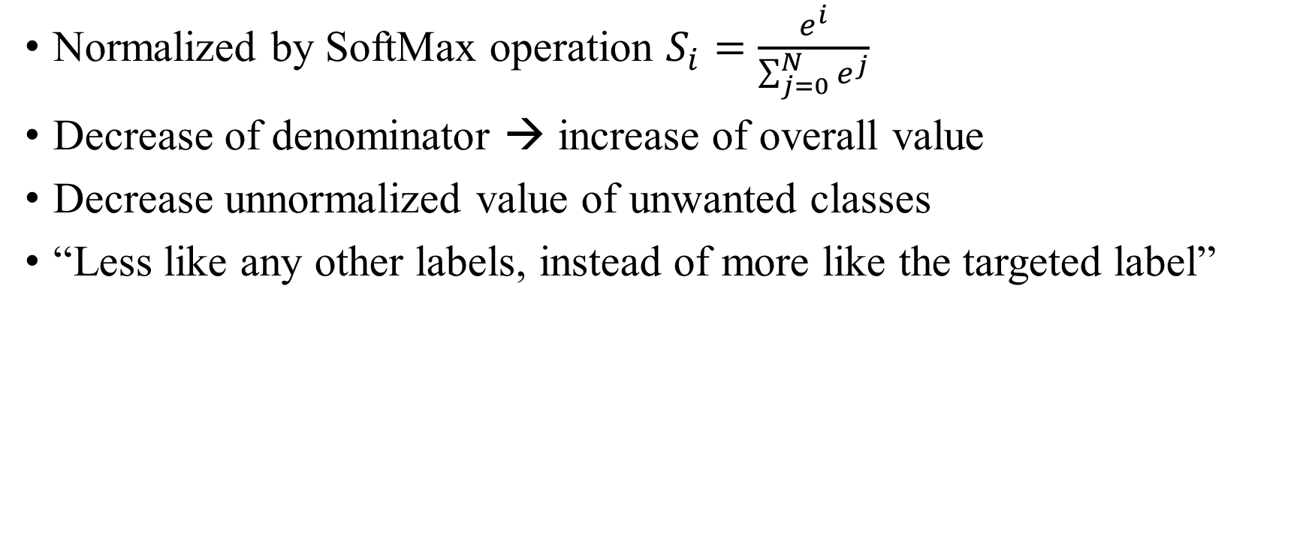
Why normalized output doesn’t work?
Normalized by SoftMax operation $S_{i}=\frac{e^{i}}{\sum_{j=0}^{N}{e^{j}}}$
Decrease of denominator → increase of overall value
Decrease unnormalized value of unwanted classes
“Less like any other labels, instead of more like the targeted label”

Slide 9
Project Settings
Victim Model: Hierarchical Graph Pooling with Structure Learning
Dataset: PROTEINS (unweighted)
1113 graphs, training: validation: testing ratio at 8:1:1
Node: Secondary Structure Element (SSEs)
Edge: SSEs in neighbouring amino-acid sequence or 3D space
Label: non-enzyme / enzyme
Surrogate data:
Variable confidence level between 0.65 to 0.99
500 surrogate data for each label
1000 data in total

Slide 10
Our Approach: Surrogate Data Generation
Difference between images & graphs: topological structure
Plan A:
Randomise adjacency matrix, optimizing node features
Creating unseen nodes, which might be infeasible
Plan B:
Assuming nodes known to the adversary
For a graph convolutional network, updating & binarizing edge weights= updating edges!
Creating a large, fully connected weighted graph, update the edge weight

Slide 11

Proof
Update node $x_{i}^{′}=Θ\sum_{j∈𝒩\left(v\right)∪\left\{i\right\}}{\frac{e_{j,i}}{\sqrt{\hat{d_{j}}\hat{d_{i}}}}x_{j}},\hat{d_{i}}=1+\sum_{j∈𝒩\left(i\right)}{e_{j,i}}$
When $e_{j,i}=0$, there’s no connection between node $i$ and node $j$
When $e_{j,i}=1$, node $i$ and node $j$ are connected
Hence, updating edge weights = updating topological connection

Slide 12
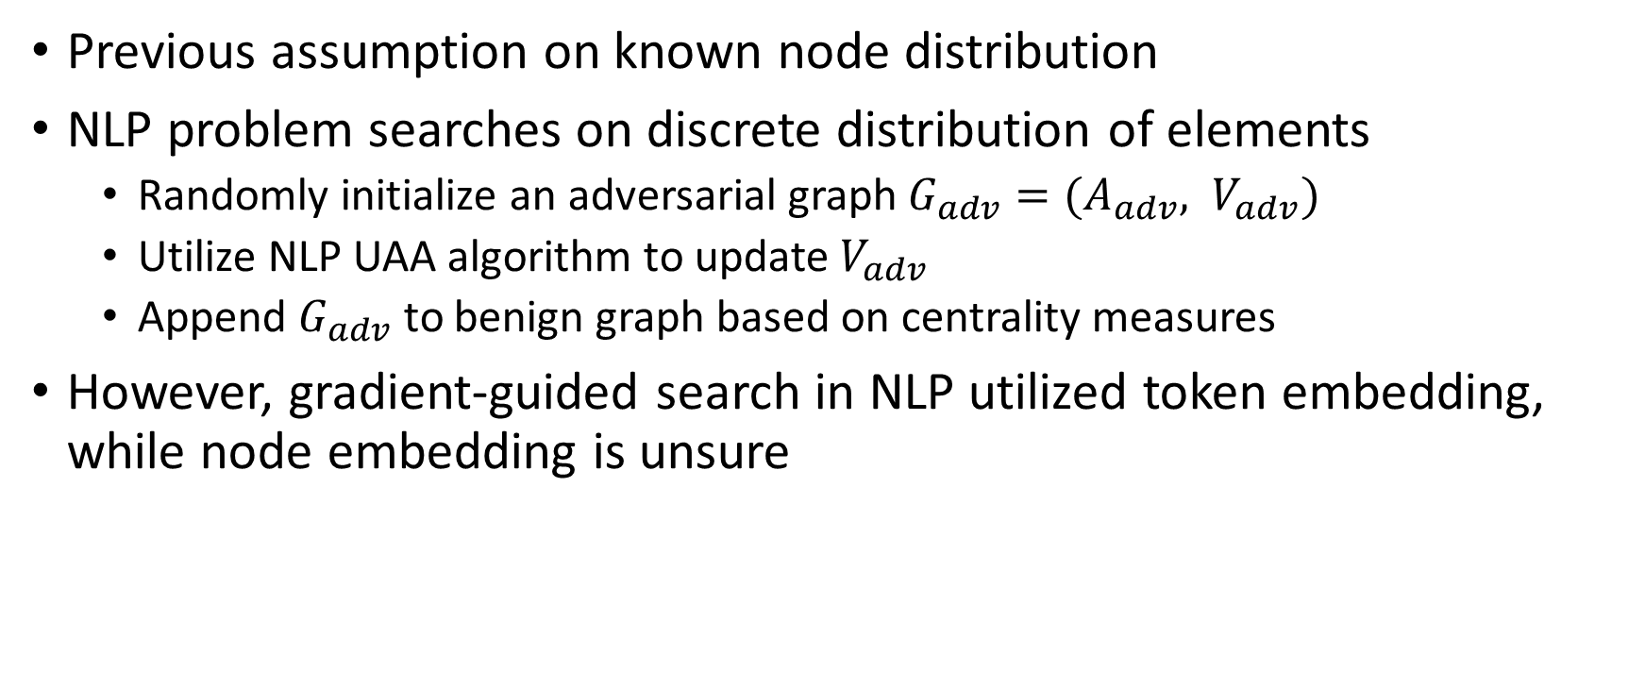
Our Approach: Universal Adversarial Attack
Previous assumption on known node distribution
NLP problem searches on discrete distribution of elements
Randomly initialize an adversarial graph $G_{adv}=({A_{adv}, V}_{adv})$
Utilize NLP UAA algorithm to update $V_{adv}$
Append $G_{adv}$ to benign graph based on centrality measures
However, gradient-guided search in NLP utilized token embedding, while node embedding is unsure

Slide 13
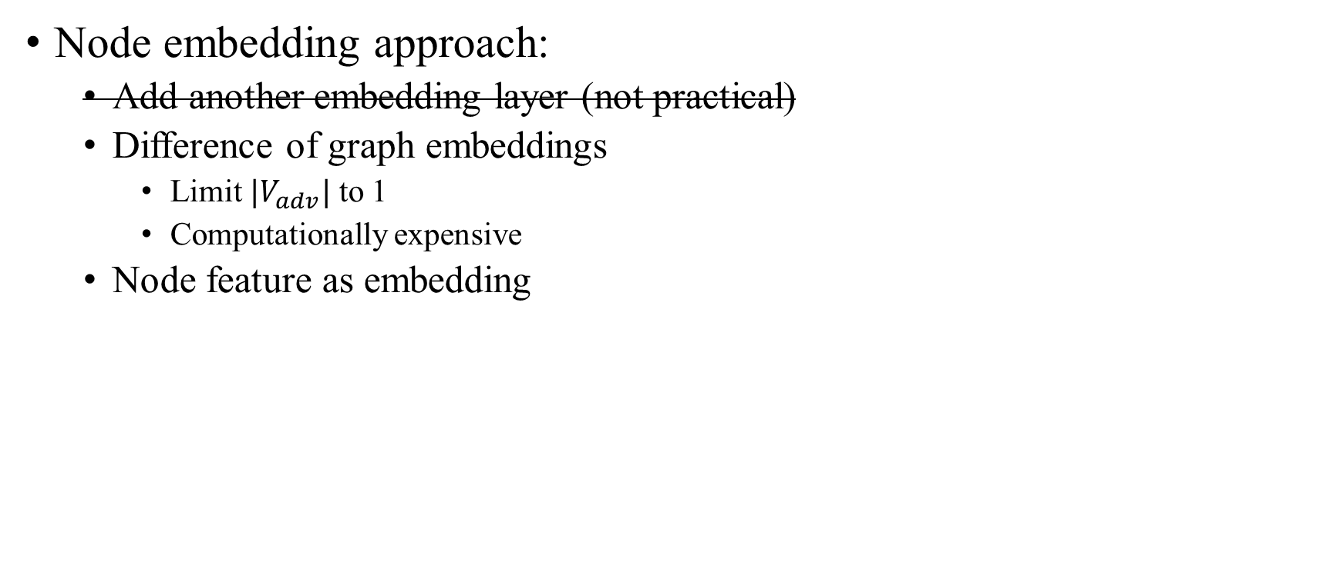
Our Approach: Universal Adversarial Attack
Node embedding approach:
Add another embedding layer (not practical)
Difference of graph embeddings
Limit ${|V}_{adv}|$ to 1
Computationally expensive
Node feature as embedding

Slide 14

Result Comparison
Node embedding methods $\left|𝒱_{adv}\right|=1$:

Slide 15
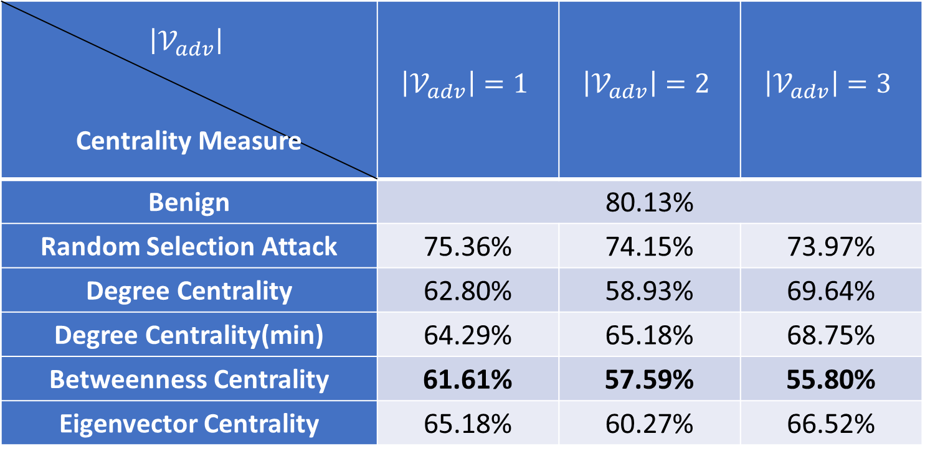
Result Comparison
$\left|𝒱_{adv}\right|$ Centrality Measure | $$\left|𝒱_{adv}\right|=1$$ | $$\left|𝒱_{adv}\right|=2$$ | $$\left|𝒱_{adv}\right|=3$$
Benign | 80.13%
Random Selection Attack | 75.36% | 74.15% | 73.97%
Degree Centrality | 62.80% | 58.93% | 69.64%
Degree Centrality(min) | 64.29% | 65.18% | 68.75%
Betweenness Centrality | 61.61% | 57.59% | 55.80%
Eigenvector Centrality | 65.18% | 60.27% | 66.52%

Slide 16
Findings
Graph-level GNNs also not robust
Node features as node embedding performs better.
Betweenness centrality performs better.

Slide 17
Conclusion
Proposed a data-free universal adversarial attack algorithm on graph-level GNNs
Lowers down the performance of a sota model to a random guessing level
Able to migrate to node-level

Slide 18
References
W. Fan et al., "Graph neural networks for social recommendation," in The World Wide Web Conference, 2019, pp. 417-426.
M. Zhang and Y. Chen, "Link prediction based on graph neural networks," arXiv preprint arXiv:1802.09691, 2018.
D. Duvenaud et al., "Convolutional networks on graphs for learning molecular fingerprints," arXiv preprint arXiv:1509.09292, 2015.
J. Gilmer, S. S. Schoenholz, P. F. Riley, O. Vinyals, and G. E. Dahl, "Neural message passing for quantum chemistry," in International Conference on Machine Learning, 2017: PMLR, pp. 1263-1272.
X. Geng et al., "Spatiotemporal multi-graph convolution network for ride-hailing demand forecasting," in Proceedings of the AAAI conference on artificial intelligence, 2019, vol. 33, no. 01, pp. 3656-3663.
S. Guo, Y. Lin, N. Feng, C. Song, and H. Wan, "Attention based spatial-temporal graph convolutional networks for traffic flow forecasting," in Proceedings of the AAAI Conference on Artificial Intelligence, 2019, vol. 33, no. 01, pp. 922-929.

Slide 19
References
D. Zügner and S. Günnemann, "Adversarial attacks on graph neural networks via meta learning," arXiv preprint arXiv:1902.08412, 2019.
D. Zügner, A. Akbarnejad, and S. Günnemann, "Adversarial attacks on neural networks for graph data," in Proceedings of the 24th ACM SIGKDD International Conference on Knowledge Discovery & Data Mining, 2018, pp. 2847-2856.
K. Xu et al., "Topology attack and defense for graph neural networks: An optimization perspective," arXiv preprint arXiv:1906.04214, 2019.
B. Wang and N. Z. Gong, "Attacking graph-based classification via manipulating the graph structure," in Proceedings of the 2019 ACM SIGSAC Conference on Computer and Communications Security, 2019, pp. 2023-2040.
K. R. Mopuri, U. Ojha, U. Garg, and R. V. Babu, "NAG: Network for adversary generation," in Proceedings of the IEEE Conference on Computer Vision and Pattern Recognition, 2018, pp. 742-751.
K. Simonyan, A. Vedaldi, and A. Zisserman, "Deep inside convolutional networks: Visualising image classification models and saliency maps," arXiv preprint arXiv:1312.6034, 2013.
Z. Zhang et al., "Hierarchical graph pooling with structure learning," arXiv preprint arXiv:1911.05954, 2019

Slide 20
References
E. Wallace, S. Feng, N. Kandpal, M. Gardner, and S. Singh, "Universal adversarial triggers for attacking and analyzing NLP," arXiv preprint arXiv:1908.07125, 2019.
K. R. Mopuri, P. K. Uppala, and R. V. Babu, "Ask, acquire, and attack: Data-free uap generation using class impressions," in Proceedings of the European Conference on Computer Vision (ECCV), 2018, pp. 19-34.
J. Hayes and G. Danezis, "Learning universal adversarial perturbations with generative models," in 2018 IEEE Security and Privacy Workshops (SPW), 2018: IEEE, pp. 43-49.
X. Zang, Y. Xie, J. Chen, and B. Yuan, "Graph universal adversarial attacks: A few bad actors ruin graph learning models," arXiv preprint arXiv:2002.04784, 2020.
L. Solá, M. Romance, R. Criado, J. Flores, A. García del Amo, and S. Boccaletti, "Eigenvector centrality of nodes in multiplex networks," Chaos: An Interdisciplinary Journal of Nonlinear Science, vol. 23, no. 3, p. 033131, 2013.
J. Bruna, W. Zaremba, A. Szlam, and Y. LeCun, "Spectral networks and locally connected networks on graphs," arXiv preprint arXiv:1312.6203, 2013.
A. Micheli, "Neural network for graphs: A contextual constructive approach," IEEE Transactions on Neural Networks, vol. 20, no. 3, pp. 498-511, 2009.

Slide 21
Thanks for your attention!

