Slide 1
Pool Design

Slide 2
Command Line Tool & Python API
Command Line:
pool create config.cfg
pool update config.cfg
pool query config.cfg
API:
pool.create(config)
pool.update(config)
query_results = pool.query(config)

Slide 3
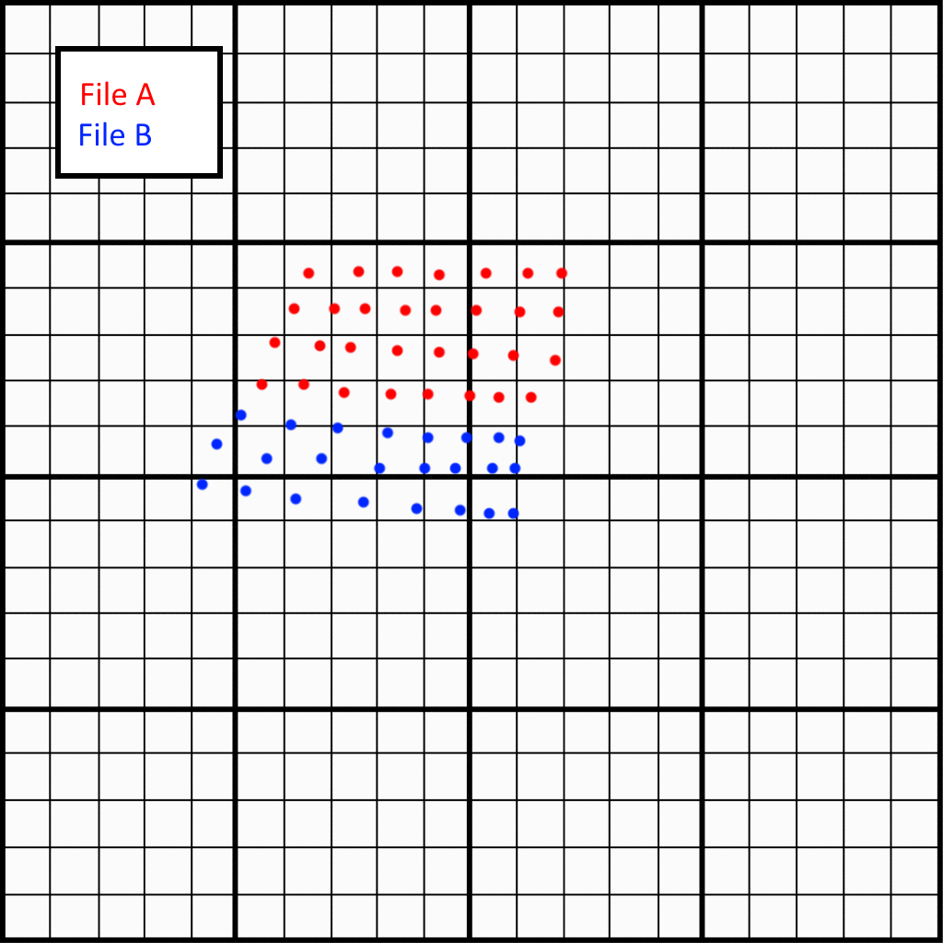

Slide 4
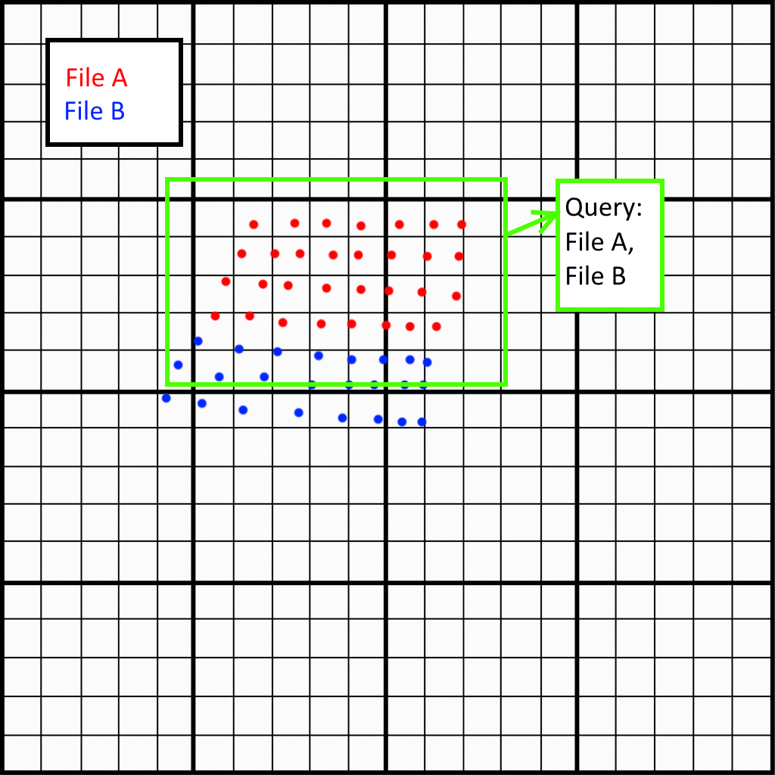

Slide 5
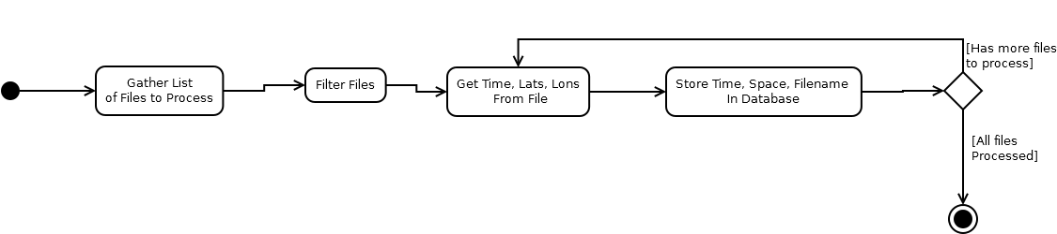
Pool Update

Slide 6
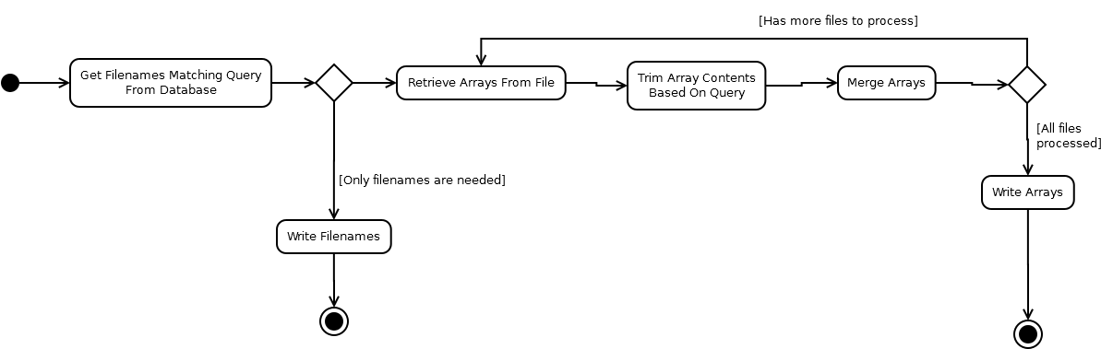
Pool Query

Slide 7
Plugins
Each step has swappable plugin
IE: “Retrieve arrays from file”
NUCAPS Plugin, ATMS Plugin, Radiosonde Plugin, etc.

