Slide 1
A Pseudo Object Oriented netCDF Application Interface Layer to “Simplify” Access to Satellite and Future Atmospheric Datasets
Scott P. Longmore CSU/CIRA/RAMMB, Fort Collins, Colorado
John A. Knaff, NOAA/NESDIS/STAR, Fort Collins, Colorado,
Mark DeMaria, NOAA/NESDIS/STAR, Fort Collins, Colorado,

Slide 2
Outline
Motivation and Objectives
HURSAT/netCDF Interface Implementation
Conclusions and Future Work

Slide 3
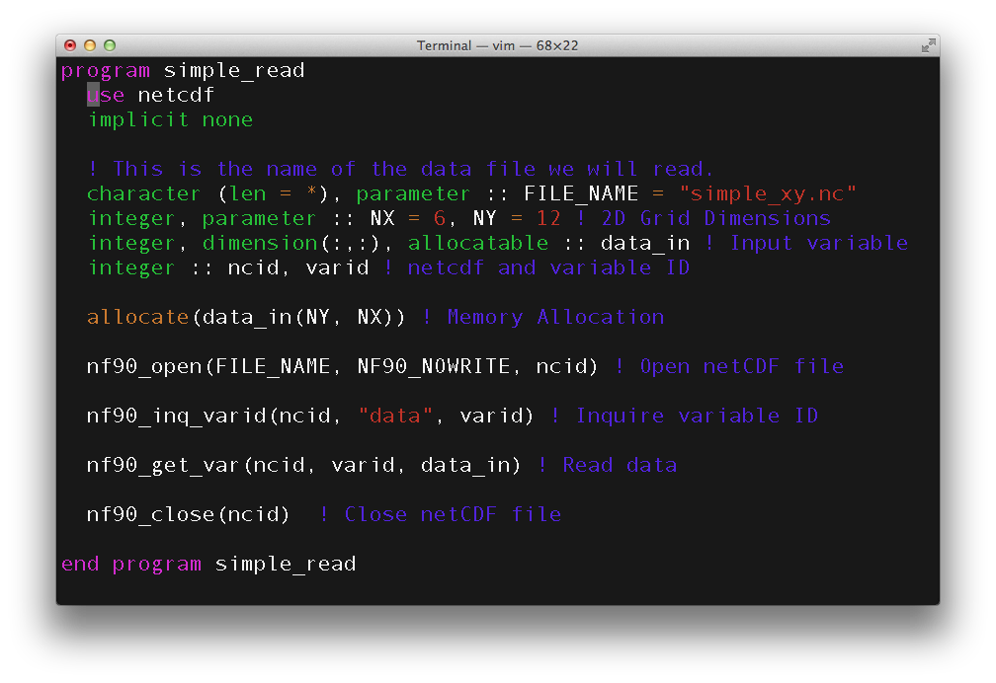
Motivation

Slide 4
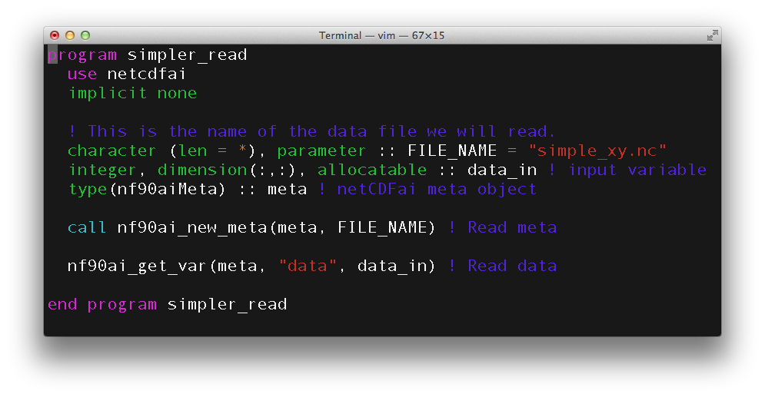
Motivation
Reduce the code lines to retrieve data
“Hide” the details: variable, attribute indexes, variable memory allocation, etc

Slide 5
Objectives
Develop a pseudo object oriented netCDF abstraction layer over the netCDF libraries
Develop an application layer module on top of the abstraction layer to read the Hurricane Satellite netCDF datasets: http://www.ncdc.noaa.gov/oa/rsad/hursat/
Application
Layer
HURSAT Reader
HURSAT Class
Abstraction
Layer
Meta Class
Variable Class
Attribute Class
Result Class
Data Access
Layer
Network Common Data Format (netCDF) Library

Slide 6
HURSAT/netCDF Interface Layers
HURSAT Application Interface Layer
Access functions utilizing HURSAT specific variable/attribute naming conventions
netCDF Abstraction Interface Layer
Common Module
Library, module, object and common function definitions
Meta “Class”
Dimension names, ids and sizes
Variable names, ids and array
Global attributes
Variable “Class”
Variable type (integer, real, character) and dimension ids
Attribute names, ids and array
Data access functions
Attribute access functions
Attribute “Class”: Character strings and array values, when applicable
Result “Class”: Return code, error handling functions

Slide 7
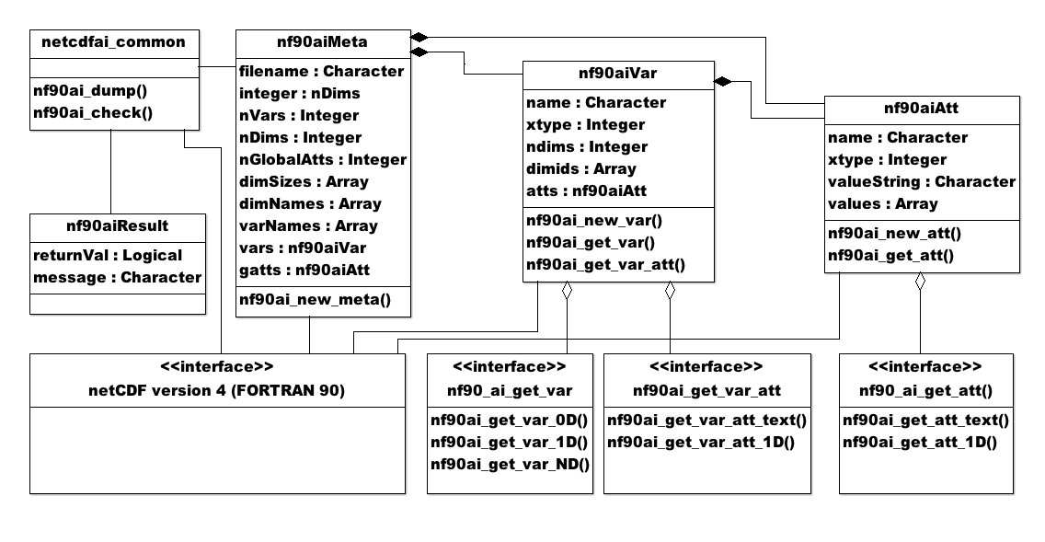
netCDF Abstraction Interface Class Diagram

Slide 8
“Interfaces” and “Function Overloading”
In object oriented languages the term "interface" is often used to define an abstract type that contains no data, but exposes behaviors defined as methods i.e. functions/subroutines. –Wikipedia

Slide 9
Conclusions and Future Work
Successfully implemented the HURSAT application and netCDF abstraction layers.
Future interface hierarchy would include multiple data formats and languages (F90, Python, etc)
Application
HURSAT Reader
Other Applications
Application
Layer
Meta-Data Classes
Time Classes
Granule Classes
Channel Classes
Derived Classes
Observation Classes
Profile Classes
Grid Classes
Projection Classes
Other Classes
Abstraction
Layer
netCDF Abstraction Interface Layer (NAIL)
HDF Abstraction Interface Layer (HAIL)
GRIB Abstraction Interface Layer (GAIL)
Other Abstraction Interface Layers
Data Access
Layer
Network Common Data Format (netCDF) Library
Hierarchical Data Format (HDF) Library
Gridded Binary Format (GRIB) Library
Other Formats and Utility Libraries

Slide 10
Conclusions and Future Work
Application Layer would include data classes for common atmospheric datasets, e.g. observation, grid, profile, projection, etc.
Application Layer framework would allow new abstraction/data layers to be added underneath.
Looking at Unidata’s Common Data Model version 4 (implemented in JAVA) for common design patterns/classes. http://www.unidata.ucar.edu/software/netcdf-java/CDM

