Slide 1
A Pseudo Object Oriented netCDF Application Programming Interface to “Simplify” Access to Satellite and Future Atmospheric Datasets
Scott P. Longmore CSU/CIRA/RAMMB, Fort Collins, Colorado
John A. Knaff, NOAA/NESDIS/STAR, Fort Collins, Colorado,
Mark DeMaria, NOAA/NESDIS/STAR, Fort Collins, Colorado,

Slide 2
Outline
Problem, Motivation and Objectives
netCDF⁽¹⁾ Pseudo Object Oriented (OO) Application Programming Interface (API)
netCDF⁽¹⁾ Translation Layer
HURSAT⁽²⁾ Source Layer
Conclusions and Future Work
netCDF – UCAR/Unidata Network Common Data Format: http://www.unidata.ucar.edu/software/netcdf
HURSAT – NOAA/NCDC HURricane SATellite Dataset: http://www.ncdc.noaa.gov/oa/rsad/hursat/

Slide 3
The Problem: Formats & Sources
Observation Data
netCDF
HDF
Radar Data
GRIB
Model Data
BUFR
Aircraft Data
McIDAS
netCDF – Network Common Data Format
HDF – Hierarchal Data Format
McIDAS - Man computer Interactive Data Access System format
GRIB – GRIdded Binary format
BUFR - Binary Universal Form for Representation of meteorological data
Text
Satellite Data
HURSAT

Slide 4
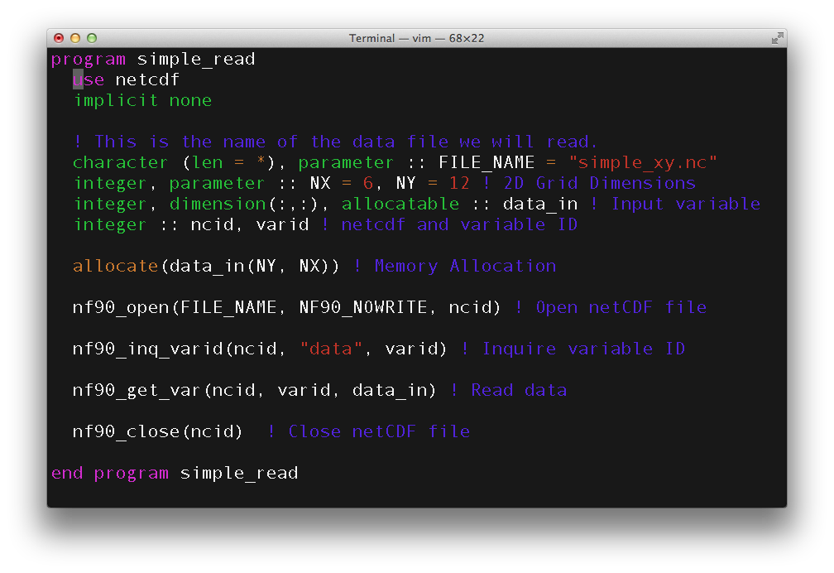
The Problem: Complexity

Slide 5
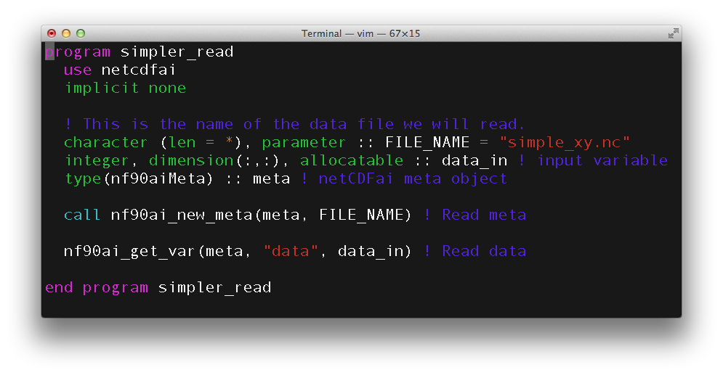
Motivation
Reduce the software lines to retrieve data
“Hide” the details: file, variable, attribute indices, memory allocation, etc

Slide 6
Objectives
Develop a pseudo OO API using tiered interface layers to abstract the netCDF library
Develop a translation layer using native netCDF library calls to place data into “objects”
Develop a source layer using translation layer “object” methods for the HURSAT datasets:
Program
TCSIZE.EXE
Source Layer
HURSAT Module
netCDF Classes
Translation Layer
Meta
Variable
Attribute
Result
Format Layer
netCDF Library

Slide 7
netCDF and HURSAT Layers
netCDF Translation Layer
Common Module
Library, sub-module, object and common function definitions
Meta “Class”
Dimension names, ids and sizes
Variable names, ids and object array
Global attributes
Variable “Class”
Variable type (integer, real, character) and dimension ids
Attribute names, ids and object array
Data access functions
Attribute access functions
Attribute “Class”: Character strings and array values, when applicable
Result “Class”: Return code, error handling function
HURSAT Source Layer
HURSAT module with access methods utilizing HURSAT specific variable/attribute naming conventions

Slide 8
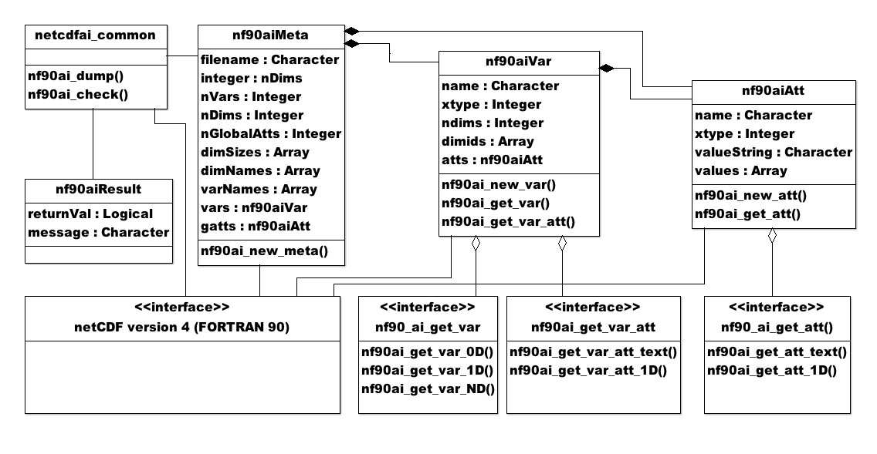
netCDF API Class Diagram

Slide 9
Definitions
In object oriented languages the term "interface" is often used to define an abstract type that contains no data, but exposes behaviors defined as methods i.e. functions/subroutines. –Wikipedia
Function overloading or method overloading is a feature that allows creating several methods with the same name which differ from each other in the type of the input and the output of the function. It is simply defined as the ability of one function to perform different tasks. –Wikipedia
Definitions:
netcdfai_get_var_1D(varName,var1D)
netcdfai_get_var_2D(varName,var2D)
netcdfai_get_var_3D(varName,var3D)
Implementation:
netcdfai_get_var(varName,varND)

Slide 10
Conclusions and Future Work
Successfully implemented the netCDF and HURSAT API layers.
Future interface hierarchy would include multiple data formats, sources and languages (F95, Python, etc)
Programs
(Drivers)
TCSIZE.EXE
PROF.EXE
OTHER.EXE
HURSAT
(Satellite)
NOMADS
(Model)
Other
Source Layer
(Modules)
Atmospheric Data Class Library
Time
Observation
Profile
Grid
Projection
Channel
Granule
Translation Layer
(Classes)
Meta
Variable
Attribute
Result
Error
Derived
Other
netCDF
GRIB
HDF
McIDAS
BUFR
Text
Other
Format Layer
(Libraries)
netCDF
GRIB
HDF
McIDAS
BUFR
Text
Other

Slide 11
Conclusions and Future Work
API Layer would include data classes for common atmospheric datasets, e.g. observation, grid, profile, projection, etc.
API Layer framework would allow new abstraction/data layers to be added underneath.
Looking at Unidata’s Common Data Model v4 (implemented in JAVA) for common design patterns/classes.
http://www.unidata.ucar.edu/software/netcdf-java/CDM

