Slide 1
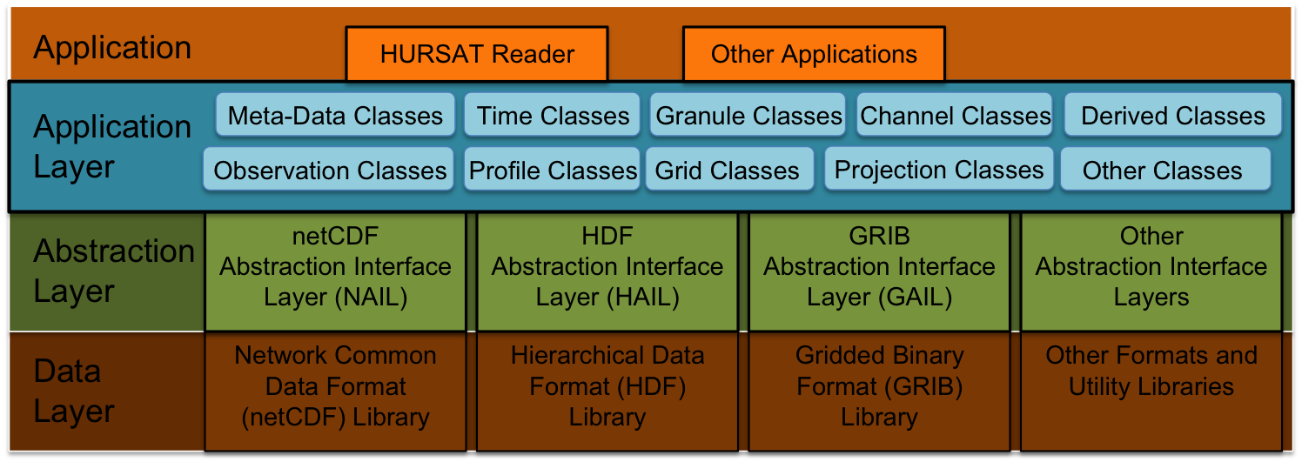
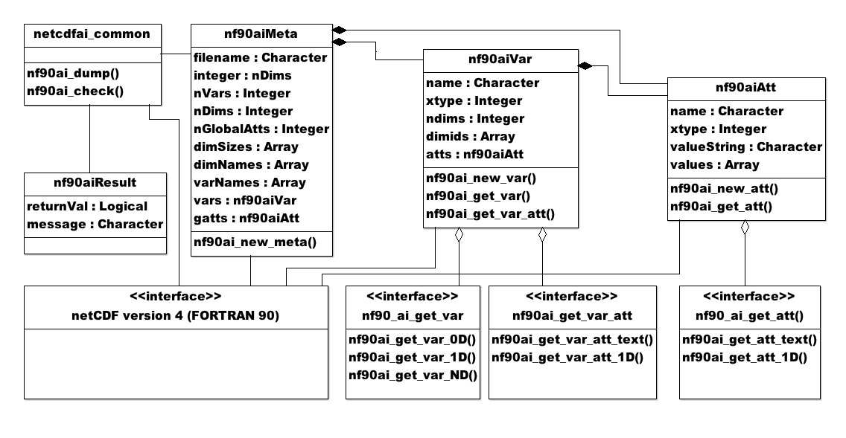
29th Conference on Environmental Information Processing Technologies “A Pseudo Object Oriented netCDF Application Interface Layer to “Simplify” Access to Satellite and Future Atmospheric Datasets” S. P. Longmore, J. A. Knaff, and M. Demaria
Application/abstraction interface layers developed to read Hurricane Satellite (HURSAT) dataset.
Pseudo OO API layer abstracts verbose/repetitive netCDF access calls.
Hierarchal interface layer design pattern can be extended to other existing data formats/libraries. (HDF, GRIB, etc)
New abstraction interface layers can be developed as needs warrant.
Interface layer hierarchy (above) and netCDF class diagrams (below)

