Slide 1
Tumor Growth Image Analysis
Songhe Cai and Marios S. Pattichis
image and video Processing and Communications Lab
Dept of Electrical Engineering and Computer Engineering
The University of New Mexico
Albuquerque, NM 87131
www.eece.unm.edu/ivpcl

Slide 2
Abstract
We study the problem of estimating tumor growth from planar images such as those generated by CT imaging systems. Tumor growth is estimated from a time sequence (a longitudinal study) of corresponding 2D/3D slices of the tumor. Following rigid body registration, we apply ordinary and multi-scale optical flow estimation methods to estimate the tumor deformation vector field.

Slide 3
Purpose
Early tumor detection is most likely to benefit from accurate characterization of tumor growth, estimated in a longitudinal CT study. This should improve lung cancer mortality.

Slide 4
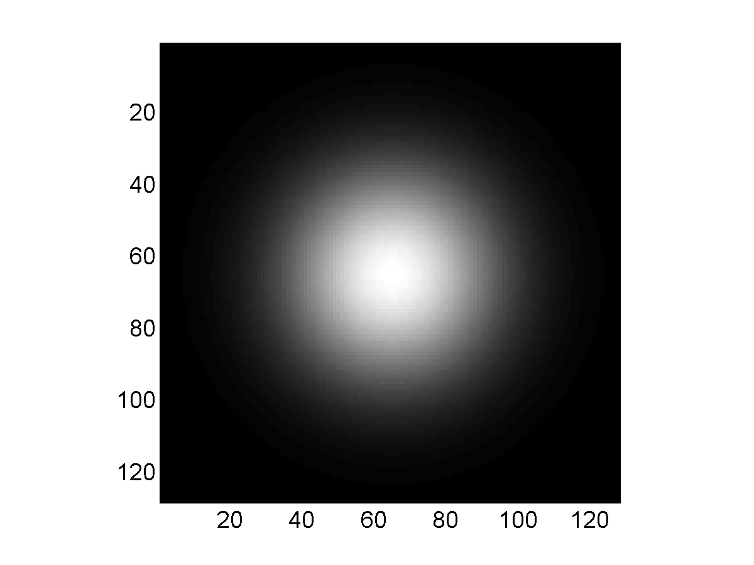
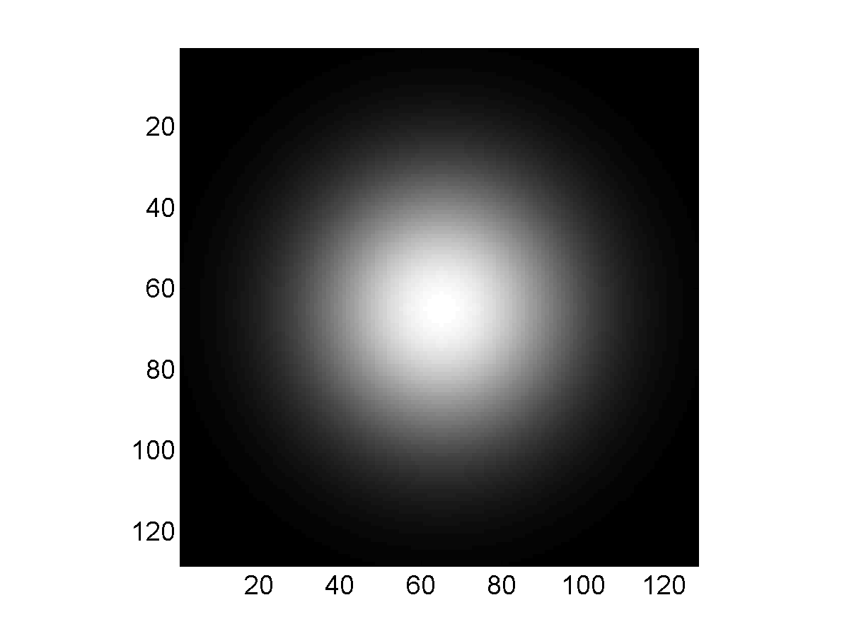

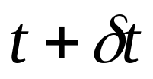
2D Object Deformation I
Object at time Object at time
Spatial extent of Gaussian objects are shown.

Slide 5
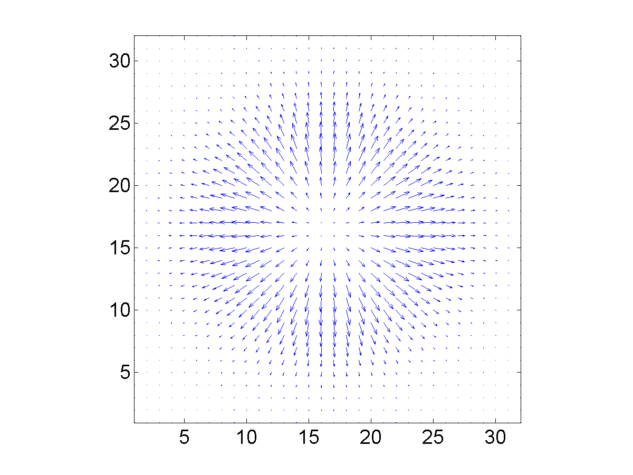
2D Object Deformation II
2D Flow Graph of Estimated Growth

Slide 6
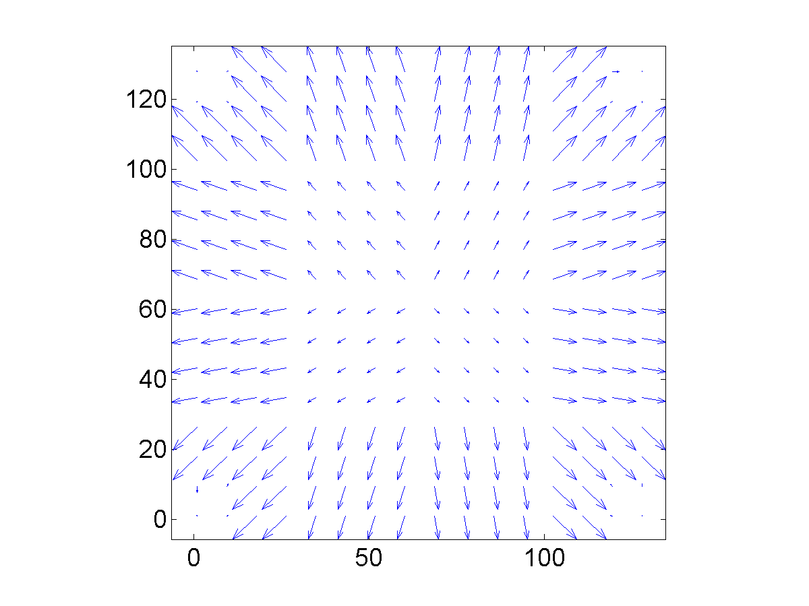
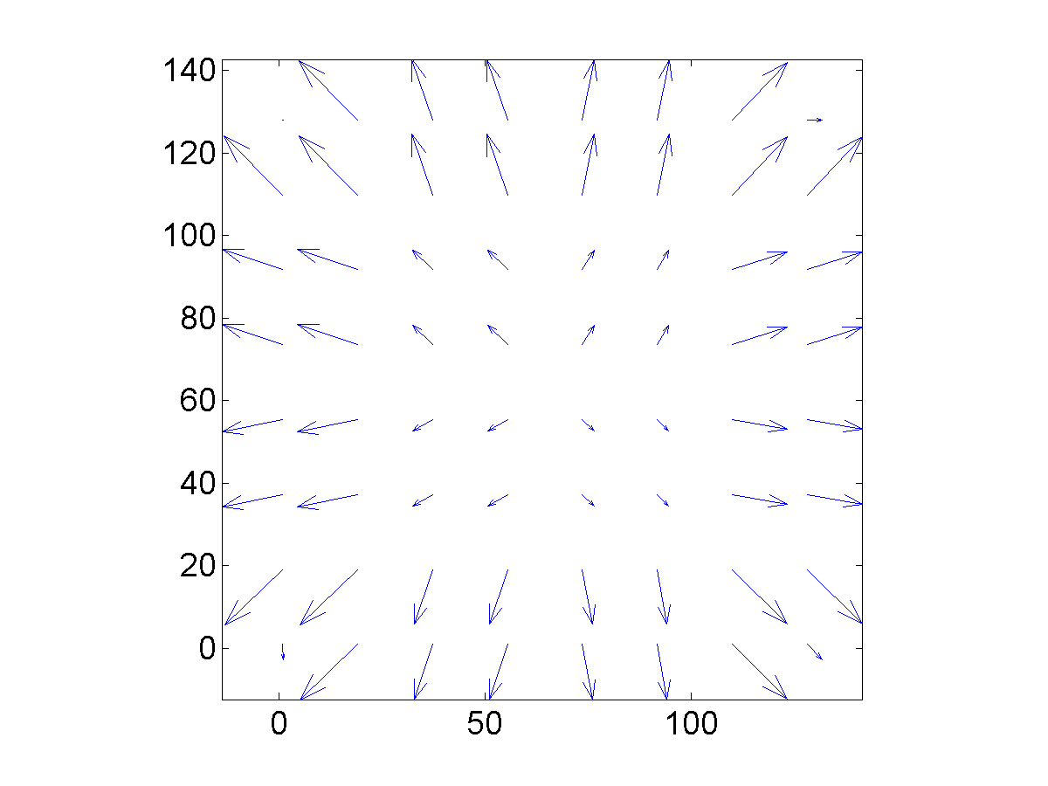
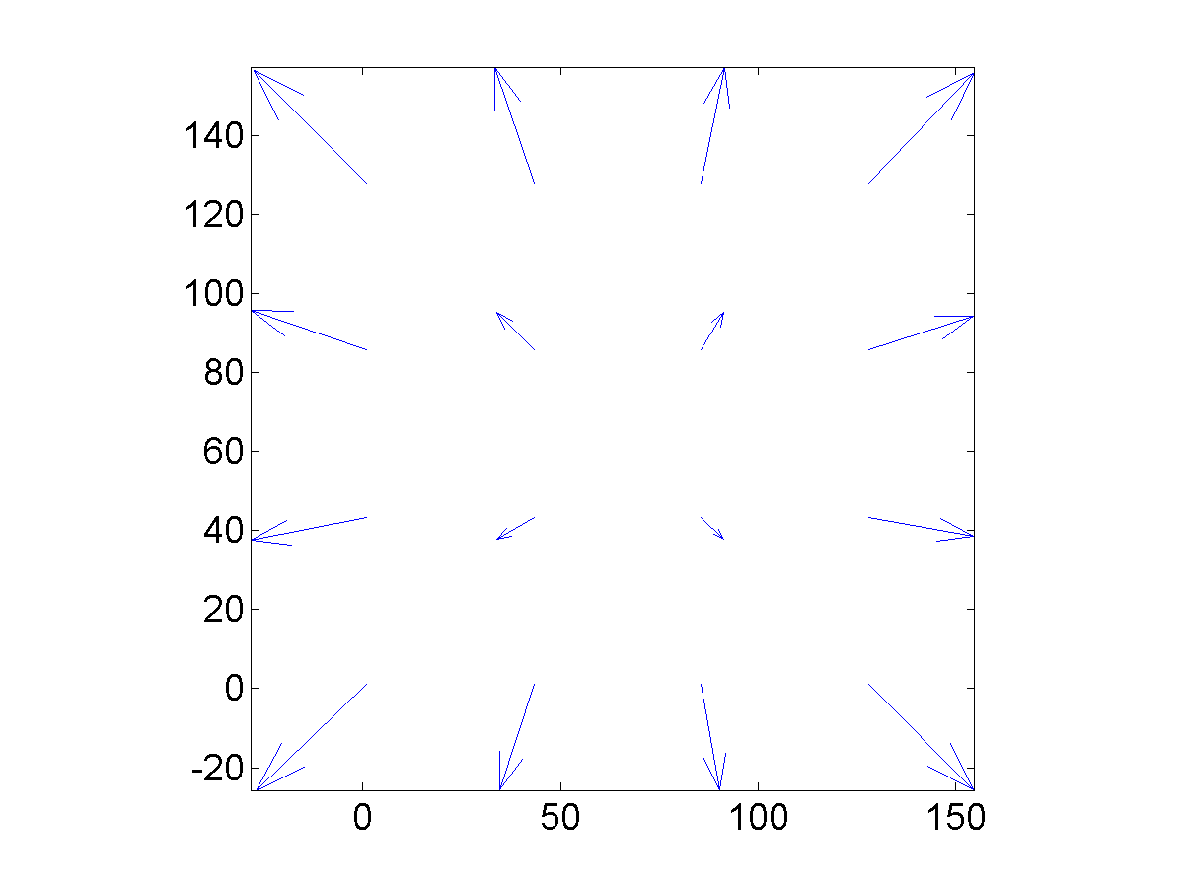
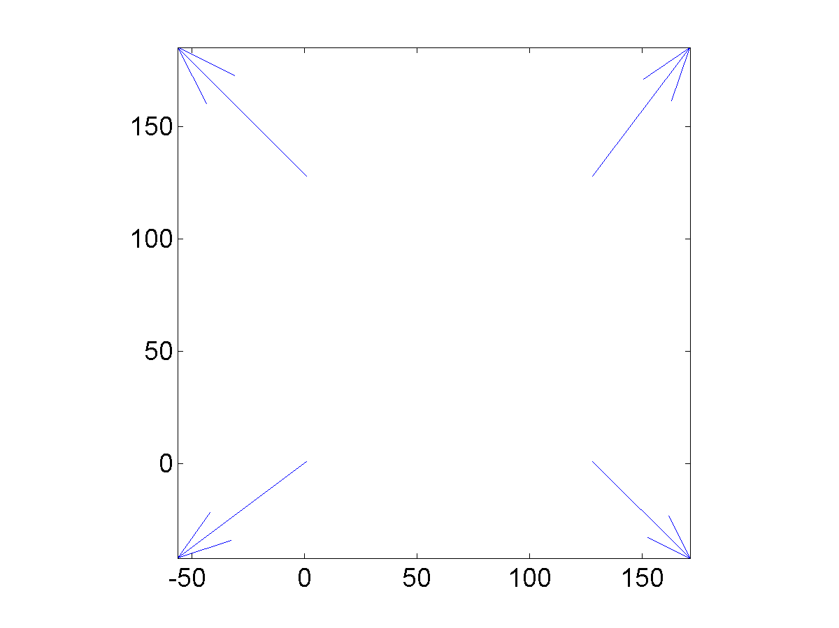
2D Deformation Object III
2D Flow Graph of Multi-scale Estimated Growth

Slide 7
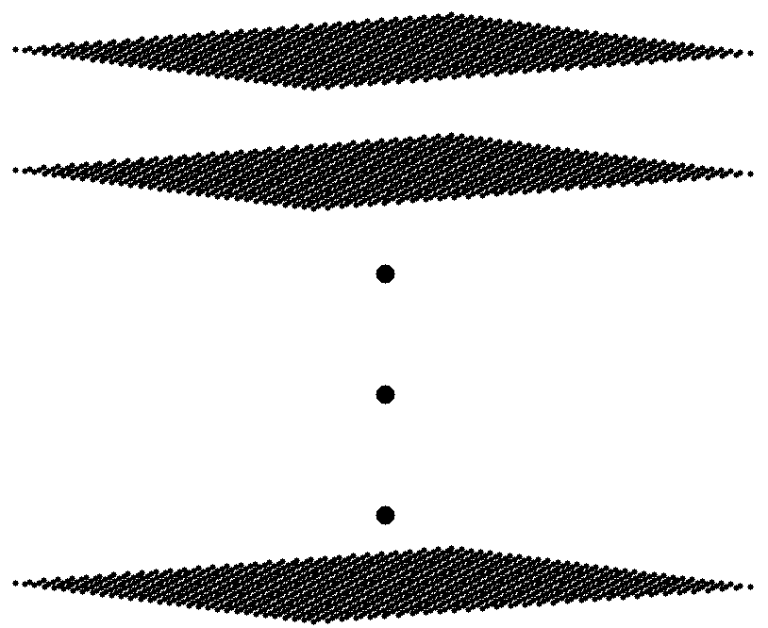
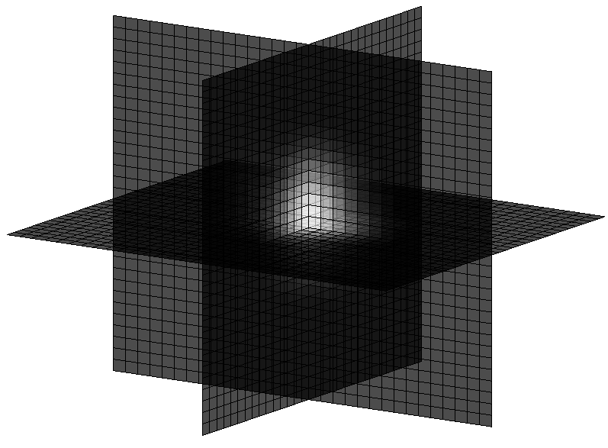



3-D object deformation I
slices of images of a function that is a
Gaussian function of radial distance up to , on a
zero background.

Slide 8
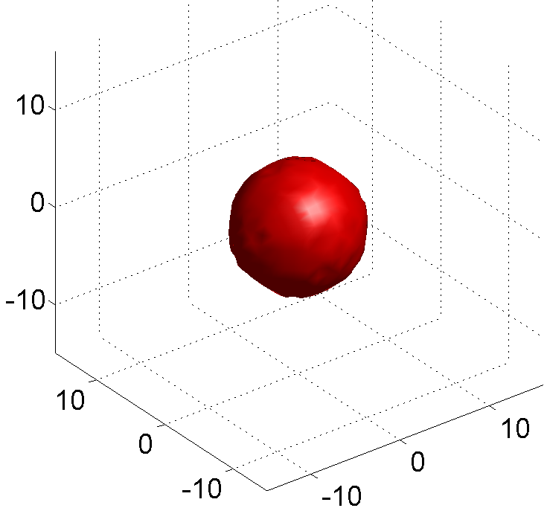
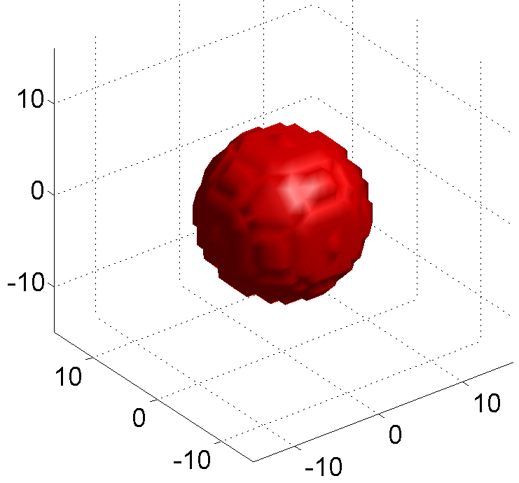
3-D Object Deformation II
Object at time Object at time
Spatial extent of Gaussian objects are shown.

Slide 9
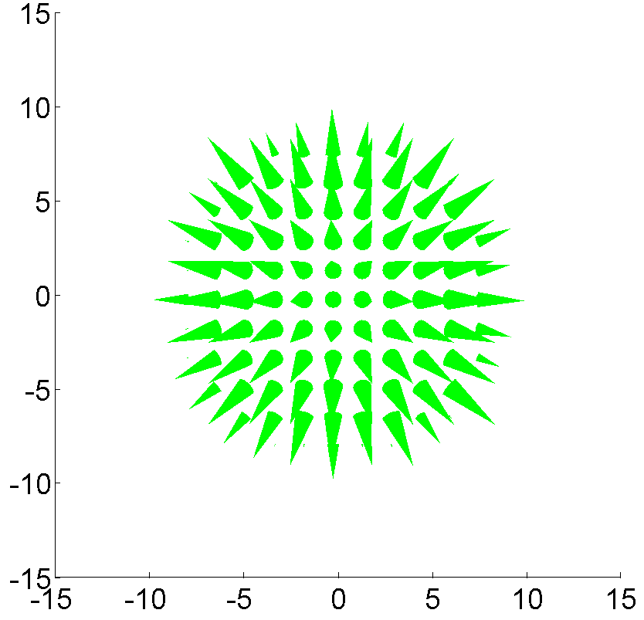
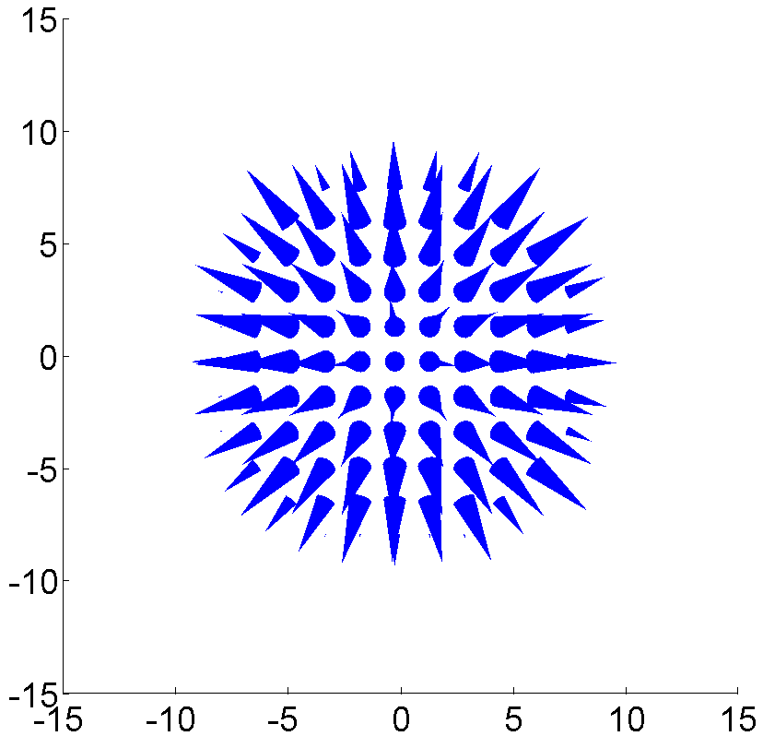
3-D Object Deformation III
Ground truth Estimated

Slide 10
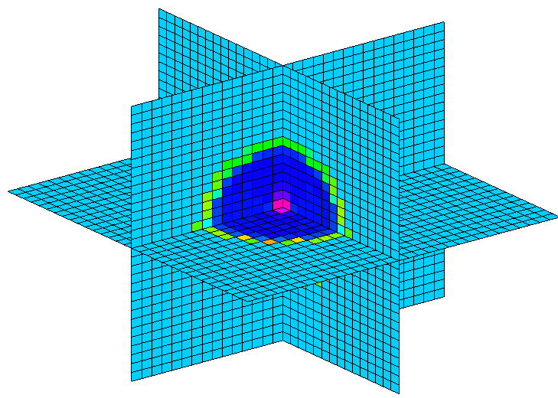
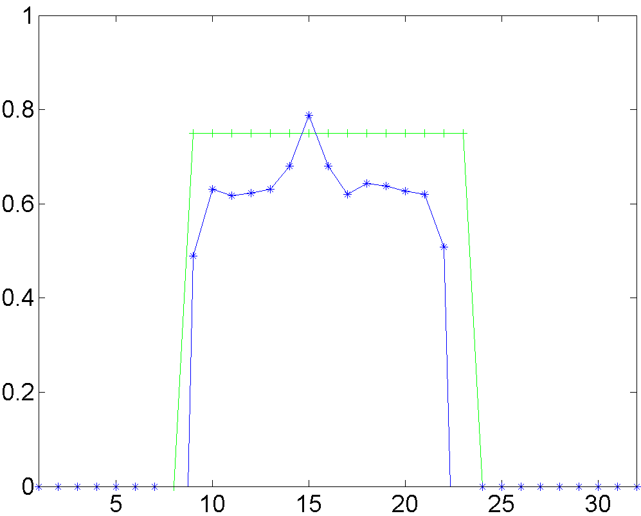
3-D Object Deformation IV
Growth Estimates (Divergence)
truth
estimated
3-D uniform growth Growth estimate along radial direction

Slide 11
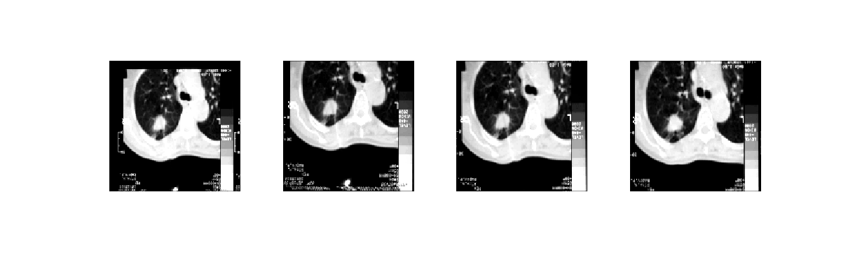
Original CT slices of lung tumor

Slide 12
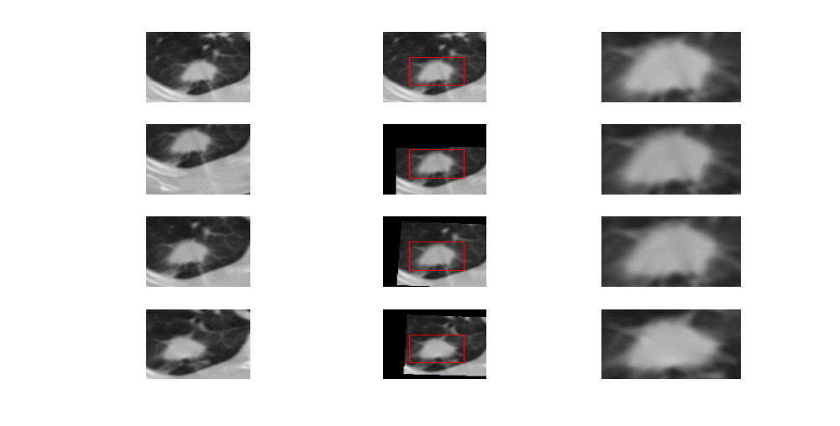
3-D Tumor Reconstruction from CT (I of II)
CT Slices Registered Slices Cropped Tumor Slices
(rigid body registration)

Slide 13
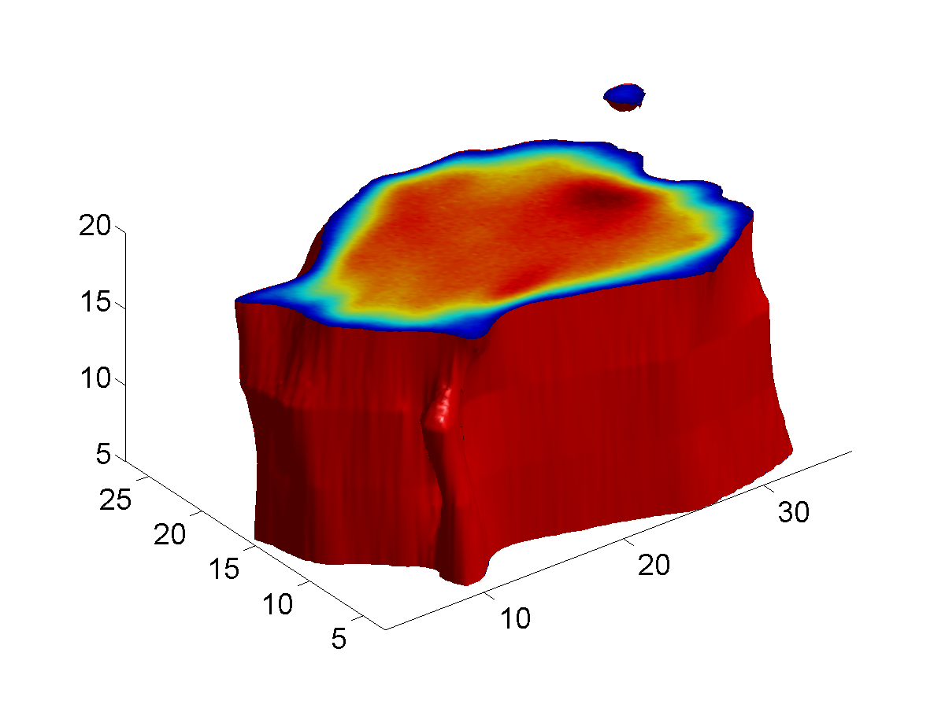
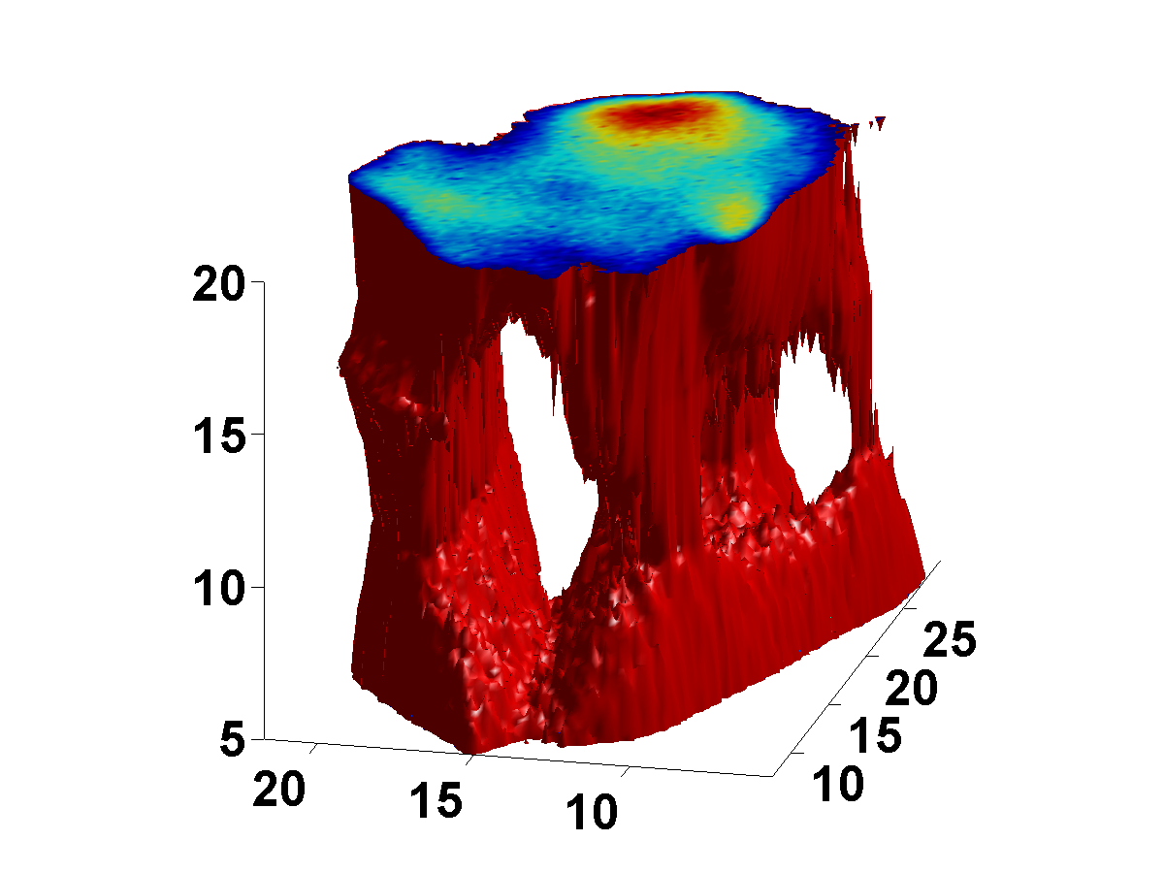
3-D Tumor Reconstruction from CT (II of II)
Threshold at level=100. Threshold at level=170.

Slide 14
Concluding Remarks
More work is currently in progress, especially multi-scale methods, like fast AM-FM based optical flow estimation.
Need to test on many benign and malignant cases.
Need to test on small tumors for effective early detection.

Slide 15
Acknowledgments
This research was supported through a grant from the UNM Cancer Research and Treatment Center. The authors would like to acknowledge the support of Rick Crowell, M.D., David S. James, M.D., and Loren Ketai, M.D. CT data was provided by Constantinos S. Pattichis of the University of Cyprus.

Slide 16
Reference
[1] B.K.P. Horn and B.G. Schunck. Determining optical flow. Artificial Intelligence, 17:185–204, 1981.
[2] J.L. Barron, D.J. Fleet, and S.S. Beauchemin. Performance of optical flow techniques. International Journal of Computer Vision, 12(1):43–77, 1994.
[3] Christophe P. Bernard: Discrete Wavelet Analysis: A New Framework for Fast Optic Flow Computation. ECCV (2),1998 ,354-368

