Slide 1
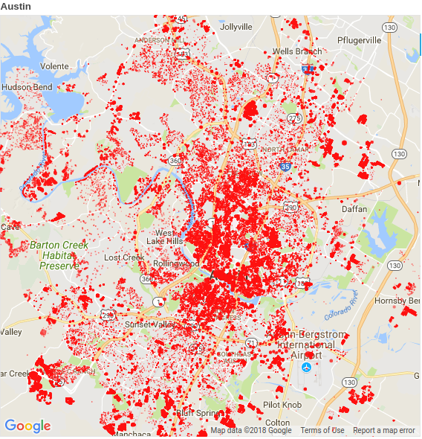
New construction map

Slide 2






Open data science technology

Slide 3
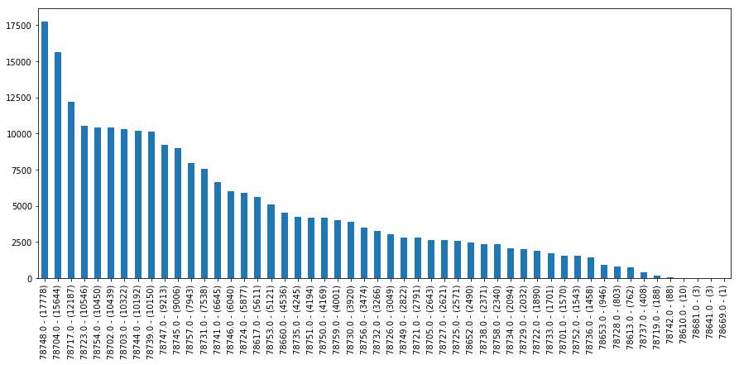
Construction permits per zip code

Slide 4
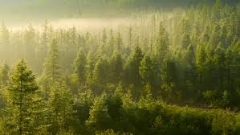
Random Forest: .72 R squared

Slide 5

Scott Nicholson Kurland
Scott.N.Kurland@gmail.com
www.linkedin.com/in/scottnkurland/
https://github.com/ScottNicholsonKurland

