Slide 1



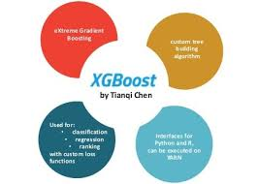


Open data science technology

Slide 2

Scott Nicholson Kurland
Scott.N.Kurland@gmail.com
www.linkedin.com/in/scottnkurland/
https://github.com/ScottNicholsonKurland

Slide 3
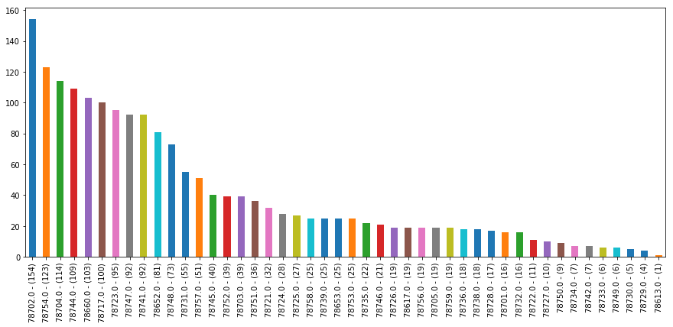
New construction permits by zip code. Downtown - 78701 - had a tenth the development of 78702; bigger projects.

Slide 4
Random Forest

Slide 5
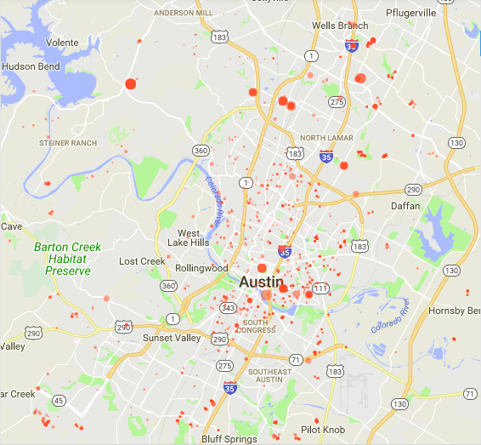
New construction map

Slide 6
XGBoost

