Slide 1
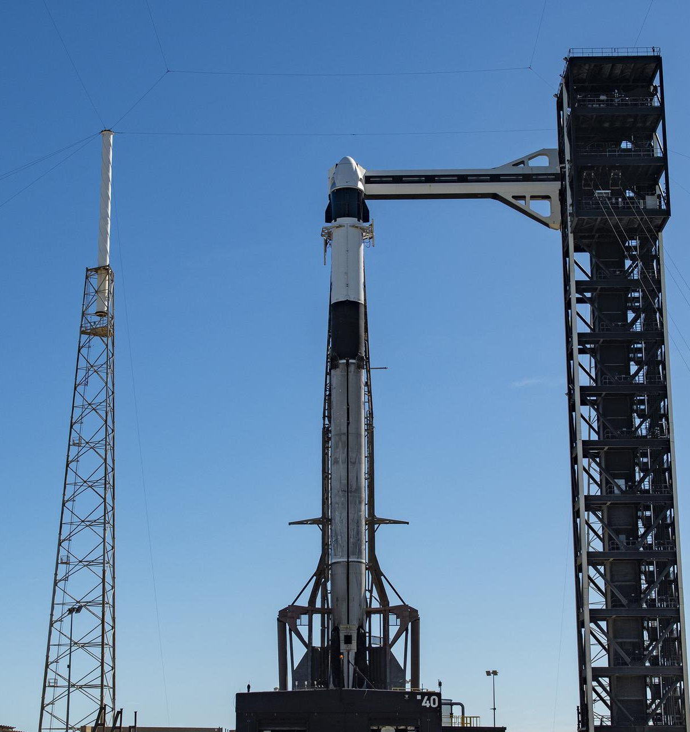
DATA SCIENCE CAPSTONE
Predicting Falcon 9
first-stage landings
From launch records to an interpretable machine-learning comparison
IBM Applied Data Science Capstone
Notes:
Sources:
- NASA Images, KSC-20260927-PH-SPX01_0004 — public domain dedication: https://images.nasa.gov/details/KSC-20260927-PH-SPX01_0004
- IBM Skills Network assignment rubric: https://mark.skills.network/learner/2977?lang=en

Slide 2
SPACEX CAPSTONE
Executive summary
90
66.7%
83.3%
Falcon 9 launches in the 2010–2020 IBM snapshot
Overall successful first-stage landing rate
Best observed test accuracy on 18 held-out rows
Methods: API + web scraping → wrangling → EDA/SQL → Folium/Dash → classification.
Result: landing performance improved strongly over time; KSC LC‑39A led sites at 77.3%.
Model result: KNN, SVM, and logistic regression tied on test accuracy; KNN won the CV tie-break.
IBM Applied Data Science Capstone
02
Notes:
Sources:
- IBM Skills Network course datasets; analysis_summary.json generated by this project

Slide 3
INTRODUCTION
Why predict a first-stage landing?
Reusable boosters can change launch economics — but only when the first stage returns safely.
Research question
Can historical mission, payload, launch-site, orbit, and booster information predict a successful Falcon 9 first-stage landing?
Target: Class = 1 for a successful landing
Scope: 90 launches from June 2010 to November 2020
Goal: interpretable comparison, not operational certification
IBM Applied Data Science Capstone
03
Notes:
Sources:
- IBM Skills Network Applied Data Science Capstone datasets

Slide 4
METHODS
End-to-end methodology
1
2
3
4
5
6
Collect
Wrangle
Explore
Query
Interact
Predict
API + Wikipedia
Target + features
Charts + trends
SQLite questions
Folium + Dash
4 classifiers
The same frozen course snapshot feeds every analysis layer, allowing figures, queries, maps, dashboard views, and model results to remain consistent.
Repository
https://github.com/ScottPhantom/SpaceX-Capstone-Project
IBM Applied Data Science Capstone
04
Notes:
Sources:
- Project README and executed notebook in the repository

Slide 5
DATA COLLECTION
Data collection — SpaceX API
1
2
3
4
Request
Normalize
Enrich
Filter
GET past launches
Flatten nested JSON
Rocket, pad, payload, core
Falcon 9, cutoff date
Key fields
flight number · date · booster · payload mass · orbit · launch site · landing outcome
Repository
https://github.com/ScottPhantom/SpaceX-Capstone-Project
IBM Applied Data Science Capstone
05
Notes:
Sources:
- SpaceX API v4 past launches: https://api.spacexdata.com/v4/launches/past
- https://github.com/ScottPhantom/SpaceX-Capstone-Project/blob/main/src/data_collection.py

Slide 6
DATA COLLECTION
Data collection — web scraping
Wikipedia launch tables provide a flat, human-readable cross-check for mission metadata.
1
2
3
4
Read HTML tables
Detect Flight No. columns
Concatenate launch rows
Export reproducible CSV
Implementation: pandas.read_html() with an explicit table-selection guard.
Repository
https://github.com/ScottPhantom/SpaceX-Capstone-Project
IBM Applied Data Science Capstone
06
Notes:
Sources:
- Wikipedia: https://en.wikipedia.org/wiki/List_of_Falcon_9_and_Falcon_Heavy_launches
- https://github.com/ScottPhantom/SpaceX-Capstone-Project/blob/main/src/data_collection.py

Slide 7
DATA WRANGLING
Data wrangling and feature engineering
Standardize dates and numeric payload mass; impute missing payload mass with the sample mean.
90
Map landing outcomes into Class: 1 = successful landing, 0 = unsuccessful landing.
rows retained
One-hot encode launch site, orbit, booster serial, grid fins, legs, and reuse indicators.
83
encoded features
Verify the 83-column model matrix contains no missing values before training.
Repository
https://github.com/ScottPhantom/SpaceX-Capstone-Project
IBM Applied Data Science Capstone
07
Notes:
Sources:
- IBM Skills Network dataset_part_1.csv, dataset_part_2.csv, dataset_part_3.csv
- https://github.com/ScottPhantom/SpaceX-Capstone-Project/blob/main/notebooks/SpaceX_Capstone_Analysis.ipynb

Slide 8
METHODOLOGY
EDA with visualization
Each chart answers a specific operational question.
Site success bar
Which launch site has the strongest observed landing rate?
Payload scatter
How do payload mass and site relate to landing outcome?
Yearly trend
Did landing performance improve over time?
Orbit summary
Which mission profiles show stronger or weaker outcomes?
Repository
https://github.com/ScottPhantom/SpaceX-Capstone-Project
IBM Applied Data Science Capstone
08
Notes:
Sources:
- https://github.com/ScottPhantom/SpaceX-Capstone-Project/blob/main/notebooks/SpaceX_Capstone_Analysis.ipynb

Slide 9
METHODOLOGY
EDA with SQL
A SQLite copy of the 101-row lab table supports transparent, repeatable questions.
1
2
3
4
Load
Filter
Aggregate
Rank
CSV → SPACEXTBL
LIKE, BETWEEN, dates
COUNT, SUM, MIN, MAX
GROUP BY + ORDER BY
Questions cover sites, NASA CRS payload, successful landings, maximum payload boosters, failure timing, and launch-site rankings.
Repository
https://github.com/ScottPhantom/SpaceX-Capstone-Project
IBM Applied Data Science Capstone
09
Notes:
Sources:
- IBM Skills Network Spacex.csv
- https://github.com/ScottPhantom/SpaceX-Capstone-Project/blob/main/notebooks/SpaceX_Capstone_Analysis.ipynb

Slide 10
METHODOLOGY
Interactive visual analytics
FOLIUM
PLOTLY DASH
Geospatial questions
Interactive filtering
Where are the launch sites?
Select one site or all sites
Which records succeeded or failed?
Filter payload mass range
How close are sites to infrastructure?
Update pie and scatter views together
Repository
https://github.com/ScottPhantom/SpaceX-Capstone-Project
IBM Applied Data Science Capstone
10
Notes:
Sources:
- https://github.com/ScottPhantom/SpaceX-Capstone-Project/tree/main/figures
- https://github.com/ScottPhantom/SpaceX-Capstone-Project/blob/main/app/spacex_dash_app.py

Slide 11
EDA RESULTS
KSC LC‑39A leads observed site success
77.3%
KSC LC‑39A · 22 launches
60.0%
CCAFS SLC‑40 · 55 launches
Site is informative, but sample sizes differ.
IBM Applied Data Science Capstone
11
Notes:
Sources:
- IBM Skills Network dataset_part_2.csv; group-by results generated by analysis_pipeline.py

Slide 12
EDA RESULTS
Payload mass alone does not determine landing outcome
Successes span light and heavy payloads.
High-mass VLEO launches are mostly successful.
Mission era, orbit, and site add context.
IBM Applied Data Science Capstone
12
Notes:
Sources:
- IBM Skills Network dataset_part_2.csv

Slide 13
EDA RESULTS
Landing performance improved over time
Orbit profile
Orbit | Launches | Success
SSO | 5 | 100.0%
VLEO | 14 | 85.7%
LEO | 7 | 71.4%
PO | 9 | 66.7%
ISS | 21 | 61.9%
GTO | 27 | 51.9%
2019 peaked at 90.0%; 2020 remained high at 84.2%.
IBM Applied Data Science Capstone
13
Notes:
Sources:
- IBM Skills Network dataset_part_2.csv

Slide 14
SQL RESULTS
SQL results — sites, payloads, and outcomes
Question | Result
Distinct launch sites | 4
NASA CRS payload mass | 48,213 kg
First successful ground-pad landing | 2015-12-22
Mission outcomes marked Success | 98 of 101
2015 drone-ship failures | 2
4
successful drone-ship landings with payloads between 4,000 and 6,000 kg
JCSAT‑14 · JCSAT‑16 · SES‑10 · SES‑11/EchoStar 105
IBM Applied Data Science Capstone
14
Notes:
Sources:
- IBM Skills Network Spacex.csv; SQL queries in executed notebook

Slide 15
SQL RESULTS
SQL results — launch-site ranking
CCAFS SLC‑40 ranks first with 34 launches.
Twelve boosters share the maximum payload mass of 15,600 kg.
SQL answers are generated from the included 101-row table.
IBM Applied Data Science Capstone
15
Notes:
Sources:
- IBM Skills Network Spacex.csv; SQL queries in executed notebook

Slide 16
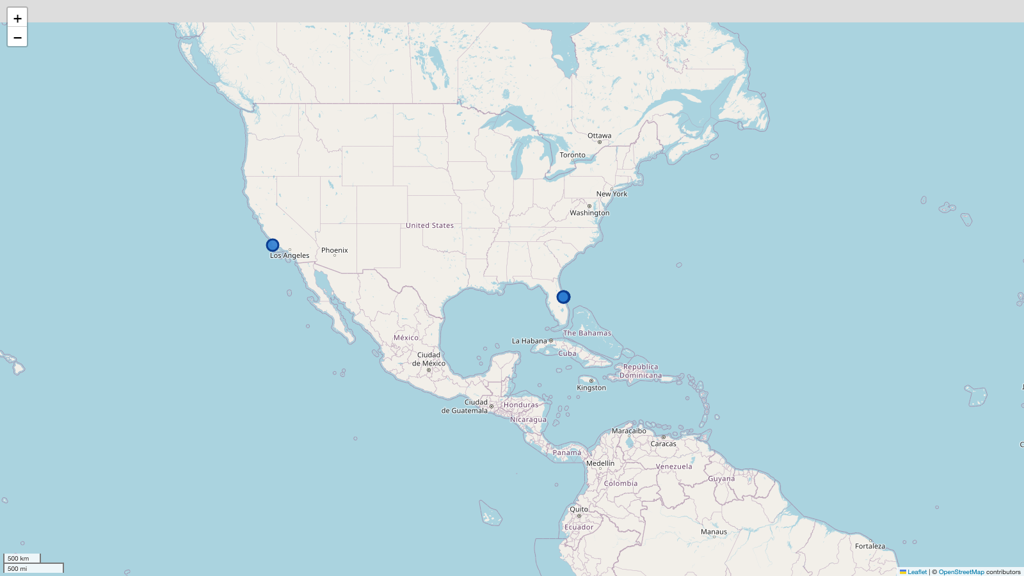
INTERACTIVE ANALYTICS
Folium — launch-site markers
Three Florida pads cluster around Cape Canaveral / Kennedy Space Center.
VAFB SLC‑4E is on the California coast.
Marker popups retain site name and coordinates.
IBM Applied Data Science Capstone
16
Notes:
Sources:
- IBM Skills Network spacex_launch_geo.csv
- OpenStreetMap contributors: https://www.openstreetmap.org/copyright

Slide 17
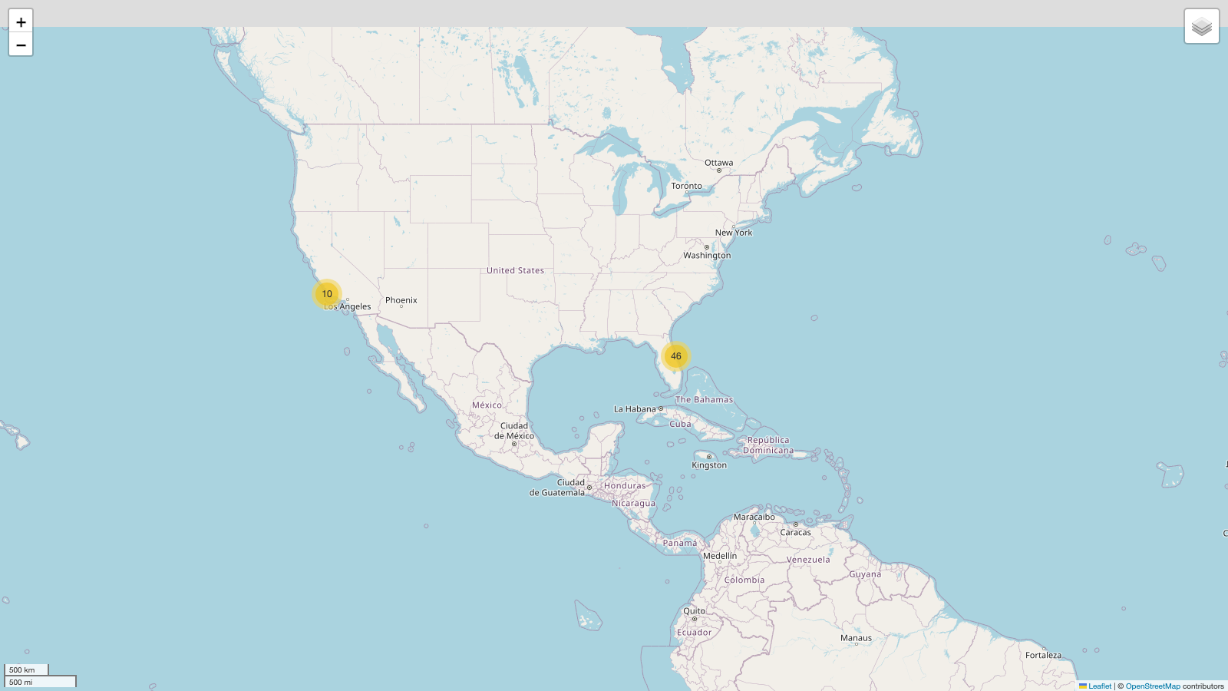
INTERACTIVE ANALYTICS
Folium — launch records and outcomes
46
mapped launch records clustered in Florida
10
mapped launch records clustered in California
IBM Applied Data Science Capstone
17
Notes:
Sources:
- IBM Skills Network spacex_launch_geo.csv
- OpenStreetMap contributors: https://www.openstreetmap.org/copyright

Slide 18
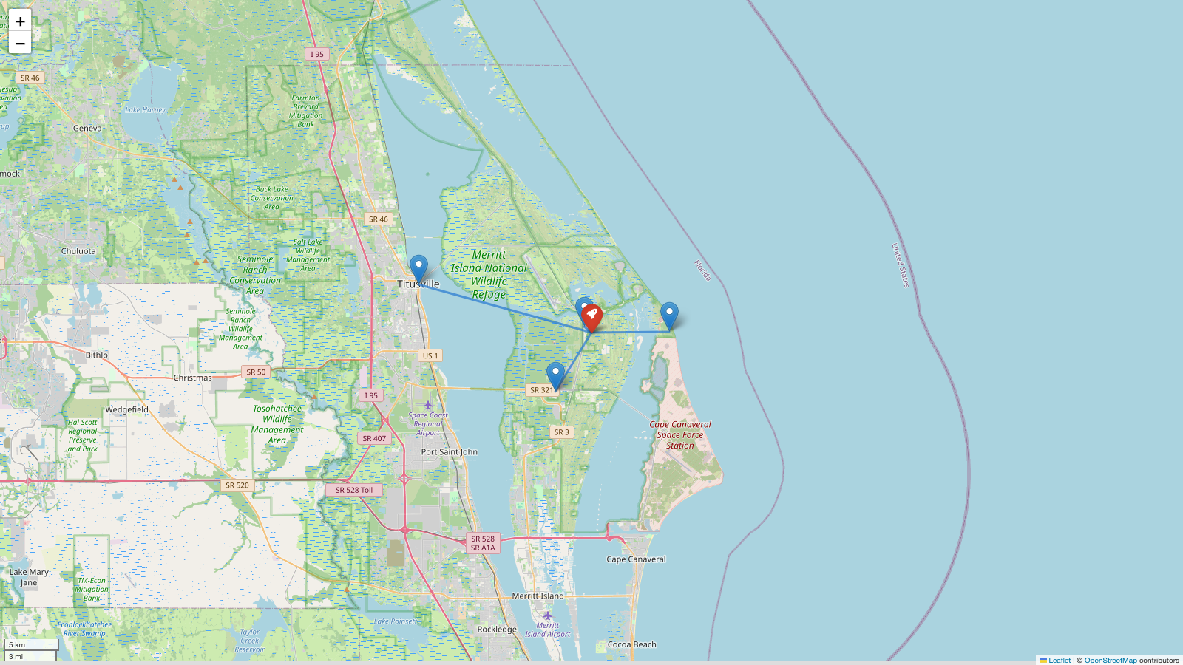
INTERACTIVE ANALYTICS
Folium — proximity to infrastructure
7.0 km
Atlantic coastline
0.9 km
NASA railway
6.3 km
NASA Causeway
16.3 km
Titusville
Nearby rail and road access support logistics; coastal siting also separates launch trajectories from populated areas.
IBM Applied Data Science Capstone
18
Notes:
Sources:
- Distances computed with the haversine formula from IBM Skills Network geospatial coordinates
- OpenStreetMap contributors: https://www.openstreetmap.org/copyright

Slide 19
INTERACTIVE ANALYTICS
Dash — success share by site
Dashboard controls
Site dropdown: all or one launch site
Payload range: minimum to maximum mass
Pie and scatter update from the same filter
Repository
https://github.com/ScottPhantom/SpaceX-Capstone-Project
IBM Applied Data Science Capstone
19
Notes:
Sources:
- IBM Skills Network spacex_launch_dash.csv
- https://github.com/ScottPhantom/SpaceX-Capstone-Project/blob/main/app/spacex_dash_app.py

Slide 20
INTERACTIVE ANALYTICS
Dash — payload versus outcome
Why interactive?
Users can isolate a site and payload band, then inspect how booster categories and outcomes change together.
IBM Applied Data Science Capstone
20
Notes:
Sources:
- IBM Skills Network spacex_launch_dash.csv
- https://github.com/ScottPhantom/SpaceX-Capstone-Project/blob/main/app/spacex_dash_app.py

Slide 21
PREDICTIVE ANALYSIS
Predictive modeling methodology
Logistic regression
SVM
Decision tree
KNN
linear baseline
nonlinear decision boundary
rule-based splits
local neighborhood
1
2
3
4
Split
Scale
Tune
Evaluate
72 train / 18 test
inside each pipeline
GridSearchCV
accuracy + precision/recall/F1
Repository
https://github.com/ScottPhantom/SpaceX-Capstone-Project
IBM Applied Data Science Capstone
21
Notes:
Sources:
- Model evaluation generated by analysis_pipeline.py; random_state=2
- https://github.com/ScottPhantom/SpaceX-Capstone-Project/blob/main/analysis_pipeline.py

Slide 22
PREDICTIVE ANALYSIS
Three models tie at 83.3% test accuracy
Selected model
K-nearest
neighbors
Highest CV accuracy
84.8%
IBM Applied Data Science Capstone
22
Notes:
Sources:
- Model evaluation generated by analysis_pipeline.py; 5-fold GridSearchCV on the training split

Slide 23
PREDICTIVE ANALYSIS
Best-model confusion matrix
Actual / Predicted | 0 | 1
0 — unsuccessful | 3 | 3
1 — successful | 0 | 12
12
3
true positives
true negatives
3
0
false positives
false negatives
Recall is 100%, but the model over-predicts success for half of the actual failures in this small test split.
IBM Applied Data Science Capstone
23
Notes:
Sources:
- KNN evaluation generated by analysis_pipeline.py on an 18-row test split

Slide 24
CONCLUSION
Conclusions and next steps
What the evidence supports
What comes next
Landing success rose materially after 2015.
Use time-aware validation to prevent era leakage.
Site, orbit, and mission era carry predictive signal.
Refresh the dataset with newer missions and richer weather/trajectory features.
KNN is the CV winner, not a uniquely dominant test winner.
Calibrate probabilities before any cost or risk decision.
https://github.com/ScottPhantom/SpaceX-Capstone-Project
IBM Applied Data Science Capstone
24
Notes:
Sources:
- All conclusions computed from the IBM Skills Network course snapshot and the executed repository analysis
- https://github.com/ScottPhantom/SpaceX-Capstone-Project

