Slide 1
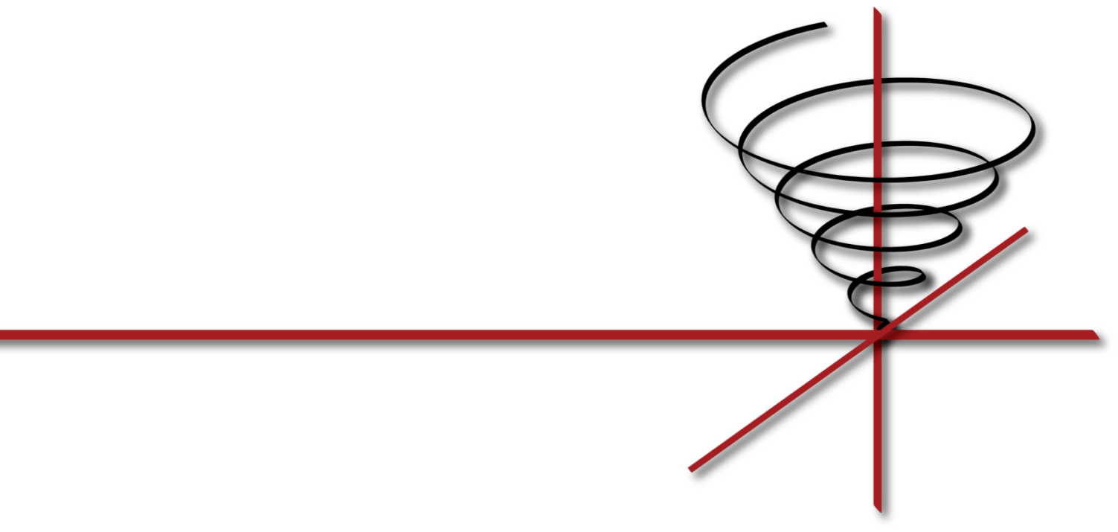
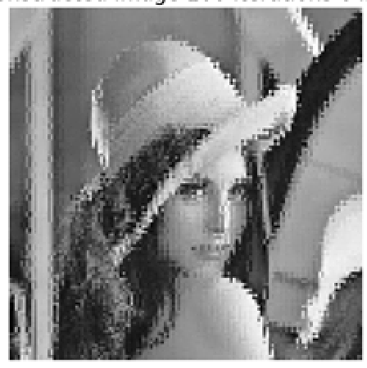
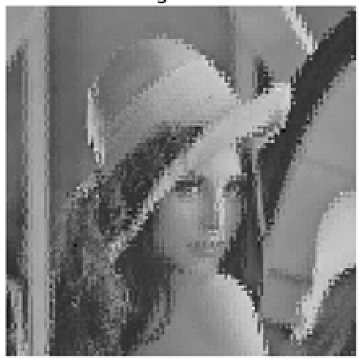
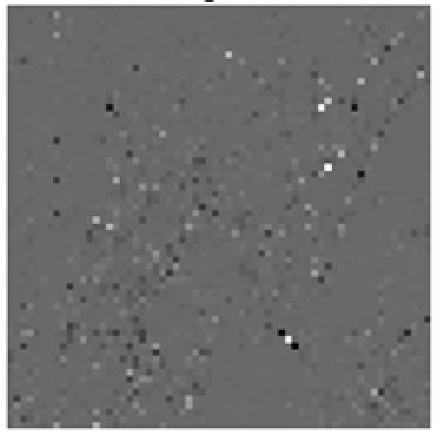
18-797 Final Project: Fast Fractal Image Compression
Final Presentation
Vrishab Commuri Scott Mionis
Bridgett Tan
Weishan Wang Carnegie Mellon University

Slide 2
Organization
Introduction
Baseline Fractal Compression
Our Work: Fast Fractal Compression
Demo
Results and Conclusions
Notes:
So lets jump right in

Slide 3
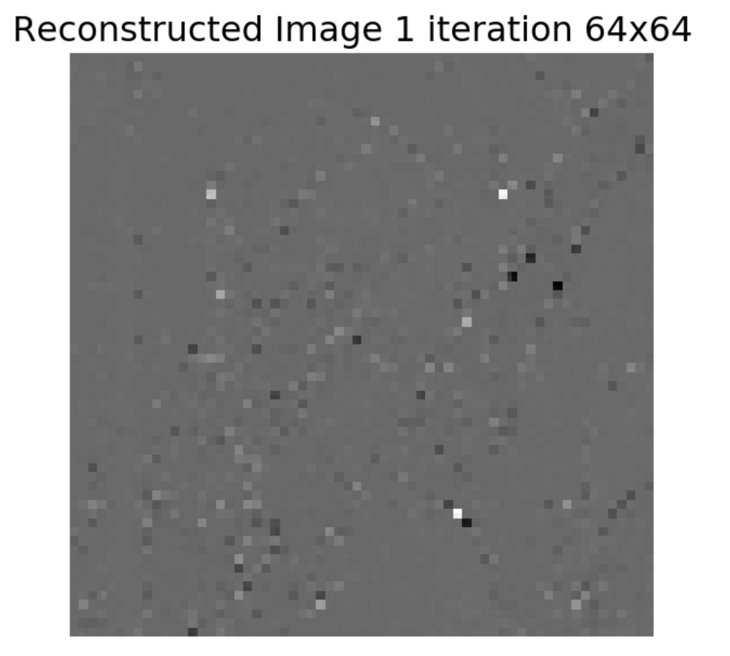
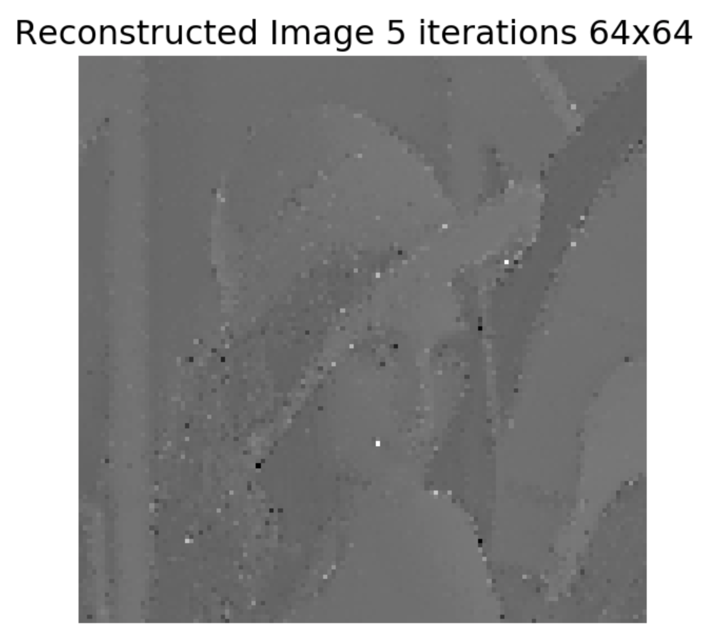
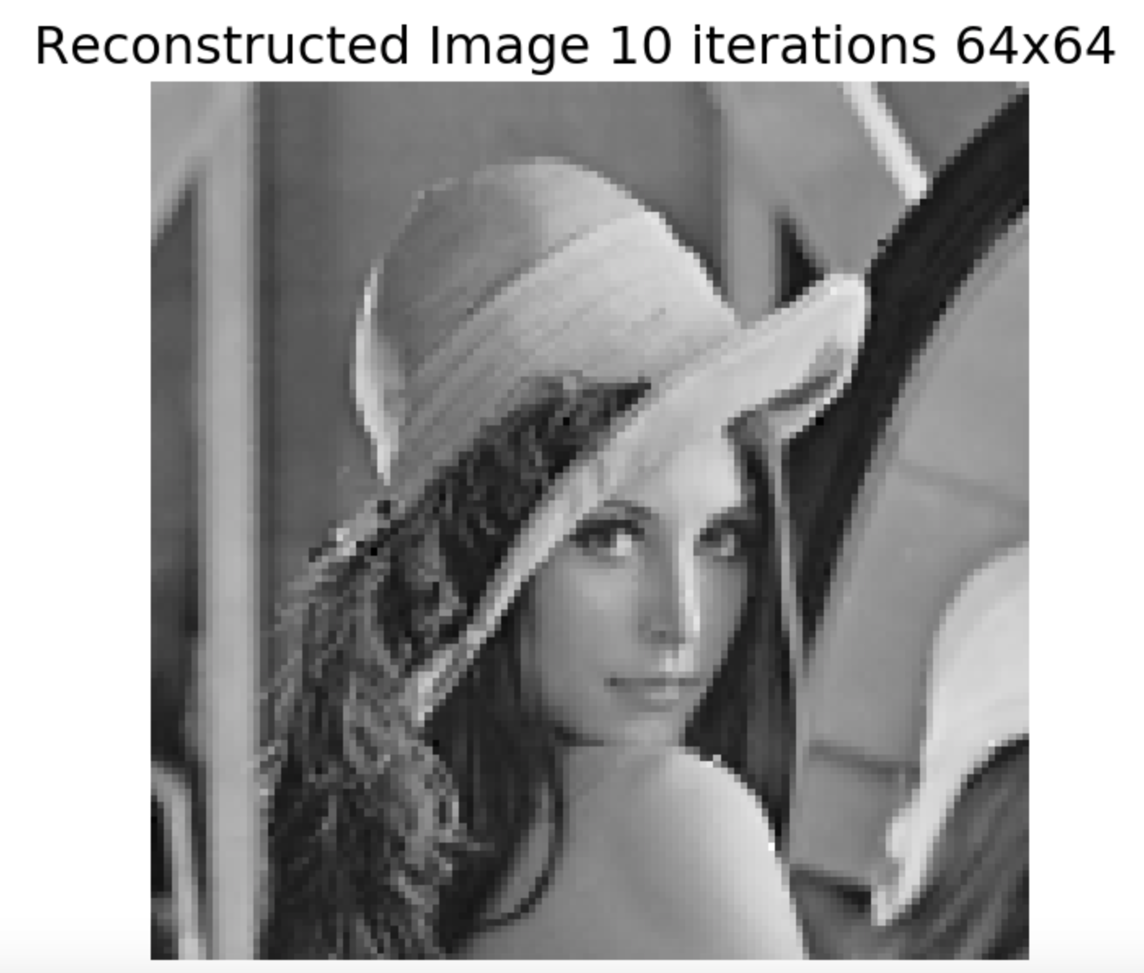
Fractal Compression
Attractor: A converged point. In our context, the original source image.
Fractal compression consists of finding a transformation T such that repeated applications of this T to an arbitrary input will eventually converge to the target attractor
Reconstructed from all-0 input, given the right fractal codebook
Notes:
A quantum computer stores information not in electrical 1/0, but in the state of a quantum particle. We pick a dual-state property of this particle to represent information, like the polarization of a photon (which can be represented by a vertical and horizontal amplitude). According to quantum physics this particle can be in a superposition of these 2 states; your photon can be oscillating at a 45 degree angle-per se.
But the vector of weights for the (vert, hor.) directions must have norm 1, because the weights actually represent the “square root” probability of being in a certain state. For our 45 degree example, measuring in the vertical and horizontal bases for example, we get a 50/50 probability of measuring either state.
These weights themselves can be negative though, and so “probability” is a bit of a misnomer.

Slide 4
Organization
Introduction
Baseline Fractal Compression
Our Work: Fast Fractal Compression
Demo
Results and Conclusions
Notes:
So lets jump right in

Slide 5

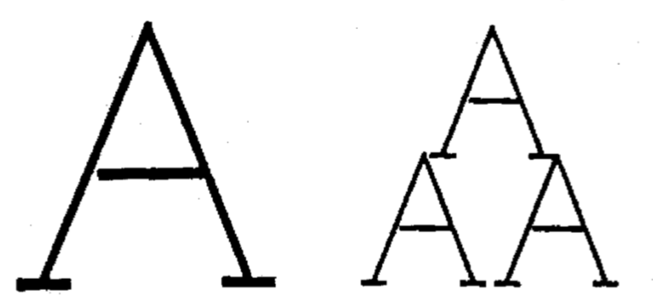
Baseline Fractal Compression
Input image partitioned into nonoverlapping square blocks.
Range blocks : M×M
Domain blocks : 2M×2M
Task: Find a fractal compression scheme (an iterative mapping) to encode each rangeblock.
Underlying assumption about the data is that there is a repeated, scale-invariant affine structure
Notes:
Some of that Bra-ket notation can be a bit strange to those of us used to linear algebra, so we can also just write a qubit state as a 2D complex vector, a state vector. The “measurement” operation then turns into a projection operation: the probability of our detector outputting 1/0 is the magnitude squared of the projection onto an orthogonal basis, and we can measure in any orthogonal basis.
Another strange physics tidbit is that measurement actually collapses quantum state, but in our world the measurement operator simply becomes a projection operator and we can sleep easy.
You’ll notice it should be impossible to plot a 4D vector on a sphere, but this is just another one of those results that can be derived with some simple linear algebra
Really complicated physics, would have to take more courses that I didn’t take – listen to Randy on this – math abstraction is just complex numbers and projections, coplex mats
Thank my friends from physics for figuring it out,. Im going to automate programming. I don’t want to explain bra ket notation

Slide 6
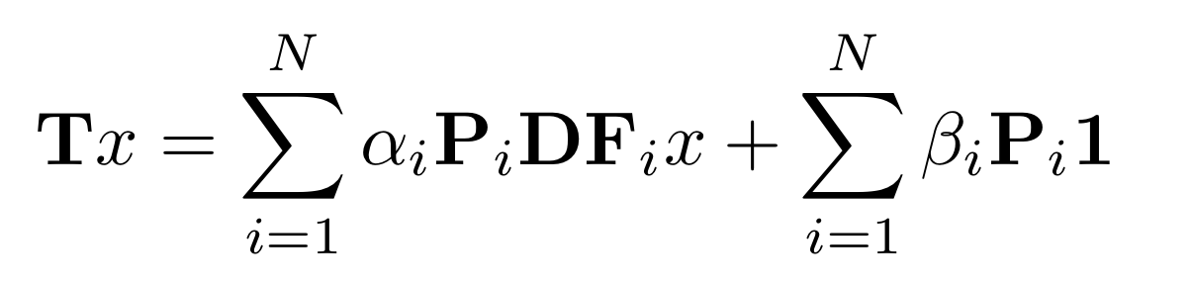


Baseline Fractal Compression
Solution:
Downsample domain blocks by 2 (or another scalar factor)
Find domain block that, when scaled by the scalar α and biased by the constant β, is the closest match to the range block.
optimal values of α and β have simple closed-form solutions.
- Returns best domain block to encode given range block
- Downsamples, transforms, places domain block
Notes:
Some of that Bra-ket notation can be a bit strange to those of us used to linear algebra, so we can also just write a qubit state as a 2D complex vector, a state vector. The “measurement” operation then turns into a projection operation: the probability of our detector outputting 1/0 is the magnitude squared of the projection onto an orthogonal basis, and we can measure in any orthogonal basis.
Another strange physics tidbit is that measurement actually collapses quantum state, but in our world the measurement operator simply becomes a projection operator and we can sleep easy.
You’ll notice it should be impossible to plot a 4D vector on a sphere, but this is just another one of those results that can be derived with some simple linear algebra
Really complicated physics, would have to take more courses that I didn’t take – listen to Randy on this – math abstraction is just complex numbers and projections, coplex mats
Thank my friends from physics for figuring it out,. Im going to automate programming. I don’t want to explain bra ket notation

Slide 7
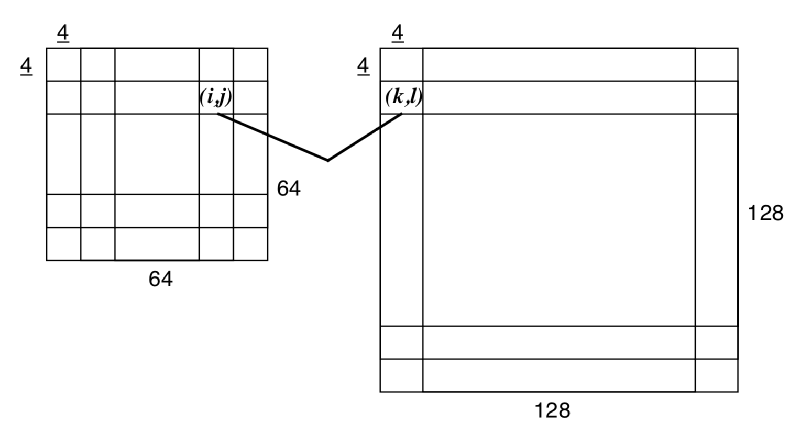
Baseline Fractal Compression
Issues:
”Fetching function” is extremely slow
For each range block R(i,j)
For each (downsampled) domain block D(k,l)
Solve for optimal α and β to satisfy: R = α D + β
Store mapping as 6-tuple (i, j, k, l, α, β) :
How do we speed up image encoding?
Notes:
Some of that Bra-ket notation can be a bit strange to those of us used to linear algebra, so we can also just write a qubit state as a 2D complex vector, a state vector. The “measurement” operation then turns into a projection operation: the probability of our detector outputting 1/0 is the magnitude squared of the projection onto an orthogonal basis, and we can measure in any orthogonal basis.
Another strange physics tidbit is that measurement actually collapses quantum state, but in our world the measurement operator simply becomes a projection operator and we can sleep easy.
You’ll notice it should be impossible to plot a 4D vector on a sphere, but this is just another one of those results that can be derived with some simple linear algebra
Really complicated physics, would have to take more courses that I didn’t take – listen to Randy on this – math abstraction is just complex numbers and projections, coplex mats
Thank my friends from physics for figuring it out,. Im going to automate programming. I don’t want to explain bra ket notation

Slide 8
Organization
Introduction
Baseline Fractal Compression
Our Work: Fast Fractal Compression
Demo
Results and Conclusions
Notes:
So lets jump right in

Slide 9
Fast Fractal Compression
General Concept: Classify and reconstruct range blocks using domain blocks as a “dictionary”
- Or rather, their singular vectors
Intuition:
Each range block is classified as compactly and as correctly as possible from downsampled blocks.
Can use a weighted combination of the downsampled domain blocks to reconstruct data
SVD is a useful tool for extracting bases
Notes:
Some of that Bra-ket notation can be a bit strange to those of us used to linear algebra, so we can also just write a qubit state as a 2D complex vector, a state vector. The “measurement” operation then turns into a projection operation: the probability of our detector outputting 1/0 is the magnitude squared of the projection onto an orthogonal basis, and we can measure in any orthogonal basis.
Another strange physics tidbit is that measurement actually collapses quantum state, but in our world the measurement operator simply becomes a projection operator and we can sleep easy.
You’ll notice it should be impossible to plot a 4D vector on a sphere, but this is just another one of those results that can be derived with some simple linear algebra
Really complicated physics, would have to take more courses that I didn’t take – listen to Randy on this – math abstraction is just complex numbers and projections, coplex mats
Thank my friends from physics for figuring it out,. Im going to automate programming. I don’t want to explain bra ket notation

Slide 10



Fast Fractal Compression (using SVD)
Algorithm:
Construct a matrix from downsampled domain blocks
(D : downsample operator)
Perform SVD to extract useful bases from this matrix
Range blocks are a weighted combination of left singular vectors
Notes:
Some of that Bra-ket notation can be a bit strange to those of us used to linear algebra, so we can also just write a qubit state as a 2D complex vector, a state vector. The “measurement” operation then turns into a projection operation: the probability of our detector outputting 1/0 is the magnitude squared of the projection onto an orthogonal basis, and we can measure in any orthogonal basis.
Another strange physics tidbit is that measurement actually collapses quantum state, but in our world the measurement operator simply becomes a projection operator and we can sleep easy.
You’ll notice it should be impossible to plot a 4D vector on a sphere, but this is just another one of those results that can be derived with some simple linear algebra
Really complicated physics, would have to take more courses that I didn’t take – listen to Randy on this – math abstraction is just complex numbers and projections, coplex mats
Thank my friends from physics for figuring it out,. Im going to automate programming. I don’t want to explain bra ket notation

Slide 11


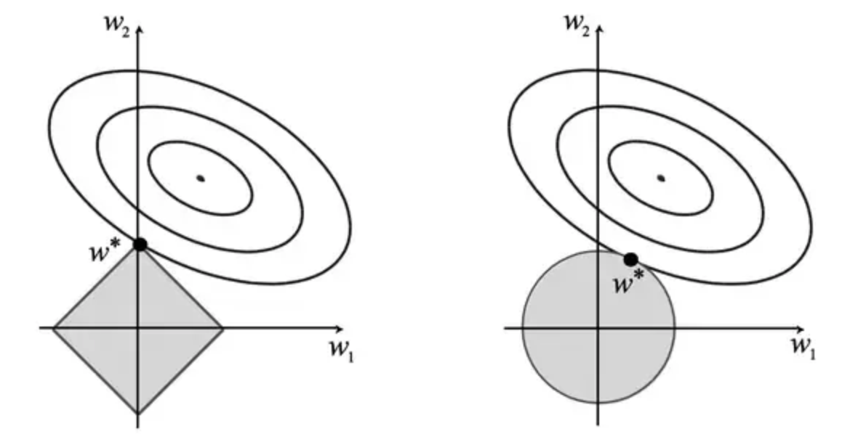
Fast Fractal Compression (using SVD)
Algorithm:
Store weights for each range block
Compress by regularizing weights
Replaces original 6-tuples
Notes:
Some of that Bra-ket notation can be a bit strange to those of us used to linear algebra, so we can also just write a qubit state as a 2D complex vector, a state vector. The “measurement” operation then turns into a projection operation: the probability of our detector outputting 1/0 is the magnitude squared of the projection onto an orthogonal basis, and we can measure in any orthogonal basis.
Another strange physics tidbit is that measurement actually collapses quantum state, but in our world the measurement operator simply becomes a projection operator and we can sleep easy.
You’ll notice it should be impossible to plot a 4D vector on a sphere, but this is just another one of those results that can be derived with some simple linear algebra
Really complicated physics, would have to take more courses that I didn’t take – listen to Randy on this – math abstraction is just complex numbers and projections, coplex mats
Thank my friends from physics for figuring it out,. Im going to automate programming. I don’t want to explain bra ket notation

Slide 12
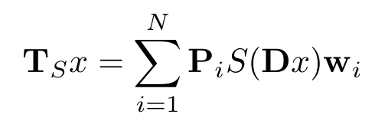



Fast Fractal Compression (using SVD)
Algorithm:
Replace original T (and the bottleneck-inducing F function)
- Computes left singular vectors
- Downsamples by 2 (or chosen integer constant)
- Places i’th domain block at proper indices in range image
Notes:
Some of that Bra-ket notation can be a bit strange to those of us used to linear algebra, so we can also just write a qubit state as a 2D complex vector, a state vector. The “measurement” operation then turns into a projection operation: the probability of our detector outputting 1/0 is the magnitude squared of the projection onto an orthogonal basis, and we can measure in any orthogonal basis.
Another strange physics tidbit is that measurement actually collapses quantum state, but in our world the measurement operator simply becomes a projection operator and we can sleep easy.
You’ll notice it should be impossible to plot a 4D vector on a sphere, but this is just another one of those results that can be derived with some simple linear algebra
Really complicated physics, would have to take more courses that I didn’t take – listen to Randy on this – math abstraction is just complex numbers and projections, coplex mats
Thank my friends from physics for figuring it out,. Im going to automate programming. I don’t want to explain bra ket notation

Slide 13
Fast Fractal Compression
Analysis:
New algorithm still leverages repeated structures in data
Transformation across scales
Solving for optimal weights is significantly more efficient than the original, iterative approach
Several properties remain to be proven
Contractivity : Upon repeated applications of T, values must not go to infinity
Convergence : Does iterated applications of T really converge to target image
For this second proof, we can leverage existing theory on IFS – Iterated Function Systems
Notes:
Some of that Bra-ket notation can be a bit strange to those of us used to linear algebra, so we can also just write a qubit state as a 2D complex vector, a state vector. The “measurement” operation then turns into a projection operation: the probability of our detector outputting 1/0 is the magnitude squared of the projection onto an orthogonal basis, and we can measure in any orthogonal basis.
Another strange physics tidbit is that measurement actually collapses quantum state, but in our world the measurement operator simply becomes a projection operator and we can sleep easy.
You’ll notice it should be impossible to plot a 4D vector on a sphere, but this is just another one of those results that can be derived with some simple linear algebra
Really complicated physics, would have to take more courses that I didn’t take – listen to Randy on this – math abstraction is just complex numbers and projections, coplex mats
Thank my friends from physics for figuring it out,. Im going to automate programming. I don’t want to explain bra ket notation

Slide 14

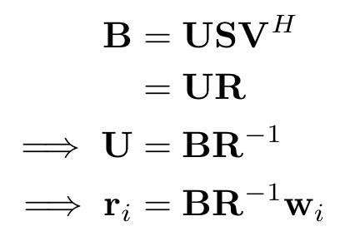

Fast Fractal Compression - Analysis
Contractivity:
Our Ts formulation does not offer a theoretical guarantee of contractivity
Easily circumvented with value truncation What values do we truncate?
Regularize this matrix to ensure that repeated iterations do not “blow up” the space
Transform from Domain space to Range block
Notes:
Some of that Bra-ket notation can be a bit strange to those of us used to linear algebra, so we can also just write a qubit state as a 2D complex vector, a state vector. The “measurement” operation then turns into a projection operation: the probability of our detector outputting 1/0 is the magnitude squared of the projection onto an orthogonal basis, and we can measure in any orthogonal basis.
Another strange physics tidbit is that measurement actually collapses quantum state, but in our world the measurement operator simply becomes a projection operator and we can sleep easy.
You’ll notice it should be impossible to plot a 4D vector on a sphere, but this is just another one of those results that can be derived with some simple linear algebra
Really complicated physics, would have to take more courses that I didn’t take – listen to Randy on this – math abstraction is just complex numbers and projections, coplex mats
Thank my friends from physics for figuring it out,. Im going to automate programming. I don’t want to explain bra ket notation

Slide 15
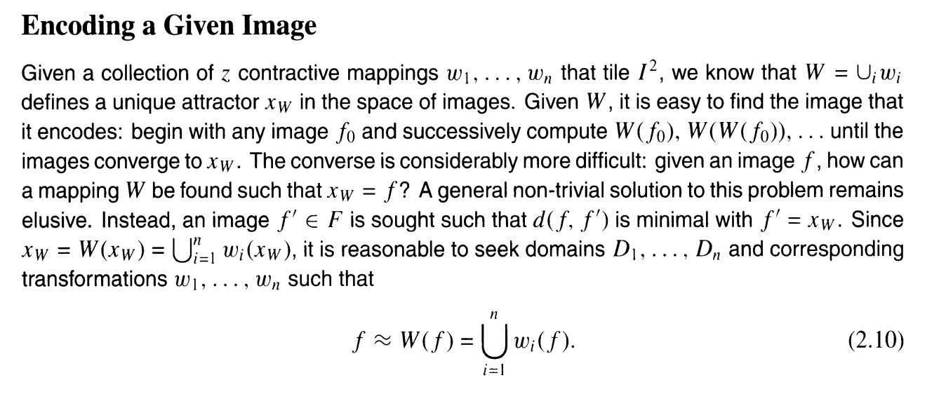
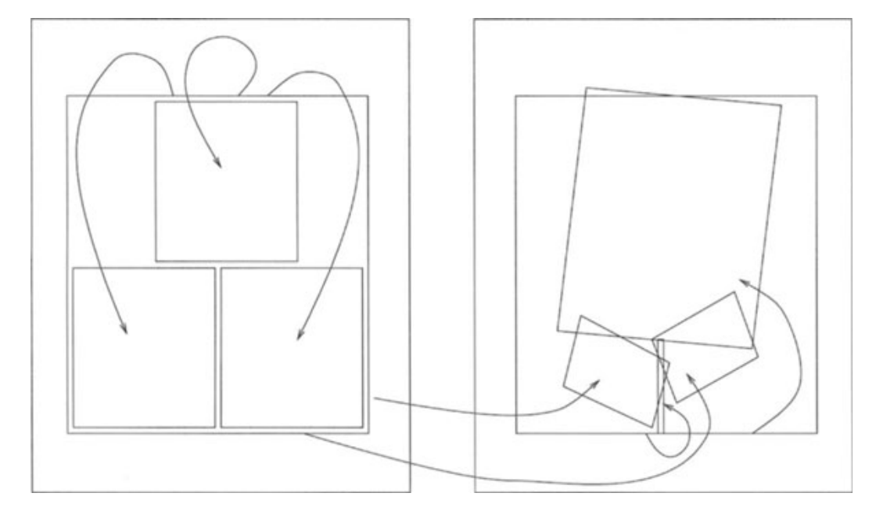
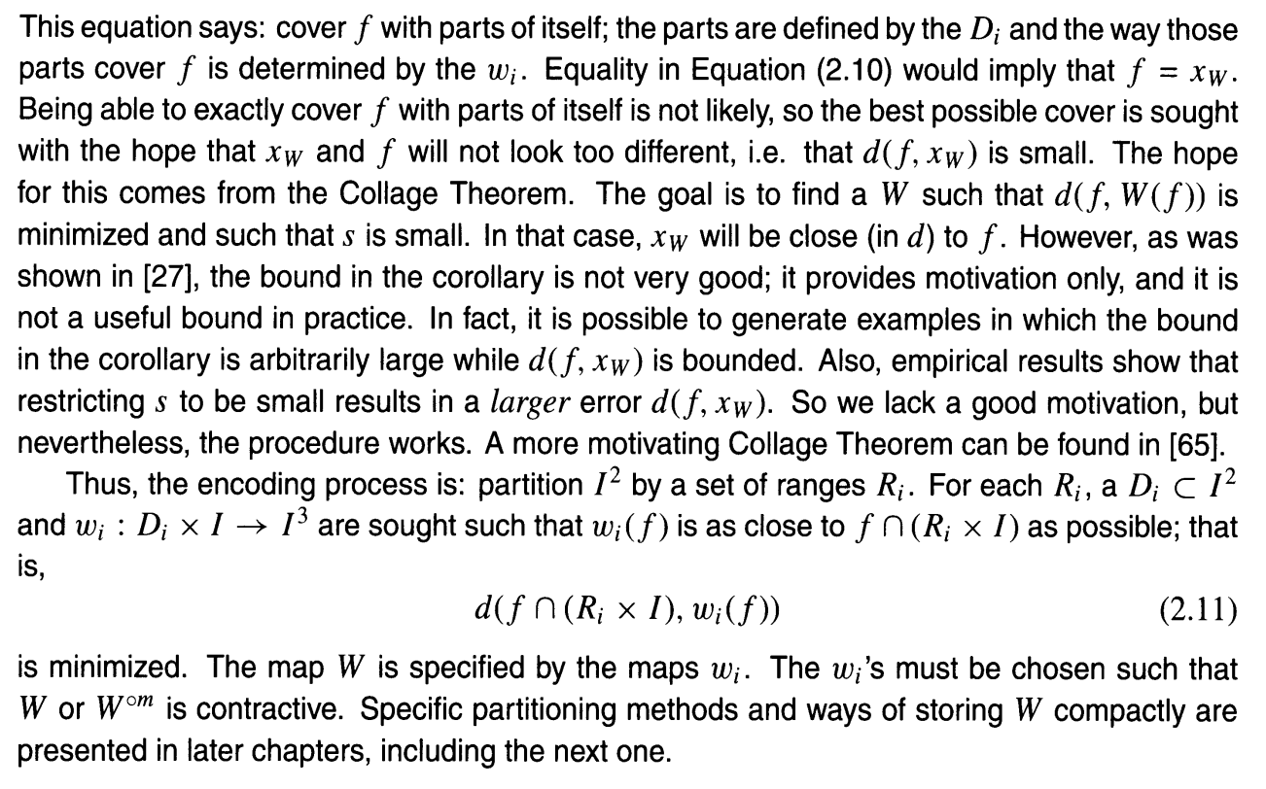
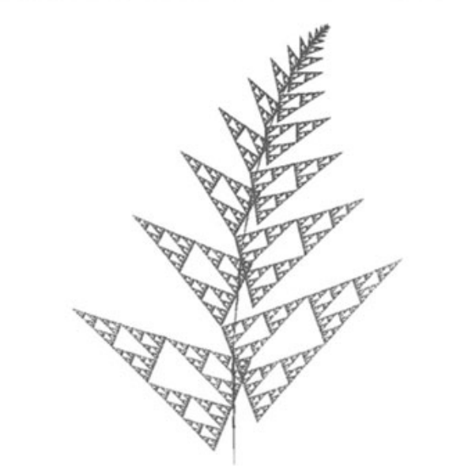
Fast Fractal Compression - Analysis
Convergence:
Y. Fisher, Fractal Image Compression: Theory and Application. New York: Springer, 1995.
Notes:
Some of that Bra-ket notation can be a bit strange to those of us used to linear algebra, so we can also just write a qubit state as a 2D complex vector, a state vector. The “measurement” operation then turns into a projection operation: the probability of our detector outputting 1/0 is the magnitude squared of the projection onto an orthogonal basis, and we can measure in any orthogonal basis.
Another strange physics tidbit is that measurement actually collapses quantum state, but in our world the measurement operator simply becomes a projection operator and we can sleep easy.
You’ll notice it should be impossible to plot a 4D vector on a sphere, but this is just another one of those results that can be derived with some simple linear algebra
Really complicated physics, would have to take more courses that I didn’t take – listen to Randy on this – math abstraction is just complex numbers and projections, coplex mats
Thank my friends from physics for figuring it out,. Im going to automate programming. I don’t want to explain bra ket notation

Slide 16
Fast Fractal Compression - Analysis
Convergence:
We probably need a better proof for convergence
Why does T converge to ourr attractor image? Magic?
Notes:
Some of that Bra-ket notation can be a bit strange to those of us used to linear algebra, so we can also just write a qubit state as a 2D complex vector, a state vector. The “measurement” operation then turns into a projection operation: the probability of our detector outputting 1/0 is the magnitude squared of the projection onto an orthogonal basis, and we can measure in any orthogonal basis.
Another strange physics tidbit is that measurement actually collapses quantum state, but in our world the measurement operator simply becomes a projection operator and we can sleep easy.
You’ll notice it should be impossible to plot a 4D vector on a sphere, but this is just another one of those results that can be derived with some simple linear algebra
Really complicated physics, would have to take more courses that I didn’t take – listen to Randy on this – math abstraction is just complex numbers and projections, coplex mats
Thank my friends from physics for figuring it out,. Im going to automate programming. I don’t want to explain bra ket notation

Slide 17
Organization
Introduction
Baseline Fractal Compression
Our Work: Fast Fractal Compression
Demo
Results and Conclusions
Notes:
So lets jump right in

Slide 18
Organization
Introduction
Baseline Fractal Compression
Our Work: Fast Fractal Compression
Demo
Results and Conclusions
Notes:
So lets jump right in

Slide 19
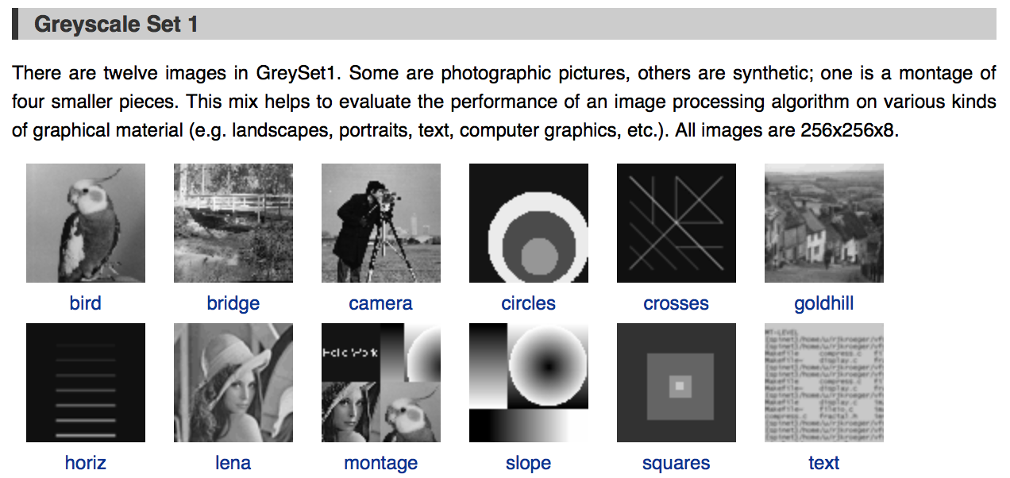
Dataset
Leveraged standard images like Lena and Mandrill
University of Waterloo’s Greyscale Set 1 dataset
Notes:
Some of that Bra-ket notation can be a bit strange to those of us used to linear algebra, so we can also just write a qubit state as a 2D complex vector, a state vector. The “measurement” operation then turns into a projection operation: the probability of our detector outputting 1/0 is the magnitude squared of the projection onto an orthogonal basis, and we can measure in any orthogonal basis.
Another strange physics tidbit is that measurement actually collapses quantum state, but in our world the measurement operator simply becomes a projection operator and we can sleep easy.
You’ll notice it should be impossible to plot a 4D vector on a sphere, but this is just another one of those results that can be derived with some simple linear algebra
Really complicated physics, would have to take more courses that I didn’t take – listen to Randy on this – math abstraction is just complex numbers and projections, coplex mats
Thank my friends from physics for figuring it out,. Im going to automate programming. I don’t want to explain bra ket notation

Slide 20
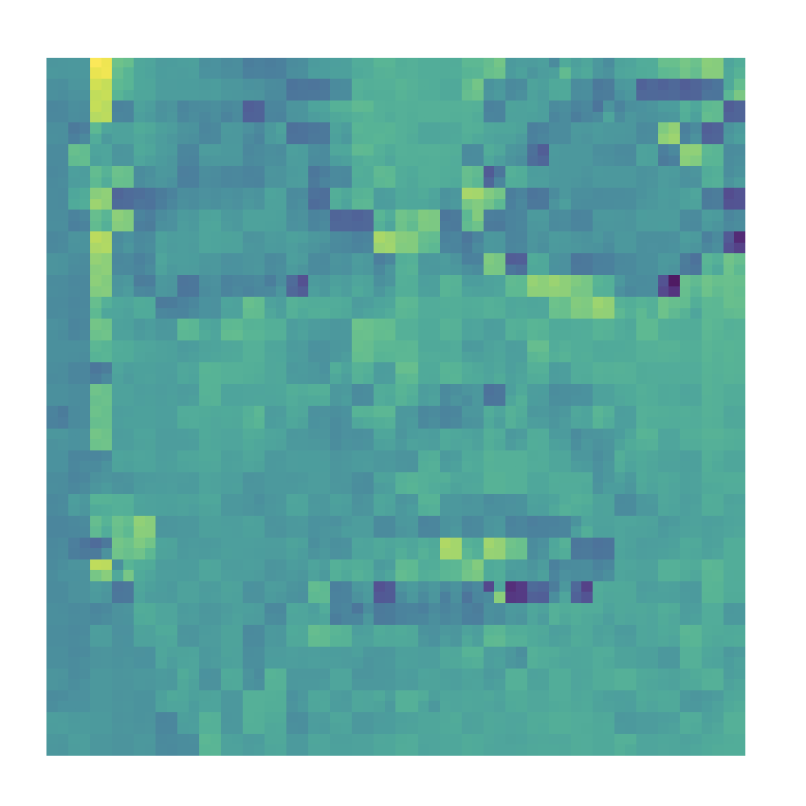
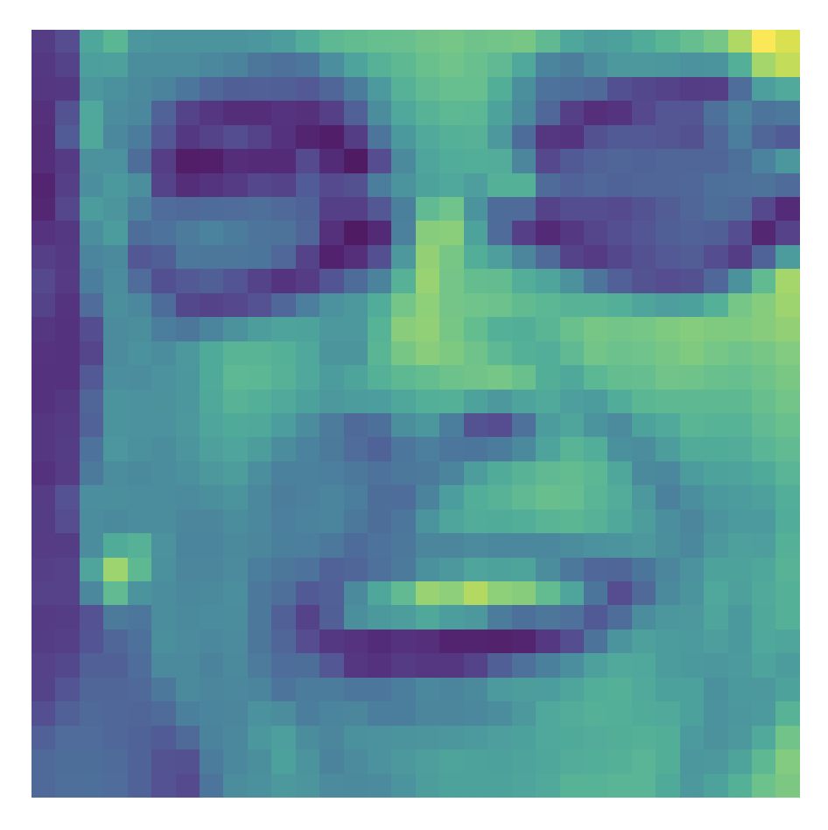
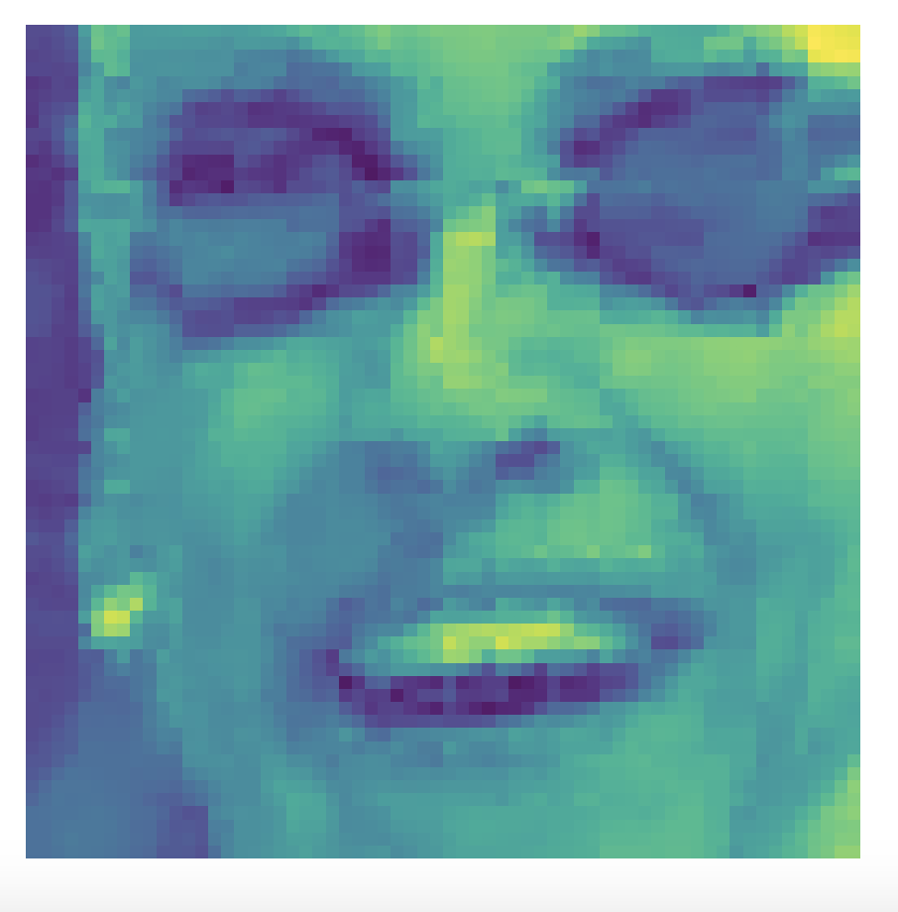
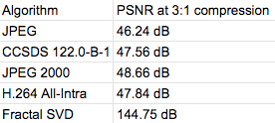
Selected Results
Baseline on Lena 512x512 is non-competitive just based on the runtime of the algorithm
Similar results on an 100x100 image
Fast Fractal Compression offers comparable results to existing schemes
Averaged over Lena, Mandrill, and the images in our dataset
Fractal SVD run with face bases derived from the average face
Notes:
Some of that Bra-ket notation can be a bit strange to those of us used to linear algebra, so we can also just write a qubit state as a 2D complex vector, a state vector. The “measurement” operation then turns into a projection operation: the probability of our detector outputting 1/0 is the magnitude squared of the projection onto an orthogonal basis, and we can measure in any orthogonal basis.
Another strange physics tidbit is that measurement actually collapses quantum state, but in our world the measurement operator simply becomes a projection operator and we can sleep easy.
You’ll notice it should be impossible to plot a 4D vector on a sphere, but this is just another one of those results that can be derived with some simple linear algebra
Really complicated physics, would have to take more courses that I didn’t take – listen to Randy on this – math abstraction is just complex numbers and projections, coplex mats
Thank my friends from physics for figuring it out,. Im going to automate programming. I don’t want to explain bra ket notation

Slide 21
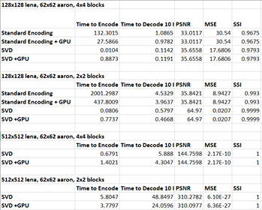
Notes:
Some of that Bra-ket notation can be a bit strange to those of us used to linear algebra, so we can also just write a qubit state as a 2D complex vector, a state vector. The “measurement” operation then turns into a projection operation: the probability of our detector outputting 1/0 is the magnitude squared of the projection onto an orthogonal basis, and we can measure in any orthogonal basis.
Another strange physics tidbit is that measurement actually collapses quantum state, but in our world the measurement operator simply becomes a projection operator and we can sleep easy.
You’ll notice it should be impossible to plot a 4D vector on a sphere, but this is just another one of those results that can be derived with some simple linear algebra
Really complicated physics, would have to take more courses that I didn’t take – listen to Randy on this – math abstraction is just complex numbers and projections, coplex mats
Thank my friends from physics for figuring it out,. Im going to automate programming. I don’t want to explain bra ket notation

Slide 22
Aside : Additional Exploration
- Multiprocessor support
- Multiple Baseline implementations
Notes:
Some of that Bra-ket notation can be a bit strange to those of us used to linear algebra, so we can also just write a qubit state as a 2D complex vector, a state vector. The “measurement” operation then turns into a projection operation: the probability of our detector outputting 1/0 is the magnitude squared of the projection onto an orthogonal basis, and we can measure in any orthogonal basis.
Another strange physics tidbit is that measurement actually collapses quantum state, but in our world the measurement operator simply becomes a projection operator and we can sleep easy.
You’ll notice it should be impossible to plot a 4D vector on a sphere, but this is just another one of those results that can be derived with some simple linear algebra
Really complicated physics, would have to take more courses that I didn’t take – listen to Randy on this – math abstraction is just complex numbers and projections, coplex mats
Thank my friends from physics for figuring it out,. Im going to automate programming. I don’t want to explain bra ket notation

Slide 23
Conclusions
Initial results for FSVD are comparable to but not significantly better than existing classical schemes
and do require some preliminary knowledge about the image for fast convergence
FSVD is a significant improvement over the existing fractal baseline, and provides an interesting context through which to analyze the repeated structures in images
Notes:
Some of that Bra-ket notation can be a bit strange to those of us used to linear algebra, so we can also just write a qubit state as a 2D complex vector, a state vector. The “measurement” operation then turns into a projection operation: the probability of our detector outputting 1/0 is the magnitude squared of the projection onto an orthogonal basis, and we can measure in any orthogonal basis.
Another strange physics tidbit is that measurement actually collapses quantum state, but in our world the measurement operator simply becomes a projection operator and we can sleep easy.
You’ll notice it should be impossible to plot a 4D vector on a sphere, but this is just another one of those results that can be derived with some simple linear algebra
Really complicated physics, would have to take more courses that I didn’t take – listen to Randy on this – math abstraction is just complex numbers and projections, coplex mats
Thank my friends from physics for figuring it out,. Im going to automate programming. I don’t want to explain bra ket notation

