Slide 1

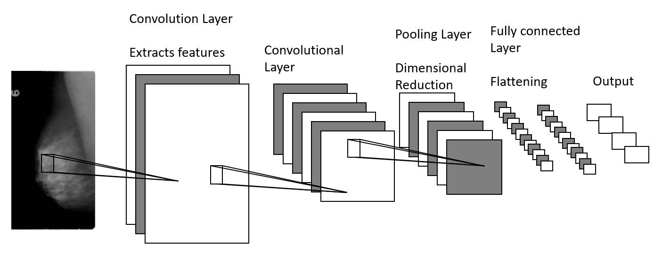
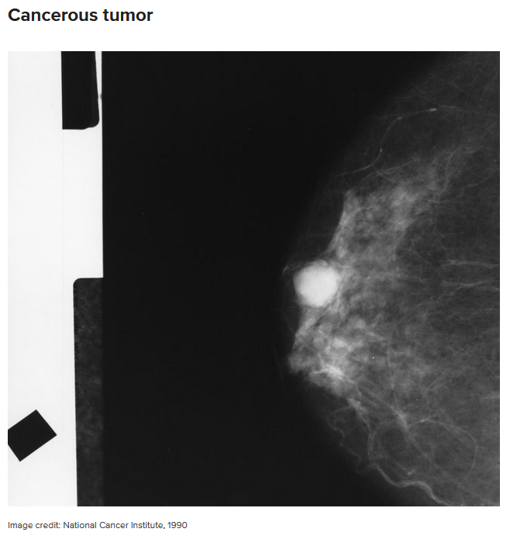
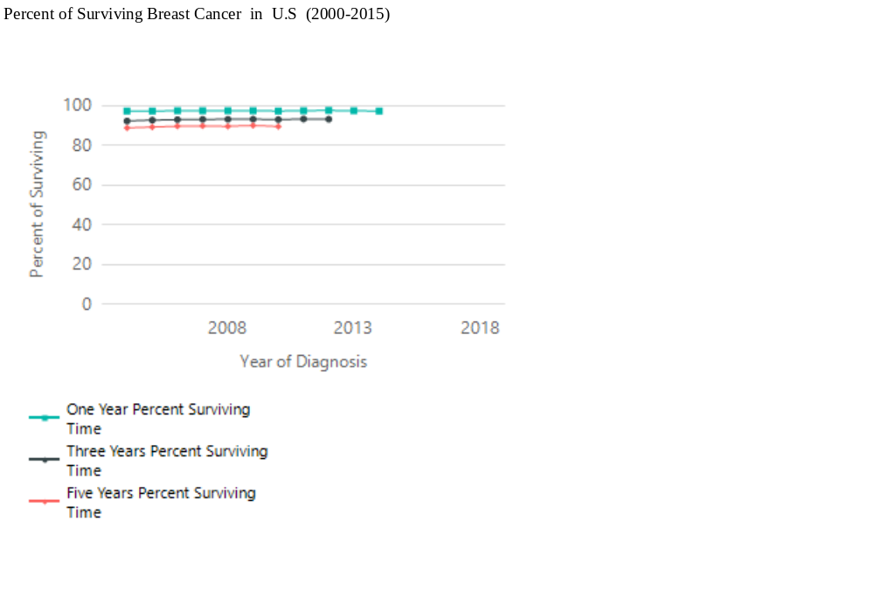
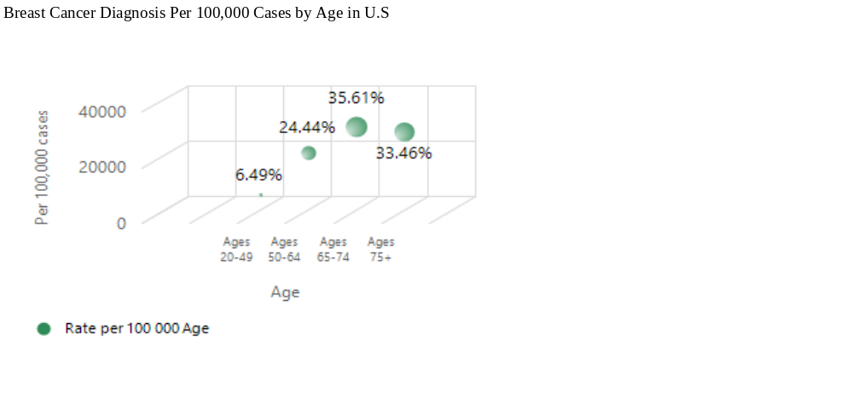
The Simultaneous Detection and Classification of Mass and
Calcification Leading to Breast Cancer in Mammograms
Scott Gozdzialski, Ireti Fasere, and Alex Stern
Master of Science in Data Science
Southern Methodist University, Dallas, TX 75275, USA
Introduction
Methods
Breast cancer is the second leading cause of death among women.
We are looking to detect and classify breast cancer within a mammogram in one step using a Convolutional Neural Network
We will attempt to differentiate between benign and malignant, calcifications and masses.
Using a Keras front end with a Tensorflow working in the background, we build a 4-layer deep learning image classifier to differentiate between the four states of the cancer we are looking to detect, calcification benign, calcification malignant, mass benign, and mass malignant.
The building of the image classifier is broken down into four fully connected layers: one flattening layer and three dropout layers using relu activation on the first two and softmax on the final flattening layer.
Mammograms
Mammograms are an early screening tool used in detecting early breast cancer in women with no indication of a condition or disease.
If mammogram results show abnormalities, a follow-up is necessary to check if it is breast cancer.
The standard system for reporting a mammogram result is called ranging from 0 to 6.
Results
Using the methods above we achieved a detection accuracy of 46% and classification percentage of 64%..
Our best category for detection is malignant masses, we detected 16 out of 25 or 64% of this type of cancer.
Our best category for classification is malignant calcifications, we properly classified 12 out or 13, or 92% of the detected cancer..
Neural Networks
In a Neural Network, neurons take multiple inputs and multiply them by a weighted value. The neuron sums all the inputs and weights, and if the sum is above a threshold, the neuron is activated.
The convolutional neural network (CNN) identifies images by examining the pixel of the image with filters and identifying features of the image structure.
Ethics
Are we responsible for patients that die due to our method missing their cancer?
We also need to consider the implications of producing false positives, where our method could create panic in a patient that is completely healthy.
Is the use of this dataset an invasion of privacy even with the anonymity of the images?
Data
The data set we used for our paper was put together by the Cancer Imaging Archive for public use..
The dataset consists of 10,239 images of mammograms
The images are split into 704 test images and 5324 training images.
Conclusions
An initial look at our results indicate there is still plenty of work to get done before a cancer detector and classifier will be viable for real world applications.
Focusing on detection only is the best way forward for the time being

