Slide 1

Running Man
Run & Track App June 30, 2019
Team member names:
Chong Hang Ho (Product Owner)
Rebecca Duong
Karl Flores
Scott Fischer (Scrum Master)

Slide 2
Run & Track App
Problem:
Many Apps Are Too Complicated and Overbearing
They Introduce Too Many Pointless Features for Profit or to Seem Different
Solution:
Create a Minimalistic Running App
Lightweight and Fast

Slide 3
Run & Track App
High-level goals:
Be able to interact with, such as structured layout objects and UI controls that allow you to build the graphical user interface for the app.
Be able to create a user Profile
Be able to track Time, Distance, and Average Speed on run
Be able to track Calories Burnt per run
Be able to visualize the Running Route on a Map
Store/Save previous runs, and be able to view in History

Slide 4
Sprint 1
User Story:
As a user, I want an interface that I can easily interact with.
As a user, I want a custom profile so my calories calculated is accurate.
As a runner, I want to keep track of how much time I spent per run.
Spikes
Create a database for a run
Learn how to setup a GPS
Infrastructure tasks
Setting up environment
Setting up a plan and a sketch

Slide 5
Sprint 2
User Story:
As a runner, I want to keep track of how many kilometers I ran per run.
As a runner, I want to track the average speed and calories burned per run.
As a runner, I want to be able to see my history so I can see if I am improving.
Spikes
Use Google Maps API
Infrastructure tasks
Set up database
Set up GPS

Slide 6
Sprint 3
User Story:
As a runner, I want to know where I am running so I can keep track of the location.
As a runner, I want a record of my running route.
As a tester, I need access to the internal database state so that I can determine if the product works properly
Spikes
Automate Testing using Android Espresso
Improve UI and Setup UI for Graphs/Visualization of Data
Infrastructure tasks
Using Google Maps API

Slide 7
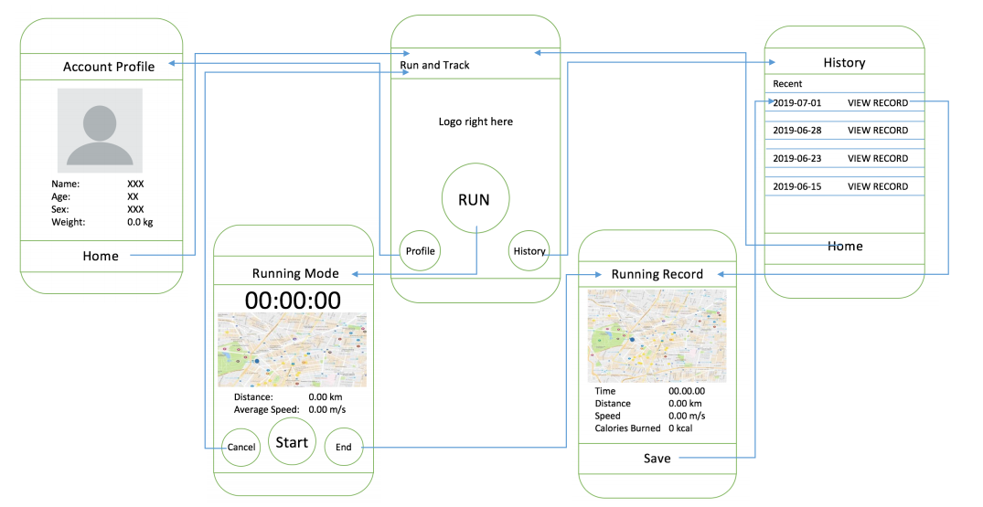
Architecture
[Describe, preferably with a diagram, the overall structure/major components of your planned product.]

Slide 8
Challenges/Risks
Unfamiliar with Android Studio
Unfamiliar with databases
Unfamiliar with Google API/GPS
Testing full functionality using an actual Phone

Slide 9
Technologies
Programming language - Java
Development Environment - Android Studio
GPS Emulator
Android Espresso
Google Maps API

Slide 10
Minimum Viable Product
A satisfactory product will do the following:
Create a profile for a user
Record the user’s run time and distance
Calculate the average speed and the calories burnt per run
See the user’s previous run history

Slide 11
Thank You!

