Slide 1

Towards Sustainable Computing:
Effective Strategies for Product Lifetime Extension in Personal Computer
Scottie Lee (589821sl)
Supervisors: Prof.dr.ir R. Dekker and Prof. N.M. Almeida Camacho
03-09-2024
Notes:
Good [morning/afternoon], everyone. My name is Scottie Lee, and I am here today to present my research on ‘Towards Sustainable Computing: Effective Strategies for Product Lifetime Extension in Personal Computers.’ This work was supervised by Prof. Dr. Ir. R. Dekker and Prof. N.M. Almeida Camacho. Thank you for joining me today.

Slide 2

Introduction
Shift in consumer habits towards frequent PC upgrades
Environmental impact of e-waste and rising hardware costs
The need for sustainable practices in personal computing
Notes:
In recent years, consumer habits have shifted significantly towards frequent upgrades of personal computers. This trend, while beneficial for staying current with technology, has led to increasing environmental concerns, particularly with the rise of e-waste. Additionally, the costs of hardware have been escalating, making this habit not only environmentally unsustainable but also economically challenging for consumers. My research aims to address these issues by exploring sustainable practices in personal computing.

Slide 3
Research Question
What are the most effective strategies for implementing Product Lifetime Extension in personal computers, specifically regarding the selection and timing of component upgrades, to balance technological advancement, environmental sustainability, and economic viability?
Notes:
The core question driving my research is: What are the most effective strategies for implementing Product Lifetime Extension, or PLE, in personal computers? Specifically, I focused on determining the optimal selection and timing of component upgrades that balance technological advancement, environmental sustainability, and economic viability. Through this research, I sought to identify how we can extend the lifespan of PCs in a way that is both cost-effective and environmentally responsible.

Slide 4
Research Methodology
Data Collection: Web Scraping from Passmark
Data Cleaning: Removal of unnecessary data
Pre-processing: Inflation adjustment
Modeling: Development of an optimization model
Notes:
To answer this question, I employed a comprehensive methodology. The first step was data collection, which involved web scraping from PassMark to gather performance and price data for various PC components. Following this, I cleaned the data to remove unnecessary entries and adjusted prices for inflation to ensure accuracy. The next step was developing an optimization model, which I will discuss in detail shortly

Slide 5
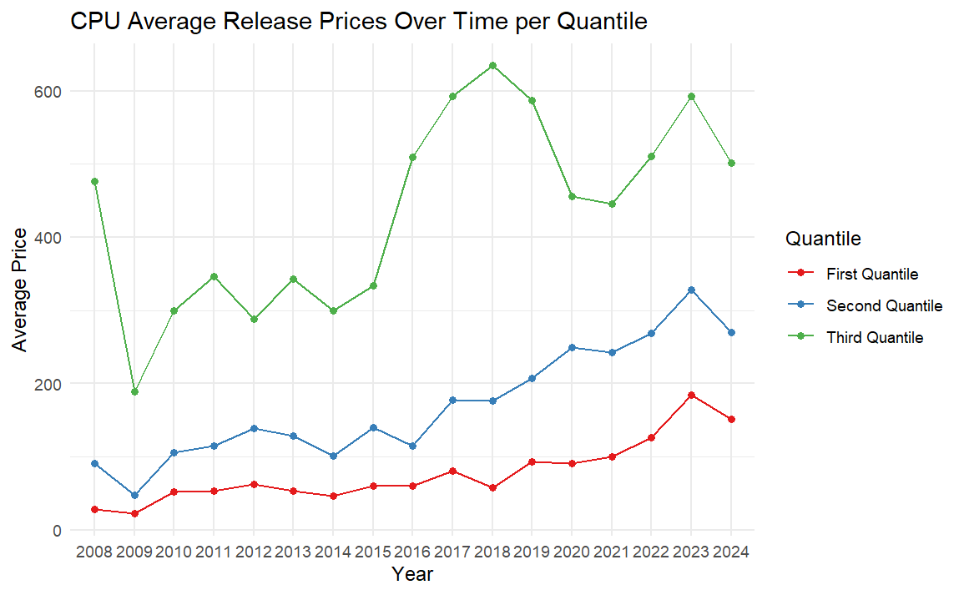
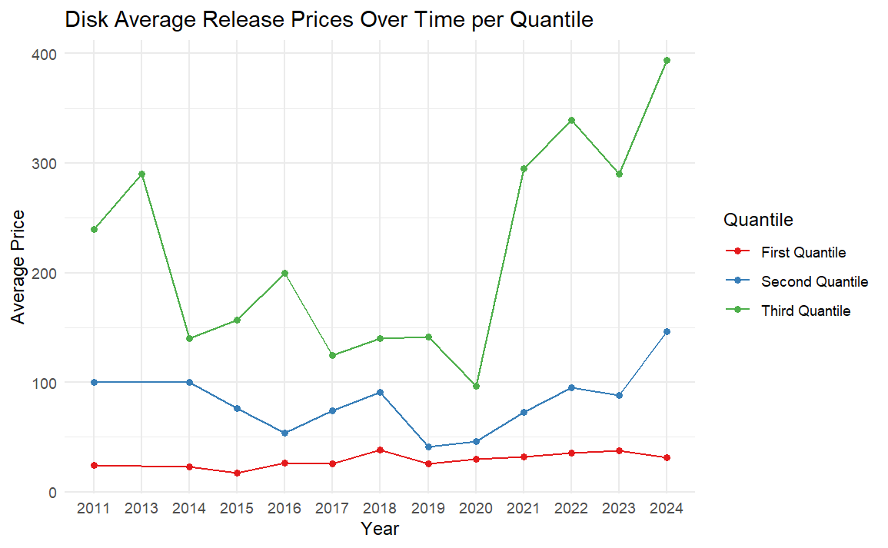
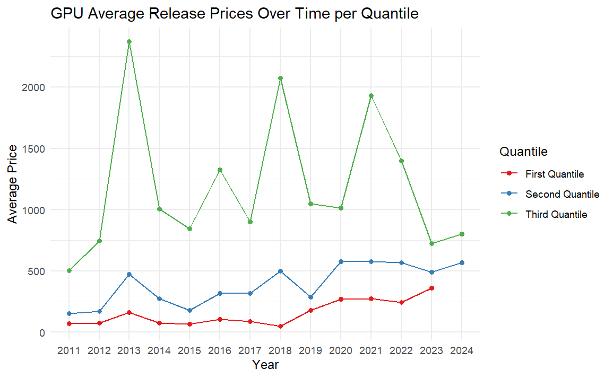
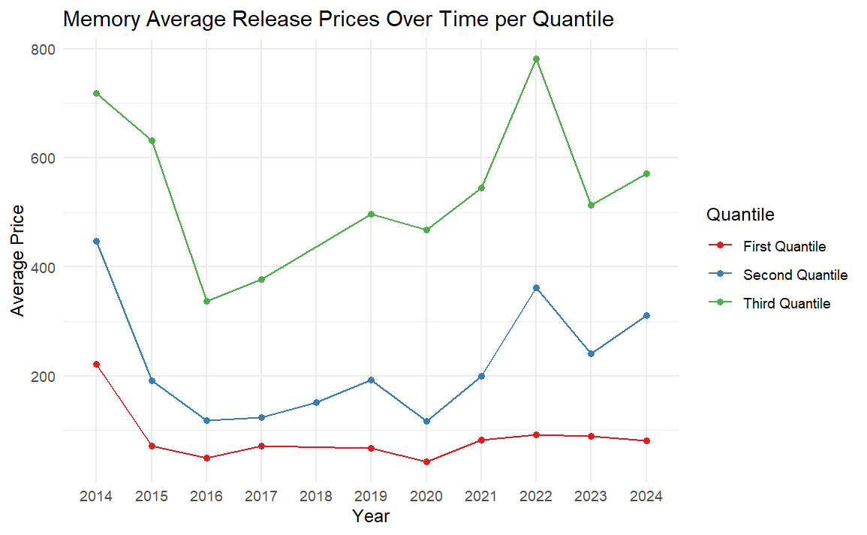
Price trends
Notes:
Understanding price trends and forecasting technological improvements was crucial for my research. I employed non-linear regression models to forecast how the performance of components deteriorates over time. This analysis helped me predict when a component might become obsolete, informing the timing for potential upgrades.

Slide 6
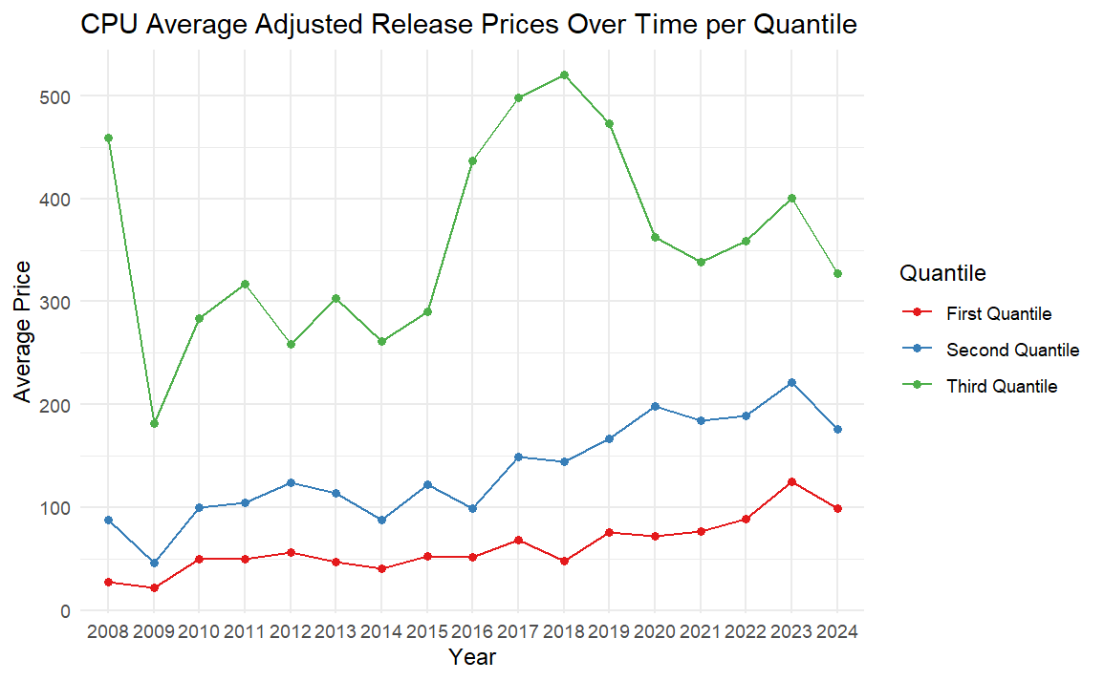
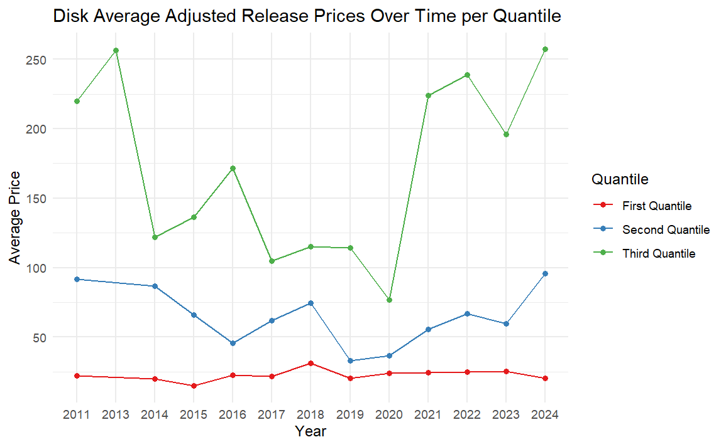
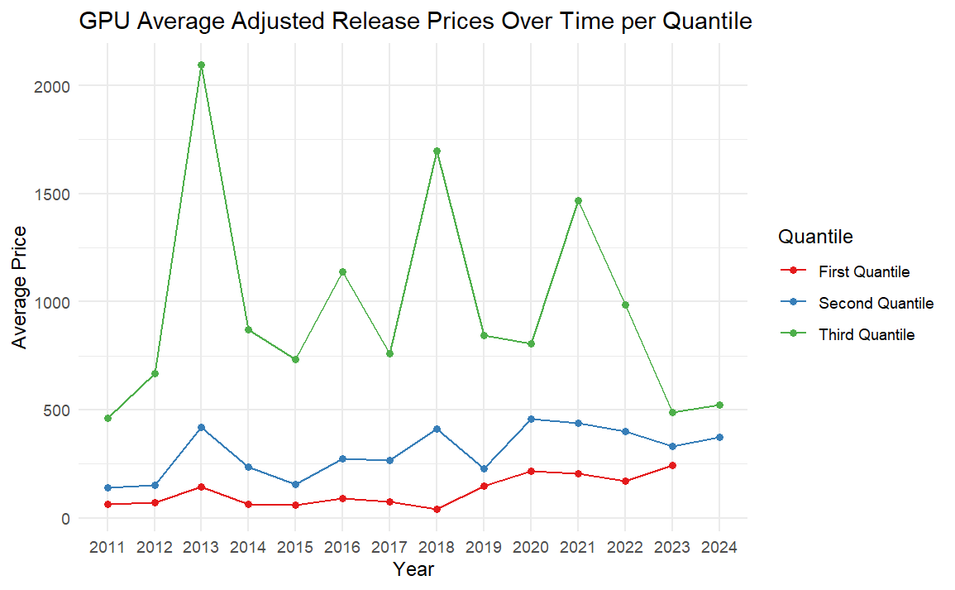
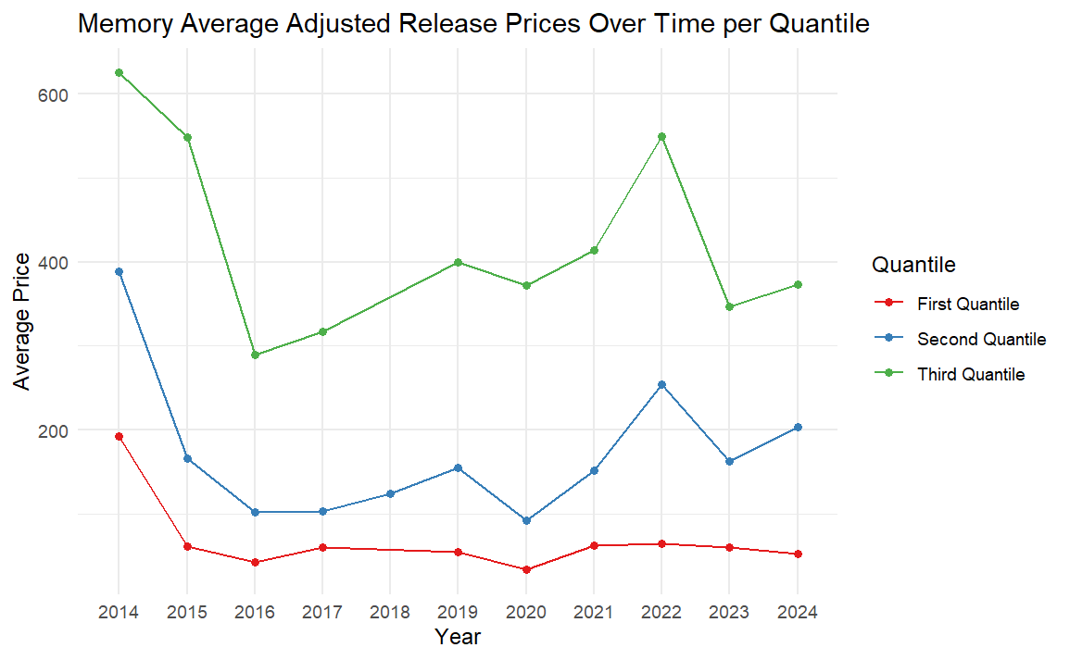
Price trends
Notes:
Understanding price trends and forecasting technological improvements was crucial for my research. I employed non-linear regression models to forecast how the performance of components deteriorates over time. This analysis helped me predict when a component might become obsolete, informing the timing for potential upgrades.

Slide 7
Optimization Model
Define System Components and Tiers (Quantiles)
Component Cost and Performance
Inflation adjustment
PassMark Rating
Optimization Problem
Maximize extended period while maintaining acceptable performance
Find optimal upgrade time
Optimization Methodology
Non-Linear Optimization: Nlopt library in R
Sustainability and Cost Analysis
Compare carbon emission
Compare average yearly cost
Full Replacement Policy of 5 years
Notes:
Central to my research was the development of an optimization model to compare the strategies of full system replacement versus selective component upgrades. I considered different scenarios, including upgrading one component at a time or multiple components together. The performance of the system was measured using the PassMark Rating, which combines scores from CPU, GPU, memory, and disk performance.

Slide 8
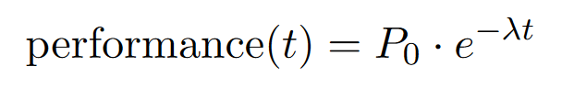
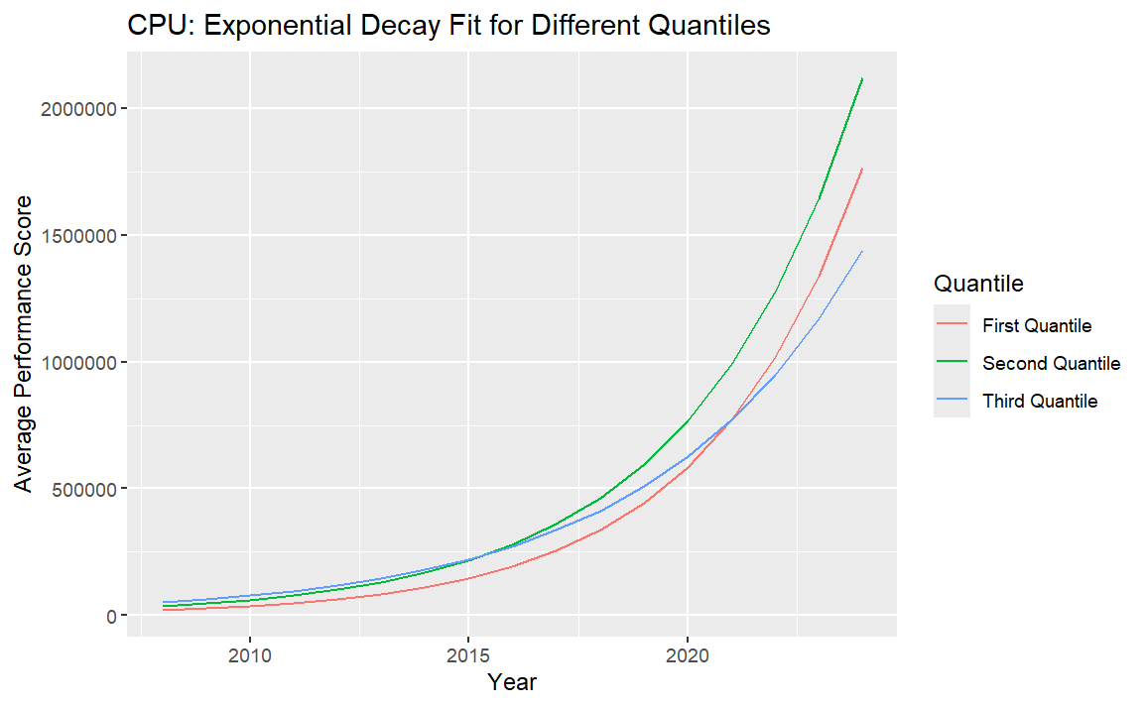
Forecasting Technological Improvements (Deterioration)
Non-linear regression
Forecasts of technological improvements

Slide 9
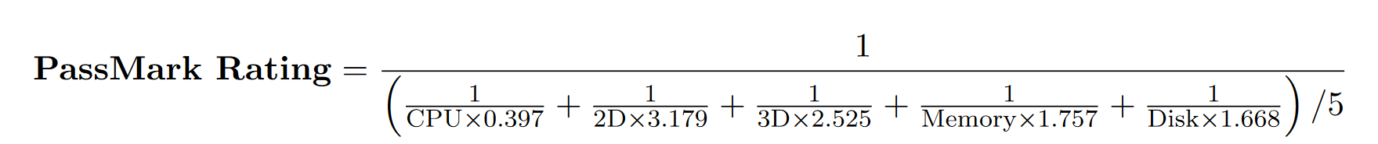
Optimization Model
Full Replacement vs. Component Upgrades
Scenarios for one-component and two components upgrades
System Performance (PassMark Rating)
Notes:
Central to my research was the development of an optimization model to compare the strategies of full system replacement versus selective component upgrades. I considered different scenarios, including upgrading one component at a time or multiple components together. The performance of the system was measured using the PassMark Rating, which combines scores from CPU, GPU, memory, and disk performance.

Slide 10
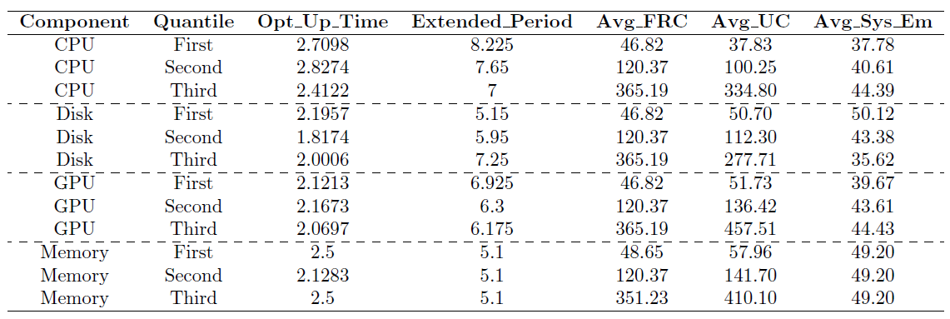
Results
Average sustainability is 47.8 kg/year
Prices are in dollar
Period is in years

Slide 11
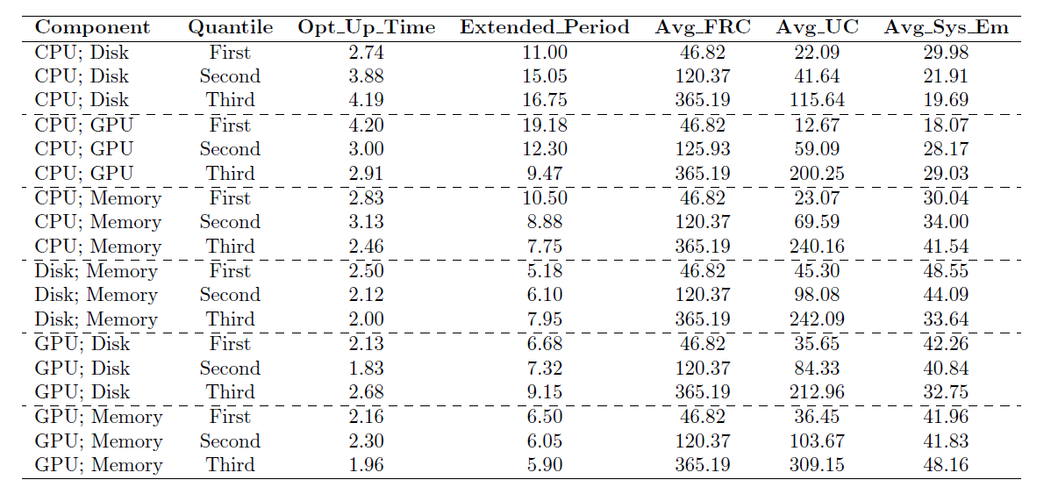
Results (2)

Slide 12
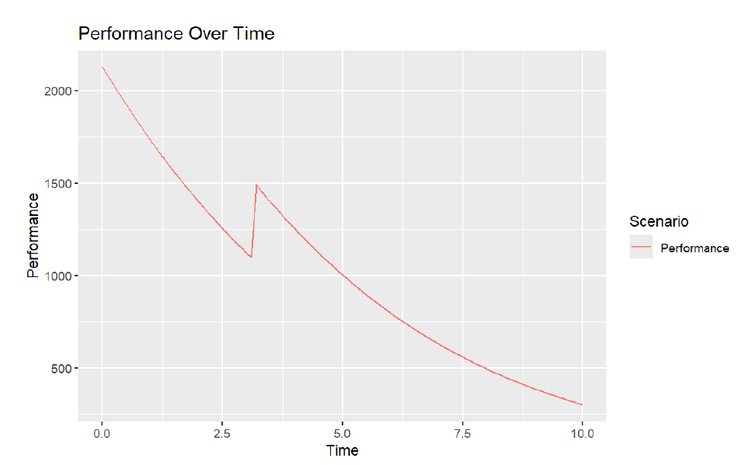
Result (3)

Slide 13
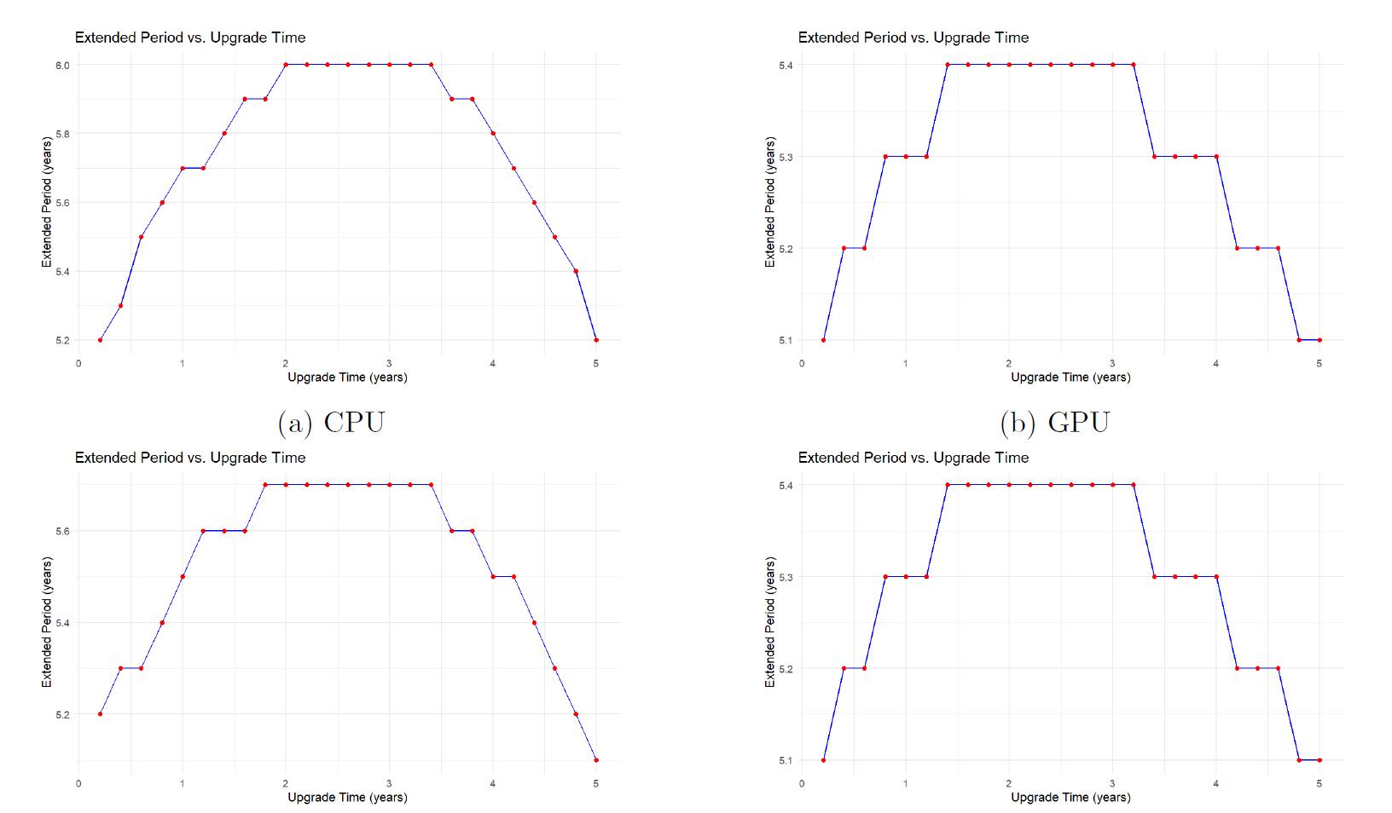
Broken Component
Notes:
My findings indicate that upgrading the CPU is the most beneficial across all tiers, as it has a significant impact on overall system performance. Disk upgrades also show considerable benefits, particularly in the higher quantiles. However, while GPU upgrades do enhance performance, they are less cost-effective due to their higher prices. Memory upgrades, on the other hand, have minimal effect on extending the system’s lifespan.

Slide 14
Key Findings
CPU: High impact on performance, most beneficial to upgrade
Disk: Significant benefits in higher quantiles
GPU: High performance impact, less cost-effective due price
Memory: Minimal effect on extending system lifespan
Notes:
My findings indicate that upgrading the CPU is the most beneficial across all tiers, as it has a significant impact on overall system performance. Disk upgrades also show considerable benefits, particularly in the higher quantiles. However, while GPU upgrades do enhance performance, they are less cost-effective due to their higher prices. Memory upgrades, on the other hand, have minimal effect on extending the system’s lifespan.

Slide 15
Marketing
Targeted Marketing
Sustainability Campaigns
Product Bundling
Notes:
These findings have important implications for marketing strategies. Companies can target specific components for upgrades in their campaigns, particularly focusing on CPUs and disks. There is also an opportunity to promote sustainability by encouraging consumers to upgrade rather than replace their entire systems. Product bundling, where the most impactful upgrades are offered together, could also be a successful strategy.

Slide 16
Limitations
Component Focus
Price Assumptions
Notes:
Like any study, my research has its limitations. The focus was primarily on a specific set of components—CPUs, GPUs, disks, and memory—excluding others like motherboards and power supplies. Additionally, the price assumptions in the model are based on inflation-adjusted values, which may not fully capture market dynamics. Lastly, the model is constrained to the scope of component upgrades, which might not fully reflect real-world scenarios where other factors come into play.

Slide 17
Conclusion
PLE strategies extend PC lifespan, reduce costs, and lower emission
Practical implications
Future research
Notes:
In conclusion, my research demonstrates that Product Lifetime Extension strategies can effectively extend the lifespan of personal computers, reduce costs, and lower carbon emissions. These strategies are not only practical but also align with the growing need for sustainability in technology. Looking forward, further research could expand on these findings by including more components and exploring other types of electronic devices.

Slide 18
Acknowledgments
Supervisors
Prof. Dr. R. Dekker and Prof. N.M. Almeida Camacho for their guidance and support throughout my research
Erasmus School of Economics
For providing the resources and academic environment that enabled this work
Notes:
I would like to express my gratitude to my supervisors, Prof. Dr. R. Dekker and Prof. N.M. Almeida Camacho, for their invaluable guidance and support throughout this research. I also want to thank Erasmus School of Economics for providing the resources and academic environment that made this work possible.

