Slide 1
IMDB Movies Reviews Clustering
Kevin Okiah
Masters of Data Science SMU
03/29/2019

Slide 2
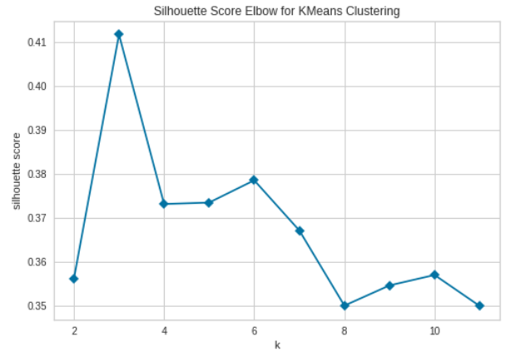
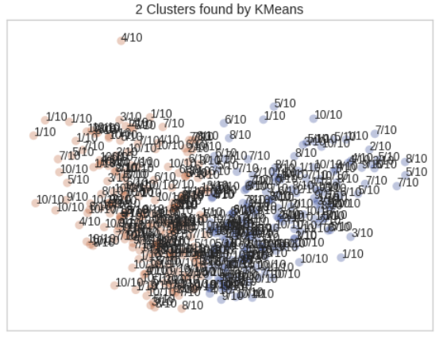
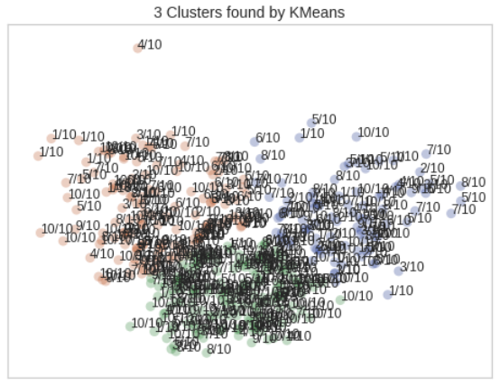
Clustering: IMDB Movie Review
Data Collection Pre-processing and Cleaning
Cluster analysis or clustering is the task of grouping a set of objects in such a way that objects in the same group are more similar to each other than to those in other groups.
In this project we run Cluster methods on reviews collected from IMDB.
The reviews are a collection of Positive Reviews (Reviews with rating greater then 6/10) and Negative reviews (Reviews with Rating less than 5/10) of action movies collected from IMDB.
~198 movie Action movie reviews are Web-Scrapped from from IMDB using selenium, urllib, Beautiful Soup, and LXML
The reviews are Cleaned, Tokenized, Lemmatized, Normalized, and Vectorized using TF-IDF.
PCA is used for Dimensionality reduction for easy visualization of Clusters
Clustering
Results Interpretation
Algorithms Explored: Kmeans, MiniBatch, Spectral and Agglomerative
Number of Clustering: 2, 3, 4
Semantically, We expect to have 2 clusters, one cluster for positive reviews and another for Negative reviews.
Using Elbow method with Silhouette Metric, 3 clusters are identified as optimal number of clusters based on average score.
2 Clusters have a Silhouette score (0.356) and 3 Clusters have a score of (0.411) which are lower than 0.5 indicating the structure of the clusters is weak requiring further analysis.
See next slide for further analysis
Silhouette Score = 0.356
Silhouette Score = 0.411

Slide 3
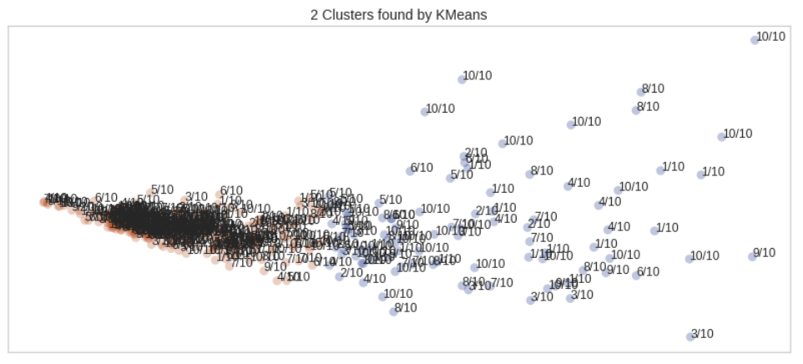
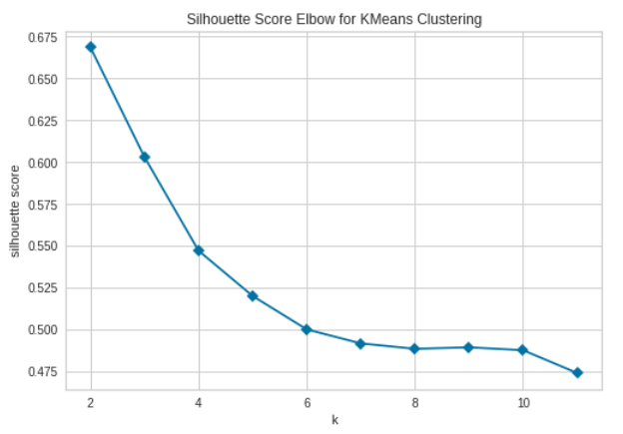
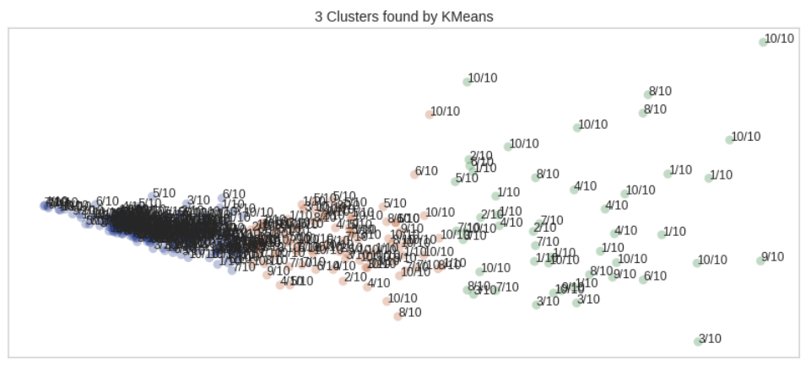
Clustering with Engineered Features
New Engineered Features
Clustering Results
Number of Words
Number of Unique Words
Average Length of Words
Avg Silhouette score =0.668
Improved Silhouette Score
Avg Silhouette score =0.60
The new Engineered features result in better formed clusters as indicated by the increase in Silhouette score (>0.5).
Two Clusters are the optimal number of clusters

