Slide 1
Text Similarity Analysis
Kevin Okiah
Masters of Data Science SMU
03/17/2019

Slide 2
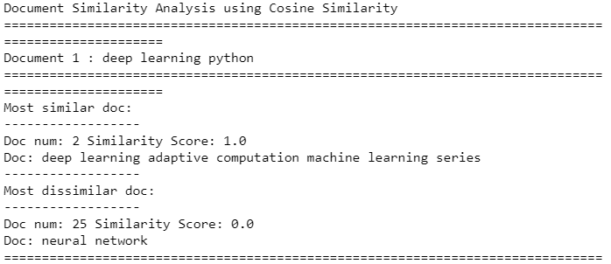
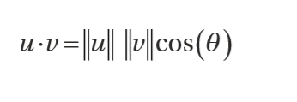
Text Similarity Analysis of Book Search Results from Amazon and Google
Approach:
Used Python, LXML, BeautifulSoup to scrape 20 search results for book title “” from Amazon.com and Google.com
Leveraged NLTK to parse, clean, normalize, and used Scikit-Learn to vectorize the clean dataset using tfdif for distance measure analysis.
Evaluated similarity between the ranked search results returned by both Amazon.com and Google.com using Cosine similarity Measure
The main objective of this project is to use text similarity is to analyze and measure how two entities of text are close or far apart from each other.
We use Cosine Similarity measure to measure text similarity between search results for a book from Amazon.com and Google.com.
Cosine similarity gives us the cosine of the angle between two vectorized forms as positive vectors in an inner product space.
Mathematically, Cosine similarity is defined as the dot product of the two term vectors u and v, divided by the product of their L2 norms.
Sample result and conclusion
Search Term
Result 1
Result 25
The top search result has the highest cosine similarity value of 1 to the search term compared to search result 25 with the lowest cosine similarity of 0.0

